Slide 1

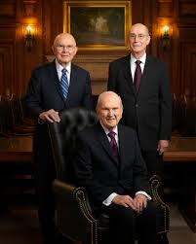
General Conference
Style!!!

Slide 2
Rules of the Game
1. Answer in the form of a question.
2. You must locate S.M. answers in your scriptures, paper or phone.
3. You must locate Hymn answers in your Hymnal

Slide 3
Conference
Doctrinal Mastery
Stories that Teach
Conference Humor
Doctrines
Apostles and Prophets
Grab Bag
100 | 100 | 100 | 100 | 100 | 100
200 | 200 | 200 | 200 | 200 | 200
300 | 300 | 300 | 300 | 300 | 300
400 | 400 | 400 | 400 | 400 | 400
500 | 500 | 500 | 500 | 500 | 500
600 | 600 | 600 | 600 | 600 | 600
Final Jeopardy

Slide 4
Doctrinal Mastery for 100
Sister Aburto taught; Followers of Christ are striving to become of “one heart and one mind,” and to become like Him. “The Lord called his people Zion”

Slide 5
Doctrinal Mastery for 100
What is Moses 7:18
Back

Slide 6
Doctrinal Mastery for 200
Many of the speakers put a strong emphasis on missionary work. We shouldn’t hold back sharing the marvelous work and a wonder of the Restoration.

Slide 7
Doctrinal Mastery for 200
Answer: Isaiah 29:13-14
“The Lord asks each one of us to share His gospel in word and deed. Our personal conversion includes the responsibility to share the gospel of Jesus Christ with the world.”
Back

Slide 8
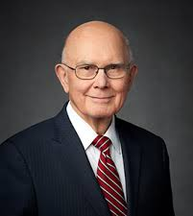
Doctrinal Mastery for 300
President Oaks spoke of developing our divine attributes and potential; being that we were created in His image

Slide 9
Doctrinal Mastery for 300
Answer: What is Genesis 1:26-27
Back

Slide 10
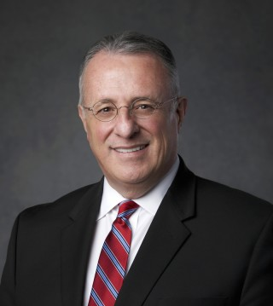
Doctrinal Mastery for 400
Elder Soares spoke of the Savior’s amazing sacrifice in our behalf. It made me think of this OT scripture that outlines some of the Savior’s sacrifices.

Slide 11
Doctrinal Mastery for 400
Answer: What is Isaiah 53:3-5
Back

Slide 12
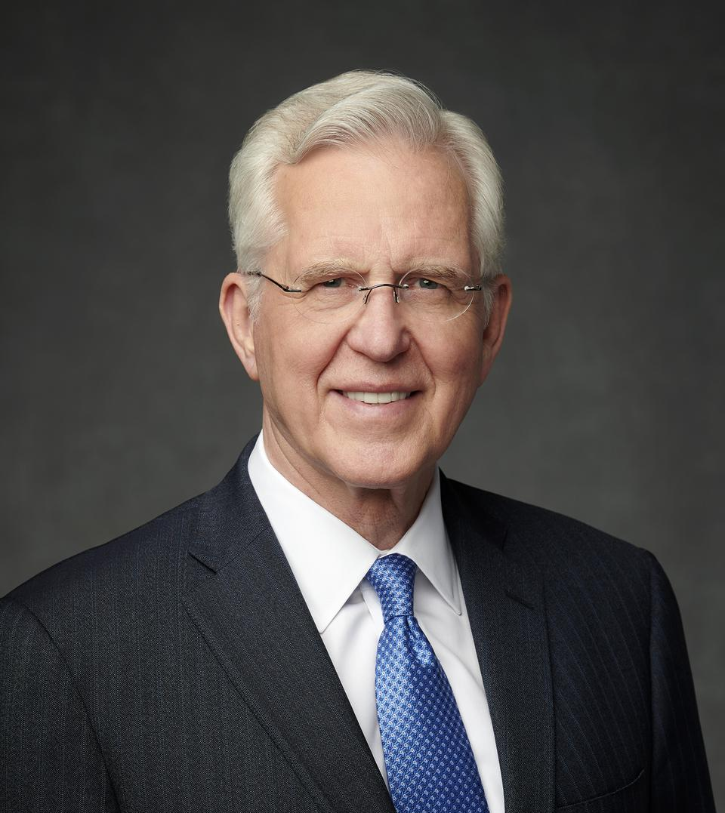
Doctrinal Mastery for 500
Elder Christofferson spoke of many examples of trusting in the Lord with all thine heart. He ended with this OT scripture.

Slide 13
Doctrinal Mastery for 500
Answer: What is Proverbs 3:5-6
Back

Slide 14
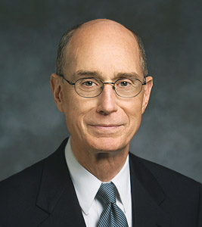
Doctrinal Mastery for 600
President Eyring taught “Our natures must be changed to become as a child to gain the strength we must have to stand steady” This change requires repentance. Sins as scarlet shall be as white as snow.”

Slide 15
Doctrinal Mastery for 600
Answer: What is Isaiah 1:18
Back

Slide 16
Stories that Teach for 100
After Sister Porter’s husband passed away, she asked the Lord: “What would Thou have me do?” Later, as she was going through the mail she saw a small picture in a catalog that caught her eye — it was of this?

Slide 17
Stories that Teach for 100
Answer: What is The Samaritan woman at the well?
“A loving Heavenly Father was inviting me to come to the Savior and learn.”
Back

Slide 18


Slide 19
Stories that Teach for 200
President Nelson told of a basketball game where one team scored 2 baskets in the last few seconds of the first half. He used this story to teach the importance of this.

Slide 20
Stories that Teach for 200
Answer: What is spiritual momentum? 1. Get on the covenant path;
2. Repent daily;
3. learn about God;
4. seek and expect miracles;
5. strive to end conflicts in your life (forgiveness)
Back

Slide 21
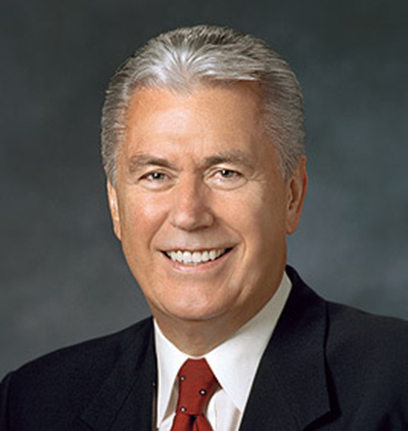
Stories that Teach 300
Elder Uchtdorf used this New Testament story to teach about giving our heartfelt all.

Slide 22
Stories that Teach for 300
What is the widow’s mite?
Back

Slide 23
Stories that Teach for 400
Sister Amy Wright told the story of her son who broke grandmas pot playing ball. His cousin tried to assure him that grandma would be forgiving because he had broke something when he was 5. The cousin answered yes you were only 5; I’m this old?

Slide 24
Stories that Teach for 400
What is 23
Back

Slide 25
Stories that Teach for 500
Elder Pace from the Sunday School Presidency used this Old Testament Story from last weeks Come Follow Me lessons to teach the importance of being obedient. Hint: Jews still commemorate this today.

Slide 26
Stories that Teach for 500
Answer: What is the story of the Passover
Back

Slide 27
Stories that Teach for 600
Elder Gong’s talk was titled; “We each have a story” more specifically his talk was about our responsibility to participate in this?

Slide 28
Stories that Teach for 600
Answer: What is Family History?
First, see yourself in both generational directions
“Second, let the adventure of family history be intentional and spontaneous.”
Third, visit FamilySearch.org.
Fourth, help unite families eternally.
Back

Slide 29
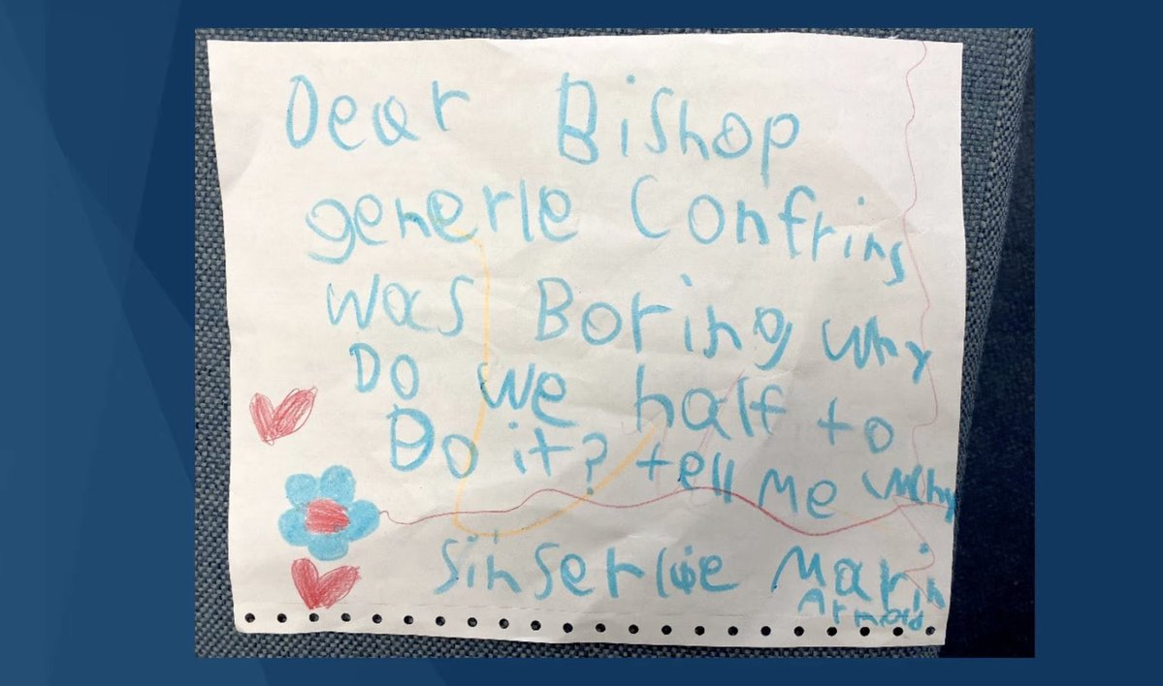
Conference Humor 100
Who showed this note?

Slide 30
Conference Humor For 100
Answer: Who is Elder Holland?
Back

Slide 31
Conference Humor For 200
Elder Bednar’s wife Susan, his 3 sons and their wives, all his grandkids, and Elder Cook, his seatmate in the quorum of the 12 will all attest to this fact about Elder Bednar?

Slide 32
Conference Humor For 200
What is that he does not sing well?
Back

Slide 33
Conference Humor For 300
Elder Uchtdorf couldn’t help but to use another airplane analogy; he used these to words to explain how large airplanes with lots of passengers' fly?

Slide 34
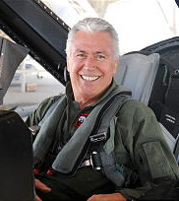
Conference Humor For 300
  What is forward thrust?
  Back

Slide 35
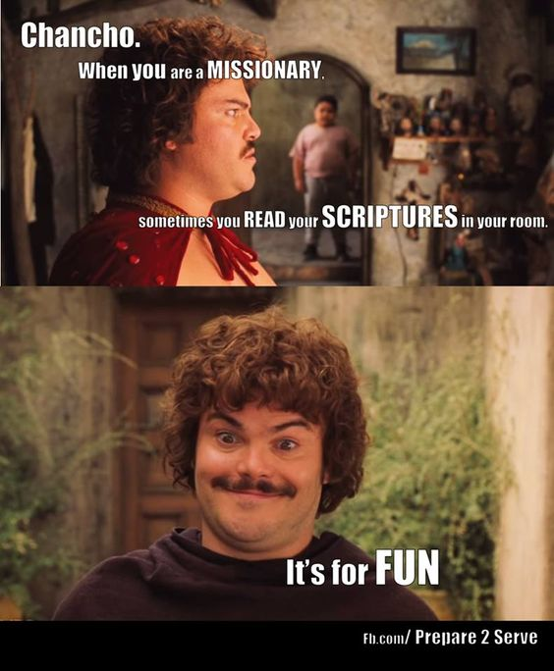
Conference Humor For 400
What movie do we get this meme from

Slide 36
Conference Humor For 400
Answer: What is Nacho Libre?
Back

Slide 37
Conference Humor For 500
Elder Holland addressed his remarks to the young people of the Church. He then defined young people as this?

Slide 38
Conference Humor For 500
  Answer: What is anyone President Nelson’s age or younger?
  Back

Slide 39
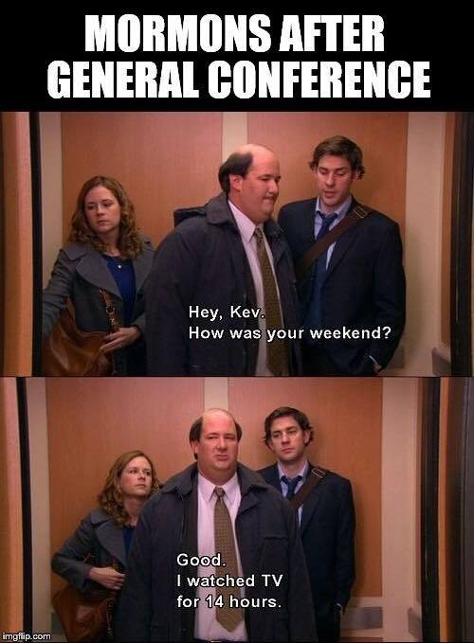
Conference Humor For 600
How many hours is General Conference?

Slide 40
Conference Humor For 600
Answer: What is 10?
Back

Slide 41
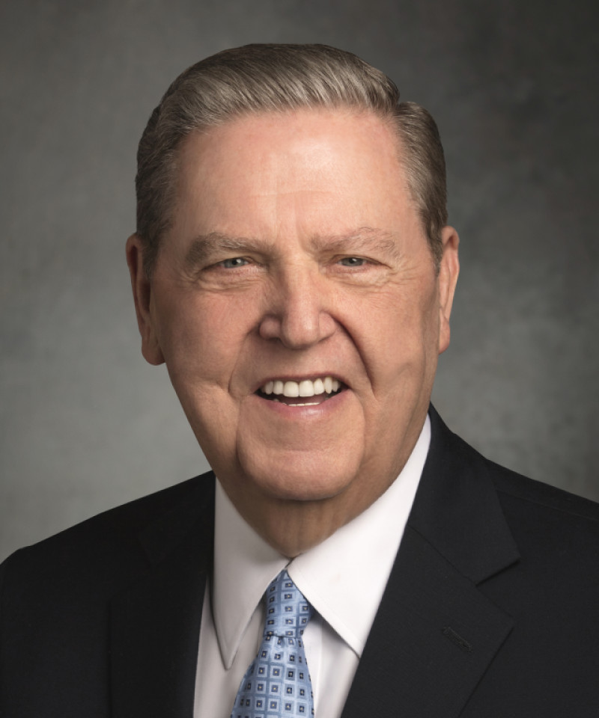
Doctrines 100
Elder Holland said:
“To any of our youth out there who are struggling, whatever your concerns or difficulties; This is manifestly not the answer.”

Slide 42
Doctrines 100
What is death by suicide. “We might sometimes want to run away from where we are, but we can never run away from who we are — children of the living God who loves us, is always ready to forgive us, and will never, ever forsake us.”
Back

Slide 43
Doctrines 200
Elder Ballard said,“ I testify that “this” is where I came to know that my Heavenly Father and my Savior Jesus Christ know and love me.”

Slide 44
Doctrines 200
Answer: What is his mission? “Commit to yourselves and to Heavenly Father that you will serve a mission and that from this time forward you will strive to keep your hearts, hands and minds clean and worthy.”
Back

Slide 45
Doctrines 300
Elder Bednar talked about this song that has the phrase,”We will heed not what the wicked may say” Must find in hymnal?

Slide 46
Doctrines 300
What is #243 Let us all press on?
Back

Slide 47
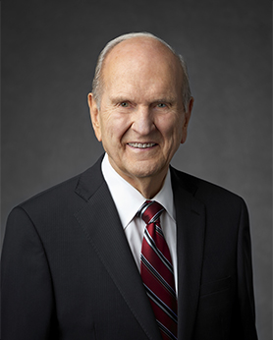
Doctrines 400
In President Nelson’s Saturday Morning address, “Today I reaffirm strongly that the Lord has asked every worthy, able young man to do this?

Slide 48
Doctrines 400
What is prepare for and serve a mission. … For you young and able sisters, a mission is also a powerful, but optional, opportunity.”
Back

Slide 50

Doctrines 500
President Oaks taught that this document is not a statement of policies but is based on unchangeable doctrines.

Slide 51
Doctrines 500
What is the Family Proclamation?
Back

Slide 52
Doctrines 600
Elder Renlund taught the Women that we shouldn't pray to this person?

Slide 53
Doctrines 600
What is Everyone has “heavenly parents, a father and a mother.” What is known doctrinally about Heavenly Mother is found in Gospel Topics. We direct our worship to our Heavenly Father in the name of Jesus Christ, and do not pray to Heavenly Mother.”
Back

Slide 54
Apostles and Prophets for 100
President Nelson has always had a soft spot for women since he has this many daughters?

Slide 55
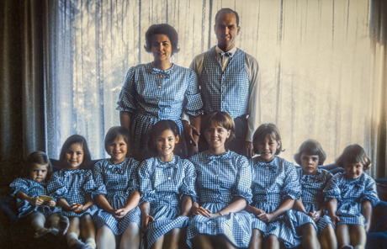
Apostles and Prophets for 100
What is 9? (and 1 son)
Back

Slide 56
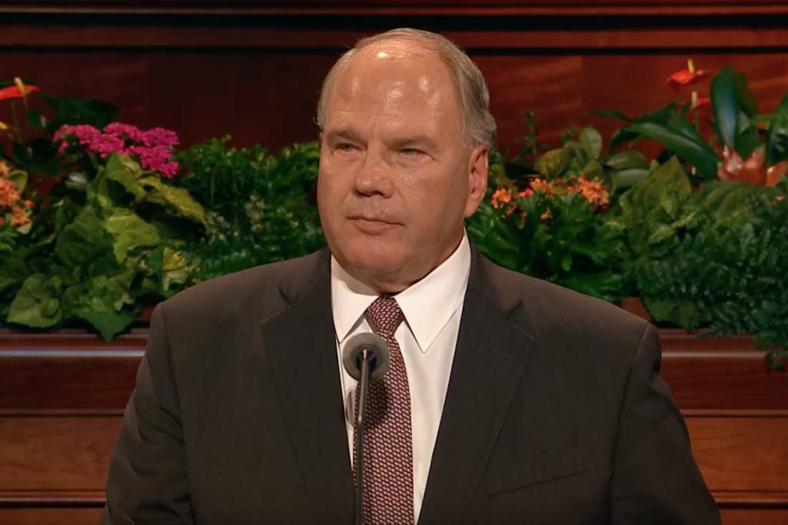
Apostles and Prophets for 200
This Apostle spoke of the importance of Religious Liberty and Freedom for all religions. (full name)

Slide 57
Apostles and Prophets for 200
Who is Ronald A. Rasband?
1. Honors the first and second great commandments; 2. fosters expressions of beliefs; 3. Inspires people to help others; 4. acts as unifying force to shape values
Back

Slide 58
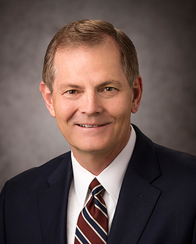
Apostles and Prophets for 300
This Apostle spoke of missionary work; how we should Love, Share, and Invite.

Slide 59
Apostles and Prophets for 300
Answer: Who is Elder Gary E. Stevenson?
Back

Slide 60
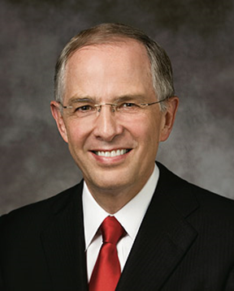
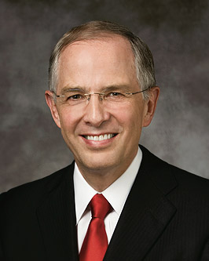
Apostles and Prophets for 400
This Apostle spoke about being a peacemaker. “Peacemakers are not passive; they are persuasive in the Savior’s way.”
(Full Name)

Slide 61
Apostles and Prophets for 400
Who is Elder Neil L. Andersen?
Back

Slide 62

Apostles and Prophets for 500
This apostle went to Yale.

Slide 63
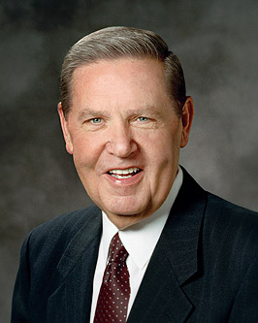

Apostles and Prophets for 500
Who is Elder Jeffrey R. Holland
Back
Interestingly, the Hebrew on the crest which is found all over Yale’s campus says Urim and Thummim meaning Light and Truth

Slide 64
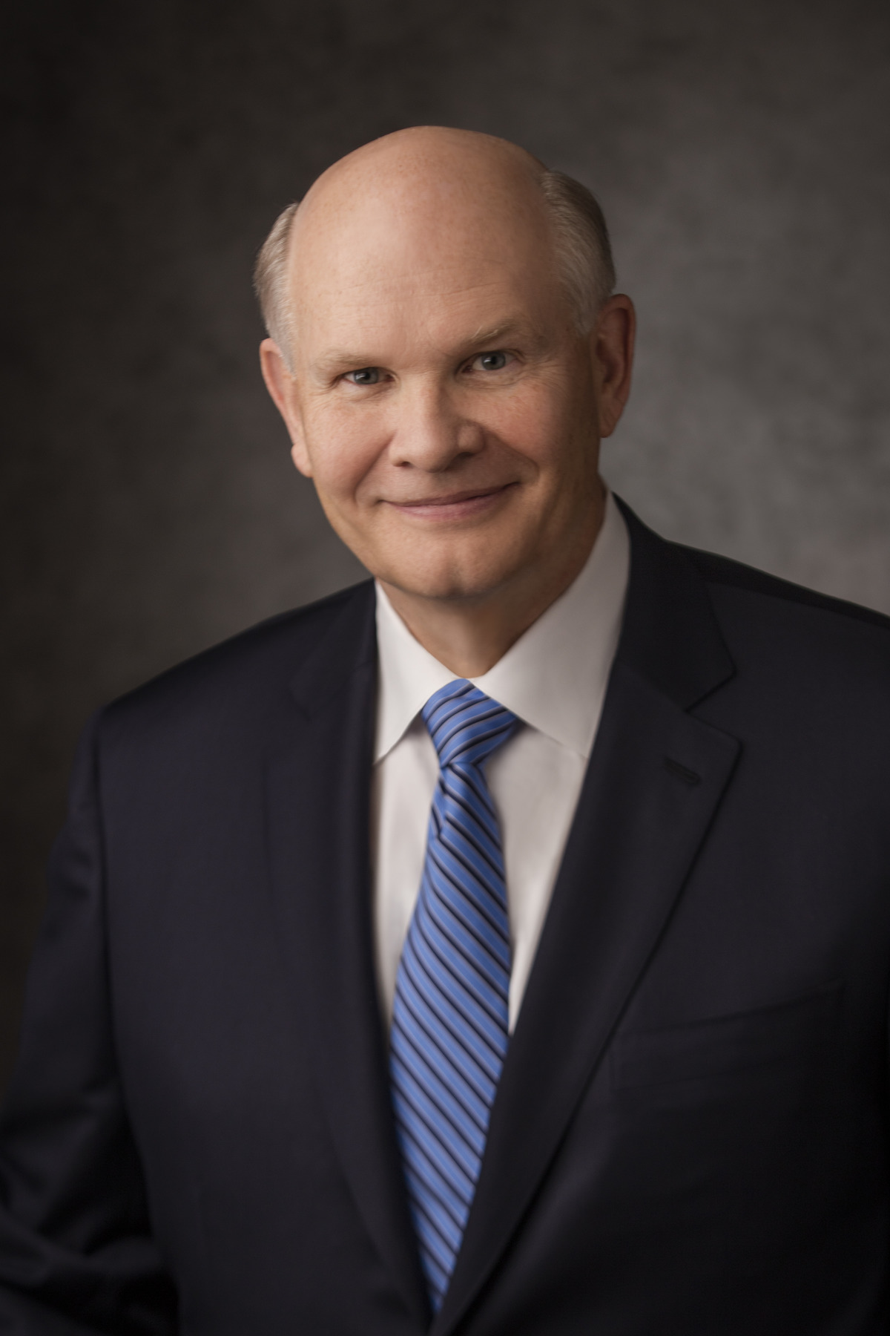
Apostles and Prophets for 600
This Apostle, invited the Women to center their life on Jesus Christ and remember the foundational truths in the Young Women theme. He like President Nelson, was also a heart surgeon.
(Full Name)

Slide 65
Apostles and Prophets for 600
Who is Dale G. Renlund
Back

Slide 66
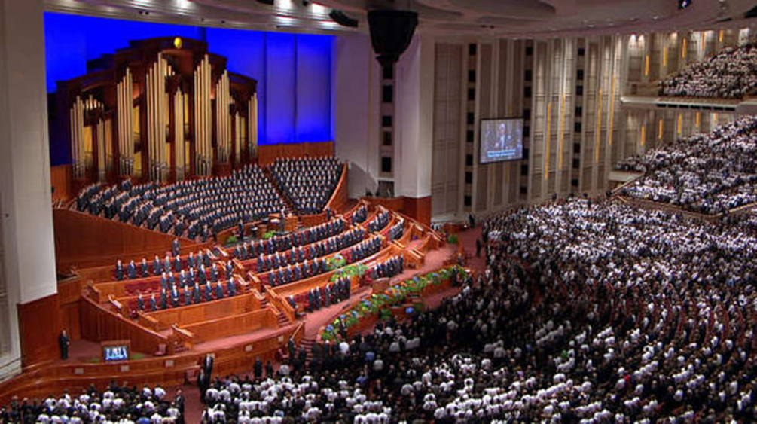
Grab Bag For 100
10,000 people were invited to attend each session of conference in the amazing conference center which holds this many people, (within 1000)

Slide 67
Grab Bag For 100
Answer: What is 21,000?
Back

Slide 68
Grab Bag For 200
These 2 new Presidencies were announced?

Slide 69
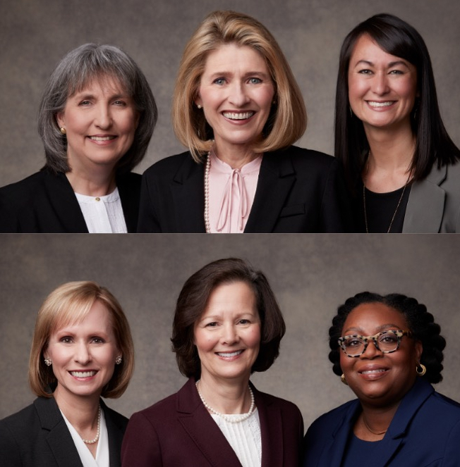
Grab Bag For 200
Answer: What are the Relief Society and Primary?
Back

Slide 71
Grab Bag For 300
How many members of the Church are there? (Within a million)

Slide 72
Grab Bag For 300
Answer:16,805,400
Back

Slide 73
Grab Bag For 400
What number Annual Conference; the first was in 1830.

Slide 74
Grab Bag For 400
What is 192nd
Back

Slide 75
Grab Bag For 500
How old is President Nelson

Slide 76
Grab Bag For 500
What is 97?
Back

Slide 77
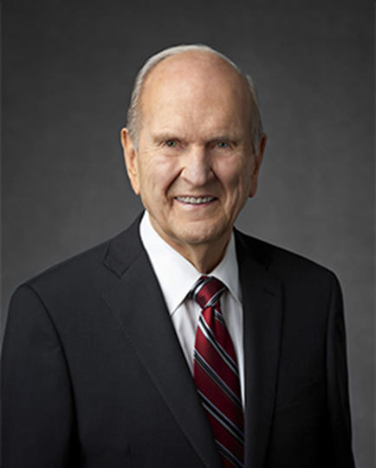
Grab Bag For 600
President Nelson announced the building of 17 new temples, Name 3 of them.

Slide 78
Grab Bag For 600
What is Wellington, New Zealand
Brazzaville, Republic of Congo
Barcelona, Spain
Birmingham, United Kingdom
Cusco, Peru
Maceió, Brazil
Santos, Brazil
San Luis Potosí, Mexico
Mexico City Benemérito, Mexico
Tampa, Florida
Knoxville, Tennessee
Cleveland, Ohio
Wichita, Kansas
Austin, Texas
Missoula, Montana
Montpelier, Idaho
Modesto, California
Back

Slide 79

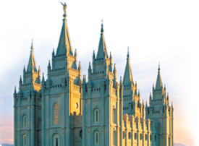
Final Jeopardy
Wager your points now…
HINT #1 – Topic: Temples

Slide 80
QUESTION:
What is the total number of temples that are built, under construction, or have been announced (Within twenty).
(Write your answer)

Slide 81
FINAL ANSWER
What is 282?

