Slide 1
The Book of Revelation

Slide 2
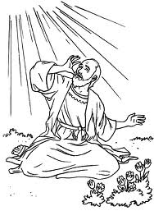
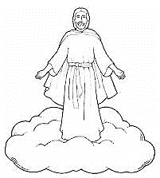
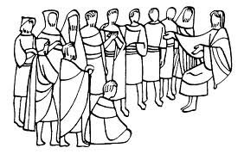
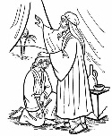
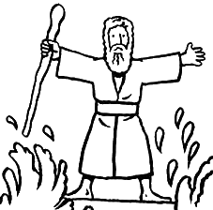
The Book of Revelation
Jesus Christ
John’s 7 Letters to 7 Churches
Throne Theophany
Revelation 1
Revelation 2-3
Revelation 4-5
Seven Seals Overview
The Little Book
2 prophets in Jerusalem
Revelation 6-9
Revelation 10
Revelation 11
The Dragon, The Beast, and the Victory
Revelation 12-14

Slide 3
REVELATION 12:1-6
https://www.youtube.com/watch?v=Dy19mYQ5TUE
The Apostle John in Patmos writing Revelation sees the vision of a woman and a dragon

Slide 4
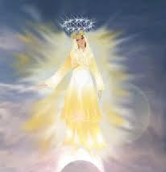
REVELATION 12:1-6
What symbols do you see?

Slide 5
Satan’s “Plan”
What was “Satan’s Plan” (Moses 4:1–4)
“Satan’s plan required one of two things: Either the compulsion of man, or else saving men in sin.” (President J. Reuben Clark in Conference Report, Oct. 1949, 193; quoted in Doctrines of the Gospel Student Manual [2010], 15).
Rebellion
“Satan rebelled against me” (Moses 4:3)
“He rebelled against the Only Begotten Son” (D&C 76:25)
“He rebelled against me, saying, Give me thine honor…” (D&C 29:36).
“Satan’s proposal was not an innocent suggestion to amend God’s plan. It was a rebellion, a revolt, an attempted mutiny to dethrone God and take over heaven. Those who protest and rebel against God and His prophets, those who demand a lowering of the standards and claim that we can find salvation in sin all support different elements of Satan’s rebellious strategy.” (Brother Mark Matthews, Ensign, March 2015)

Slide 6
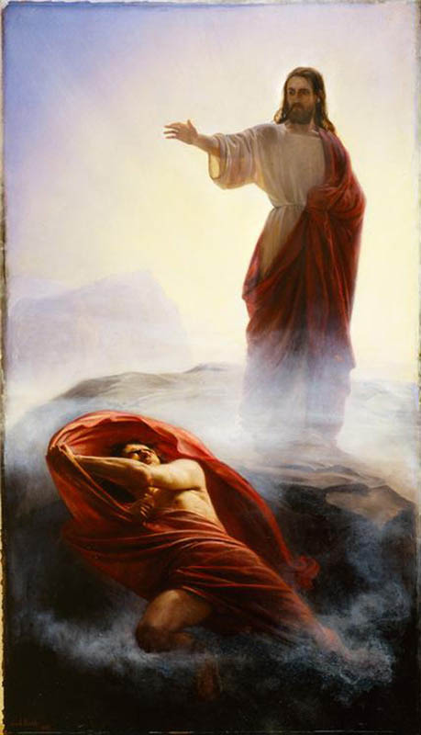
Revelation 12:7-10
Dragon (vs7)
Greek: "to see," or "seeing one,"
Satan (vs 9)
Greek: the adversary, oppose
Lucifer
“Light Bearer” (Bible Dictionary)
Devil (vs 9)
D.E.V.I.L.
Slanderer: “One who throws something across the path of another”

Slide 7
Revelation 12:10 “The Accuser of our Brethren”
“Satan is the typical prosecutor; he never defends. Satan finds fault, and where he finds no actual fault, he cleverly creates the appearance of fault. It is his essence to lie and to accuse. We should not be surprised to see good Saints in our day attacked with false accusations in the media.” Following Christ: The Parable of the Divers and More Good News, Salt Lake City: Deseret Book Co., 1995, 115.
WHO CAN TESTIFY OF THIS?
1 Corinthians 13:5 Charity “thinketh no evil...”
NIV: “keeps no record of wrongs”
http://alfoxshead.blogspot.com

Slide 8
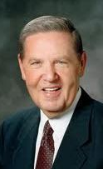
“If something is buried in the past, leave it buried. Don’t keep going back with your little sand pail and beach shovel to dig it up, wave it around, saying, ‘Hey! Do you remember this?’ Splat! Well, guess what? That is probably going to result in some ugly morsel being dug up out of your landfill with the reply, ‘Yeah, I remember it. Do you remember this?’ Splat. And soon enough everyone comes out of that exchange dirty and muddy and unhappy and hurt, when what God pleads for is cleanliness and kindness and happiness and healing.” (Elder Jeffrey R. Holland, BYU Devotional, 13 January 2009)

Slide 9
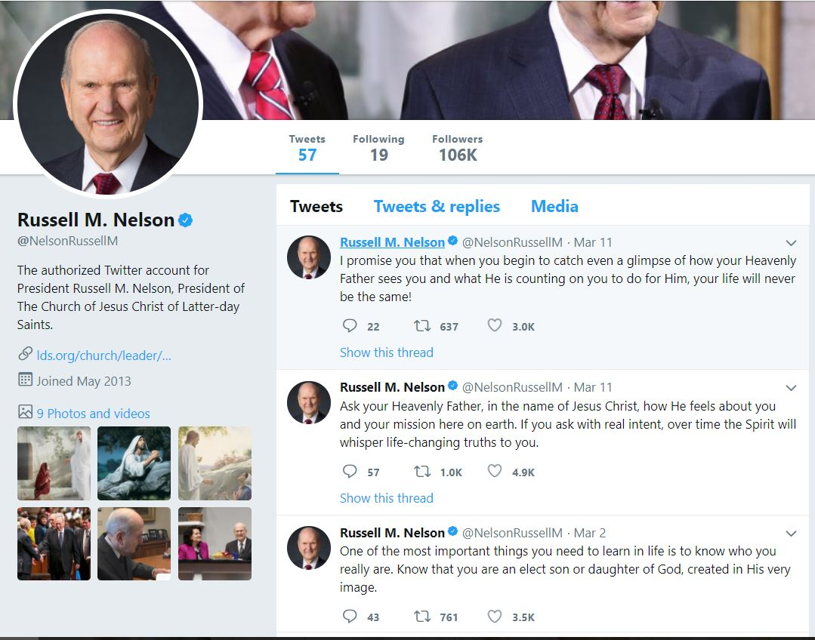
OVERCOMING SATAN: Revelation 12:11
WHO CAN TESTIFY OF THIS?

Slide 10
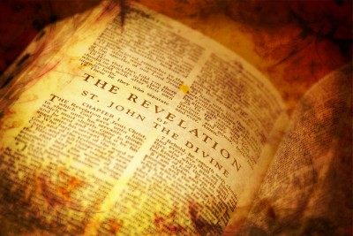
Application for Preparation
Do you find ways to testify and “let your voice be heard” through social media and other means?

Slide 11
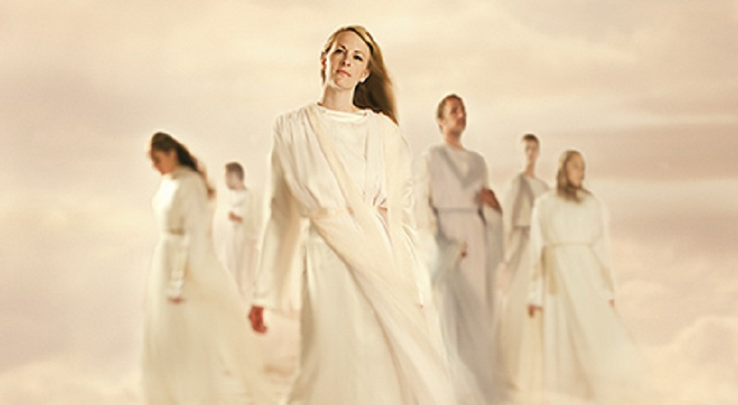
TRUE/FALSE STATEMENTS about the Pre Earth Life
Some people became ‘bad’ in the pre-earth life.
Your nature/disposition was developed in the pre-earth life.
God knows what we will do before we do it.
Priesthood holders were foreordained to be Priesthood holders.
If you don’t do what you were foreordained to do, you will be held accountable for it.
Your organs have a spirit.
We went to church in the pre-earth life.

Slide 12
True/False
Some people became ‘bad’ in the pre-earth life.

Slide 13
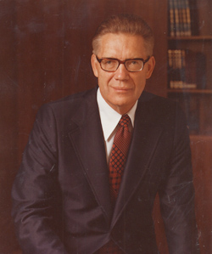
“As the ages rolled, no two spirits remained alike. Mozart became a musician; Einstein centered his interest in mathematics; Michelangelo turned his attention to painting. … Abraham and Moses and all of the prophets sought and obtained the talent for spirituality. When we pass from preexistence to mortality, we bring with us the traits and talents there developed.”
Bruce R. McConkie, The Mortal Messiah [1979], 1:23, 25) as quoted in The Gospel and the Productive Life

Slide 14
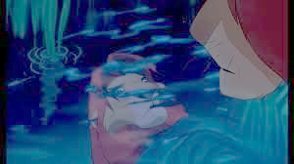
True/False
Your nature/disposition was developed in the pre-earth life.

Slide 15
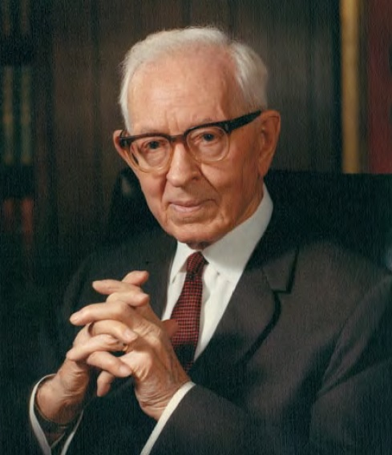
“Environment and many other causes have great influence, but we must not lose sight of the fact that the characteristics of the spirit, which were developed through many ages of a former existence, play a very important part in our progression through mortal life."
(Joseph Fielding Smith, Era, Vol 19, pp.315-316, 425-426)

Slide 16
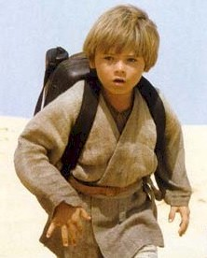
True/False
God knows what we will do before we do it.

Slide 17
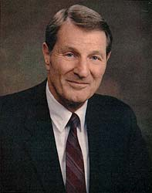
“By reason of that surpassing knowledge, God reads the future; He knows what each of us will do under given conditions. His foreknowledge is based on intelligence and reason. He foresees the future as a state which naturally and surely will be.”
The Great Apostasy, p. 20. James E. Talmage, Quoted by Neal A. Maxwell, Things As They Really Are, p.28)

Slide 18
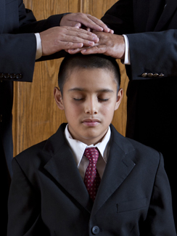
True/False
All Melchizedek Priesthood holders were foreordained to be Melchizedek Priesthood holders.

Slide 19
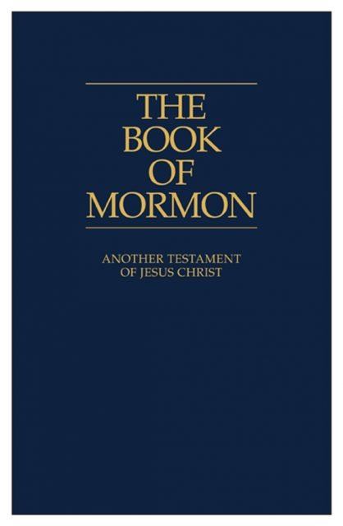
Alma 13:2-3 (cross-reference Jeremiah 1:5-6): “And those priests were ordained after the order of his Son … being called and prepared from the foundation of the world according to the foreknowledge of God.”

Slide 20
True/False
If you don’t do what you were foreordained to do, you will be held accountable for it.

Slide 21
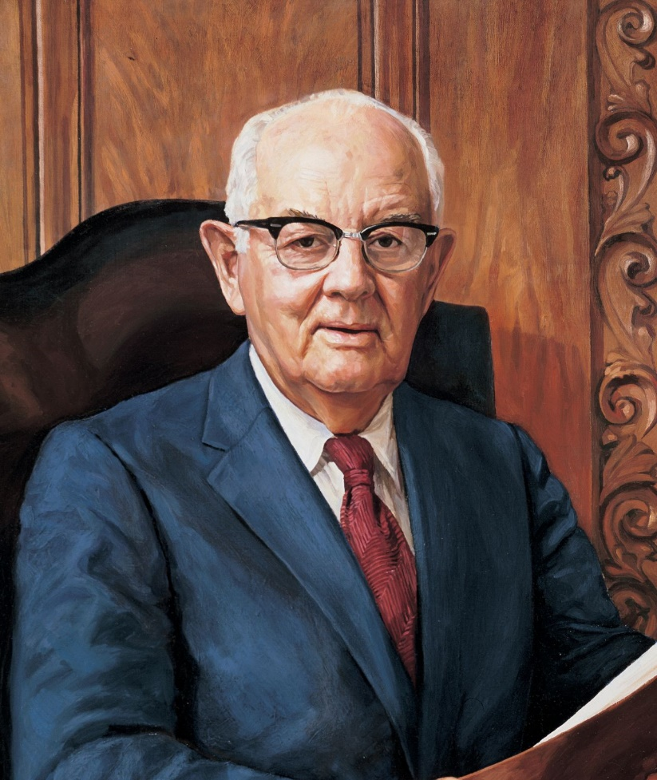
“While we do not now remember the particulars, this does not alter the glorious reality of what we agreed to. You are accountable for those things which long ago were expected...”
Spence W. Kimball, Ensign, Nov. 1979, p. 102.

Slide 22
“Orson Hyde taught, ‘It is not impossible that we signed the articles thereof with our own hands, which articles may be retained in the archives above to be presented to us when we rise from the dead…Our forgetfulness cannot alter the facts.” (Journal of Discourses, 7:314–15.) Hence, the degree of detail involved in the covenants and promises we participated in may be a more highly customized thing than many of us surmise.”
Neal A. Maxwell, Brigham Young University 10 October 1978.

Slide 23
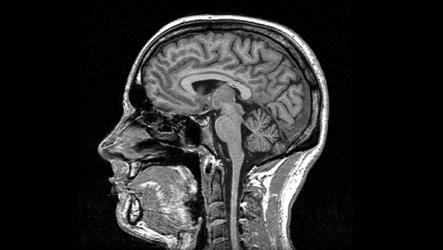
True/False
Your organs have a spirit.

Slide 24
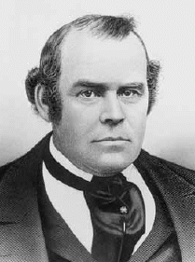
“The spirit of man consists of an organization of the elements of spiritual matter after the pattern of the fleshly tabernacle. It possesses, in fact, all the organs and parts exactly corresponding to the outward tabernacle”
(DGSM p. 14 )(Parley P. Pratt, Key to the Science of Theology, 79).

Slide 25
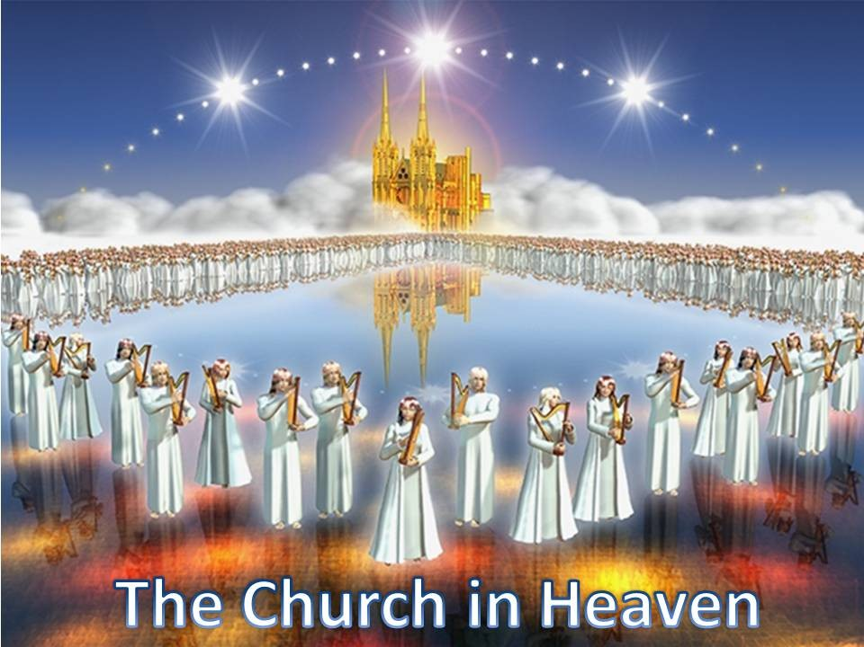
True/False
We went to Church in the pre-earth life.

Slide 26
“It is reasonable to believe that there was a Church organization there. Priesthood had been conferred and the leaders were chosen. Ordinances pertaining to that pre-existence were required and the love of God prevailed.” (DGSM p. 14) (Joseph Fielding Smith, The Way to Perfection, 50–51).

Slide 27
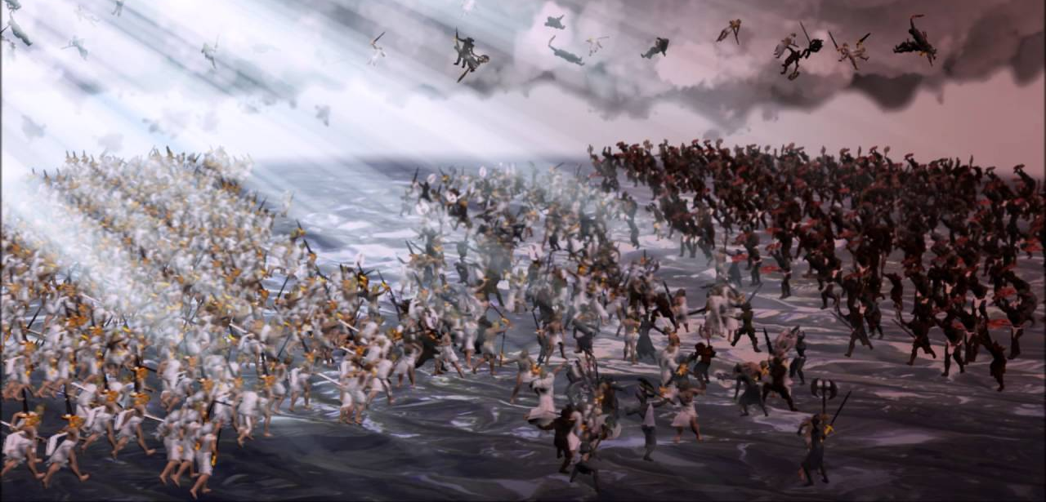
Revelation 12:12-13, 17

Slide 28
The Book of Revelation

