Slide 1
The Book of Revelation

Slide 2
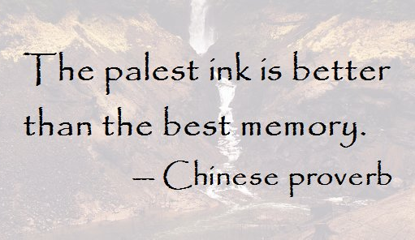
The Book of Revelation
"Knowledge carefully recorded is knowledge available in time of need. [Notes] should be kept to communicate to the Lord how you treasure His word. That practice enhances the likelihood of your receiving further light.”
Elder Richard G. Scott

Slide 3
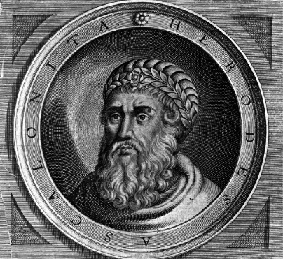
King Herod “The Great”
Wanted a legacy
Builds roads and aqueducts
10 wives; executed multiple sons
Age 70, suffering with painful kidney disease
Imprisoned Rabbis and wealthy men and ordered their execution to take place...
…on the day he died (so somebody would mourn at his passing)
Worst news ever…
Wise Men (Magi)
5 miles away….
The New King is learning to walk
Matthew 2:1-16 (Outsmarted)

Slide 4
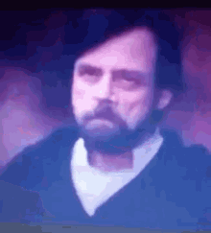
“During this time, all the Apostles except John had been killed. John was banished to Patmos after being plunged into boiling oil in Rome by Domitian. He did not suffer anything from it. It is said that all in the audience of the Colosseum were converted to Christianity upon witnessing this miracle.” (New Testament Seminary Student Manual, 2015).

Slide 5
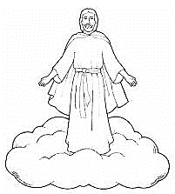
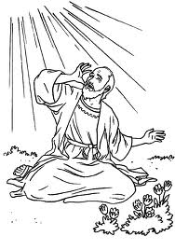
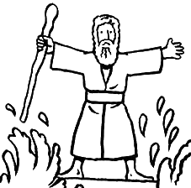
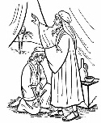
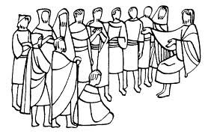
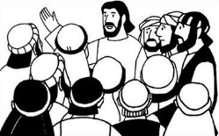
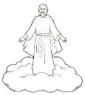
The Book of Revelation
Jesus Christ
John’s 7 Letters to 7 Churches
Throne Theophany
Seven Seals Overview
Revelation 1
Revelation 2-3
Revelation 4-5
Revelation 6-9
The Little Book
2 prophets in Jerusalem
The Dragon, The Beast, and the Victory
Righteous Rewarded
Revelation 10
Revelation 11
Revelation 12-14
Revelation 15
Armageddon
Wicked Destroyed
The Second Coming
Millennium & Final Judgment
Celestialized Earth
Revelation 16
Revelation 17-18
Revelation 19
Revelation 20
Revelation 21-22

Slide 6
A time you needed help in a major way?
~car broke down ~lost at Disneyland ~locked keys in car ~SPRAINED ANKLE ~broken bone ~ran out of Nutella

Slide 7
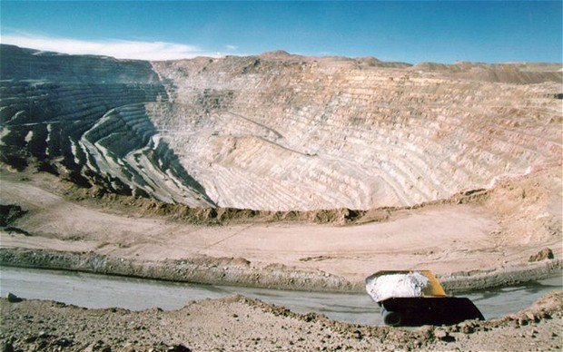
5 August 2010. $20 million.

Slide 8
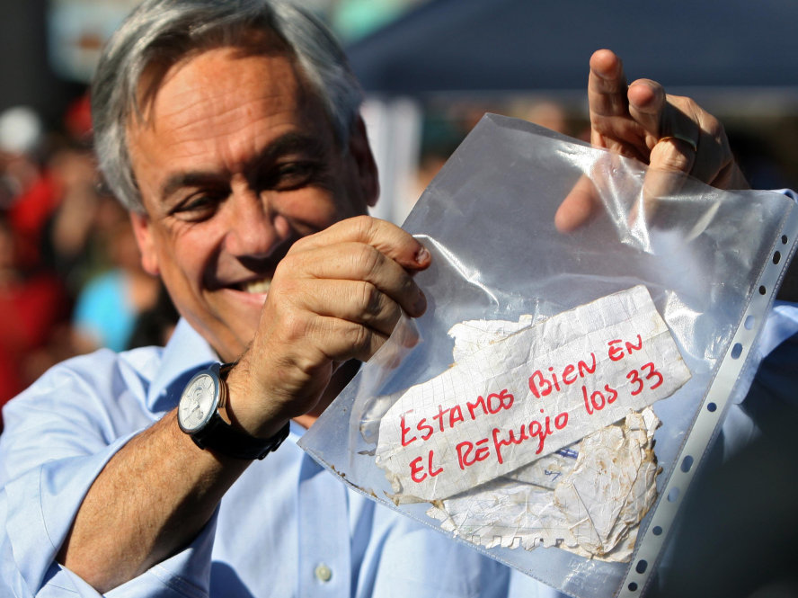
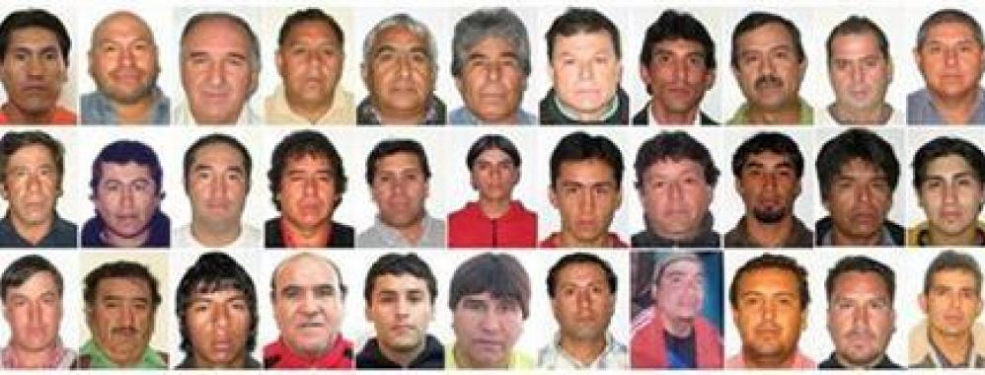
8 boreholes 17 days (2,300’)

Slide 9
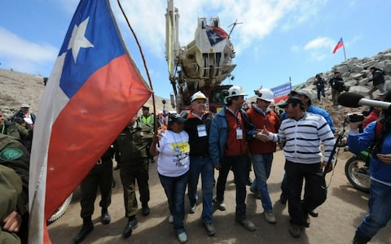
Literally cut off

Slide 10
D&C 1:31
STANDARD: PERFECTION 1sin = Cut off

Slide 11
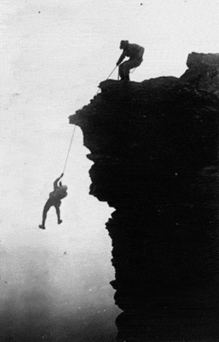
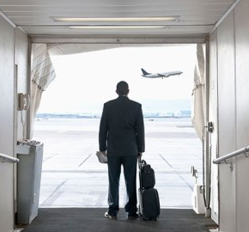
TRAVELER A
TRAVELER B

Slide 12
What if I die with 1 unrepented sin?
Mosiah 2:38

Slide 13
What if I die with 1 unrepented sin?
Will we suffer forever? Even if it’s just one small unrepented sin?
JACOB 6:10
Mosiah 2:38

Slide 14
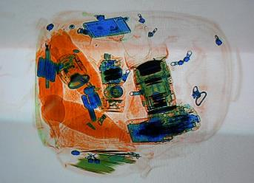
Alma 42:25
“Can’t God just be merciful? I’m a good person!”
How many SINS HAVE YOU committed?
30-40/day
x 1 year
x 80 years
= 1 million sins

Slide 15
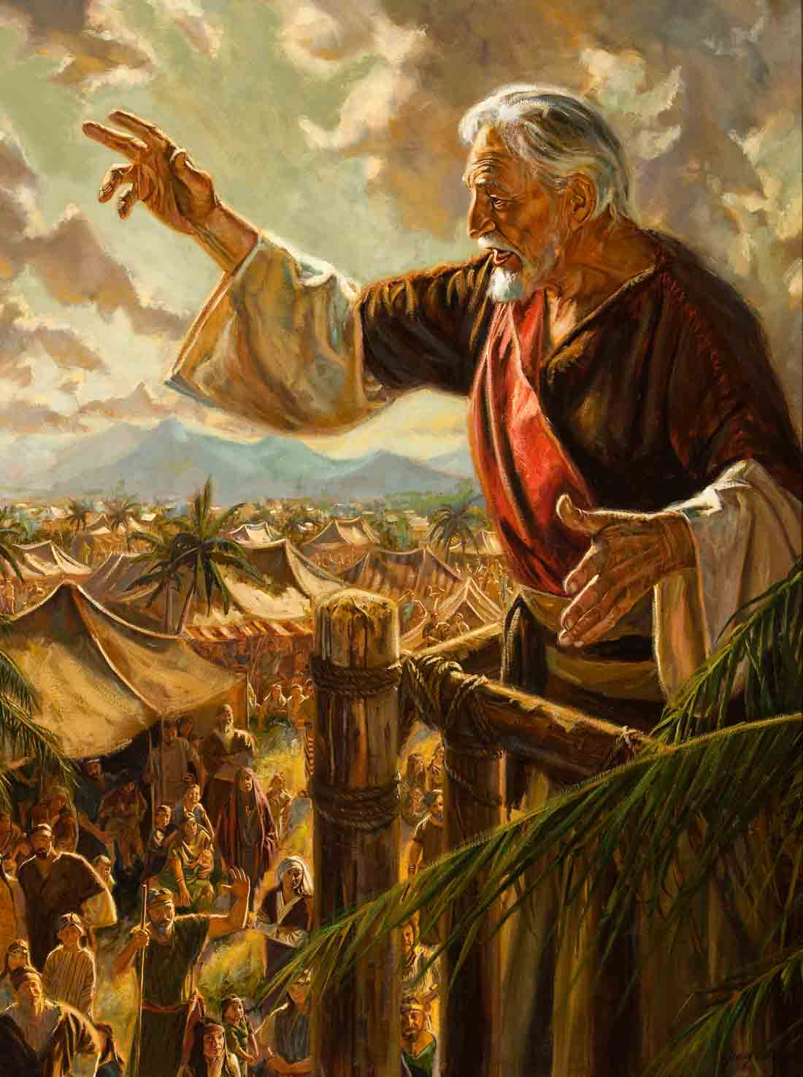
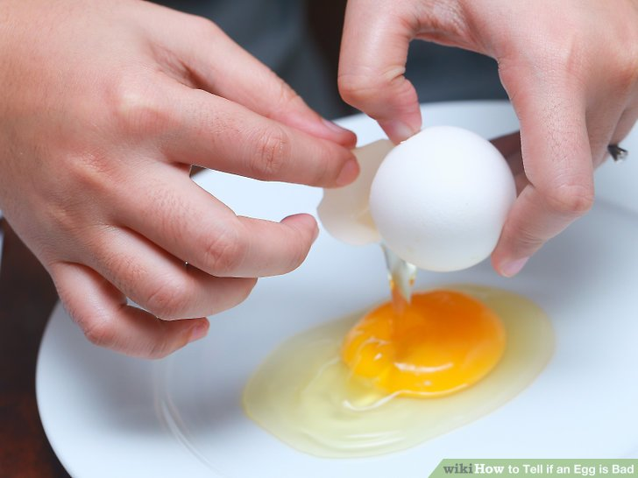
Does ‘going’ to church and ‘going’ the temple or ‘going’ on a mission pay off the debt?

Slide 16
“Well, Maybe my angel that is assigned to record my sins isn’t a great writer?”
2 problems:
HOW MANY SINS CUT YOU off?
Second problem:
The Book of life

Slide 17
“The book of life is written in the body, engraven on the bones, sinews, and flesh. Every thought, word, and deed has an effect on the human body and leave their marks which God can read like a book.” (Bruce R McConkie, Mormon Doctrine, p. 97.)

Slide 18
Fine! I’ll just not repent. Suffering won’t be that bad, right?
D&C 19:15
Alma 12:33
So what am I supposed to do? I’m not perfect!

Slide 19
Mosiah 26:30
(Cross-Reference Moroni 6:8) “As often as they repented and sought forgiveness with real intent, they were forgiven.”

Slide 20
Elder Holland: “You can change and you can do it very fast. repentance can come instantaneously, even if you have serious amends to make. Repentance takes exactly as long as it takes you to say, “I’ll change”—and mean it.”

Slide 21
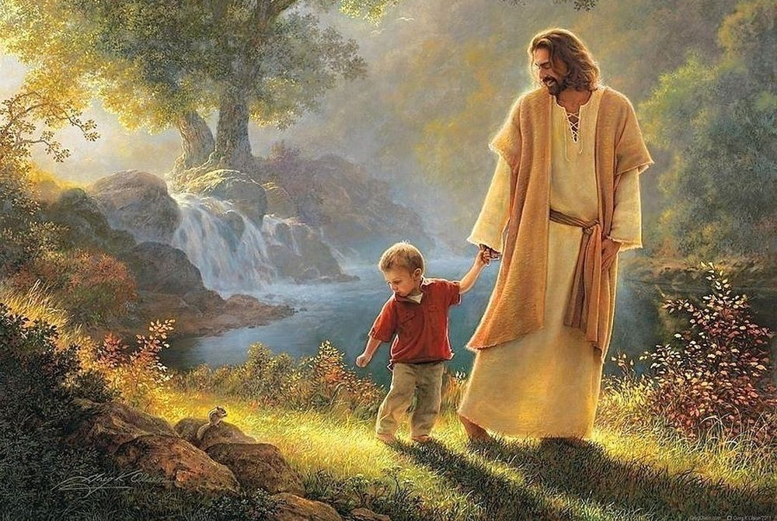
The source of your righteousness is not from a law you have kept. You do not create your own righteousness. Righteousness is found in Christ. Going to church, on a mission, attending the temple keep us from sin. We are not saving ourselves by these actions - but we are begging for the Power of the Atonement.

Slide 22
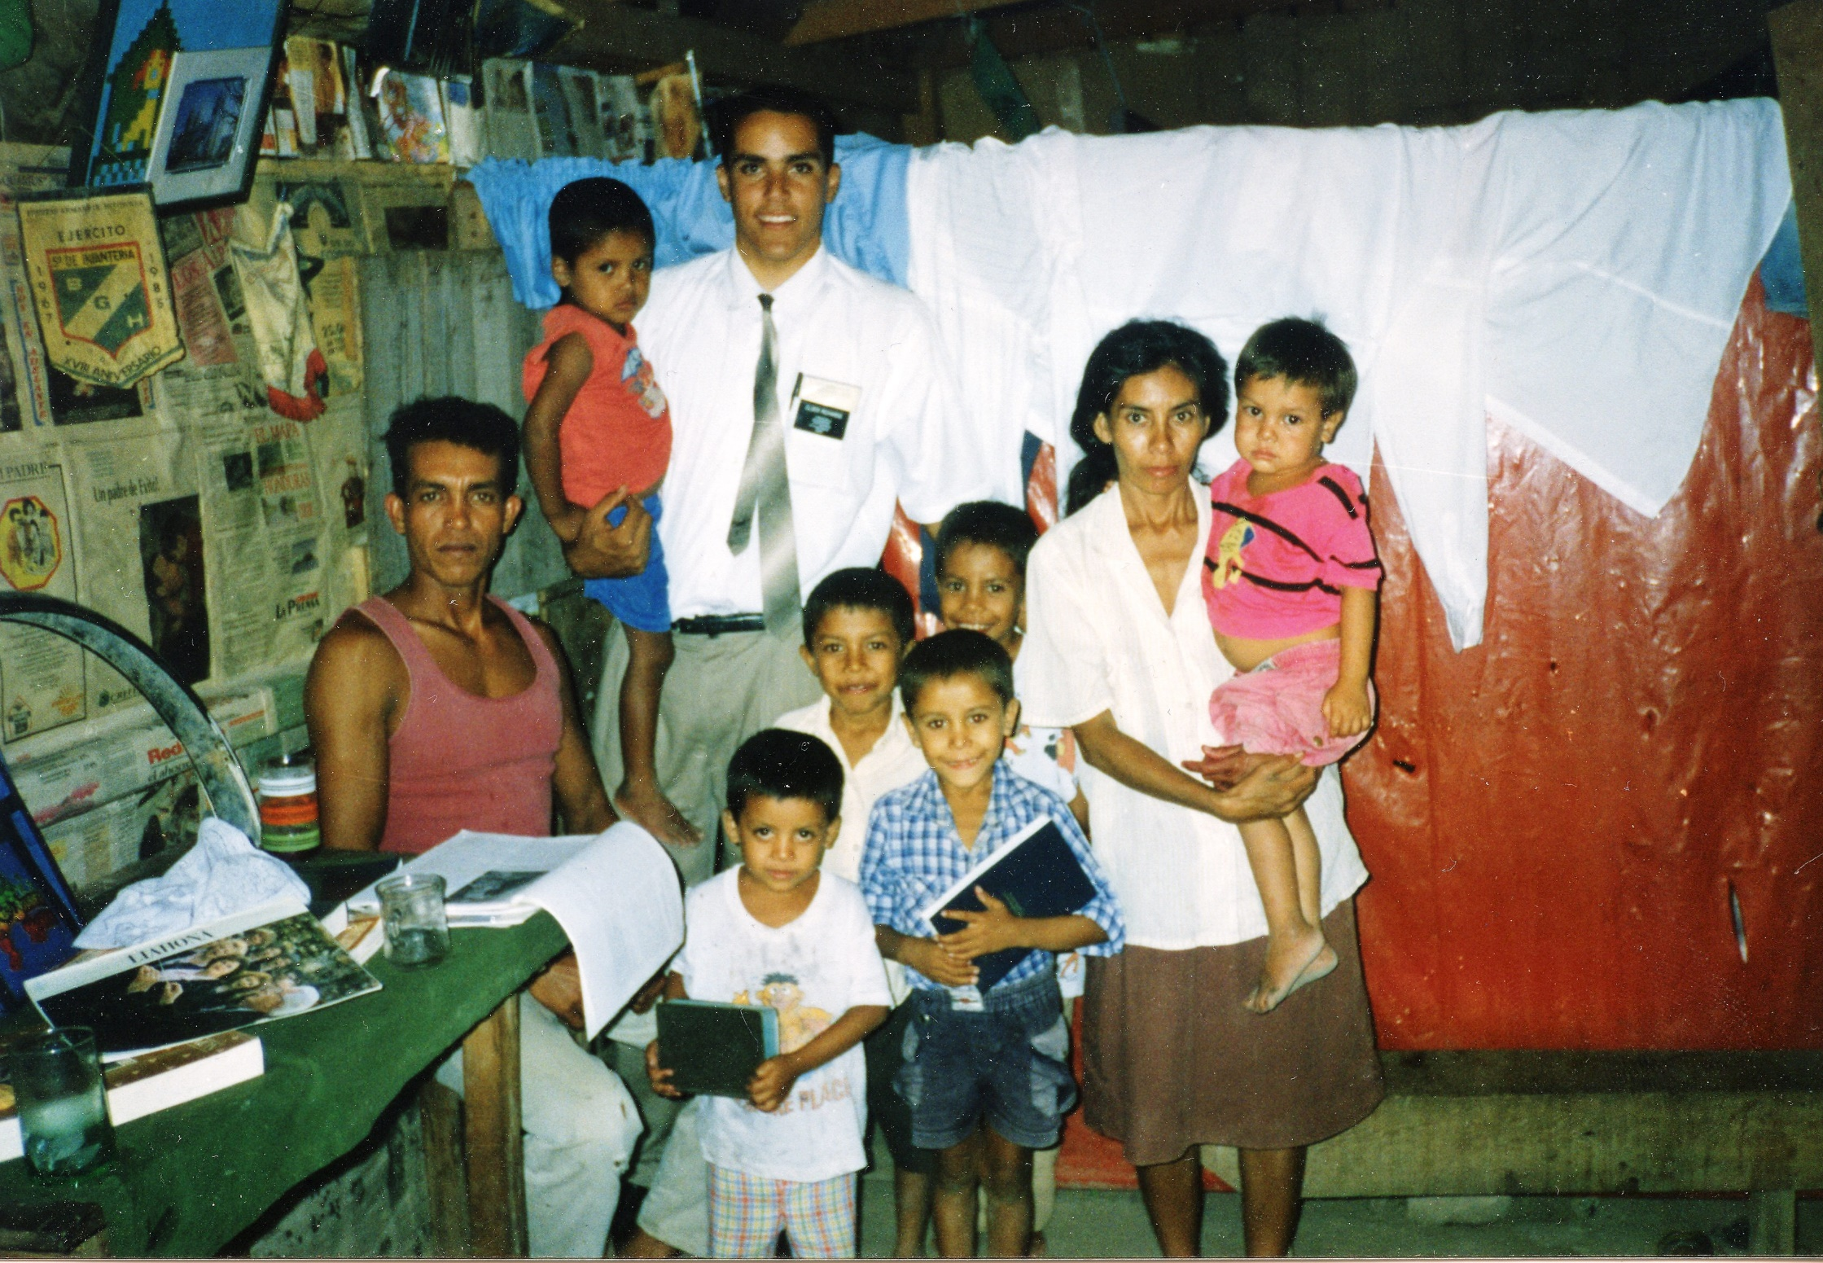

Slide 23
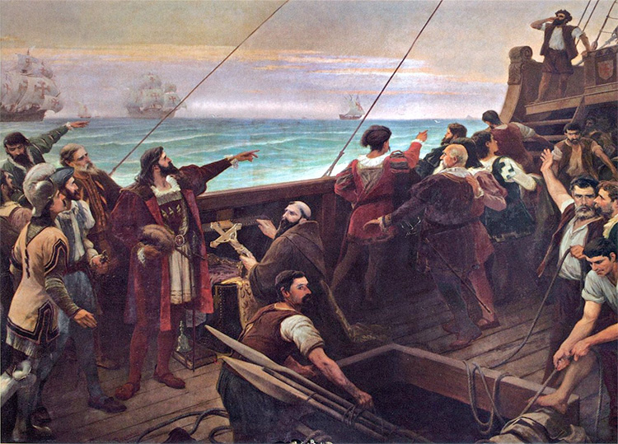

Slide 24
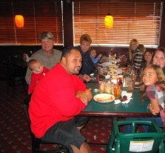
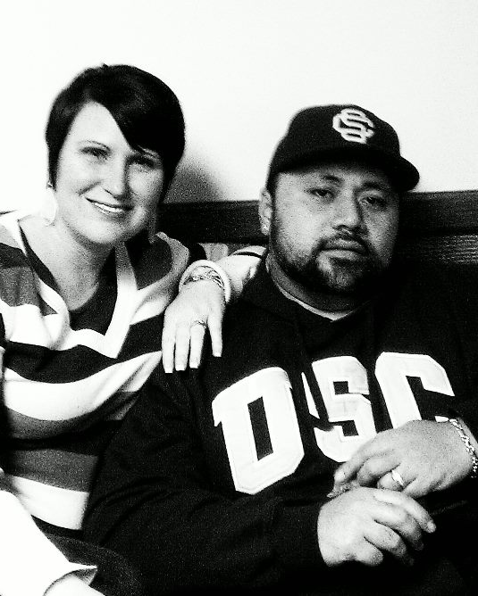
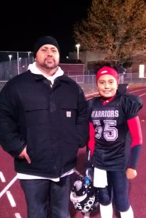
FORSAKE

Slide 25
3 Nephi 27:13
SCRIPTURE 9
“Once we have repented, there is no black mark on our right ankle that says “2018 sin” or brown stain behind our left ear that says “2017 trespass.” (LDS.org)

Slide 26
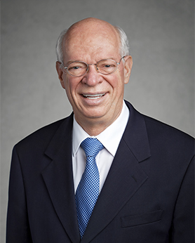
“Let me be direct and clear. You are going to make it as long as you keep repenting and do not rationalize or rebel. God is not a heartless referee looking for any excuse to throw us out of the game. Please take hope and comfort from this eternal truth: He intends for us to make it!” (Elder Cornish, October 2016 General Conference

Slide 27
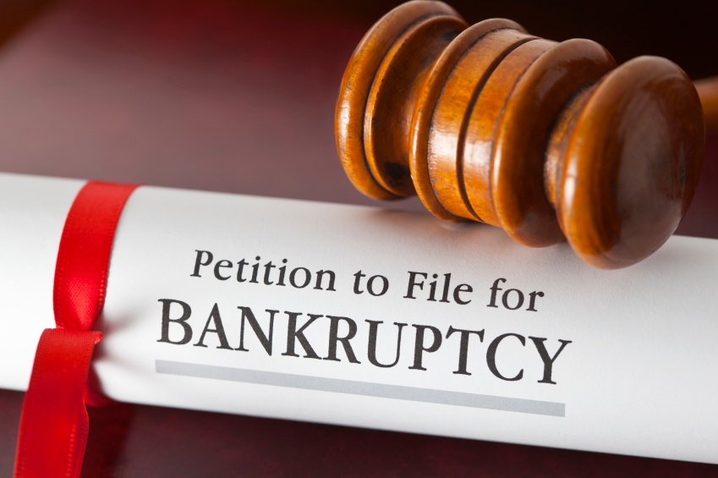
Back to our debt… What do people do with a bill they can’t pay?

Slide 28
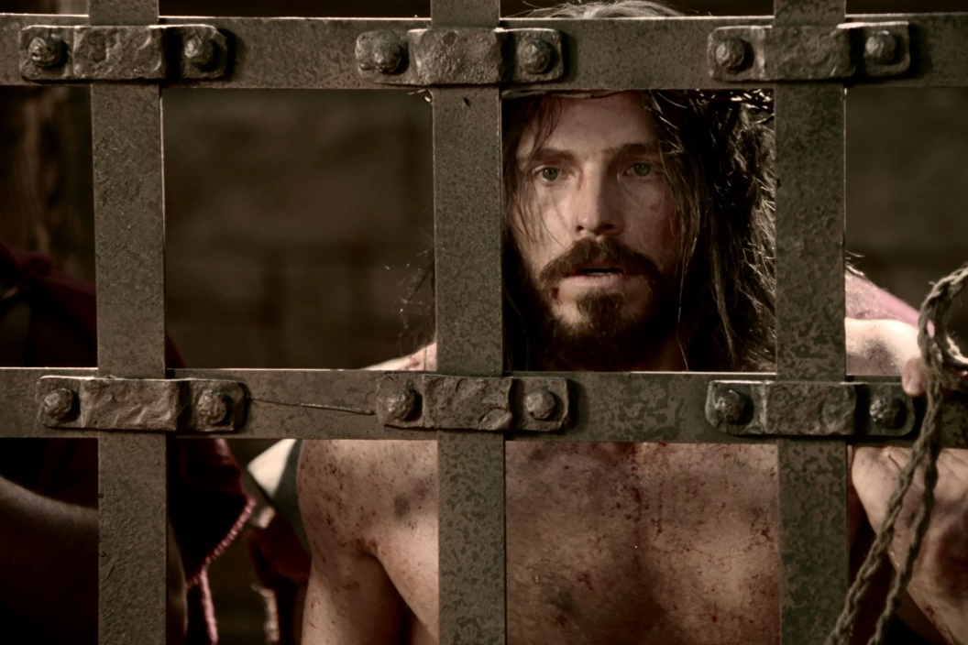
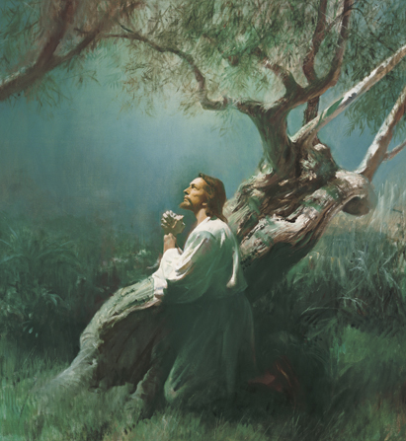
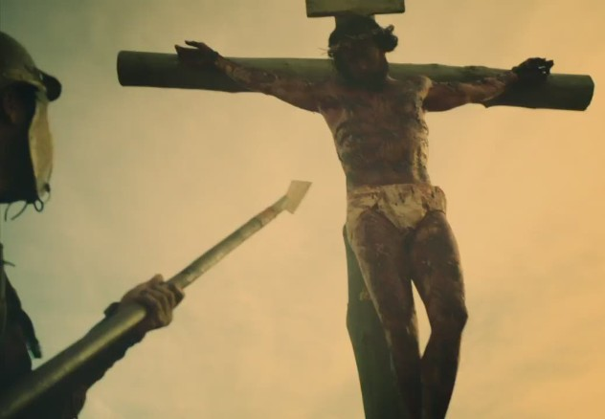
One day God ask, “You owe me perfection. Where is the payment?” It should be a short conversation...

Slide 29
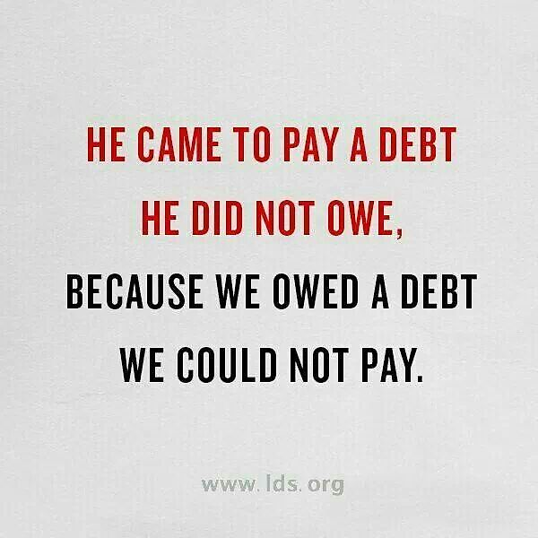

Slide 30
D&C 45:3-5

Slide 31
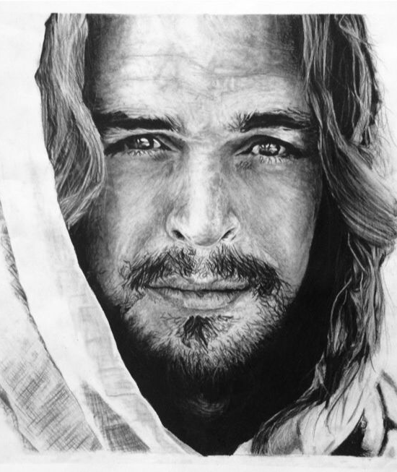
Being born in a barn in Bethlehem didn’t burden him. The mocking didn’t move him. The banter didn’t bother him. The harassment didn’t hinder him. Sadducees couldn't stop him. Pharisees couldn’t finish him Peter’s Denial couldn’t derail him. Herod couldn’t halt Him. Pilate couldn’t pressure him. Judas couldn’t jinx Him. Satan couldn’t slow Him.

Slide 32
The Romans didn’t rattle Him. Soldiers didn’t slow him. The garden didn’t grip him. The scourging didn’t stall him. The thorns didn’t thwart him. Calvary couldn’t quell him. The cross couldn't conquer him. The tomb couldn’t retain him. Even death couldn't disrupt him.

Slide 33
Mountain move. Storms stop. wrongs Retreat. confusions quit. Diseases depart. Restlessness retires. Filth flees. problems perish. doubts disappear. weakness withdraws. Hurts are healed. The Grave grumbles

Slide 34
Christ’s death certificate is our Birth Certificate ...If we surrender our will to him.

Slide 35
Remember:
You are cut off
Boreholes drilled 2000 years ago.
Go through the X-ray.
Stop trying to cover-up your rotten eggs.
Take your Vitamin J.
He’s paid the bill. He just needs you to come to him.

