Slide 1
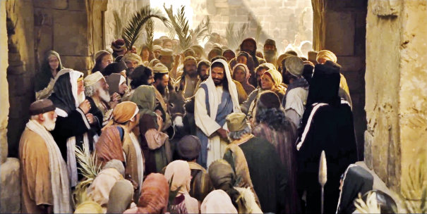
The Triumphal Entry
Mark 11

Slide 2
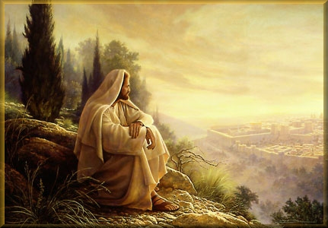
If you had one week to live... how would you spend it?

Slide 3
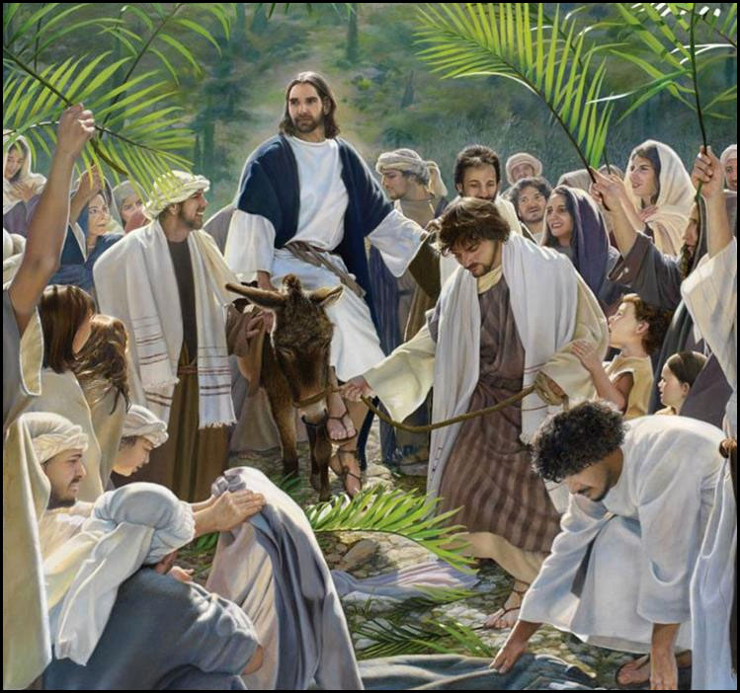
Mark 11:1-9
Cross Reference Luke 19:40

Slide 4
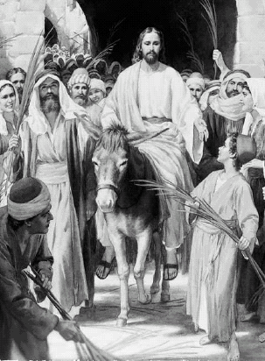

Jesus Triumphant Entry:
https://www.youtube.com/watch?v=rdyJO-_aAv8 (3:45)

Slide 5
Where would you have been?
What might you have said or done? How would you have felt?

Slide 6
What does “Hosanna” mean?
What is the Hosanna shout? Have you ever done one?
  The Hosanna Shout memorializes the pre-earthly Council in Heaven, as "when all the sons of God shouted for joy" (Job 38:7).
Is it just a Latter-Day Saint practice?
When is the next Hosanna Shout planned for?
  President Lorenzo Snow taught that this shout will herald the Messiah at His Second Coming (1 Thes. 4:16).
Why did Jesus ride a colt? (See Zech 9:9)
Of all animals, why was Jesus riding a colt?
What does the colt’s actions say about Jesus?
How are you like the donkey?

Slide 7
What is the significance of the triumphal entry?
https://www.youtube.com/watch?v=RSY0YN5aQwE

Slide 8
As illustrated in this account, what can happen as we publicly acknowledge and speak about Jesus Christ?
Mormon Messages for Youth video“Nine Ways to Use Technology to Share Your Beliefs” (2:02),

Slide 9
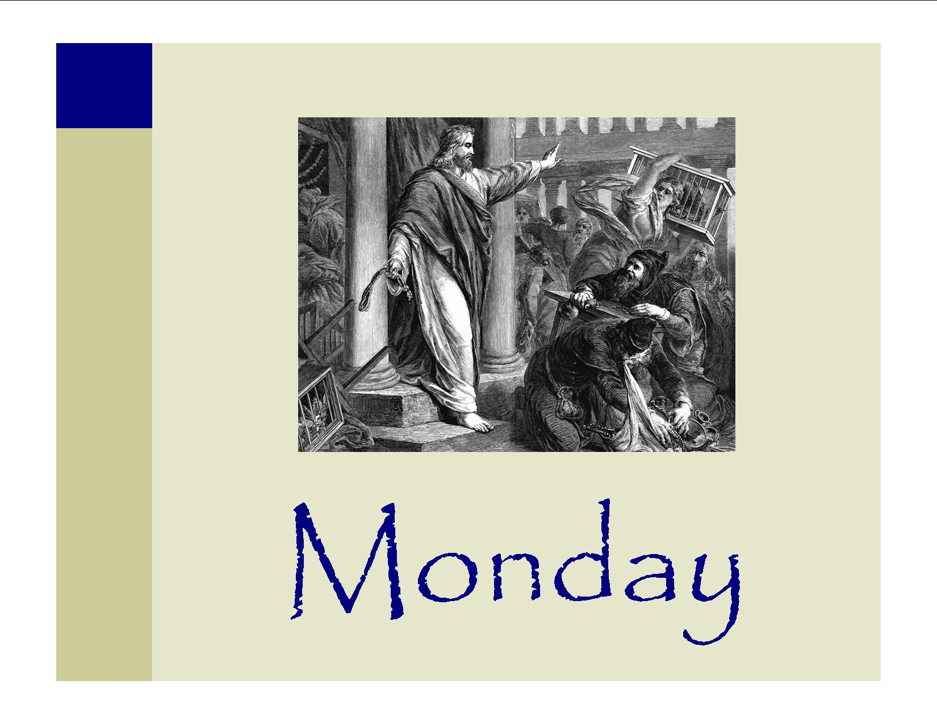
MONDAY
Matthew 21:12–13
What is the temple mount? How did he clear that area?
How can we show reverence for the house of the Lord?
What is the result (See Matt 21:14)
  When have you, or someone you know, experienced the Lord’s healing influence by worshipping in the temple?

Slide 10
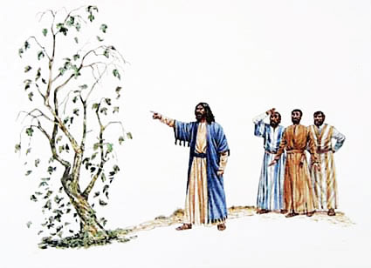
TUESDAY
Jesus only cursed one thing during his ministry. What was it?
Matthew 21:17-20 (What is the symbolism?)

Slide 11
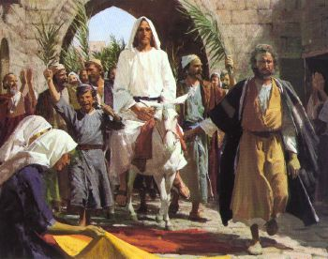
The Triumphal Entry
John 12

Slide 12
Why riding a colt?
“He came riding on a donkey, in token of peace, acclaimed by the Hosanna shouts of multitudes; not on a caparisoned steed with the panoply of combat and the accompaniment of bugle blasts and fanfare of trumpets. . . . The donkey has been designated in literature as ‘the ancient symbol of Jewish royalty,’ and one riding upon an ass as the type of peaceful progress” (James E. Talmage, Jesus the Christ, 3rd ed. [1916], 516–17).
The donkey “was a symbol of Jewish royalty. … Riding on a donkey … showed that Jesus came as a peaceful and ‘lowly’ Savior, not as a conqueror upon a warhorse” (New Testament Student Manual [Church Educational System manual, 2014], 64).

