Slide 1
Lost sheep, lost coin, lost son
Luke 15

Slide 2
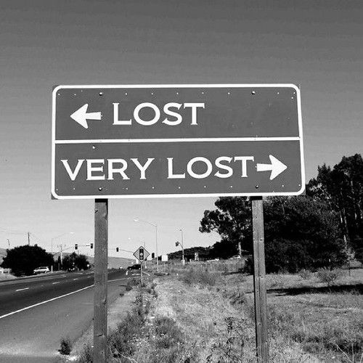
Have you ever lost something that was important to you?

Slide 3
Scripture Study Tips
Relevancy in personal study
Today’s Tip:
Story board; diagram

Slide 4
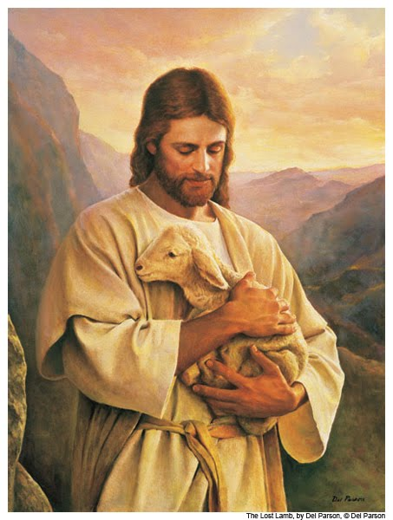
Luke 15
 | LUKE 15:3-7 | LUKE 15:8-10
What was lost?
How was it lost?
How was it found?
What words describe the reaction to it being found?
Cross Reference Doctrine and Covenants 18:10‑‑16.

Slide 5
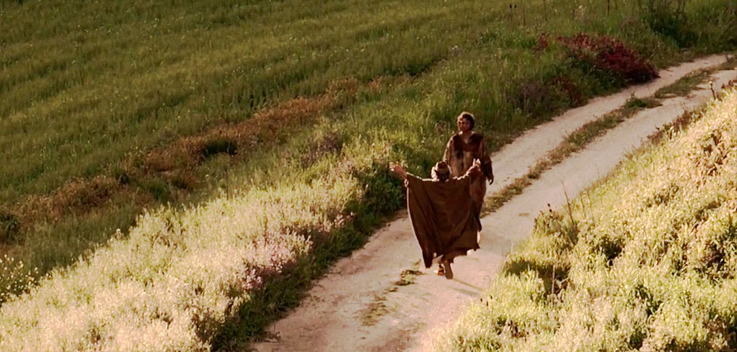
Luke 15:11-32

Slide 6
Luke 15
Feeling footloose and frisky, a featherbrained fellow forced his father to fork over his farthings. Fast he flew to foreign fields and frittered his family's fortune, feasting fabulously with floozies and faithless friends. Flooded with flattery, he financed a full‑fledged fling of "funny foam" and fast food. Fleeced by his fellows in folly, facing famine, and feeling faintly fuzzy, he found himself a feed‑flinger in a filthy foreign farmyard. Feeling frail and fairly famished, he fain would have filled his frame with foraged food from the fodder fragments.
"Fooey," he figured, "my father's flunkies fare far fancier," the frazzled fugitive fumed feverishly, facing the facts. Finally, frustrated from failure and filled with foreboding (but following his feelings) he fled from the filthy foreign farmyard.

Slide 7
Luke 15
Faraway, the father focused on the fretful familiar form in the field and flew to him and fondly flung his forearms around the fatigued fugitive. Falling at his father's feet, the fugitive floundered forlornly, "Father, I have flunked and fruitlessly forfeited family favor." Finally, the faithful Father, forbidding and forestalling further flinching, frantically flagged the flunkies to fetch forth the finest fatling and fix a feast.
Faithfully, the father's first‑born was in a fertile field fixing fences while father and fugitive were feeling festive. The foreman felt fantastic as he flashed the fortunate news of a familiar family face that had forsaken fatal foolishness. Forty‑four feet from the farmhouse the first‑born found a farmhand fixing a fatling. Frowning and finding fault, he found father and fumed, "Floozies and foam from frittered family funds and you fix a feast following the fugitive's folderol?" The first‑born's fury flashed, but fussing was futile.

Slide 8
Luke 15
The frugal first‑born felt it was fitting to feel "favored" for his faithfulness and fidelity to family, father, and farm. In foolhardy fashion, he faulted the father for failing to furnish a fatling and feast for his friends. His folly was not in feeling fit for feast and fatling for friends; rather his flaw was in his feeling about the fairness of the festival for the found fugitive. His fundamental fallacy was a fixation on favoritism, not forgiveness.
Four facets of the father's fathomless fondness for faltering fugitives are:
> 1) Forgiveness
> 2) Forever faithful friendship
> 3) Fadeless love, and
> 4) A facility for forgetting flaws

Slide 9
DISCUSSION
Prodigal Son
What helped him come to himself and recognize his awful situation?
How did he expect his father to respond to his return home?
What do you think he felt when his father treated him as he did when he returned?
The Father
What might he have felt while his son was gone?
When his elder son resented how he treated his younger brother, what could the father have said to help him understand the situation?
Older Brother
What might he had been thinking and feeling while his brother was gone?
Why was it difficult for him to rejoice in his brother’s return?
What blessings had he received for being faithful to his father?

Slide 10
Luke 15:11-32
QUESTIONS
Does the Prodigal have a deeper understanding of the Atonement than his brother?
What gave the Prodigal Son courage to return home?
If you were to choose a ‘moral’ for the story, what might it be?

Slide 11
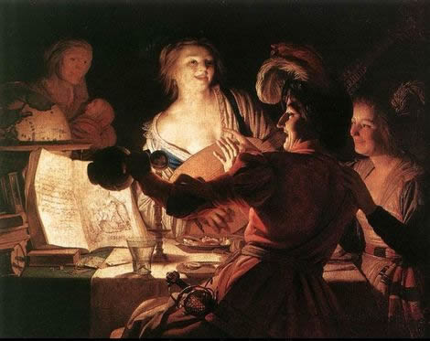

Slide 12
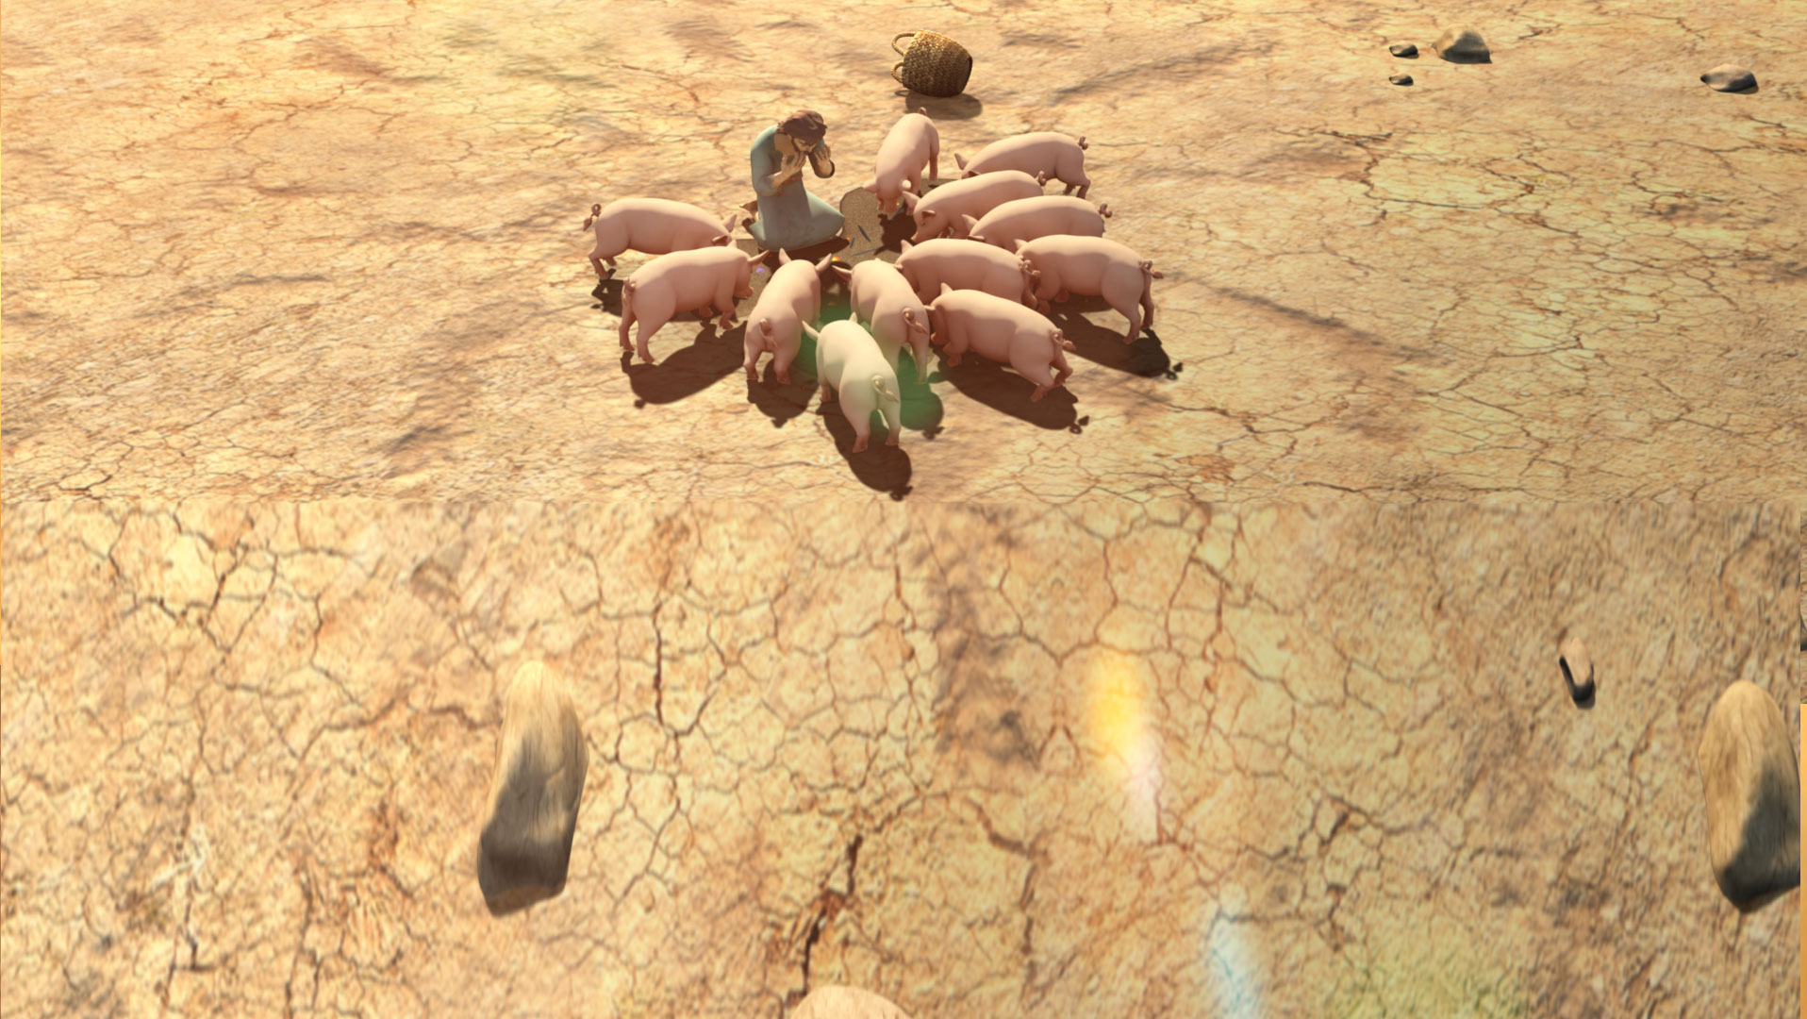
Luke 15:11–32 Video

Slide 13
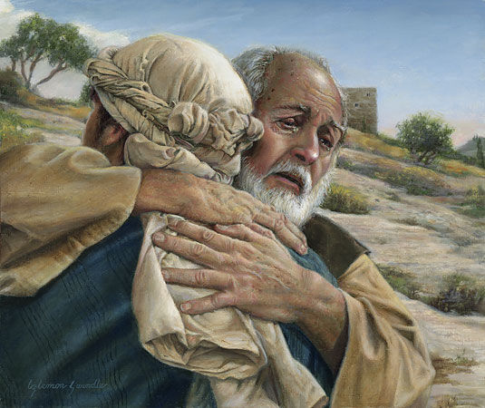

Slide 14
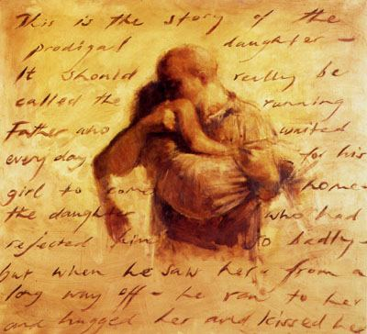

Slide 15
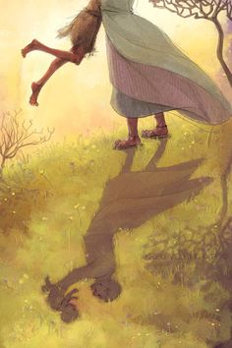
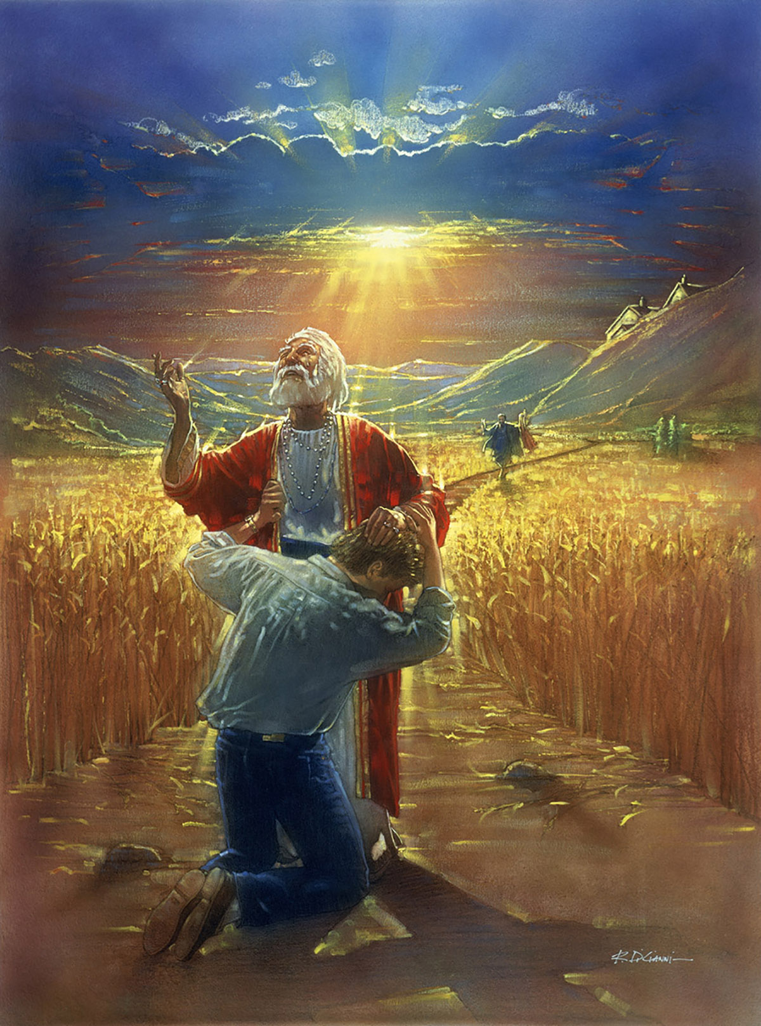

Slide 16
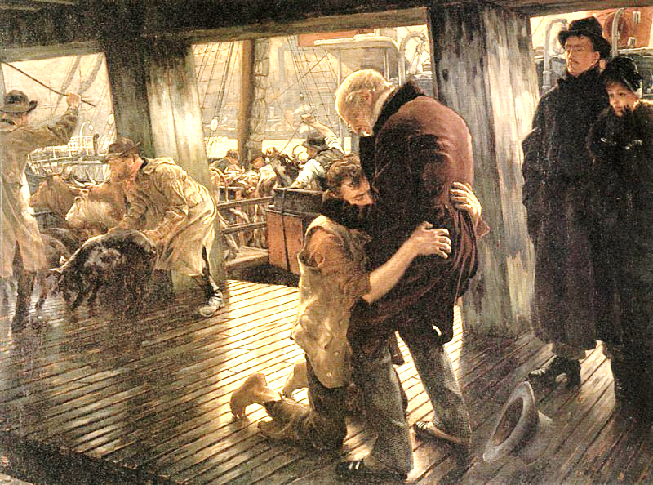

Slide 17
Luke 15
Luke 15:11–32 Video
“The Prodigal Son”(5:35) from The Life of Jesus Christ Bible Videos.
Or https://www.youtube.com/watch?v=Jve8Y9x35iE

Slide 18
Luke 15
Luke 15:11–32 Video
“The Prodigal Son”(5:35) from The Life of Jesus Christ Bible Videos.
Or https://www.youtube.com/watch?v=Jve8Y9x35iE

Slide 19
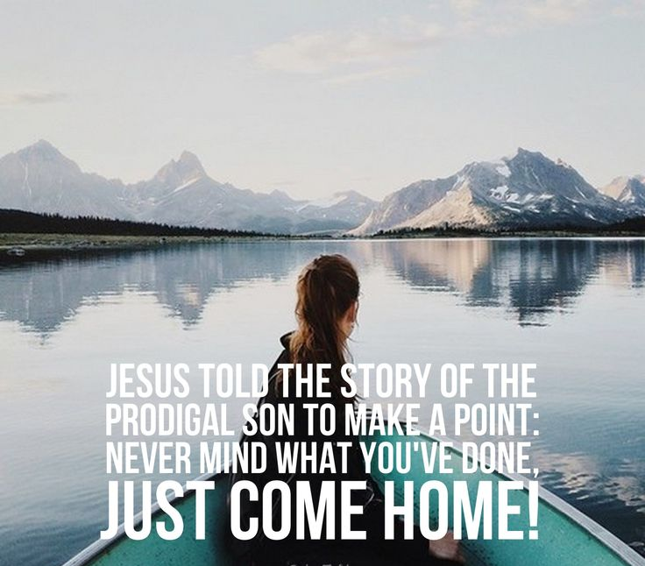

Slide 20
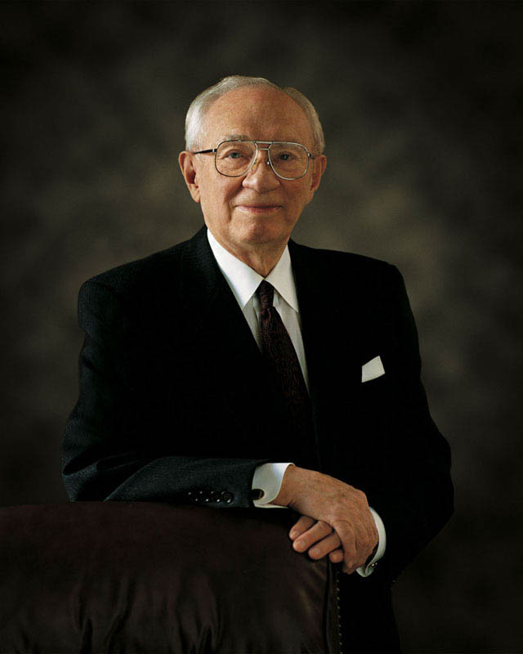
Luke 15
“Some of our own cry out in pain and suffering and loneliness and fear. Ours is a great and solemn duty to reach out and help them, to lift them, to feed them if they are hungry, to nurture their spirits if they thirst for truth and righteousness. …
“There are those who were once warm in the faith, but whose faith has grown cold. Many of them wish to come back but do not know quite how to do it. They need friendly hands reaching out to them. With a little effort, many of them can be brought back to feast again at the table of the Lord.
“I would pray that each of us would resolve to seek those who need help, who are in desperate and difficult circumstances, and lift them in the spirit of love into the embrace of the Church, where strong hands and loving hearts will warm them, comfort them, sustain them, and put them on the way of happy and productive lives” (“Reach with a Rescuing Hand,” Ensign, Nov. 1996, 86).

Slide 21
What is something you could ‘go-and-do’ today that would bring you closer to Jesus Christ?
NEXT LESSON: Think about Lazarus being raised from the dead.

Slide 22
The Prodigal Son
Unprecedented: In all of Middle Eastern literature from ancient times to the present, there is no case of any son, older or younger, asking for his inheritance from a father who is still in good health.
Shocking: By asking for his inheritance, the son is effectively saying to his father "I wish you were dead." Jesus probably had to pause regularly to accommodate the gasps and shouts of incredulity from his original audience.
Embarrassing: The polite way a Middle-Easterner gets rid of unwanted hangers-on is to assign them as task he knows they will refuse... However, to the amazement of the listener, the citizen's attempt to get rid of the younger son fails and the prodigal convinces himself that he can still win by working his way back up from the very bottom.
Repentance: Eventually the son realizes that he's going to starve to death, and it's this realization, rather than actual repentance, which drives him to leave the farm and travel back to his father's village [look at his plans to say (v18-19), and what he actually says when he meets his dad (v21)].

Slide 23
The Prodigal Son
Aristotle said, "Great men never run in public," yet the father runs probably because his son would have been subject to a ceremony on his return to the village called the kezazah, in which the villagers would have broken a large pot at his feet and yelled at him, telling him that he was now cut off from his people. So when the father runs, it's at least partly because he wants to reach the son before the rest of the village can get to him. He is literally running to save him. Instead of subjecting him to the utter shame of the kezazah, he embraces him, shows the village that his son is forgiven, and then moves to quickly restore him through the killing of the fattened calf – another moment that would have had the audience's heads spinning.

