Slide 1
Matthew 19

Slide 2
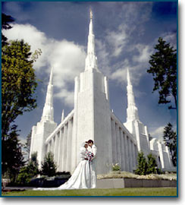
Matthew 19
"The greatest single decision affecting your eventual destiny is…
……the decision you make that moonlit night when you ask that individual to be your companion for life. That's the most important decision of your entire life!" (The Teachings of Spencer W. Kimball, 301).

Slide 3

Matthew 19
The Ring Finger
https://www.youtube.com/watch?v=57MakDoK624

Slide 4
Matthew 19
Matthew 19:3–6 What principles of marriage are found here? What do we learn about marriage by understanding Jesus' teachings about divorce?
Hillel vs Shammai
Hillel
Liberal view of marriage, permitting divorce in a variety of circumstances (even if the wife spoiled a meal!)
Shammai
Conservative view of marriage; only in the case of adultery.
Jesus’ answer? (Matthew 19:4)
“Have you read your scriptures?”
Application: Most people get divorced or support non-Christian marriage because (1) they don’t understand or haven’t consistently read the scriptures or (2) they don’t understand the doctrine of marriage.

Slide 5

What’s the difference between
questioning and asking questions?
What’s the difference between
questions and doubts?
What if my answer doesn’t come?
How is the process of seeking spiritual truth different than seeking educational truth?
What role will my attitude and motive make when seeking answers?
What’s the difference between a
Diet of Doubt and a Feast of Faith?
What truth have come because someone asked a question?

Slide 6
Gospel Questions
  What do the scriptures teach? Are my non-scriptural sources credible?
  Are multiple General Authorities teaching the doctrine in the same way?
  Does my view differ from God’s view?
  Am I willing to surrender my view if it contradict with God’s view?
  Is my approach to finding my answer dignified & reverent? (What’s my tone?)
  What scripture verses led you to believe that the practice of gay marriage was ordained from God or scripturally encouraged?
  What have church leader’s taught?
  How do you define marriage? How does The Lord define marriage?
  If God were to reveal the truth about marriage to me through the Holy Ghost, would I be willing to change my opinion?
  Is my tone is seeking truth about marriage reverent and dignified?

Slide 7
“We should not be haphazard in our reading but rather develop a systematic plan for study.” (President Howard W. Hunter, Ensign, Nov. 1979, 64, emphasis added).
“The only way you can be sure that a busy schedule doesn’t crowd out scripture study is to establish a regular time to study the scriptures” (President Henry B. Eyring Ensign, July 2005, 24).
“Set a consistent time and place to study when you can be alone and undisturbed” (Elder M. Russell Ballard, “Be Strong in the Lord, and in the Power of His Might”).
“Couple prayer with scripture study. It will give increased success in your daily activities. It will bring increased alertness to your minds.” (Elder M. Russell Ballard, “Be Strong in the Lord, and in the Power of His Might”).
“Please…read slowly and more carefully and with more questions in mind…Ponder and examine every word, every scriptural gem…Such an examination may unearth a treasure hidden in a field” (Elder Jeffrey R. Holland, Summer 1992 CES Satellite Broadcast, 4).
“I suggest that you memorize scriptures that touch your heart and fill your soul with understanding. They have power that is not communicated when paraphrased.” (Elder Richard G. Scott, Ensign, Nov. 1999, 87).

Slide 8
“We should not be haphazard in our reading but rather develop a systematic plan for study.” (President Howard W. Hunter, Ensign, Nov. 1979, 64, emphasis added).
“The only way you can be sure that a busy schedule doesn’t crowd out scripture study is to establish a regular time to study the scriptures” (President Henry B. Eyring Ensign, July 2005, 24).
“Set a consistent time and place to study when you can be alone and undisturbed” (Elder M. Russell Ballard, “Be Strong in the Lord, and in the Power of His Might”).
“Couple prayer with scripture study. It will give increased success in your daily activities. It will bring increased alertness to your minds.” (Elder M. Russell Ballard, “Be Strong in the Lord, and in the Power of His Might”).
“Please…read slowly and more carefully and with more questions in mind…Ponder and examine every word, every scriptural gem…Such an examination may unearth a treasure hidden in a field” (Elder Jeffrey R. Holland, Summer 1992 CES Satellite Broadcast, 4).
“I suggest that you memorize scriptures that touch your heart and fill your soul with understanding. They have power that is not communicated when paraphrased.” (Elder Richard G. Scott, Ensign, Nov. 1999, 87).
HOW TO STUDY SCRIPTURE
Plan a Time & Place
Start with Prayer
Read Slowly with Question
Memorize

Slide 9
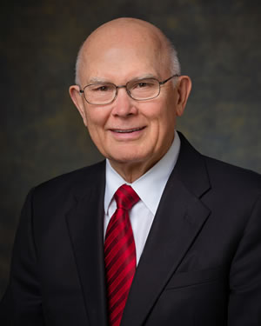
“Reading the scriptures will put us in a position where we can obtain inspiration to answer any doctrinal or personal question, whether or not that question directly concerns the subject we are studying in the scriptures. That is a grand truth not understood by many….Even though the scriptures contain no words to answer our specific personal questions, a prayerful study of the scriptures will help us obtain such answers” (Elder Dallin H. Oaks, “Studying the Scriptures,” Fireside given November 24, 1985).

Slide 10

MARRIAGE
Read Matthew 19:7-9
Cross Reference D&C 131:1-4.
3 types of marriage:
    D&C 132:13
    D&C 132:15
    D&C 132:19
  Celestial Law = No divorce
  Telestial Law= Divorce permitted (vs 8)
    United Order vs Tithing
When is Divorce permitted?

Slide 11

Matthew 19
"Divorce is not part of the gospel plan no matter what kind of marriage is involved. But because men in practice do not always live in harmony with gospel standards, the Lord permits divorce for one reason or another, depending upon the spiritual stability of the people involved. . . . Under the most perfect conditions there would be no divorce permitted except where sex sin was involved. In this day divorces are permitted in accordance with civil statutes" (Doctrinal New Testament Commentary, 1:547).

Slide 12

Mormon Message: Love and Marriage

Slide 13
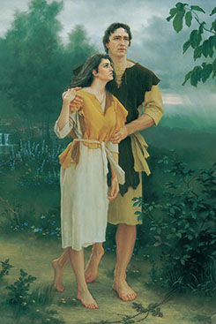

Slide 14
Why were Adam and Eve family created? (Genesis 1:26-27).
Why was Eve created?
  To help Adam rule and give helpful feedback and suggestion so they can rule together.
  Her mind, personality, her attributes are perfect to help them rule together as equal partners.
  If she’s never consulted, he is helpless (and hopeless).
  1 Peter 3:7
Why did Adam name Eve? What does naming things imply?
  (1) Authority and (2) Responsibility
    Remember that Adam doesn’t have absolute authority - he has authority under the one he’s submitted to
    He’s not the man WITH authority, he’s the man UNDER authority.

Slide 15
What does Satan’s conversation with Eve teach us?
  Satan is after dominion - he deceives Eve trying to turn her into the leader and the decision maker.
After they partake, the Lord asks, “Adam, where art THOU?” (not “Adam and Eve, where are YA’LL?”) Why?
  The scriptural line of authority is simple:
    God leading Man
    Husband leading with his Wife
    Parents leading children
On a side note, in the Bible, the father raised the children. He was ultimately responsible. Mothers had one job: help (helpmate). Fill in the gaps when dad can’t be there (when he’s working, for example).
  If a wife has to wake up her husband for church or to have family prayer or to the temple, the man is failing in his role.

Slide 16
Jesus quoted from the Old Testament 78 times during his 400 verses of words;
his Apostles quoted the Old Testament 209 times
“It is written…”
“Moses taught…”
“It hath been said…”
Generally speaking, why do people get divorced?
Generally speaking, why do people wait to be married?
(could the answer be the same to both questions?)
CASE STUDY ABOUT THE POWER OF SCRPITURE STUDY: Genesis 19:30-38
Share a scriptural account wherein someone tries ‘living’ the gospel their own way – and it fails

Slide 17
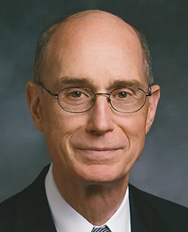
“The spiritual strength sufficient to stand firm just a few years ago will soon not be enough. Even the best are sorely tested. And the testing will become more severe. Some say to themselves: “For now, I’ll go with the flow.” Well, the flow has become a flood and soon will be a torrent. Swimming back upstream to purity was never easy. It is getting harder and may soon be frighteningly difficult.”
President Eyring, We Must Raise our Sights, Aug 2001 Symposium

Slide 18
Matthew 19
Q: Will a temple divorce invalidate the sealing of our children?
  “In the case of a cancellation of the sealing, this does not cancel the sealing of the children to the parents, since they were born in the covenant, which is a birthright blessing. The decision as to with whom they will go will be determined by the Lord in the hereafter.”
Q: Is there anyway that I can be unsealed from my very cruel and abusive father?
  God is not only just, but also kind, loving, gentle and merciful. No one who loves the Lord and obeys His commandments will ever be required to enter into some familial relationship against their will.
Q: If families are to be forever, how can they be if a couple divorces?
  If a couple make covenants and then breaks them or get divorced, the promised blessings will not be received.

Slide 19
Who can testify to the blessings of having an eternal family?
What have you learned about creating a happy marriage from people you know that are married?

Slide 20

What is something you could ‘go-and-do’ today that would bring you closer to Jesus Christ?
NEXT LESSON: What is one thing you should give up to feel closer to Jesus Christ?

