Slide 1
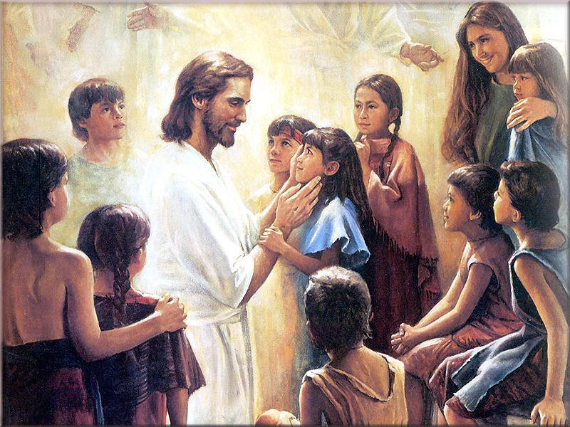
Matthew 18

Slide 2
Matthew 18
Currently, who’s number one in:
High School Football
College Football
Pro Football
Pro Baseball
NBA
HS Cross Country Running
Kingdom of Heaven?
Matt 18:1
Why were they concerned about who was the greatest?

Slide 3
Matthew 18
The Royal Class (less than 1%)
‘Patricians’
  <1 million sestercies
Senate (Law Makers)
Equestrians
  <4 million sestercies in equine wealth
Money changers (bankers)
Plebians (Common Citizens; Merchants; Stewards)
  75% of Jews
Junians (Former Slaves; former POWs)
Women
Ptochos (beggars)
Slaves (large debts)
Children

Slide 4
Matthew 18
Read Matt 18:2-6
What attributes must we learn from children that will help us get to the Celestial Kingdom?
Cross Reference Mosiah 3:19

Slide 5
Scripture Study Tips
Relevancy in personal study
Today’s Tip:
Make the scriptures relevant

Slide 6
What makes a man a ‘man’?

Slide 7
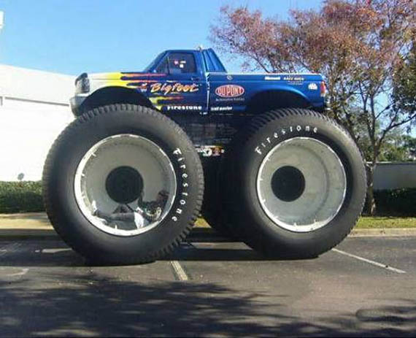

Slide 8
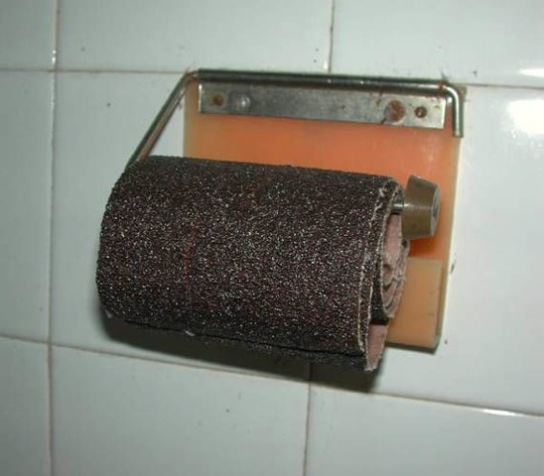

Slide 9
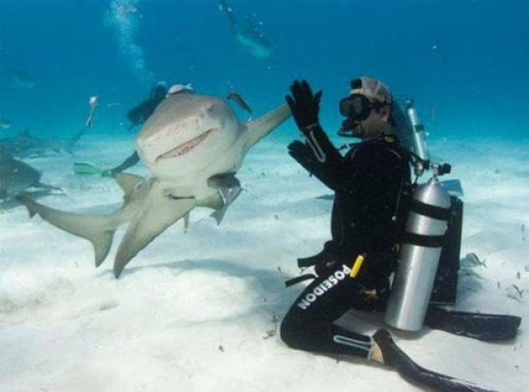

Slide 10
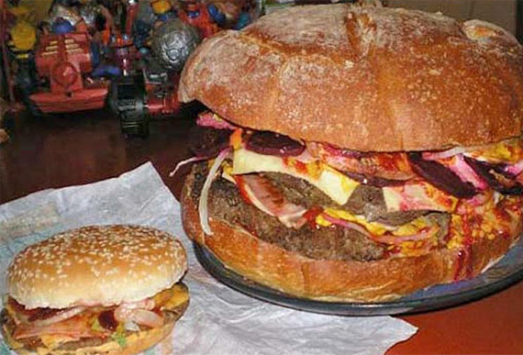

Slide 11
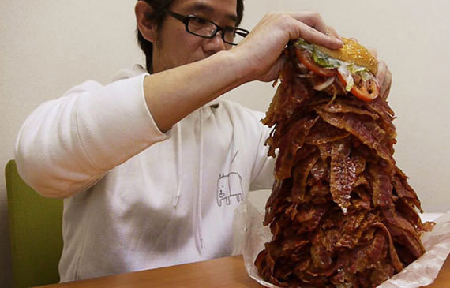

Slide 12
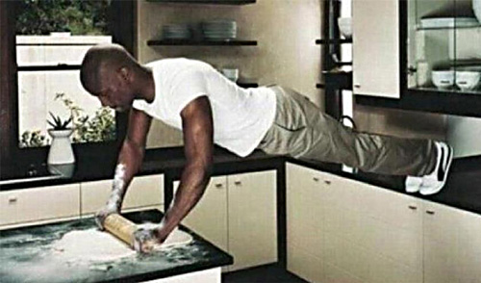

Slide 13
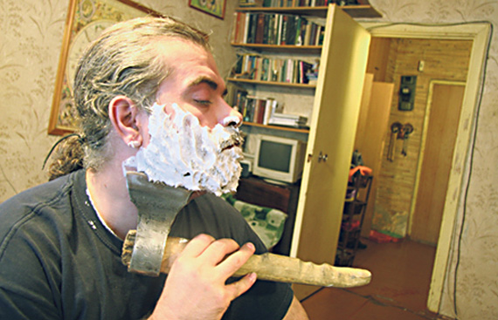

Slide 14
Who was One of the manliest man ever?

Slide 15
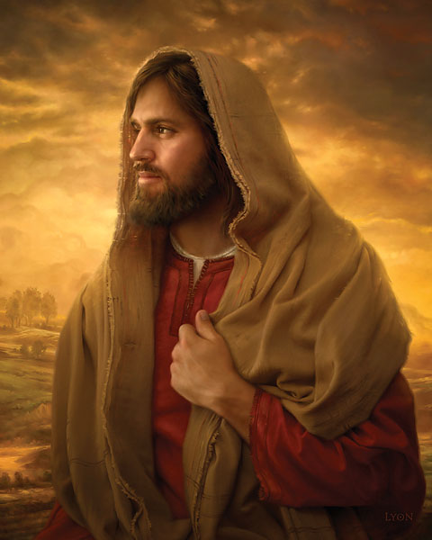
If Christ was one of the manliest men ever, then why did he possess so many feminine attributes?

Slide 16
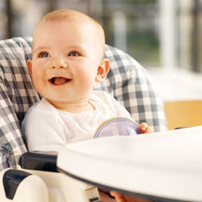
How dependent is a baby on parents?
How dependent are little children on the Savior?
Mosiah 3:16
100%

Slide 17
How dependent are we supposed to be on the Savior?
Mosiah 3:17
100%

Slide 18
Mosiah 3:19
TAKE NAME + CHANGE BEHAVIOR = CHRISTLIKE
by covenants and through atonement become like Christ

Slide 19
Doctrine and Covenants 121
Unrighteous |  | Righteous
D&C 121:37 ACTION |  | D&C 121:41-42 ACTION
D&C 121:37-38 CONSEQUENCE |  | D&C 121:45-46 CONSEQUENCE

Slide 20
Doctrine and Covenants 121
Unrighteous |  | Righteous
D&C 121:37 ACTION | Cover sins Gratify pride, vain ambitions Exercise control | D&C 121:41-42 ACTION
D&C 121:37-38 CONSEQUENCE |  | D&C 121:45-46 CONSEQUENCE

Slide 21
Doctrine and Covenants 121
Unrighteous |  | Righteous
D&C 121:37 ACTION | Cover sins Gratify pride, vain ambitions Exercise control | D&C 121:41-42 ACTION
D&C 121:37-38 CONSEQUENCE | Heavens withdraw themselves Sprit grieved Amen to the priesthood | D&C 121:45-46 CONSEQUENCE

Slide 22
Doctrine and Covenants 121
Unrighteous |  | Righteous
D&C 121:37 ACTION | Cover sins Gratify pride, vain ambitions Exercise control | D&C 121:41-42 ACTION | Persuasion, longsuffering, gentleness, love, kindness, FAITH. Charity, clean thoughts
D&C 121:37-38 CONSEQUENCE | Heavens withdraw themselves Sprit grieved Amen to the priesthood | D&C 121:45-46 CONSEQUENCE

Slide 23
Doctrine and Covenants 121
Unrighteous |  | Righteous
D&C 121:37 ACTION | Cover sins Gratify pride, vain ambitions Exercise control | D&C 121:41-42 ACTION | Persuasion, longsuffering, gentleness, love, kindness, FAITH. Charity, clean thoughts
D&C 121:37-38 CONSEQUENCE | Heavens withdraw themselves Sprit grieved Amen to the priesthood | D&C 121:45-46 CONSEQUENCE | Confidence, distills, constant companion

Slide 24
Matthew 18
Matt 18:6 – Who is in danger of this consequence?

Slide 25
Jesus Came To Elevate People
The second born son (Prodigal son)
Women
The poor (widow’s mite)
Sinners (Jesus spoke publically with ‘sinners’)
The Centurion and Tax collectors
Children
Mother in laws
The ill
The convicted (on the cross).
Everybody is somebody. To discriminate is to declare that your standards are higher than God’s.

Slide 26
STORY II: Forgiveness

Slide 27
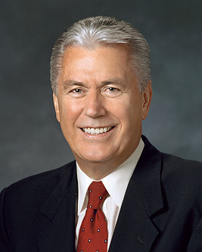
A couple who had been married for 60 years. They had rarely argued during that time, and their days together passed in happiness and contentment. They shared everything and had no secrets between them—except one. The wife had a box that she kept at the top of a sideboard, and she told her husband when they were married that he should never look inside.
As the decades passed, the moment came that her husband took the box down and asked if he could finally know what it contained. The wife consented, and he opened it to discover two doilies and $25,000. When he asked his wife what this meant, she responded, “When we were married, my mother told me that whenever I was angry with you or whenever you said or did something I didn’t like, I should knit a small doily and then talk things through with you.”
The husband was moved to tears by this sweet story. He marveled that during 60 years of marriage he had only disturbed his wife enough for her to knit two doilies. Feeling extremely good about himself, he took his wife’s hand and said, “That explains the doilies, but what about the $25,000?”
His wife smiled sweetly and said, “That’s the money I got from selling all the doilies I’ve knitted over the years.”

Slide 28
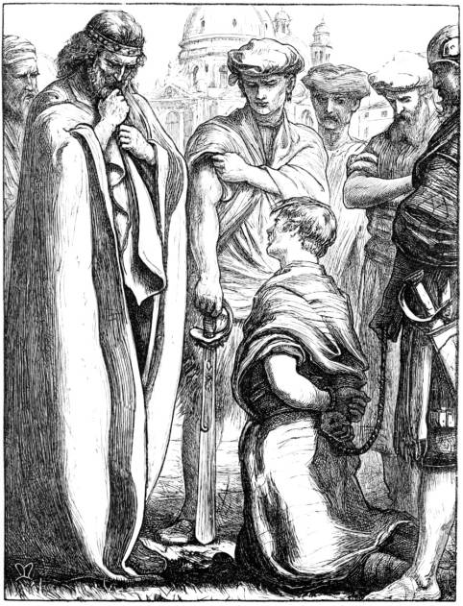

Matthew 18
Matthew 18:23-35 (Who knows this story?)
100 pence?
1 talent?
10,000 talents???
If you were to pay $1000/day, $365,000/year it would take 10,958 years, 11 months and 1 day to pay this debt. Even if you started on the day Adam and Eve walked out of the garden, you’d still owe about $1.8 billion.
REINACTMENT: https://www.youtube.com/watch?v=cvrgEBJbddI

Slide 29

Question of the Day: How do you know if you’ve fully forgiven someone?
“Holding on to anger is like grasping a hot coal with the intent of throwing it at someone else; you are the one who gets burned.”
“You will not be punished for your anger, you will be punished by your anger.”
“Anybody can become angry - that is easy, but to be angry with the right person and to the right degree and at the right time and for the right purpose, and in the right way - that is not easy.” Aristotle

Slide 30
Forgiving Others: Joseph
  1. His brothers hated him
  2. His brothers threw him into a pit
  3. Sold into slavery
  3. He was separated from his parents
  4. He was tempted to be immoral
  5. He was falsely accused
  6. He was kept in prison for years

Slide 31
Forgiving Others: Joseph
Please CAREFULLY read Genesis 45:1-9 looking for principles of forgiveness
Genesis 45:1
  Joseph sent the Egyptians out.
  If you have forgiven completely, you don't gossip.
Genesis 45:4
  Joseph asked his brothers to draw near.
  If you've forgiven, you make your offenders feel comfortable in your presence
Genesis 45:5
  Now therefore be not grieved, nor angry with yourselves, that ye sold me hither.
  You don't seek revenge.
Genesis 45:9
  Haste ye, and go up to my father, and say unto him, Thus saith thy son Joseph, God hath made me Lord of all Egypt: come down unto me, tarry not.
  As you forgive others, you’ll seek healing in the lives of everyone that was involved in the incident.

Slide 32
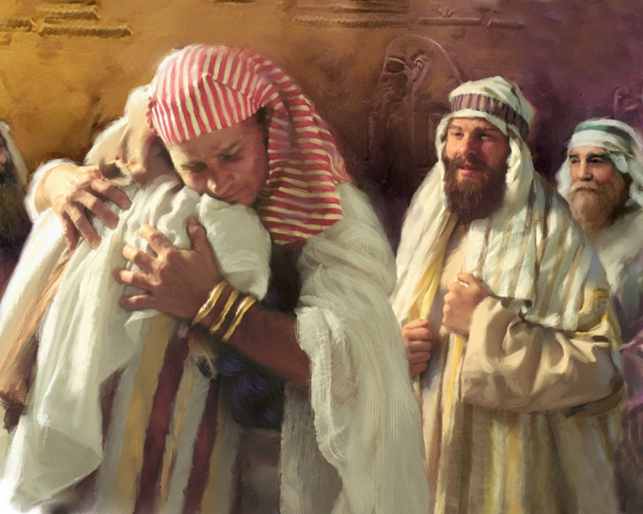
Question of the Day: How do you know if you’ve fully forgiven someone?
You don't gossip.
You make your offenders feel comfortable in your presence
You don't seek revenge.
You’ll seek healing in the lives of everyone that was involved in the incident.

Slide 33
Forgiving Others
Why forgive others?
How do you know if you’ve forgiven someone?
What are some scriptural stories of forgiveness?
What can a person do if he or she is struggling to forgive someone?
How has the Lord helped you forgive someone who has sinned against or offended you?

Slide 34
Forgiving Others
When people hurt you over and over, think of them like sand paper. They may scratch and hurt you a bit, but in the end, you end up polished and they end up useless
It’s better to have God’s approval than the World’s applause
Trials are like fertilizer: stinky, dirty, and dark. But they help us grow strong and produce a great harvest.
Pits and Prisons lead to Palaces
New Beginnings are often Disguised as Painful Endings
Broken can become blessed if you let God do the mending.

Slide 35
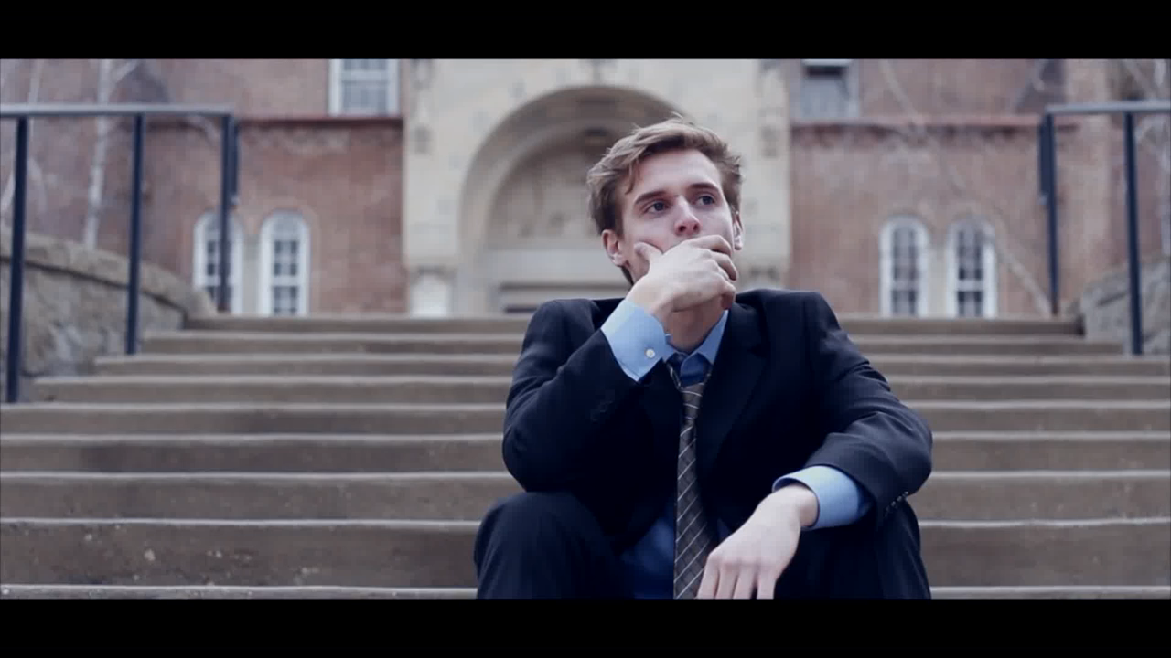
Read Matt 18:15 Best way to resolve disputes.
Matt 18:22 How often should we forgive?
D&C 64:9-11.
Offense (Greek): a stick for bait used in a trap.
MODERN VIDEO https://www.youtube.com/watch?v=n-Dl5dqLz5M
Christians initiate reconciliation
Notes:
Matthew 18:15-17. Moreover if thy brother shall trespass against thee, go and tell him his fault between thee and him alone: if he shall hear thee, thou hast gained thy brother. Meaning, you should go to the person who wronged you even when you are the victim. This completely overturns the common wisdom that says, “Since I was the victim, I’m going to wait for that person to come to me.” There is no room for this sort of game among the disciples of Jesus. Even when you are the victim of another’s sin, you should be the one who goes and initiates reconciliation.

Slide 36
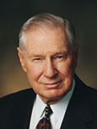
“We need to recognize and acknowledge angry feelings. It will take humility to do this, but if we will get on our knees and ask Heavenly Father for a feeling of forgiveness, He will help us. Only as we rid ourselves of hatred and bitterness can the Lord put comfort into our hearts. …
“… When tragedy strikes, we should not respond by seeking personal revenge but rather let justice take its course and then let go. The Savior has offered to all of us a precious peace through His Atonement, but this can come only as we are willing to cast out negative feelings of anger, spite, or revenge. For all of us who forgive, even those who have committed serious crimes, the Atonement brings a measure of peace and comfort”
(James E. Faust,“The Healing Power of Forgiveness,” Ensign or Liahona, May 2007, 69).

Slide 37
“Remember, heaven is filled with those who have this in common: They are forgiven. And they forgive”
(“The Merciful Obtain Mercy,” Ensign or Liahona, May 2012, 77).

Slide 38

What is something you could ‘go-and-do’ today that would bring you closer to Jesus Christ?
NEXT LESSON: Think about someone you’ve seen repent and change.

