Slide 1
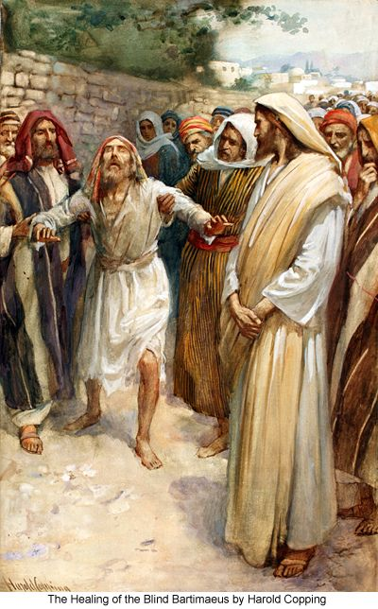
Healing the Blind Man
How many of you have bad eyesight?
What was the most shocking thing for you when you got your first pair of glasses?

Slide 2
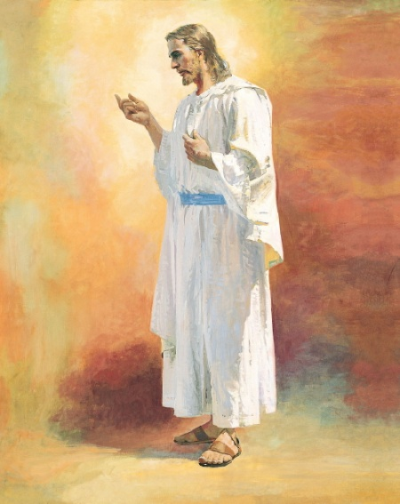
I feel my Savior’s Love
I feel my Savior’s love, in all the world around me,
His spirit warms my soul, through everything I see. I feel my Savior’s love - His gentleness enfolds me,
And when I kneel to pray my heart is filled with peace. I feel my Savior’s love, and know that he will bless me,
His spirit warms my soul, through everything I see. He knows I will follow Him, give all my life to Him.
I feel my Savior’s love, the love He freely gives me.

Slide 3
Mark 8:22‑‑26. Look for what was what was so unique about this healing
How might being healed gradually increase someone’s faith in Jesus Christ?
Why is it important to understand that some blessings come gradually?
Cross-reference 2 Corinthians 12:7-10. What’s the principle?
Mark 7-8

Slide 4
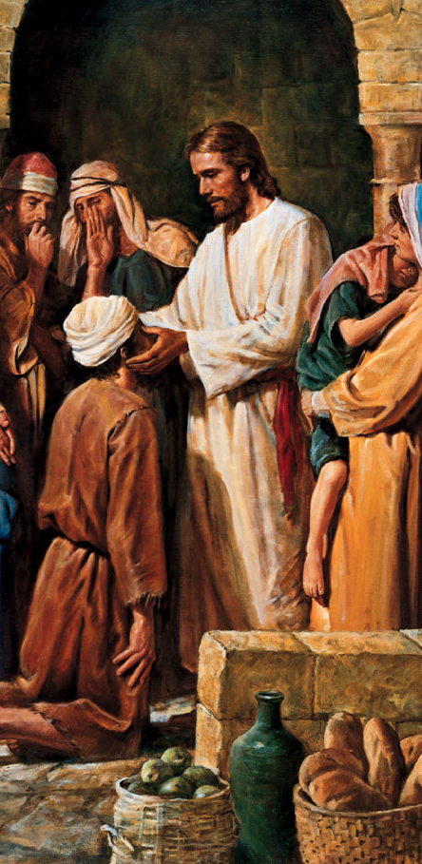
Elder Bruce R. McConkie: "This miracle is unique; it is the only recorded instance in which Jesus healed a person by stages. It may be that our Lord followed this course to strengthen the weak but growing faith of the blind man.... Men also are often healed of their spiritual maladies by degrees, step by step as they get their lives in harmony with the plans and purposes of Deity" (Doctrinal New Testament Commentary, 1:379‑‑ 80).
Mark 7-8

Slide 5
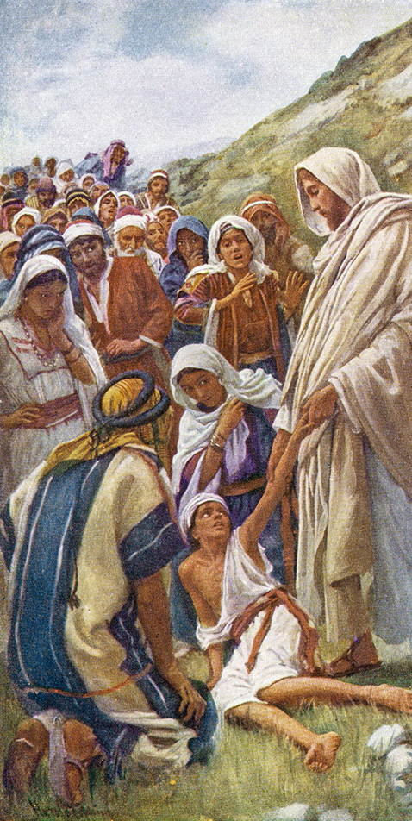
Has anyone in your family battled serious health issues? How has it been for them or for your family?
Read Mark 9:17–27 and imagine being this father.
Re-read Mark 9:23. How can this passage help someone who faces difficulties?
The father said, “Help thou mine unbelief” (Mark 9:24). What have prophets counseled us to do in times of unbelief, or fear?
Have you seen someone receive help in a time of unbelief or fear? What did they do to find relief or answers?

Slide 6
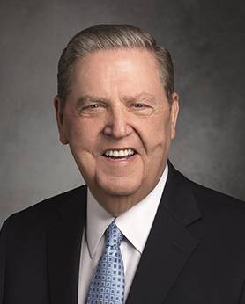
“This father is saying, ‘Our whole family is pleading. Our struggle never ceases. We are exhausted. Our son falls into the water. He falls into the fire. He is continually in danger, and we are continually afraid. We don’t know where else to turn. Can you help us? We will be grateful for anything—a partial blessing, a glimmer of hope, some small lifting of the burden carried by this boy and his mother and by me.”
“In moments of fear or doubt or troubling times, hold the ground you have already won, even if that ground is limited. Hold fast to what you already know and stand strong until additional knowledge comes ” (“Lord, I Believe,” Ensign or Liahona, May 2013, 93).
VIDEO: https://www.churchofjesuschrist.org/si/seminary/three-doctrinal-mastery-resources?lang=eng

Slide 7
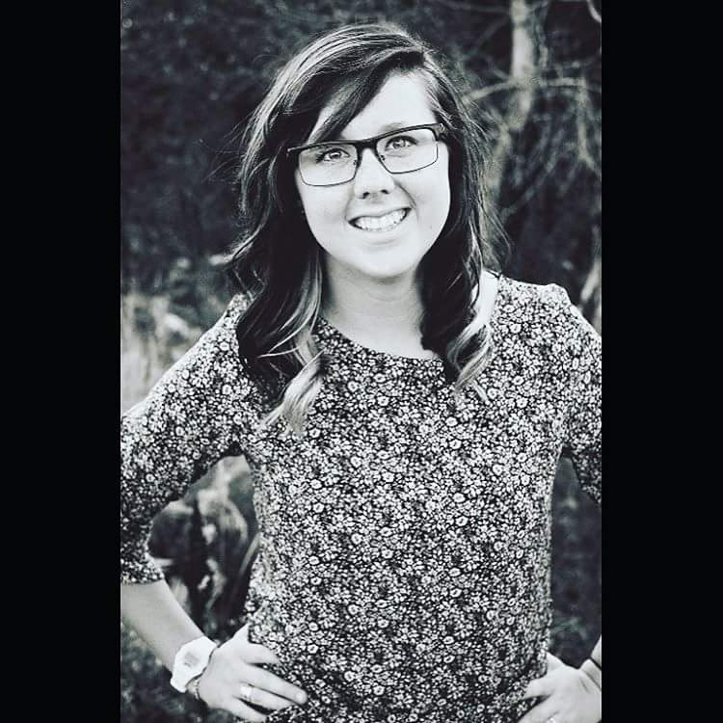
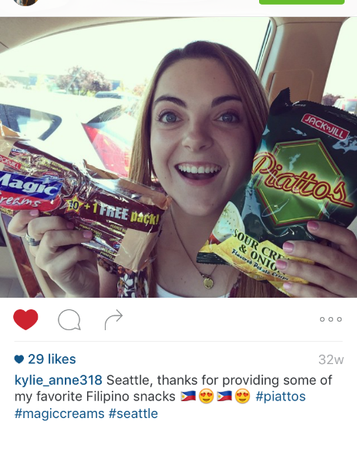
Cassie
Grew up in a very strong Catholic family.
Moved from Saint Louis to USU
College soccer scholarship.
On the drive to Utah her dad simply stated: “Don't become a Mormon. They wear secret funny underwear"…
27 out of 30 of her teammates were LDS.
Mark 7-8

Slide 8
“After 7 months of missionary lessons and seven long month of giving up addictions, loving and hating the lessons of the gospel, not understanding half the things I was being taught and not making any commitments with the missionaries, I asked them to stop visiting me.
My life began spinning out of control. I decided I needed to go to a church. Any church. I drove around and walked into a random church (not hard to find in Utah) in normal clothes--and a very closed mind. All of a sudden, I saw one of my teammates stand and share her beliefs. And then another followed. And then a third. They were all in the same chapel for some reason! The last teammate got up and said, "I just want to let you all know I know the power of fasting. My teammates and I are here today fasting for our friend investigating the church. We are hoping she will commit to the gospel, go to church, and get an answer to her prayers.”
I was baptized the next week.
Mark 7-8

Slide 9
Soon after, I drifted far FAR away from the gospel and its standards. Again. I hit rock bottom. Like deep dark rock bottom. My friend one day said, "Hey, you should serve a mission." Sounds easy enough to me?! I mean who wouldn't want to go to a third world country, speak a different language and build orphanages all day, right? That's what a mission is, right?
I spoke with my bishop and told him my desire to serve a mission. He said that I wasn’t ready and that I had a lot of work to do and that he wouldn’t recommend me for service until I turned my life back around. Well, later that night he called back and said, “Cassie, I know this sounds weird, but I feel impressed that you should indeed serve a mission now. Soon. Let’s start working on your papers.”
I returned to church, began meeting with my bishop, put in my mission papers, and received my call, and opened it.
Seattle Washington?
Mark 7-8

Slide 10
I served a mission. Struggled a lot, taught a lot, grew a lot. But never fully felt converted.
Then one day I had a thought hit me. I wrote, “It isn't an "event" that will give you a testimony. It isn't completing certain things that will give you permanent beliefs. It is the small things we do on a daily basis. I spent so long looking for a single event that would increase my faith that I missed all the little lessons along the way…I’ve recognized the Lord’s hand in my life and now I can finally say that I am completely converted to the Gospel of Jesus Christ.”
Mark 7-8

Slide 11
https://www.youtube.com/watch?v=177PUNrqPpo
https://www.youtube.com/watch?v=oPRmPKuqzu0

Slide 12
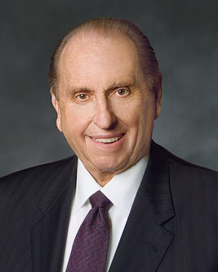
“How many times has your heart been touched as you have witnessed the need of another? How often have you intended to be the one to help? And yet how often has day-to-day living interfered and you’ve left it for others to help, feeling that ‘oh, surely someone will take care of that need.’
We become so caught up in the busyness of our lives. Were we to step back and take a good look at what we’re doing, we may find that we have immersed ourselves in the ‘thick of thin things.’ In other words, too often we spend most of our time taking care of the things which do not really matter much at all in the grand scheme of things, neglecting those more important causes” (President Monson, “What Have I Done for Someone Today?” Ensign or Liahona, Nov. 2009, 85).

Slide 13
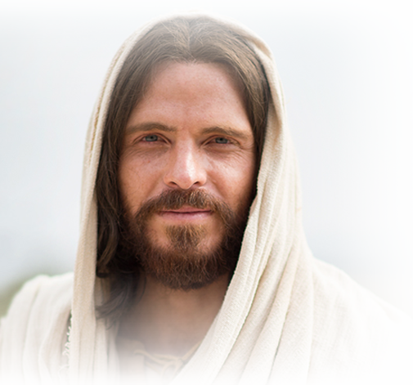
What is something you could ‘go-and-do’ today that would bring you closer to Jesus Christ?
NEXT LESSON: Think about the blessings you’ve seen from the Priesthood.

Slide 14
Have you ever prayed for blindness?
2 Kings 6:16-23.
The Lord can make temptations and weaknesses and disappointments become blind to us.
Mark 7-8

