Slide 1
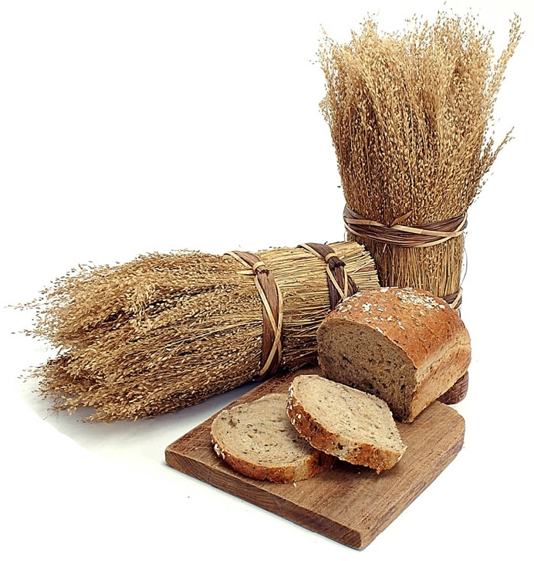
The Bread of Life
John 6

Slide 2
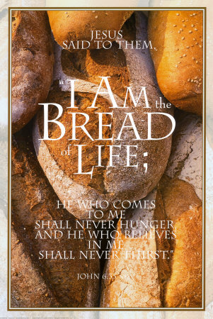
John 6: The Bread of Life
What motivates people to do the things they do?
Fear
Duty
Reward
Love

Slide 3
Scripture Study Tips
Relevancy in personal study
Today’s Tip:
Ask questions

Slide 4
John 6:5–13.
How many people did He feed?
Why didn’t Jesus have more food on hand? Why the ‘limit’?
  Gideon, 300 men
  Abraham, 318 men
  Elijah, vs 450 priests
  Abraham, 10% to Melchizedek
  Manna
Sometimes the Lord wants us to limit our resources so we remember him – We are asked to give It up so we show that we recognize God’s ownership.

Slide 5

Vs 11 - What was the first thing Jesus did before feeding the 5000?
C.S. Lewis: “I have noticed how the most balanced minds rejoice most, while the cranks, misfits and malcontents rejoice least… Rejoicing almost seems to be an inner health. Joy is incomplete till it is expressed.”
When we don’t have enough…”Thank you for the opportunity to see your hand in my life…”
Notes:
(He praised God even though it wasn’t enough. He gave thanks over his problem: “I have a problem… 5000 people … 5 loaves and 2 fishes… and all I want to do is praise your name right now…Thanks for providing. Thank you for being YOU. Thank you for knowing where a solution will come…”)

Slide 6

There once was a woman who woke up one morning, looked in the mirror, and noticed she had only three hairs on her head. "Well," she said, "I think I'll braid my hair today." So she did and she had a wonderful day.
The next day she woke up, looked in the mirror and saw that she had only two hairs on her head. "H-M-M, " she said, "I think I'll part my hair down the middle today." So she did and she had a grand day.
The next day she woke up, looked in the mirror and noticed that she had only one hair on her head. "Well," she said, "Today I'm going to wear my hair in a pony tail." So she did and she had a fun, fun day.
The next day she woke up, looked in the mirror and noticed that there wasn't a single hair on her head....
"YEAH!" she exclaimed.
"I don't have to fix my hair today!"
Notes:
(He praised God even though it wasn’t enough. He gave thanks over his problem: “I have a problem… 5000 people … 5 loaves and 2 fishes… and all I want to do is praise your name right now…Thanks for providing. Thank you for being YOU. Thank you for knowing where a solution will come…”)

Slide 7
There are 11 references to bread in John 6:31-52: In what ways is bread symbolic of Jesus Christ?
Read John 6:22‑‑26. Why did the multitude go in search of Jesus? (see vs 26)
Read John 6:49-51. What is your manna (your daily reminder of the Lord)?
What happens in John 6:60,66?
Read John 6:67‑‑69. How did Peter respond to the Savior's question?
What things do we walk away from if we walk away from Christ?

Slide 8
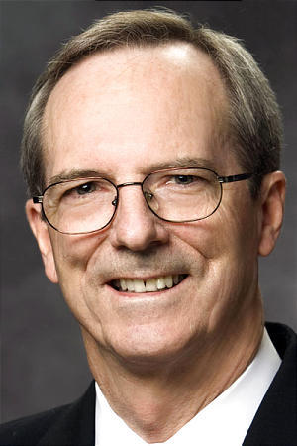
“I can live with some human imperfections even among prophets of God. I can live with some alleged scientific findings contrary to the Book of Mormon – time will correct those.
But I cannot live without the priesthood of God. And I cannot live without knowing my wife and children are sealed to me for eternity. That is the choice we face. A few unanswered questions on one hand versus a host of doctrinal certainties and the power of God on the other. The choice is an easy one.”
Elder Callister
January 2014 CES Devotional

Slide 9

Video: To Whom shall we go https://www.youtube.com/watch?v=aPhaBc0OZVo

Slide 10

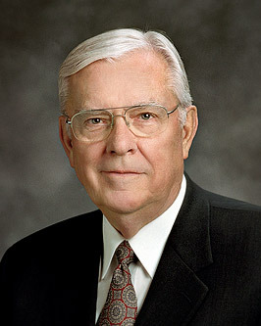
Elder Ballard, October 2016 General Conference
VIDEO: To Whom Shall We Go
https://www.churchofjesuschrist.org/youth/video/to-whom-shall-we-go?lang=eng

Slide 11
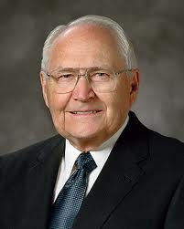

JASON HINDS
Have you seen people share their ‘5 loaves and 2 fishes’ talents and it blessed other people?
Elder PErry
https://www.youtube.com/watch?time_continue=335&v=pxG07IuP36M

Slide 12
Once, on a very nice day in Washington Square Park in New York City, my companion and I were contacting in the park with little success. In the park, people were watching some Broadway-quality street dancers. At the end of the performance, my companion approached the dancers with a challenge: “We have the fastest man in NYC with us today, and he would like to have a race. Which one of you is the fastest?” One of them came out and said, “That’s me, bro. I’m a runner too.” The other dancers blocked the street, and the crowd leaving the dance performance was called back. Someone exclaimed, “It’s the Mormons!” Soon we had a large audience for the race.
My opponent was in athletic dancing clothes. I was in my suit, holding my Book of Mormon. The dancer asked if I wanted to give my suit coat and Book of Mormon to my companion, but I said, “I’m good. I will run with them.” He started the race with, “On your mark, get set, go,” and took off. I gave him a head start of a couple seconds, and then I began to chase him down. As I passed the dancer, I held up the Book of Mormon and said, “The Church is true, bro!” and ran on to win the race. Because of this performance, we became very popular in the neighborhood. Many people immediately took pass-along cards, and we made several return appointments. Gospel seeds were planted. I contacted people on the street and invited them to race me—if I won, they would agree to come to church. I ran in 77 races on my mission and never lost. (Jason Hinds, June 2012, New Era).

Slide 13
A few years ago I was visiting in Brazil, where a new mission president had just arrived. He was excited about returning to his old field of labor in the mission field, the same area in which he had served as a nineteen-year-old missionary.
Years previous, he and his senior companion were assigned to open a new city some distance from the mission headquarters. As they arrived in this new city and walked down the street, they passed a church with a minister standing at the front door. As they walked by the church, the minister went in and called to his whole congregation to follow him out into the street. There they followed the missionaries and started calling them names; then they became more violent and started to throw rocks at them.
The young elder was excited about this experience—his first day in the mission field and already he was being stoned, he thought. Then, a big rock suddenly hit him squarely in the middle of the back, and his feeling changed to anger.
Before entering the mission field he had been quite a baseball pitcher; and in the flush of anger he wheeled around, grabbed the first rock he could find on the ground, reared back in his famous pitching pose, and just ready to let the rock fly when suddenly…

Slide 14
…he realized why he was there. He had not been sent all the way to Brazil to throw rocks at people; he was there to teach them the gospel. But what was he to do with the rock in his hand? If he dropped it to the ground, they would think it a sign of weakness and probably continue to throw rocks at them. Yet he could not throw it at the crowd. Then he saw a telephone post some distance away. He reared back and let the rock fly directly at the telephone post, hitting it squarely in the middle.
The people in the crowd took a couple of steps back. They suddenly realized that that rock probably could have hit any one of them right between the eyes. Their mood changed; instead of throwing rocks at the missionaries, they began to throw them at the telephone post.
After this incident, every time the elder went down that street he was challenged to a rock-throwing contest. The rock-throwing contests led to discussions of the gospel, which led to conversions, which led to the establishment of a branch of the Church in that community.
Do you see the talents that we have but we never consider using to help build the Kingdom? I think we ought to use the talents our Father in Heaven has given to us to help this great work grow (Prophecies, Visions, and Dreams, L. TOM PERRY, BYU Speeches, 1979)

Slide 15
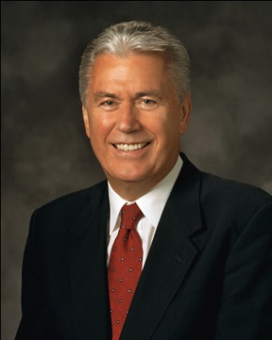
“We spend so much time and energy comparing ourselves to others—usually comparing our weaknesses to their strengths. This drives us to create expectations for ourselves that are impossible to meet. As a result, we never celebrate our good efforts because they seem to be less than what someone else does.
“God wants to help us to eventually turn all of our weaknesses into strengths, but He knows that this is a long-term goal. It’s OK that you’re not quite there yet. Keep working on it, but stop punishing yourself” (President Uchtdorf, October 2011)

Slide 16
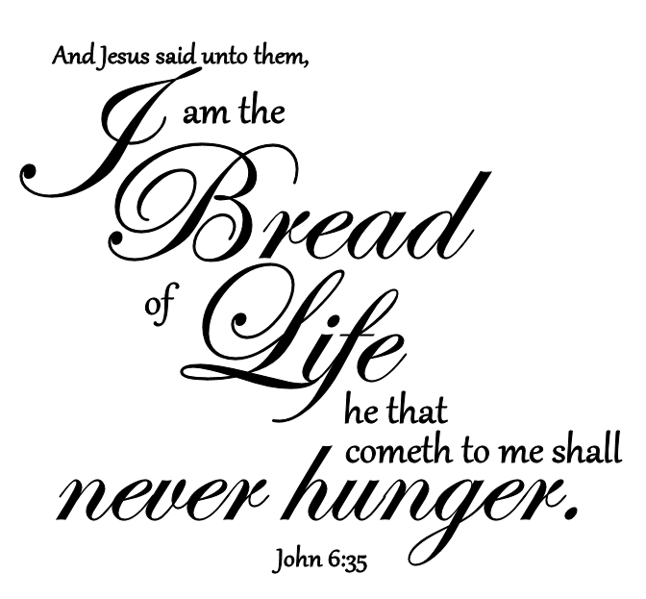
John 6
I Need Thee Every Hour
I need thee every hour,
Most gracious Lord
No tender voice like thine
Can peace afford
I need thee every hour
Stay thou near by
Temptations lose their power
When thou are nigh
I need thee, oh, I need thee
Every hour I need thee
Oh, bless me now, my Savior
I come unto thee

Slide 17
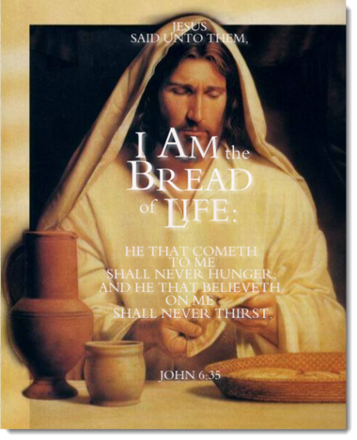
Will ye also go away?

Slide 18

What is something you could ‘go-and-do’ today that would bring you closer to Jesus Christ?
NEXT LESSON: Have you ever seen someone ‘blind’ start to see?

Slide 19
Where will you go to find others who share your belief in personal, loving Heavenly Parents, who teach us how to return to Their eternal presence?
Where will you go to be taught about a Savior who is your best friend, who not only suffered for your sins but who also suffered “pains and afflictions and temptations of every kind” so “that his bowels may be filled with mercy”?
Where will you go to learn more about Heavenly Father’s plan for our eternal happiness and peace?
Where will you go to find living prophets and apostles?
Where will you go to find people who live by a prescribed set of values and standards?
Where will you go to experience the joy that comes through the saving ordinances and covenants of the temple?
Elder Ballard, October 2016 General Conference

Slide 20
I don’t pretend to know why faith to believe comes easier for some than for others. I’m just so grateful to know that the answers are always there, and if we seek them—really seek with real intent and with full purpose of a prayerful heart—we will eventually find the answers to our questions as we continue on the gospel path.
There may be some doctrine, some policy, some bit of history that puts you at odds with your faith, and you may feel that the only way to resolve that inner turmoil right now is to “walk no more” with the Saints. If you live as long as I have, you will come to know that things have a way of resolving themselves. An inspired insight or revelation may shed new light on an issue. Remember, the Restoration is not an event, but it continues to unfold.
Never fail to give equal time to the Lord through honest attempts to understand what the Lord has revealed. As Elder Neal A. Maxwell once said, “We should not assume … that just because something is unexplainable by us it is unexplainable.”
Elder Ballard, October 2016 General Conference

Slide 21
You see the 5 loaves and 2 fishes…God sees the 12 baskets of leftovers!
PRAY BIG PRAYERS
Exodus 1:8-12 – “The more they afflicted them, the more they multiplied and grew.”
Suppose you start with a checkerboard of 64 squares. On the first square you place one grain of wheat. On the second square you place two grains, and on the third square you place four grains. How much wheat would you have to place on the last square if you continue doubling each succeeding square?
It would take enough wheat to cover India to a depth of fifty feet.
The Lord can indeed “add” blessings, but he loves to “multiply” blessings even more!

