Slide 1
Jesus walks on water

Slide 2
Scripture Study Tips
Relevancy in personal study
Today’s Tip:
Use the maps

Slide 3
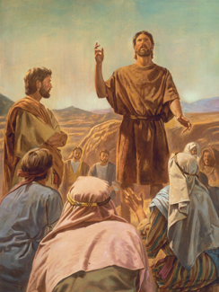
Herod (Herod Antipus, the son of Herod that killed all the male babies when Jesus was born) had been rebuked by John for committing adultery with his brother’s wife (Herodius).
John was in prison in Macherus, the hottest dryest part of the provience.

Slide 4
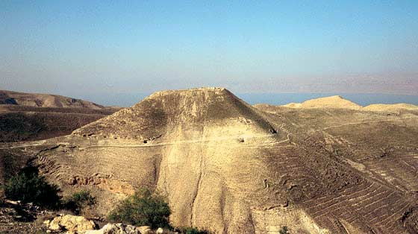
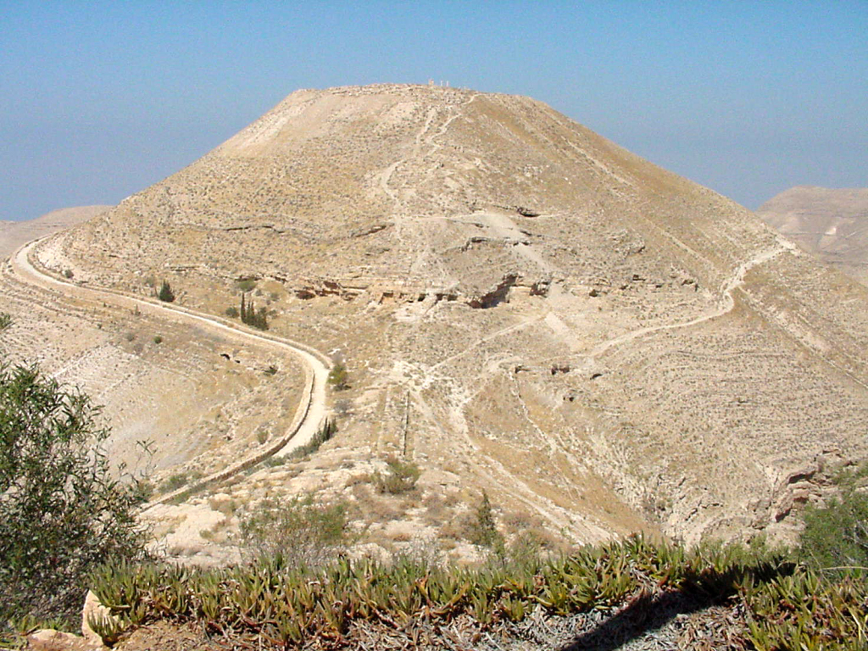
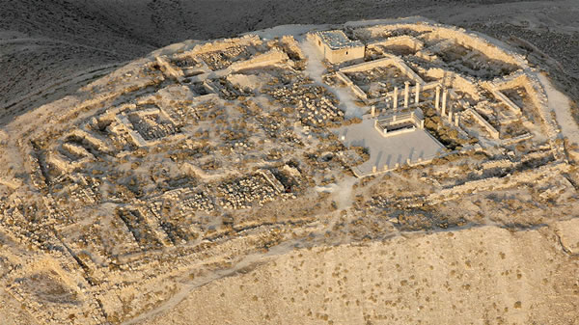
Macherus
After 1.5 years in prison, Matthew 11:2-3

Slide 5
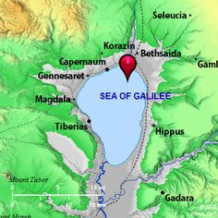
Luke 7:1 “Now when he had ended all his sayings in the audience of the people, he entered into Capernaum.”
He sends reply: Matthew 11:4-6
Machaerus

Slide 6
Explain Matthew 11:6
Blessed is the one who doesn’t interpret silence as hate.
Blessed is the one who doesn’t confuse ‘unanswered’ as ‘uninterested’.
Machaerus

Slide 7
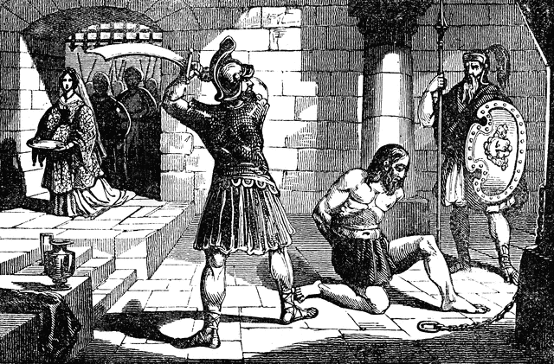
John’s death: Matthew 14:1-9
The response: Matthew 14:13-14
How can showing compassion for others help us when we are suffering?

Slide 8
Matthew 14:22-33
At what time did Jesus come to the disciples?
How was Christ able to see the disciples at that time of day?
What does Matthew say about why Peter sank?
What did Peter do when he began to sink?
At what point did Jesus go help Peter?
How far did Jesus walk to help the disciples?

Slide 9
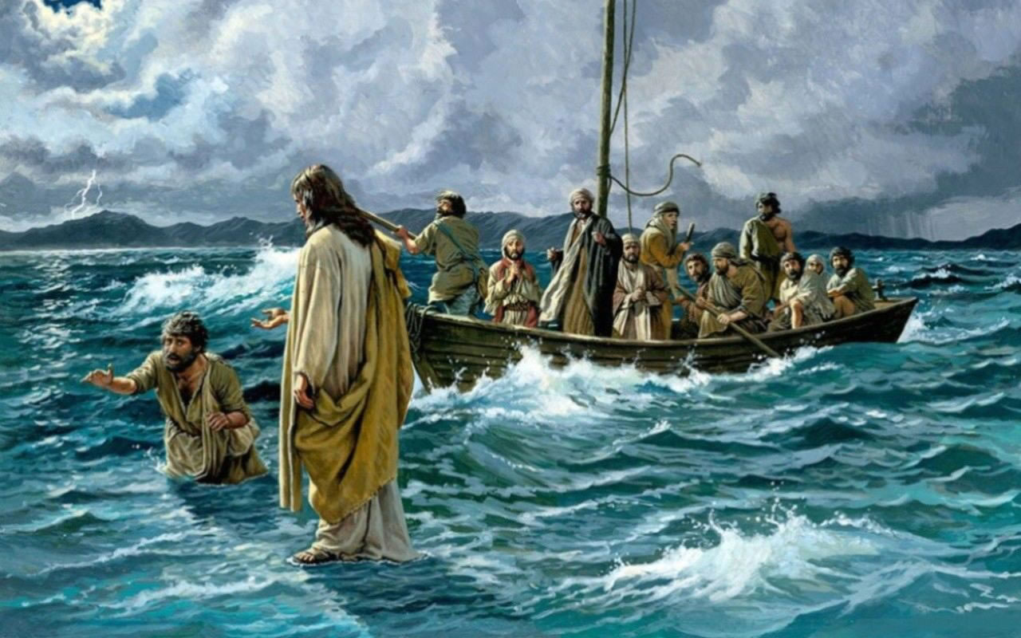
Mark 6:45-52
And straightway he constrained his disciples to get into the ship, and when even was come, the ship was in the midst of the sea, and he alone on the land. And he saw them toiling in rowing; for the wind was contrary: and about the fourth watch of the night he cometh unto them, walking upon the sea, and would have passed by them. They all saw him, and were troubled. And immediately he talked with them, and saith unto them, Be of good cheer: it is I; be not afraid. And he went up unto them into the ship; and the wind ceased: and they were sore amazed in themselves beyond measure, and wondered.
What detail is missing? Why?
Peter wanted this story to focus on Christ, not on himself.
Do we have the same attitude about our accomplishments?

Slide 10
Concern vs Worry
Which is ‘better’?
Concern
When a negative situation needs to be addressed
Worry
When thinking controls your life
You control concern. Worry controls you. It’s a dictator. Worry tells you if you’re going to be able to sleep and when to cry.
Every time you feel worry, it’s a signal to pray.
Let worry turn into worship
Worrying does not empty tomorrow of its trouble. It empties today of its strength.

Slide 11
What principles are found in this detail:
John 6:21
We can only go so far with our own rowing; Christ gets us to our destination must faster.

Slide 12
"Only when with wavering faith he removed his glance from the Master to look at the furious waves and the black gulf beneath him, only then did he begin to sink.
“If we could, like Peter, fix our eyes on Jesus, we too might walk triumphantly over the swelling waves of disbelief and remain un-terrified amid the rising winds of doubt. But if we turn away our eyes from him in whom we must believe and look to the power and fury of those terrible and destructive elements around us rather than to him who can help and save us, then we shall inevitably sink in a sea of conflict and sorrow and despair."
(Howard W. Hunter, Nov. 1992)

Slide 13
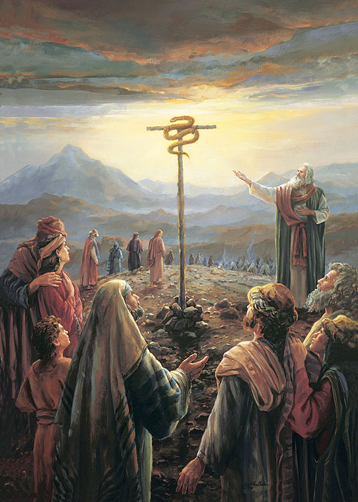

Slide 14
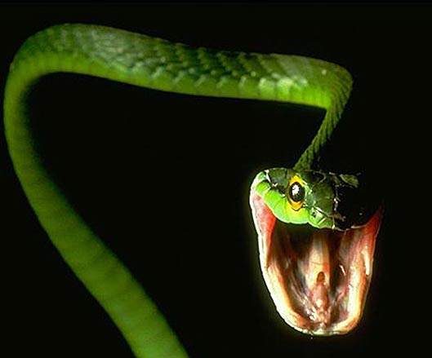

Slide 15
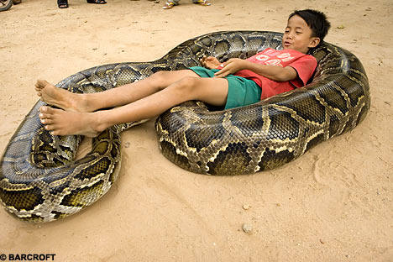

Slide 16
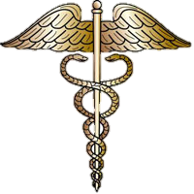
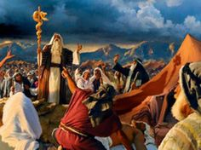
Fiery Flying Serpents
Numbers 21:4-9
1 Nephi 17:41
2 Nephi 25:20
John 3:14-15
Alma 33:19-20
Helaman 8:14-16
Bonus Question: Of all animals, why would Satan appear as a snake in the Garden of Eden?

Slide 17
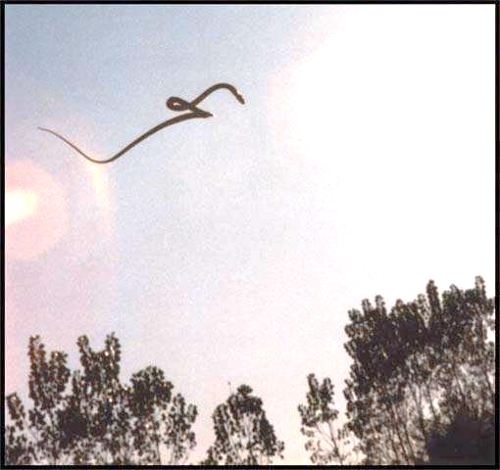
Fiery Flying Serpents

Slide 18
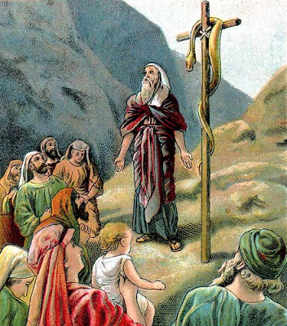
What percentage of Israelites were bitten?
Where do you look when you are getting bitten by poison?
Social media?
Friends? Family?
Google?
(Everyone who looked around died. Those that looked up, lived).
Who sent the snakes?

Slide 19
“Mountains to Climb” (5:05).

Slide 20
Matthew 15:23 – What principle do you see?

Slide 21
Can you imagine her thoughts?
Did he hear me?
Should I repeat my question?
Is he paying attention to me?
Am I not good enough for him?
Am I not asking correctly?
Am I not using the right language?
Is there some secret code I don’t know?
Is he pre-occupied?
What is his problem?
Does he not love me and my daughter like he seems to love everyone else?

Slide 22
What is something you could ‘go-and-do’ today that would bring you closer to Jesus Christ?
NEXT LESSON: How does bread symbolize Christ?

