Slide 1

Parables
Matt 13

Slide 2
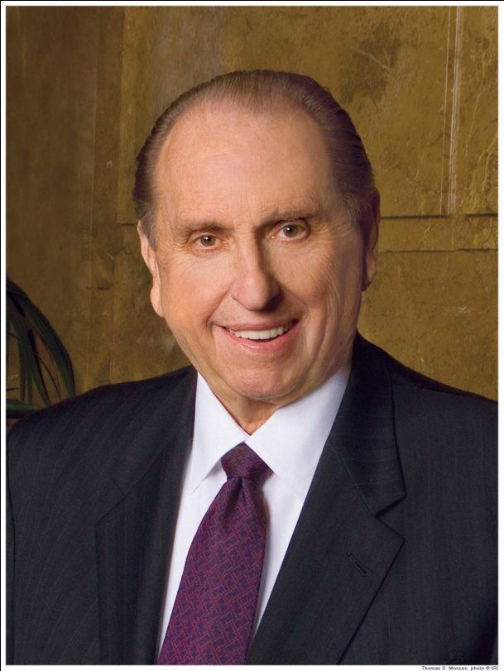
“Learn the background and setting of the Master’s parables and the prophets’ admonitions. Study them as though they were speaking to you, for such is the truth…I promise you… that if you will study the scriptures diligently, your power to avoid temptation and to receive direction of the Holy Ghost in all you do will be increased .”
President Thomas S. Monson “Be Your Best Self”, General Conference, April 2009.

Slide 3
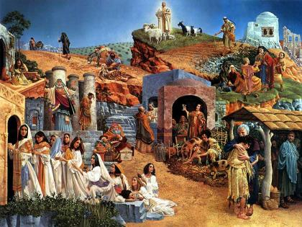
What parables do you see?

Slide 4

Parable: (parabole) To reveal and conceal truth

Slide 5
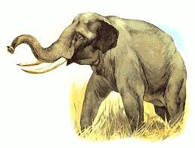
VIDEO: https://www.churchofjesuschrist.org/si/seminary/three-doctrinal-mastery-resources?lang=eng

Slide 6
It was six men of Indostan
To learning much inclined
Who went to see the Elephant
(Though all of them were blind)

Slide 7

The First approached the Elephant
And happening to fall against his side,
At once began to bawl:
“The Elephant Is very like a wall!”

Slide 8

The Second, feeling of the tusk,
Cried, “What have we here?
To me ’tis mighty clear
This wonder of an Elephant
Is very like a spear!”

Slide 9

The Third approached the animal,
And happening to take
The squirming trunk, thus boldly spake:
“The Elephant Is very like a snake!”

Slide 10

The Fourth reached out an eager hand,
And felt about the knee.
“‘Tis clear enough the Elephant
Is very like a tree!”

Slide 11

The Fifth, who chanced to touch the ear,
Said: “E’en the blindest man
This marvel of an Elephant
Is very like a fan!”

Slide 12

The Sixth no sooner had begun
About the beast to grope,
Then, seizing on the swinging tail
Said, “I see! The Elephant Is very like a rope!”

Slide 13
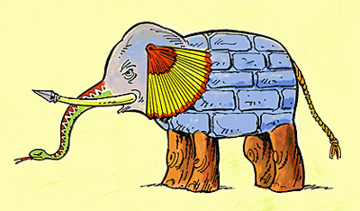
And so these men of Indostan
Disputed loud and long,
Though each was partly
in the right,
And all were in the wrong!

Slide 14

Matthew 13:3‑‑8,
Matthew 13:24--29
VIDEO: The Sower https://www.churchofjesuschrist.org/media-library/video/2012-06-1290-the-sower?lang=eng

Slide 15
The Parable of the Sower (Matt 13)
Lehi’s Tree of Life Vision (I Nephi 8)
The Savior’s Explanation (18-22)
Then cometh the wicked one, and catcheth away that which was sown in his heart;
He that heareth the word with joy, yet he hath not root in himself, and endureth but for a while; for when persecution ariseth because of the word, he is offended.
The care of this worl choke the word, and he becometh unfruitful.
He that heareth the word and understandeth and endureth, shall bear fruit.
v. 23 There arose a mist of darkness…insomuch
that they did lose their way… and were lost
v. 28 After they had tasted of the fruit they were ashamed, because of those who were scoffing at them; and they fell away into forbidden paths and were lost…
v. 31 …other multitudes were feeling their
way towards that great and spacious building…and were drowned in the fountain
v. 12 and as I partook, it filled my soul with exceeding great joy; wherefore I began to be desirous that my family should partake also…

Slide 16

What do we need to do to germinate our seed of testimony?
ALMA 32:28

Slide 17
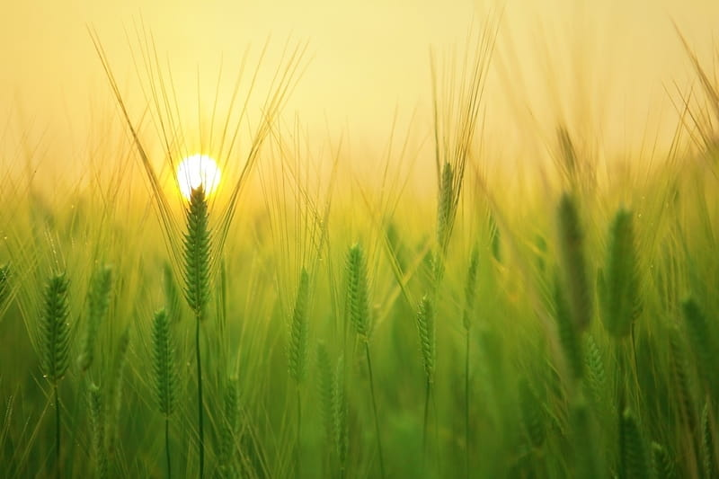
The Sower
  What do SEEDS need to germinate?
  What does GERMINATE mean?
  What does DORMANCY mean?
How does WATER affect seed germination?
How does OXYGEN affect seed germination?
How does Light affect seed germination?
How does SOIL affect seed germination?
HOME GROWN vs Store Bought vegetables?

Slide 18
SEEDS. When a seed is exposed to the proper conditions, it will germinate.
GERMINATE: To expand into a greater being from a small existence; to begin to grow after a period of dormancy.
  DORMANCY: Lying asleep; inactive; capable of being activated; dormant seeds are ripe seeds that do not germinate because they are subject to external environmental conditions.
WATER: The uptake of water by seeds is called imbibition, which leads to the swelling and the breaking of the seed coat.
OXYGEN: If a seed is buried too deeply within the soil, the seed can be oxygen starved.
Light/darkness: Many seeds will not germinate until sufficient light and temperature for growth of the seedling occurs.
Home Grown vs. Store Bought: Studies show that home grown food has more nutrients and flavor than store bought food.

Slide 19
  Soil Test
  I am genuinely willing to follow council from scripture, modern-day prophets, and leaders
  I try to express kindness and show gratitude regularly.
  I quickly reject information on the internet that contradicts Church teachings.
  When trials or challenges come into my life, I council with God (and do not blame God or others).
  I am attentive and try to eliminate distractions in gospel settings.
  When I realize I have made a mistake, I seek repentance quickly.
  I care more about what Heavenly Father thinks than with what my friends think.
  My phone is primarily used for seeking revelation.
  I attend the temple regularly.
  I often engage in personal scripture study.
  1. Never 2. Rarely 3 Sometimes 4. Usually 5 Always

Slide 20
Why might it also be called the parable of the soils?
How’s your soil???

Slide 21

How much do you need to know before you can tell if the seed is good?
ALMA 32:30

Slide 22
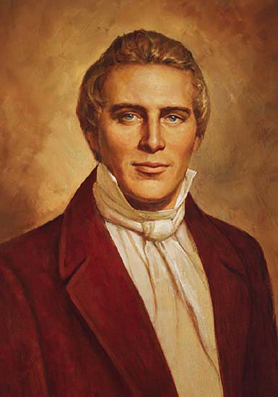
“This is good doctrine. It tastes good. I can taste the principles of eternal life, and so can you….I know that when I tell you these words of eternal life as they are given to me, you taste them, and I know that you believe them. You say honey is sweet, and so do I. I can also taste the spirit of eternal life. I know that it is good (Joseph Smith, HC, 6:312).

Slide 23
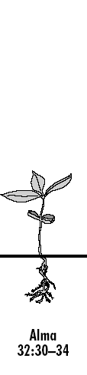
What is the overall goal of our faith? To become dormant?
Dormant (Late Middle English) ‘Fixed in position’
ALMA 32:34

Slide 24
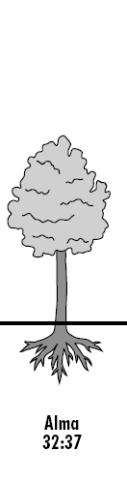
What do you need to do once the seed begins to grow?
ALMA 32:37

Slide 25
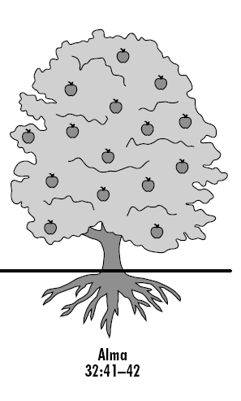
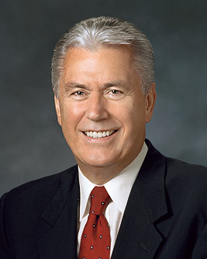
What blessings come from this process?
“Too often we approach the gospel like a farmer who places seed in the ground in the morning and expects corn on the cob by the afternoon” (President Dieter F. Uchtdorf, The Way of the Disciple, Ensign, May 2009, 76-77).
ALMA 32:41-42

Slide 26

Who do you know (personally or scripturally) that is a pillar or example of faith?
In what circumstances has your faith nourished you?

Slide 27
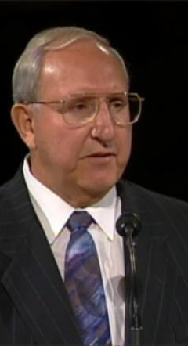
Elder Featherstone tells of a young man who came to him for a mission interview. Elder Featherstone inquired as to the young man’s transgressions. In a haughty manner the young man replied, “There isn’t anything I haven’t done.” Elder Featherstone inquired about specifics—morals, drugs, and so on. Again he replied, “I told you I have done everything.” Elder Featherstone asked, “What makes you think you’re going on a mission?” “Because I have repented,” came the reply. “I haven’t done any of these things for a year.”
Elder Featherstone then looked at the young man across the table—twenty-one years of age—sarcastic, haughty, with an attitude far removed from sincere repentance.

Slide 28
“My dear young friend,” he said, “I’m sorry to tell you this, but you are not going on a mission…you shouldn’t have been ordained an elder and you really should have been tried for your membership in the Church. What you’ve committed is a series of monumental transgressions. You haven’t repented; you’ve just stopped doing something. Someday, after you have been to Gethsemane and back, you’ll understand what true repentance is.” At this, the young man started to cry. It lasted for about five minutes. There was no exchange of words, only silence. Then he left Elder Featherstone’ office.

Slide 29
About six months later, Elder Featherstone saw this same young man. The details of the interview flashed though his mind. Elder Featherstone reached down from the podium to shake his hand.
As the young man looked up, Elder Featherstone could see that something wonderful had taken place in his life. Tears streamed down the young man’s cheeks and an almost holy glow came from his countenance. “You’ve been there, haven’t you?” asked Elder Featherstone. Through the tears he said, “Yes, Bishop Featherstone, I’ve been to Gethsemane and back.” “I know,” Elder Featherstone replied. “It shows in your face. I believe now that the Lord has forgiven you.”

Slide 30
More Parables
Matt 13

Slide 31
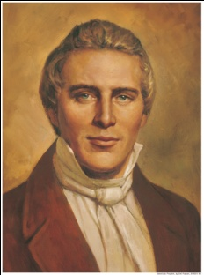
Matthew 13
“The parables in Matthew 13 afford us as clear an understanding upon the important subject of the restoration and the gathering of Israel.”
Teachings of the Prophet Joseph Smith, 94.

Slide 32
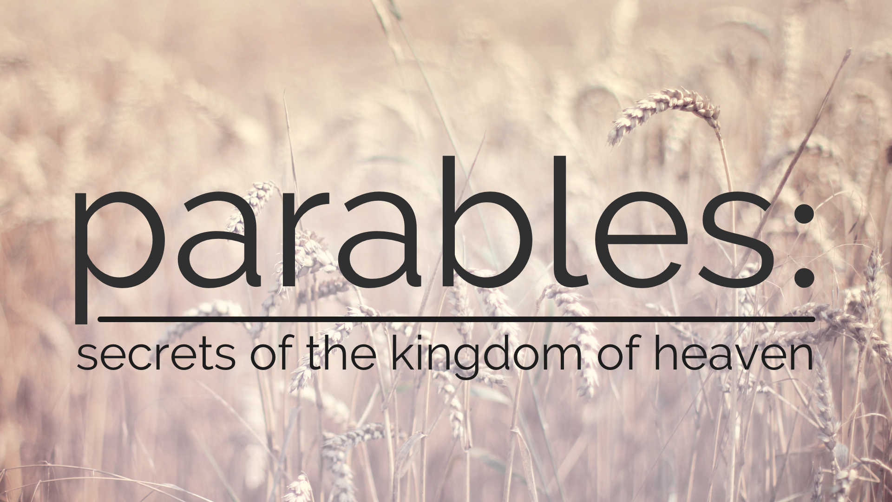
Parable | Reference | Restoration Connection
The Wheat and Tares | Matthew 13:24-26
The Mustard Seed | Matthew 13:31-32
The Leaven | Matthew 13:33
Hidden Treasure | Matthew 13:44
Pearl of Great Price | Matthew 13:45-46
The Fish Net | Matthew 13:47-50
New & Old Treasures | Matthew 13:52

Slide 33
The Wheat and the Tares
“If the righteous and wicked are separated too soon, you will destroy the wheat, or the Church, with the tares; therefore it is better to let them grow together until the harvest, or the end of the world” ( Teachings, 98).
NOTE: The Lord focuses on when the wheat is ready (the righteous) not when the weeds are big (how wicked the world is). “Wow! These weeds are big-- better harvest!” isn’t how the Lord operates.

Slide 34
The Mustard Seed
“Let us take the Book of Mormon, which a man took and hid in his field, securing it by his faith, to spring up in the last days. . . ., and it has sprouted and come forth out of the earth, and righteousness begins to look down from heaven, and God is sending down His powers to lodge in the branches thereof” ( Teachings, 98).

Slide 35
The Leaven
“It may be understood that the Church . . . has taken its rise from a little leaven that was put into three witnesses. Behold, how much this is like the parable! It is fast leavening the lump, and will soon leaven the whole” ( Teachings, 100).

Slide 36
The Hidden Treasure
“See the Church, selling all that they have, and gathering themselves together unto a place that they may purchase for an inheritance, that they may be together and bear each other’s afflictions in the day of calamity” ( Teachings, 101).

Slide 37
The Pearl of Great Price
“The Saints again traveling to find places for Zion, who, when they find the place for Zion, or the pearl of great price, straightway sell that they have, and buy it” (Teachings, 102).

Slide 38
The Fish Net
“Behold the seed of Joseph, spreading forth the Gospel net upon the face of the earth, gathering of every kind, that the good may be saved in vessels, and the angels will take care of the bad. So shall it be at the end of the world” ( Teachings, 102).

Slide 39
The Gathering?
Gathering Israel in the latter days consists of the following:
The spiritual gathering, which includes coming to know that Jesus is the Christ and joining The Church of Jesus Christ of Latter-day Saints.
The assembling of Church members to organized stakes.
The gathering of the descendants of Israel’s twelve sons—including the lost ten tribes—to the lands of their inheritance.
Terry L. Niederhauser, Encyclopedia of Mormonism, (1992), 2:351.
VIDEO: Families Gathering Families on Both Sides of the Veil
https://www.churchofjesuschrist.org/media-library/video/2017-02-1060-families-gathering-families-on-both-sides-of-the-veil?lang=eng

Slide 40
The New and Old Treasures
“For the works of this example, see the Book of Mormon, also the translation of the Bible [the Joseph Smith Translation]—thus bringing forth out of the heart things new and old” ( Teachings, 102).

Slide 41


Notes:
https://www.youtube.com/watch?v=h9n9QpMjIvo
START 8mins in

Slide 42
https://www.youtube.com/watch?v=h9n9QpMjIvo
START 8mins in
Notes:
https://www.youtube.com/watch?v=h9n9QpMjIvo
START 8mins in

Slide 43

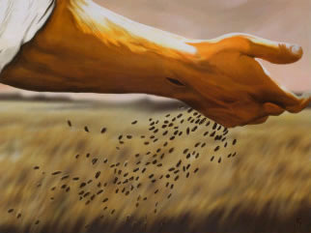
Have you seen anyone be ‘gathered’ into the gospel?
Why is having a soft heart the key to gospel success?
Who do you know (personally or scripturally) that is an example of faith?
In what future circumstances will you need your faith to nourish you?

Slide 44
“Learn the background and setting of the Master’s parables and the prophets’ admonitions. Study them as though they were speaking to you, for such is the truth…I promise you… that if you will study the scriptures diligently, your power to avoid temptation and to receive direction of the Holy Ghost in all you do will be increased .”
President Thomas S. Monson “Be Your Best Self”, General Conference, April 2009.

Slide 45

What is something you could ‘go-and-do’ today that would bring you closer to Jesus Christ?
NEXT LESSON: Think about applications from Peter walking on water.

