Slide 1
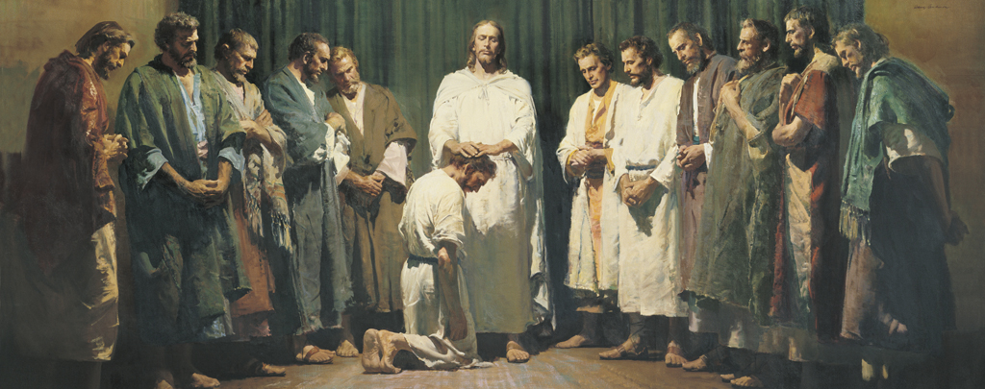
Jesus ordains and commissions His Apostles
Name Jesus’ original 12 Apostles

Slide 2
MATTHEW 10:1-5
Peter. Andrew, Peter’s brother. James, son of Zebedee. John, James’ brother. Philip. Bartholomew. Thomas. Matthew. James, son of Alphaeus. Thaddeus. Simon the Cananean. Judas Iscariot.

Slide 3
Principles about when we are in the service of the Lord
 | PROMISES | WARNINGS
Matt 10:6-10
Matt 10:16,22-24
Matt 10:27-31
Matt 10:36-39

Slide 4
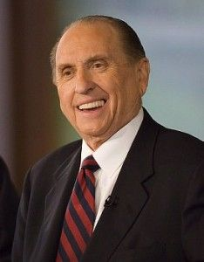
“I believe the Savior is telling us that unless we lose ourselves in service to others, there is little purpose to our own lives. Those who live only for themselves eventually shrivel up and figuratively lose their lives, while those who lose themselves in service to others grow and flourish—and in effect save their lives” (“What Have I Done for Someone Today?” Ensign or Liahona, Nov. 2009, 85).

Slide 5
PRIESTHOOD PRINCIPLES
T or F Priesthood keys are the right to preside and direct within a jurisdiction.
T or F Only the President of the Church holds all priesthood keys.
T or F An Elder holds as much priesthood as an Apostle.
T or F The office of Apostle is higher than the office of Elder.
T or F All priesthood holders are organized into quorums.
T or F We should not aspire to callings, refuse callings, or ask to be released from callings.
T or F We should not seek to visit with General Authorities for counsel or blessings.
T or F Some priesthood principles are found in the scriptures, some in church handbooks, some in neither.
T or F All quorums have a presidency.
T or F Priesthood authority is always conferred by ordination.
T or F One must be set apart to be a ministering brother or sister.
T or F Women may exercise priesthood authority.
T or F There is a maximum number of priesthood holders in each priesthood quorum.
T or F A Bishop cannot call or release an Elders Quorum President.
T or F A Bishop cannot excommunicate an Elder in his ward.
T or F For a temple recommend, I must be interviewed by the Bishop and Stake President.
T or F Technically it is possible for a man to hold more than one priesthood office at a time.

Slide 6
T or F Keys are the right to preside and direct the affairs of the Church within a jurisdiction. DC 107:18-22, 67m General Authorities, Elder Neuenschwander.
T or F Only the President of the Church holds all priesthood keys. The 12 also; DC 27:12-13; DC 107:15 Bishop
T or F An Elder holds as much priesthood as an Apostle. Quote Symposium 98, term Elder Packer Ensign 93, 8
T or F No. Packer Ensign 93,9 different areas of service
T or F All men ordained to offices in the priesthood are NOT organized into quorums. 107:85-- 107:60-63 because of Bishops and Patriarchs
T or F We do not aspire to callings, refuse callings, or ask to be released from our callings in the church. A of F 5, all are called, DC 20:38, 68, DC 107:10, UO,3; inspiration, not where, but how we serve. Presiding officers authority.
T or F We should not go to the General Authorities for counsel or blessings. 107:40, what would happen if everyone did this?, UO, 4. More prominent, better blessing? Fathers first. Be a good follower, followship. Called by revelation, how calls are presented is important.
T or F Some priesthood principles are found in the scriptures, some in church handbooks, some in neither. Packer, UO, 3 for example, one who presides sits on stand close to one conducting, 1 counselor always on right, 2nd on left
T or F All quorums are presided over by a presidency consisting of a president and two counselors. DC 107:21 Not the 70, all have a president.
T or F In the Church authority is always conferred by ordination. Sometimes setting apart Packer 93, 10 offices come by ordination, keys and callings received by stting apart.
T or F Inherent in the duties of the priesthood. DC 20:53,51
T or F When women serve in church offices they are given authority. Yes, but no keys, Packer Ensign 93, 10. T or F There is a maximum number of priesthood holders in each priesthood quorum.
T or F A Bishop cannot call or release an Elders Quorum Presidency (Stake duty)
T or F A Bishop can excommunicate an Elder in his ward. Disfellowship yes, deprive of priesthood no
T or F To receive a temple recommend I must be interviewed by the Bishop and Stake President. Mel Priesthood ordinances
T or F Sometimes a man may hold more than one ordained office at a time. Bishop Patriarch

Slide 7
Scripture Study Tips
Relevancy in personal study
Today’s Tip:
Pay attention to every word

Slide 8
Why did the Savior teach, “Therefore take no thought, saying, What shall we eat? or, What shall we drink? or, Wherewithal shall we be clothed?”
Once we talk about things, we give them life. When we articulate our problems we give them power. We should talk more about the promises than our problems. Rather than dwelling on the negative, we should focus on and speak about the positive. When we aren’t promoted or when our hearts are broken or when trials come our way, we should speak about how one door has been closed but God will open the next door.
Cross Reference James 3:10 (next to Matthew 10), “Out of the same mouth proceedeth blessing and cursing.”
Spoken words - are powerful. There is a difference between thoughts in our mind and those that we choose to speak.

Slide 9
2 Chronicles 20 contains the account of one of the biggest battles in the Old Testament. Jehoshaphat is battling against three armies.
2 Chronicles 20:22-23
(Jehoshaphat didn’t even had to fight the battle - it was the Lord’s battle)
2 Chronicles 20:24-25
What’s the name of the valley in vs 26?
(Berachah means “Blessing” in Hebrew)
They called this location, The Valley of Blessings. The location of the biggest trial and fighting was seen as a location of blessings, not defeat.
Application?
Sometimes we face situations that leave us filled with fear and uncertainty. We don’t know how to respond because our situation seems impossible. But God works in ways we cannot see and if we will do life with Him, our growing trust in Him will compel us to call out to Him for help. And He will answer us and help us. God can turn your pit of despair into a valley of blessing, if you will trust in Him and do life His way!
It may seem like you are in the valley of the shadow of death, but if you will trust God with your life, He will bring you the victory that He knows you need!
YOU CAN CHOOSE THE NAME OF YOUR VALLEY. Yes, it could be the valley of depression or the valley or despair or the valley of losing friends or the valley of embarrassment… but you can name it the valley of victory or the valley of breakthrough or the valley of blessings.

Slide 10
Latter Day Priesthood Miracles

Slide 11
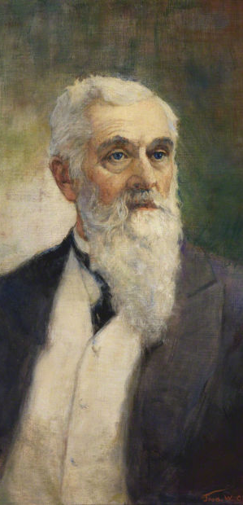
In this incident, Ella Jensen, President Lorenzo Snow’s nineteen-year-old niece, had just died of scarlet fever. Ella’s parents sent for President Snow, who came together with Rudger Clawson, Ella’s stake president and later President of the Quorum of the Twelve Apostles. President Clawson relates: “As we entered the home we met Sister Jensen, who was very much agitated and alarmed. We came to Ella’s bedside. … ”Turning to me President Snow said: ‘Brother Clawson, will you anoint her,’ which I did. We then laid our hands upon her head and the anointing was confirmed by President Snow, who blessed her and among other things, used this very extraordinary expression, in a commanding tone of voice, ‘Come back, Ella, come back. Your work upon the earth is not yet completed, come back.’” Ella’s father, Jacob Jensen, continues the account:

Slide 12
“After President Snow had finished the blessing, he turned to my wife and me and said; ‘Now do not mourn or grieve any more. It will be all right. Brother Clawson and I are busy and must go. …’ “Ella remained in this condition for more than an hour after President Snow administered to her, or more than three hours in all after she died. We were sitting there watching by the bedside, her mother and myself, when all at once she opened her eyes. She looked about the room, saw us sitting there, but still looked for someone else, and the first thing she said was: ‘Where is he? Where is he?’ We asked, ‘Who? Where is who?’ ‘Why, Brother Snow,’ she replied. ‘He called me back.’” (in LeRoi C. Snow, “Raised from the Dead,” Improvement Era, Sept. 1929, 885–86). Ella recovered from her illness, served in the Church, married Henry Wright, and eventually had eight children.

Slide 13
Bryce Reynolds
Sanctify Yourselves
https://www.youtube.com/watch?v=Hew-QARTo00

Slide 14
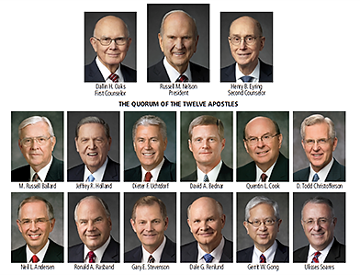
On your electronic device, search for the following:
 | Any Apostle/Prophet
Education
Family
Quotes
Stories
Random Facts

Slide 15
In what ways have the ministries and messages of modern Apostles influenced your life?

Slide 16
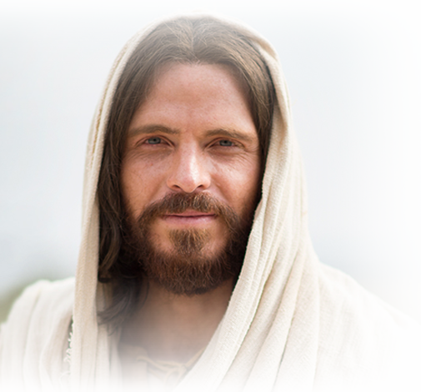
What is something you could ‘go-and-do’ today that would bring you closer to Jesus Christ?
NEXT LESSON: Have you experienced strength in the midst of adversity?

