Slide 1

3 days

Slide 2
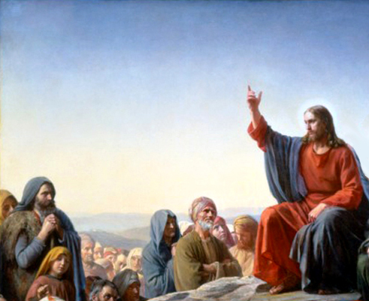
The Sermon on the Mount
Reverse Charades

Slide 3
The Sermon on the Mount
SALT
1/10

Slide 4
The Sermon on the Mount
LIGHT
2/10

Slide 5
The Sermon on the Mount
ANGER
3/10

Slide 6
The Sermon on the Mount
LOVE
4/10

Slide 7
The Sermon on the Mount
TITHING
5/10

Slide 8
The Sermon on the Mount
FASTING
6/10

Slide 9
The Sermon on the Mount
PRAYER
7/10

Slide 10
The Sermon on the Mount
JUDGE
8/10

Slide 11
The Sermon on the Mount
WISE
9/10

Slide 12
The Sermon on the Mount
ROCK
10/10

Slide 13
The Sermon on the Mount
JESUS
bonus

Slide 14
Scripture Study Tips
Relevancy in personal study
Today’s Tip:
Simplify

Slide 15

Let’s read it.

Slide 16
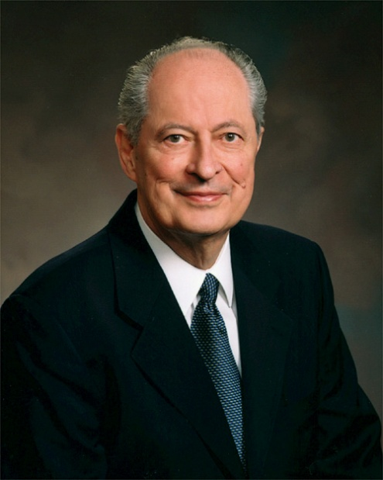
Elder Robert D. Hales:
“Wouldn’t it be pleasing to Jesus if we could let our light so shine that those who followed us would be following the Savior?”
(“That Ye May Be the Children of Light” [BYU fireside address, Nov. 3, 1996])
Who is someone you wanted to follow because you knew they were following the Savior?

Slide 17
Cross Reference D&C 3:4 The Dimmer Switch
For although a man may have many revelations, and have power to do many mighty works, yet if he:
1) boasts in his own strength, and
2) sets at naught the counsels of God, and
3) follows after the dictates of his own will and carnal desires,
4) he must fall and incur the vengeance of a just God upon him.

Slide 18
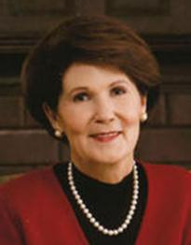
“For many years I tried to measure the quiet, reflective, thoughtful Pat Holland against the robust, bubbly, talkative, and energetic Jeff Holland. I have learned through several fatiguing failures that you can’t have joy in being bubbly if you are not a bubbly person. I have given up seeing myself as a flawed person because my energy level is lower than Jeff’s, and I don’t talk as much as he does, nor as fast. Giving this up has freed me to embrace and rejoice in my own manner and personality in the measure of my creation. Ironically, that has allowed me to admire and enjoy Jeff even more.
Patricia Holland, Portraits of Eve: God’s Promises of Personal Identity, LDS Women’s Treasury: Insights and Inspiration for Today’s Woman (Salt Lake City: Deseret Book Co., 1997), 104.

Slide 19
“Somewhere, somehow the Lord “blipped the message onto my screen” that my personality was created to fit precisely the mission and talents he gave me. For example, the quieter, calmer talent of playing the piano reveals much about the real Pat Holland. I would never have learned to play the piano if I hadn’t enjoyed the long hours of solitude required for its development. The moment I indulge in imitation of my neighbor, I feel fractured and fatigued and find myself forever swimming upstream.”
Patricia Holland, Portraits of Eve: God’s Promises of Personal Identity, LDS Women’s Treasury: Insights and Inspiration for Today’s Woman (Salt Lake City: Deseret Book Co., 1997), 104.

Slide 20
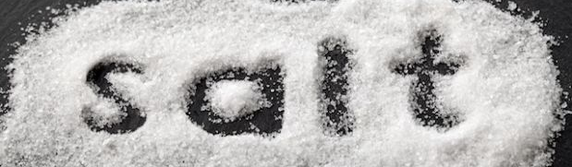
Matthew 5: 15
Ye are the salt of the earth; but if the salt have lost its savour, wherewith shall it be salted? It is thenceforth good for nothing, but to be cast out, and to be trodden under foot of men.
How does salt lose its savor?
What is salt used for? What does it do?
Make a list of its uses and relate them to the Gospel
Are you salt on your job? Or are you just like every other worker?
Doctor? Lawyer? Teacher? Mom?
Notes:
Salt loo

Slide 21
Salt prevents bacteria from growing.
  Christians prevent cultural decay.
    We (the salt) aren’t influencing cultural meat because we are staying in the shaker. The politicians, educators, lawyers aren’t the salt – we are.
Salt creates thirst.
  Be so salty that people become so thirsty that they beg for living water.
Salt gives flavor.
  Popcorn without salt? Ever had a French fry without salt? Food tastes better with salt – it brings out flavor.

Slide 22
  Are you salt on your job? Or are you just like every other worker?
Doctor? You’re not just a doctor. You’re God’s representative in the medical field so others can see how God would treat sick people if he were on the earth.
Lawyer? You’re not just a lawyer. You’re God’s representative in the courtroom so others can see how God handles people with legal issues.
Teacher? You’re not just a teacher. You’re God’s representative in the classroom so others can see what God looks like when God teaches a lesson.
Mom? You’re not just a mom. You’re God’s representative in the home so children can see what God looks like when God raises a family.

Slide 23


Story: Sam

Slide 24

What are the purposes of law?
Guidelines (protect)
As a Mirror (remind)
    Does you mirror help you look better?
    Do you use your mirror to make yourself look better?

Slide 25
The Sermon on the Mount
Matthew 5-7
TELESTIAL | TERRESTRIAL | CELESTIAL
GOOD | BETTER | BEST
PUBLIC | vs | PRIVATE

Slide 26

The Sermon on the Mount
Matthew 5-7
TEACHING | LAW OF THE WORLD | LAW OF MOSES | LAW OF CHRIST
Anger
Chastity/ Adultery
Honesty
Retaliation and Revenge
Love
Tithing and Offerings
Prayer
Fasting
Judging Others

Slide 27
The Sermon on the Mount
Matthew 5-7
TEACHING | LAW OF THE WORLD | LAW OF MOSES | LAW OF CHRIST
Anger |  | 5:21 | 5:22-26
Chastity/ Adultery |  | 5:27,31 | 5:28-30
Honesty |  | 5:33 | 5:34-37
Retaliation and Revenge |  | 5:38 | 5:39
Love |  | 5:43 | 5:44-47
Tithing and Offerings |  | 6:2 | 6:3-4
Prayer |  | 6:5 | 6:6-7
Fasting |  | 6:16 | 6:17-18
Judging Others |  | 7:3-4 | 7:1

Slide 28
The Sermon on the Mount
Matthew 5-7
TEACHING | LAW OF THE WORLD | LAW OF MOSES | LAW OF CHRIST
Anger |  | 5:21 | 5:22-26

Slide 29
The Sermon on the Mount
Matthew 5-7
TEACHING | LAW OF THE WORLD | LAW OF MOSES | LAW OF CHRIST
Anger |  | 5:21 | 5:22-26
Chastity/ Adultery |  | 5:27,31 | 5:28-30

Slide 30
The Sermon on the Mount
Matthew 5-7
TEACHING | LAW OF THE WORLD | LAW OF MOSES | LAW OF CHRIST
Anger |  | 5:21 | 5:22-26
Chastity/ Adultery |  | 5:27,31 | 5:28-30
Honesty |  | 5:33 | 5:34-37

Slide 31

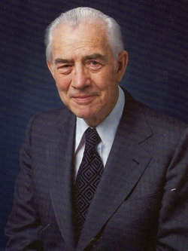
“If all were honest, we could have heaven here on earth. We would have no need for Armies or Navies, nor even a policeman in the smallest community. There would be no crime, no invasion of other people’s rights, no violence. There would be no divorce. Conflict between children and parents would disappear, and juvenile delinquency would come to an end.
“It is the lie of the drug peddler that tempts a child to indulge, and the lie of the seducer that persuades a girl to surrender her virtue….It is the lie of the shoddy workman that hides a faulty repair….It is the lie on the lips of the neighborhood gossip that brings character assassination to many innocent victims.
(Elder Mark E. Petersen, October 1971 General Conference)

Slide 32
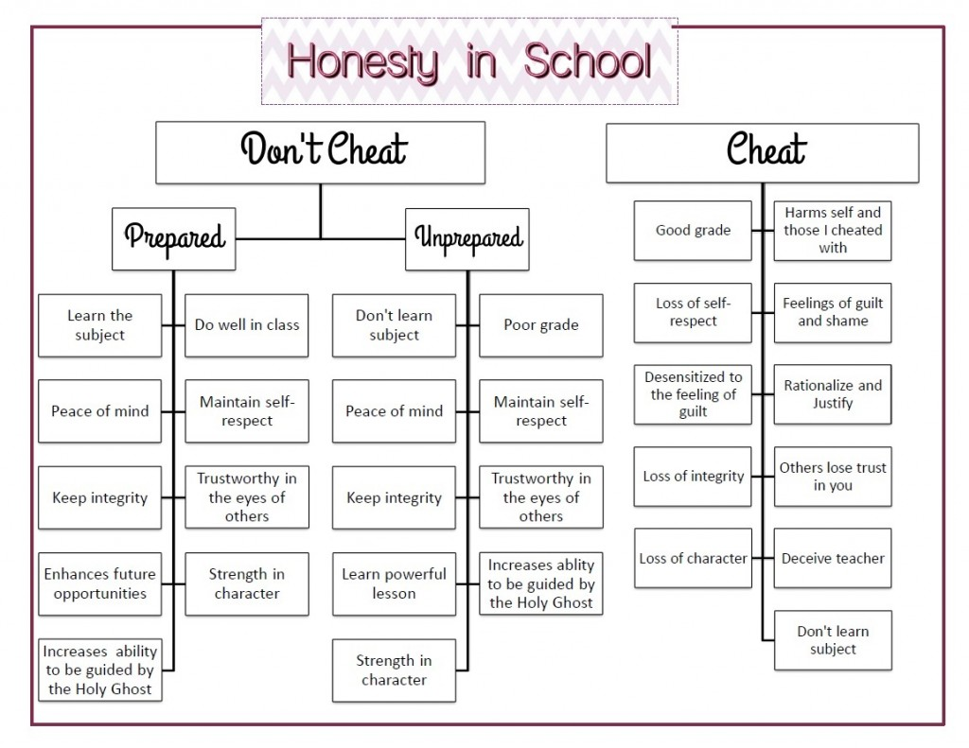
3 Nephi 12:38-42

Slide 33
The Sermon on the Mount
Matthew 5-7
TEACHING | LAW OF THE WORLD | LAW OF MOSES | LAW OF CHRIST
Anger |  | 5:21 | 5:22-26
Chastity/ Adultery |  | 5:27,31 | 5:28-30
Honesty |  | 5:33 | 5:34-37
Retaliation and Revenge |  | 5:38 | 5:39

Slide 34
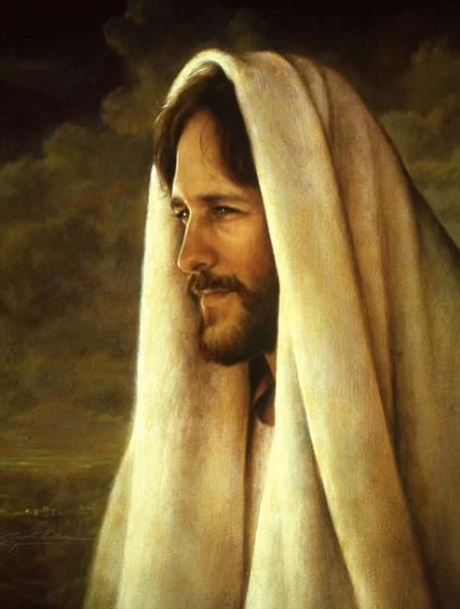
By show of hands…
How many of you have a close family member or friend who doesn’t believe what you believe?
Ever been mocked or bullied for what you believe?
Ever been attacked on social media for what you believe?

Slide 35
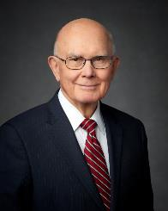
“Followers of Christ should be examples of civility. We should love all people, be good listeners, and show concern for their sincere beliefs. Though we may disagree, we should not be disagreeable. Our stands and communications on controversial topics should not be contentious. We should be wise in explaining and pursuing our positions and in exercising our influence. …When our positions do not prevail, we should accept unfavorable results graciously and practice civility with our adversaries”
( “Loving Others and Living with Differences,” Ensign or Liahona, Nov. 2014, 27).

Slide 36

“If you haven’t already, you will one day find yourself called upon to defend your faith or perhaps even endure some personal abuse simply because you are a member of The Church. Such moments will require both courage and courtesy on your part…
Defend your beliefs with courtesy and with compassion.”
(Jeffrey R. Holland, “The Cost—and Blessings—of Discipleship,”
Ensign or Liahona, May 2014, 9).
3 Ne 11:29
EGO

Slide 37
The Sermon on the Mount
Matthew 5-7
TEACHING | LAW OF THE WORLD | LAW OF MOSES | LAW OF CHRIST
Anger |  | 5:21 | 5:22-26
Chastity/ Adultery |  | 5:27,31 | 5:28-30
Honesty |  | 5:33 | 5:34-37
Retaliation and Revenge |  | 5:38 | 5:39
Love |  | 5:43 | 5:44-47

Slide 38
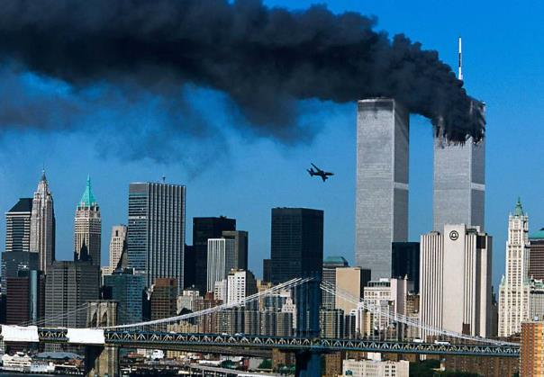
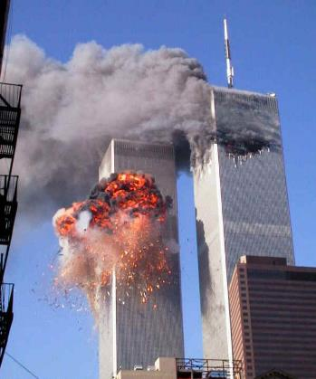

Slide 39
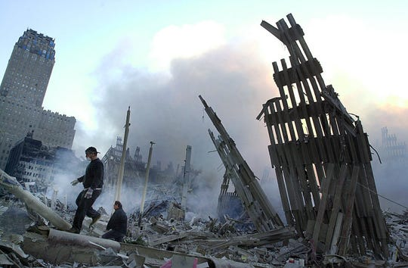
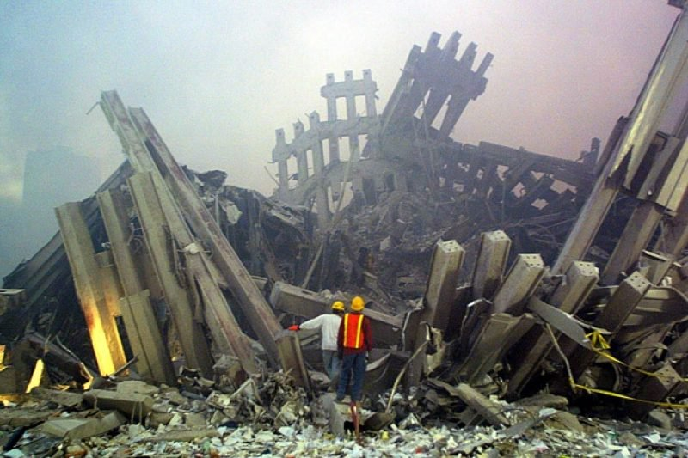
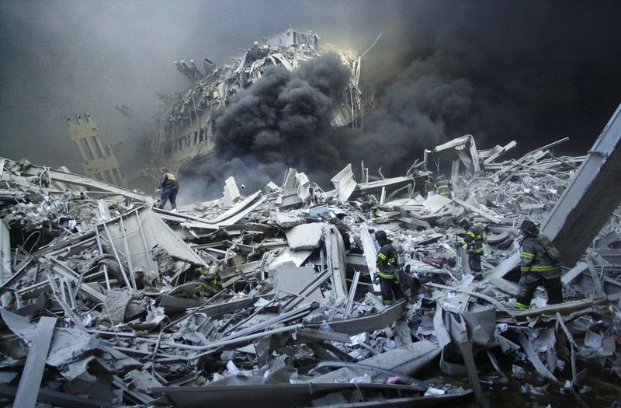
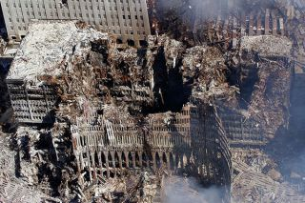

Slide 40
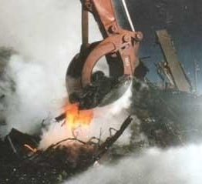
Ground Zero
Temperatures ranging from 400ºF to 2,800ºF.
Molten metal flows.
75 firefighters + 24 hours a day + millions of gallons of water = fire burned for 100 days.
3000+ people died.

Slide 41
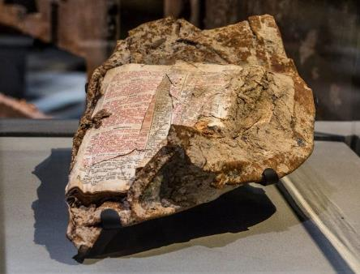
Matthew 5:43-44
Words from Matthew 5 were found at Ground Zero fused to a chunk of steel.
⁴³ Ye have heard, Thou shalt love thy neighbour, and hate thine enemy.
⁴⁴ But I say unto you, Love your enemies, bless them that curse you, do good to them that hate you, and pray for them which despitefully use you, and persecute you.

Slide 42
The Sermon on the Mount
Matthew 5-7
TEACHING | LAW OF THE WORLD | LAW OF MOSES | LAW OF CHRIST
Anger |  | 5:21 | 5:22-26
Chastity/ Adultery |  | 5:27,31 | 5:28-30
Honesty |  | 5:33 | 5:34-37
Retaliation and Revenge |  | 5:38 | 5:39
Love |  | 5:43 | 5:44-47
Tithing and Offerings |  | 6:2 | 6:3-4

Slide 43
The Sermon on the Mount
Matthew 5-7
TEACHING | LAW OF THE WORLD | LAW OF MOSES | LAW OF CHRIST
Anger |  | 5:21 | 5:22-26
Chastity/ Adultery |  | 5:27,31 | 5:28-30
Honesty |  | 5:33 | 5:34-37
Retaliation and Revenge |  | 5:38 | 5:39
Love |  | 5:43 | 5:44-47
Tithing and Offerings |  | 6:2 | 6:3-4
Prayer |  | 6:5 | 6:6-7

Slide 44
The Sermon on the Mount
Matthew 5-7
TEACHING | LAW OF THE WORLD | LAW OF MOSES | LAW OF CHRIST
Anger |  | 5:21 | 5:22-26
Chastity/ Adultery |  | 5:27,31 | 5:28-30
Honesty |  | 5:33 | 5:34-37
Retaliation and Revenge |  | 5:38 | 5:39
Love |  | 5:43 | 5:44-47
Tithing and Offerings |  | 6:2 | 6:3-4
Prayer |  | 6:5 | 6:6-7
Fasting |  | 6:16 | 6:17-18

Slide 45
The Sermon on the Mount
Matthew 5-7
TEACHING | LAW OF THE WORLD | LAW OF MOSES | LAW OF CHRIST
Anger |  | 5:21 | 5:22-26
Chastity/ Adultery |  | 5:27,31 | 5:28-30
Honesty |  | 5:33 | 5:34-37
Retaliation and Revenge |  | 5:38 | 5:39
Love |  | 5:43 | 5:44-47
Tithing and Offerings |  | 6:2 | 6:3-4
Prayer |  | 6:5 | 6:6-7
Fasting |  | 6:16 | 6:17-18
Judging Others |  | 7:3-4 | 7:1

Slide 46

Matthew 6:33

Slide 47
Matthew 6:33
At a baseball game once, I saw a batter connect solidly with the ball. It screamed towards the outfield and bumbled around in the corner of the field. The outfielder scrambled to catch up with it and in the process, the runner made it all the way home. An inside the park homerun! But then something strange happened. I saw a conversation between the infielders. The ball was then tossed to the first baseman and I then saw the umpire clinch his fist and scream “He’s out!”. I didn’t know what happened! My friend leaned over and explained that the runner had missed first base and, by rule, was called out once the ball was thrown there and one the baseman stepped on the bag, he was out.
In life, if we don’t seek His kingdom first, we’ll eventually be called out. Even if we hustle through life and make it all the way ‘home’, if we haven’t touched first base along the way, all our other efforts aren’t worth much at all.

Slide 48



Luke 6:31–38
The Platinum Rule?
  Treat Others as They Want to be Treated
Matthew 7:24-27
https://www.youtube.com/watch?v=4Pr42yeJGzc

Slide 49
The Sermon on the Mount
Matthew 5-7
WORLD | MOSES | JESUS
TELESTIAL | TERRESTRIAL | CELESTIAL
GOOD | BETTER | BEST
PUBLIC < -------------> PRIVATE

Slide 50

PUBLIC | vs | PRIVATE
Public downfalls always stem from private sins.

Slide 51
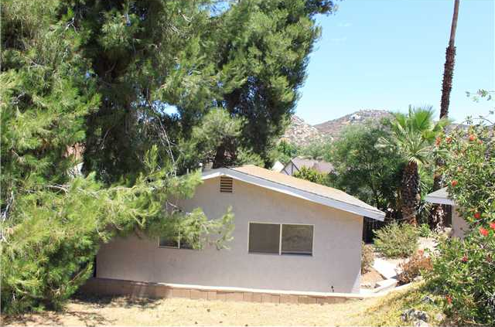
Painter came to repair a small crack in a wall. It was patched and painted, but showed up again about a month later. The homeowner called him back and asked him to do it again. The same process was undertaken but again, about a month or two later, the crack was back in full view. The homeowner, frustrated, called a different painter. The new painter arrived. He looked and looked and looked at the wall, not moving a muscle. Shaking his head, the told the homeowner that he wasn’t the man for the job. The homeowner, a bit perplexed, ask why. The painter replied, “Sir, what you have isn’t a patch and paint problem, it’s a foundation problem. Your home’s foundation is shifting. A patch will not help until you solidify your foundation.”

Slide 52
Painter came to repair a small crack in a wall. It was patched and painted, but showed up again about a month later. The homeowner called him back and asked him to do it again. The same process was undertaken but again, about a month or two later, the crack was back in full view. The homeowner, frustrated, called a different painter. The new painter arrived. He looked and looked and looked at the wall, not moving a muscle. Shaking his head, the told the homeowner that he wasn’t the man for the job. The homeowner, a bit perplexed, ask why. The painter replied, “Sir, what you have isn’t a patch and paint problem, it’s a foundation problem. Your home’s foundation is shifting. A patch will not help until you solidify your foundation.”

Slide 53
The Sermon on the Mount
Matthew 5-7
TEACHING | PUBLIC LIFE (LAW OF MOSES ) | PRIVATE LIFE (LAW OF CHRIST )
Anger
Chastity
Honesty
Retaliation and Revenge
Love
Tithing and Offerings
Prayer
Fasting
Judging Others

Slide 54
The Sermon on the Mount
Matthew 5-7
TEACHING | PUBLIC LIFE (LAW OF MOSES ) | PRIVATE LIFE (LAW OF CHRIST )
Ministering
Sabbath Observance
Family Home Evening
Scripture Study
Prayer
Church Attendance
Electronics
Social Media
Gossip

Slide 55


Slide 56
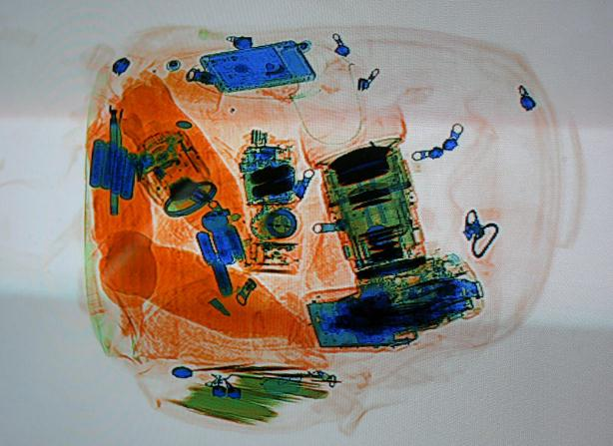
BE LIGHT: My Parable of the Security Checkpoint

Slide 57

Recap and Review
Matthew 5-7

Slide 58
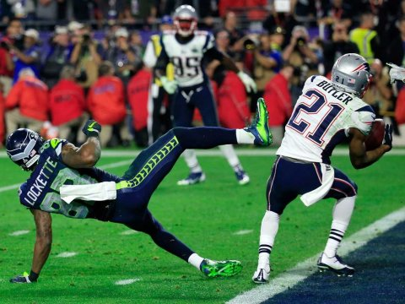
An Analogy
Where were you in 2015?

Slide 59
An Analogy
SCENE I: Popeyes in Vicksburg, Mississippi (2010). Malcolm Butler washing dishes, taking orders, frying chicken.
Kicked off the Hinds Community College football team for a misdemeanor drug charge.
He makes $7.25 per hour and lives in a mobile home.

Slide 60
An Analogy
SCENE II: Malcolm Butler walks onto the Patriots training camp to tryout for the team. During the practice, he breaks up so many passes, Patriots veterans nickname him Scrap. Even Tom Brady begins to wonder: Who's that guy running down so many of my passes?
Malcom Butler makes the roster.

Slide 61
The Beatitudes
An Analogy
SCENE III: The Patriots have a great year and make it to the SuperBowl.
“If the Seahawks line up near the goal line with two wide receivers bunched together, jump the route,” said coach Belichick randomly to Malcolm Butler during practice in the week leading up the Super Bowl.

Slide 62
The Beatitudes
An Analogy
SCENE IV: Superbowl Sunday. The Seattle Seahawks are at the 2 yard line with 26 seconds left and “Beast Mode” Marshawn Lynch in the backfield, one of the NFLs leading rushers. Seattle has an 84.4% chance of winning, according to win probability analytics. If they hand the ball off to Lynch, and the game is over.

Slide 63
The Beatitudes
SCENE V: Seattle lines up….and Butler sees the formation…and hears his coaches random comment come to his mind about what to do.

Slide 64
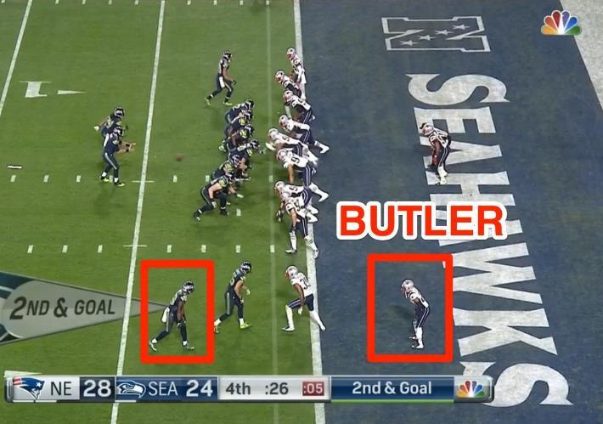
The Beatitudes

Slide 65
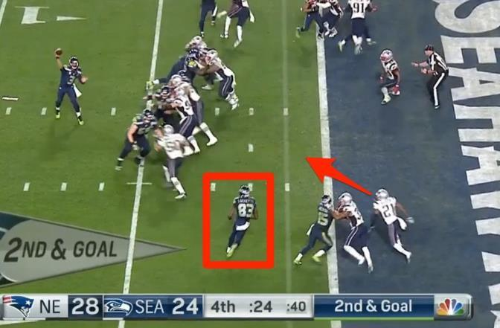
The Beatitudes

Slide 66
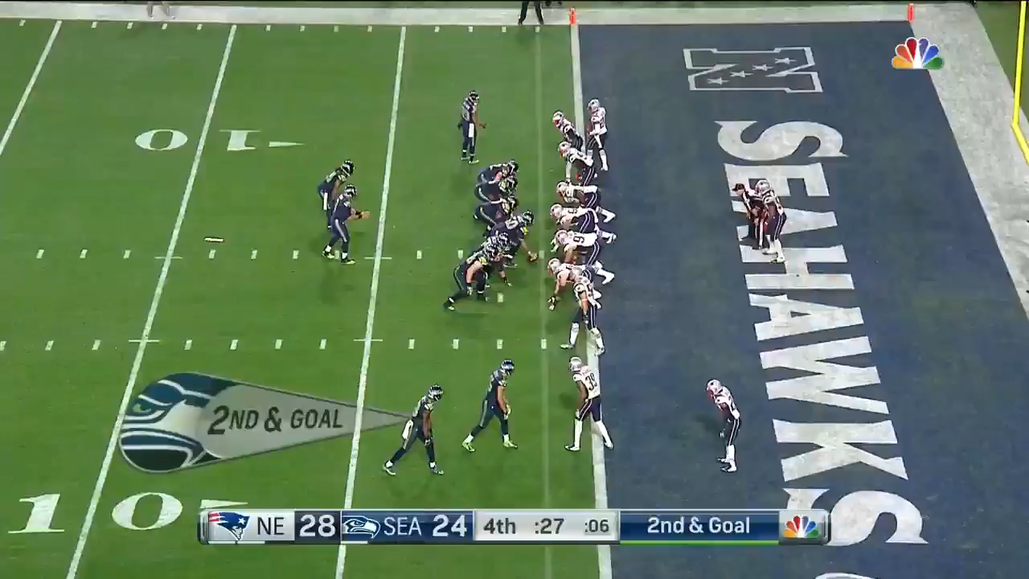
The Beatitudes
https://www.youtube.com/watch?v=U7rPIg7ZNQ8

Slide 67

The Beatitudes
What has your ‘Coach’ whispered to you?
Which one would you like to apply more fully in your life?
Controlling Anger
Being Chaste
Being Honest
Not Retaliating
Loving your enemies
Tithing, Praying, Fasting
Avoiding being judgmental
Being Generous
Being Meek
Hungering & Thirsting After Righteousness
Being Merciful
Purifying your Heart
Being a Peacemaker
Being a Light to the World
Being Salt

