Slide 1
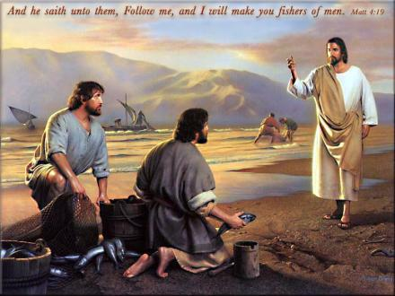
Come, Follow Me
I will make you fishers of men

Slide 2
Scripture Study Tips
Relevancy in personal study
Today’s Tip:
Look for significant phrases

Slide 3
Have you ever asked the wrong question at the right time?
Look at what Andrew asked: John 1:37–38

Slide 4
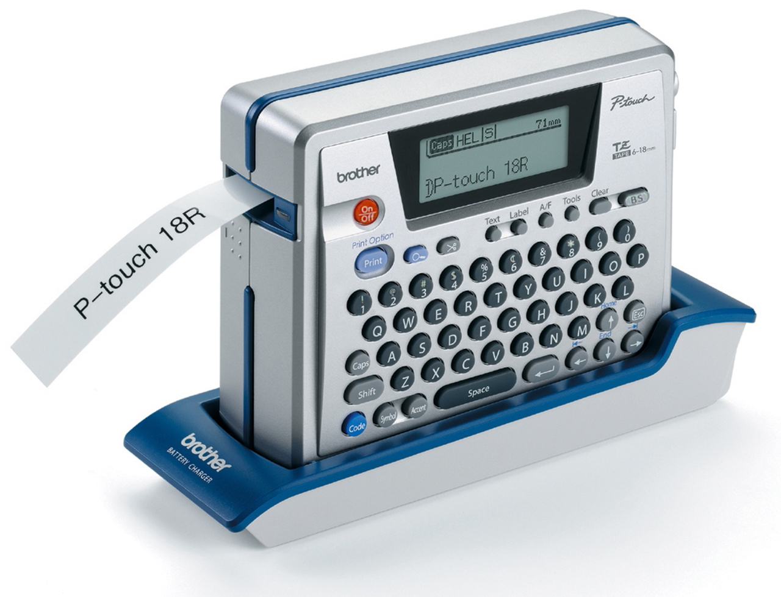
Who has the right to label something?
The manufacturer
The purchaser
The owner
Does Christ label people?
John 1:39-42
John 1:43-47

Slide 5
Who has the right to label something?
The manufacturer (think of the labels on clothing)
The purchaser - think of when you bought a new backpack or a baseball mitt, the first thing we do is write our name on it.
The owner (what if I came into your house and started labeling things - even if I was right, I do not have the right)
Does Christ like to label people?
Simon = rock. Sons of Zebedee - Sons of Thunder. Nathanniel - no guile.

Slide 6
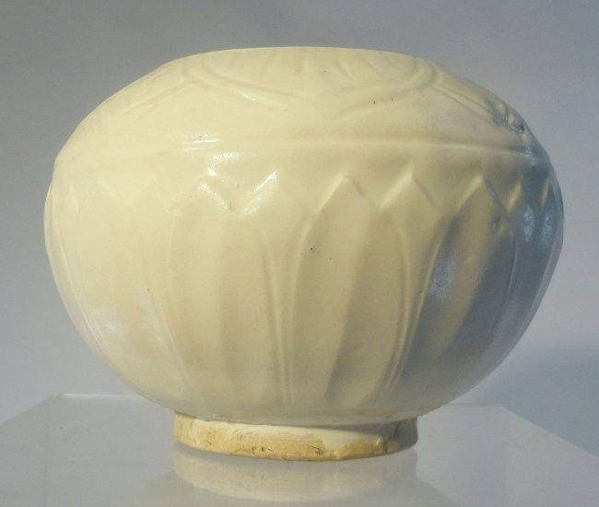
THE LORD’s LABELS
Children of the Living God (Rom 9:26)
Children of the Most High (Luke 6:35)
His treasure, Heirs of God (Gal 4:7)
Crown jewels (D&C 101)
Children of the Promise (Rom 9:8)
Beloved, Redeemed (gain possession of something in exchange for payment)
Elect (Col 3:12 - He’s voting for you!)

Slide 7
Bought in a 2007 New York yard for $3.
It sat on the family’s mantel until they decided to have it valued.
The family ultimately sold this vase (a Chinese Ding Bowl) in 2013…
….for $2.2 million.
Stop looking around and start looking up: Vertical Validation
Numbers game on social media Mission call vs temple endowment? Mission farewell
Moses, Enoch, Paul – so many great people with challenges
If God hasn’t removed ‘it’, ‘it’ is not a mistake. “His grace is sufficient.”
You are fully equipped for success. If the Lord hasn’t given you something you’ve asked, you don’t need it for your success.

Slide 8
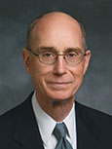
Why is the phrase, “Come and see” so powerful?
“When you give your heart to inviting people to come unto Christ, your heart will be changed. By helping others come unto Him, you will find that you have come unto Him yourself” (“Come unto Christ,” Ensign, Mar. 2008, 49).

Slide 9
Who has invited you?
Who have you invited?
Tip: Invite with a vision
Background music – name that tune
Inviting All the Come Unto Christ (Junior Reyes Youth Video)
https://www.youtube.com/watch?v=ynVgDWKWHtU

Slide 10
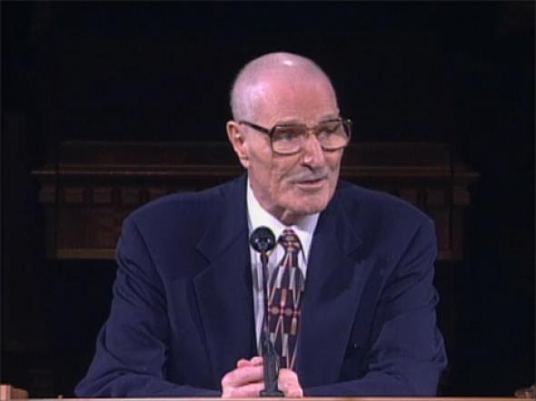
“If we are serious about our discipleship, Jesus will eventually request each of us to do those very things which are most difficult for us to do” (Elder Neal A Maxwell)

Slide 11
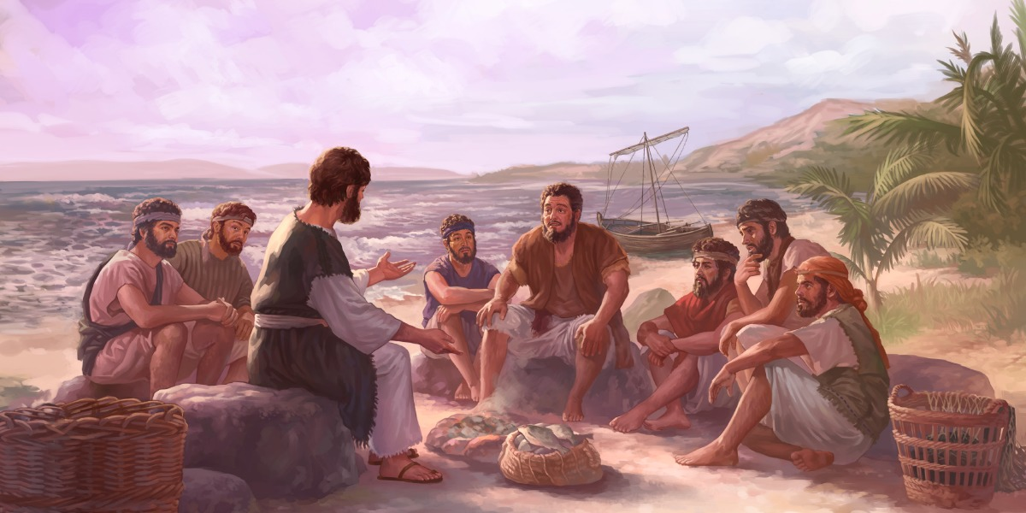
“If being a member of the Lord's church isn't demanding, if it isn't taking great effort, if at times it isn't humiliating, challenging, tiring (and yet inspiring) then somewhere along the way, we have put down our cross.” (My Stake President)

Slide 12
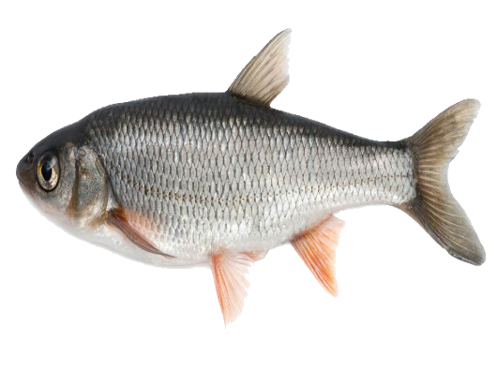
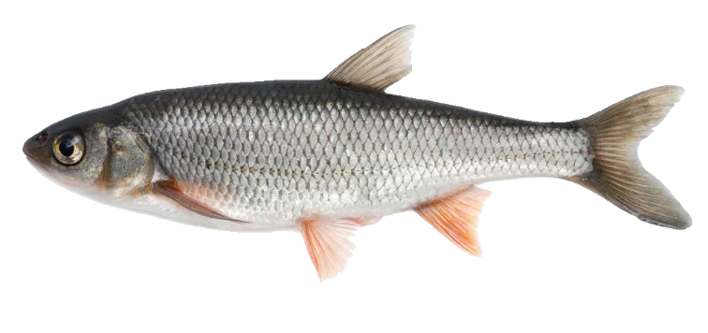
Luke 5:1–7
What principles do you see?
What do you think happened to the fish?
Why would Jesus call them while their nets were full? (vs 10-11)
What might Simon’s own fishing experience have led him to think in this moment?
What principle is found in the word “Nevertheless”?

Slide 13
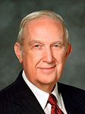
“This life is an experience in profound trust—trust in Jesus Christ, trust in His teachings, trust in being led by the Holy Spirit. To trust means to obey willingly without knowing the end from the beginning (see Prov. 3:5–7). Your trust in the Lord must be more powerful and enduring than your confidence in your own personal feelings and experience” (“Trust in the Lord,” Ensign, Nov. 1995, 17).

Slide 14
https://www.youtube.com/watch?v=poNuGusSX5c

Slide 15
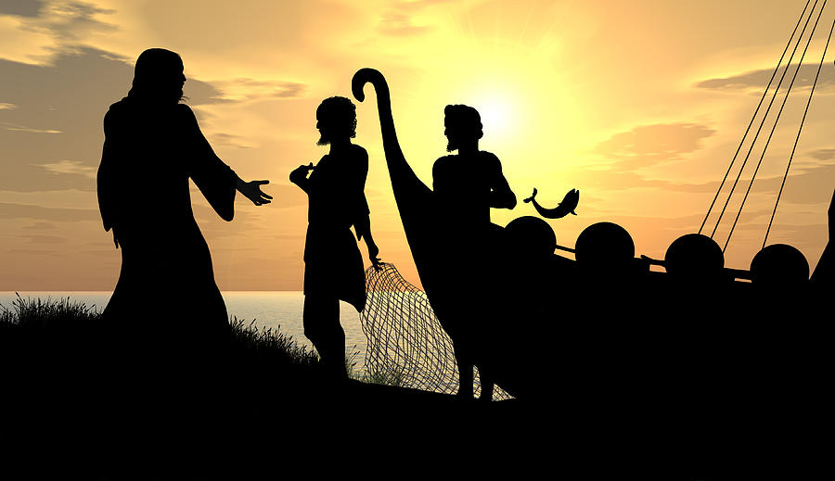
What might the nets symbolize?

Slide 16
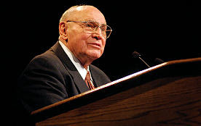
“Nets are generally defined as devices for capturing something. In a narrower but more important sense, we might define a net as anything that entices or prevents us from following the call of Jesus Christ, the Son of the living God.
“Nets in this context can be our work, our hobbies, our pleasures, and, above all else, our temptations and sins. In short, a net can be anything that pulls us away from our relationship with our Heavenly Father or from His restored Church”
~Elder Joseph B. Wirthlin, October 2002

Slide 17
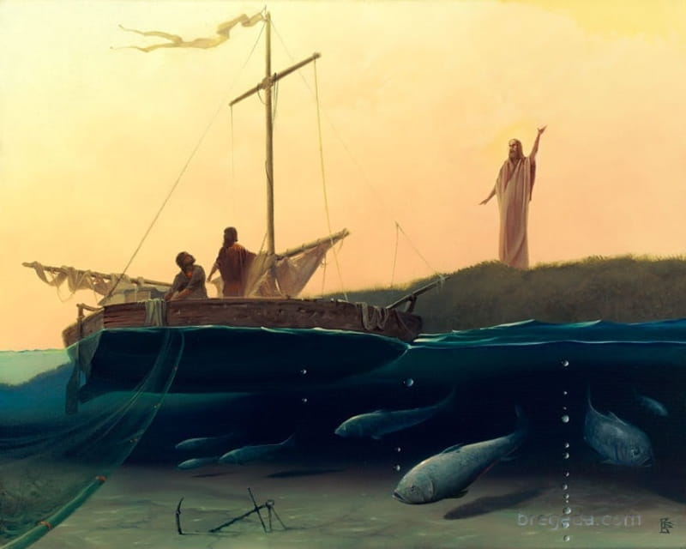
How have you received greater blessings by following the Lord’s directions even when you didn’t fully understand the reasons?
Circumstances say: NO FISH.
Nevertheless says: SO WHAT?
Facts say, NO FISH.
Faith says… NO FISH...YET!

Slide 18
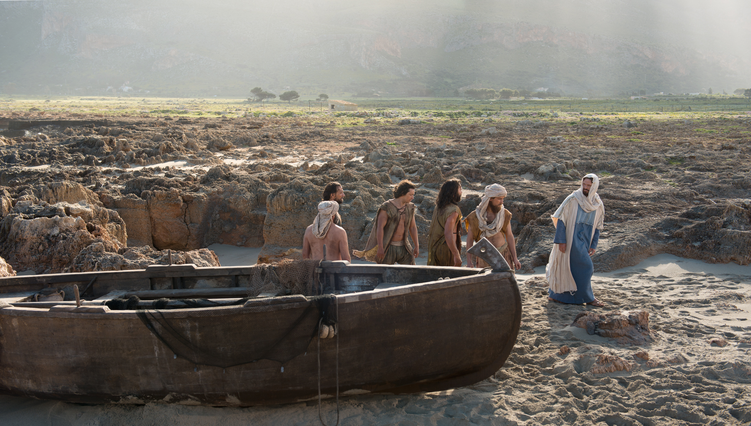
What is something you could ‘go-and-do’ today that would bring you closer to Jesus Christ?
NEXT LESSON: Think about a time that someone was healed.

