Slide 1
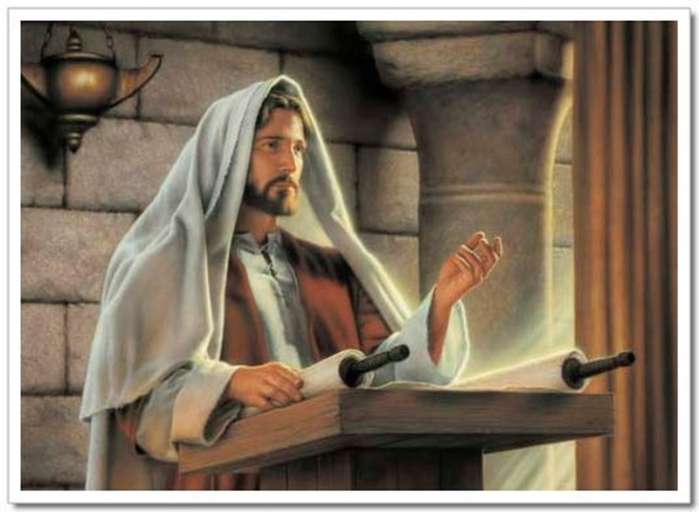
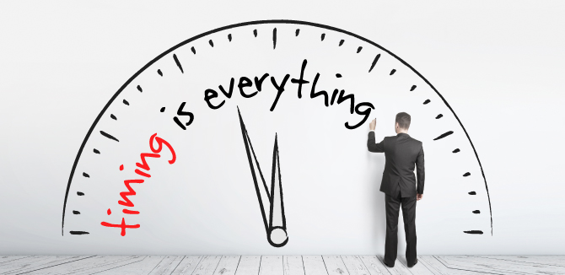
Luke 4:16‑‑32
John 4:46–54

Slide 2
Who in our class will…
Get married first:
Be the Richest:
Have the most kids:
Become famous:
First to become a bishop:
Be College Valedictorian:

Slide 3
Scripture Study Tips
Relevancy in personal study
Today’s Tip:
See yourself in the story

Slide 4
Luke 4:16‑‑22, 28-30
Why might it be hard to accept a person you grew up with as a chosen leader?
Broken
Bruised
Captive
Poor
Blind
When have these words described you?
What experiences have you had that have shown you that Jesus Christ continues to heal and deliver us in our day?
Notes:
https://www.youtube.com/watch?v=4vPDN5WU8vM

Slide 5
{VIDEO}
Bible Video – Jesus Declares that he is the Messiah
https://www.churchofjesuschrist.org/bible-videos/videos/jesus-declares-he-is-the-messiah?lang=eng

Slide 6
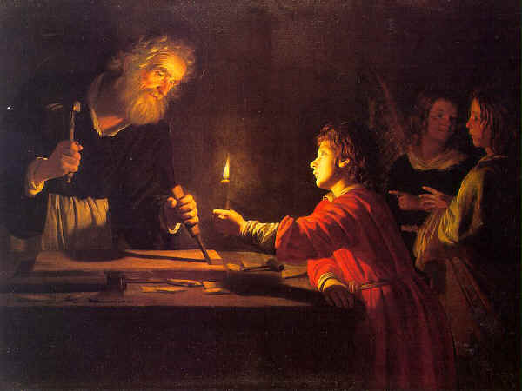
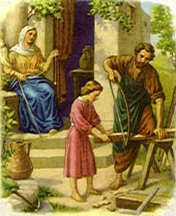
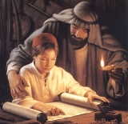
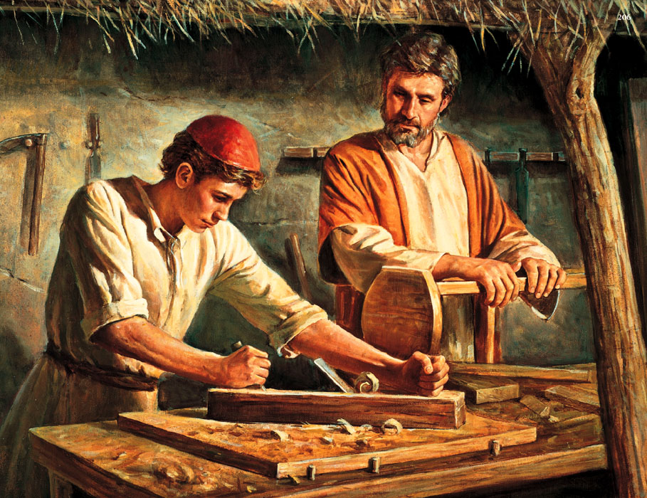

Slide 8
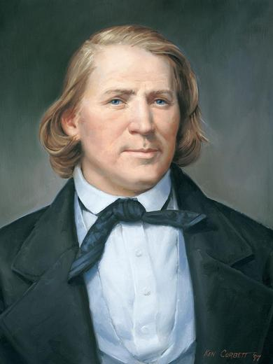
Do Mormons consider their prophets to be infallible?
Were Biblical prophets infallible? (Compare Acts 9:7 & Acts 22:9)
How are Church members protected against error by leaders? (see Doctrine and Covenants 21: 4-6).
What blessings come to those who accept chosen (yet infallible) leaders?
“Can a Prophet or an Apostle be mistaken? I acknowledge that I will not lead this people astray one hair’s breadth from the truth, and I will never knowingly do a wrong (though I may commit many wrongs, and so may you). I know that the Saints lift their hearts to God that I may be led right” (Brigham Young).

Slide 9
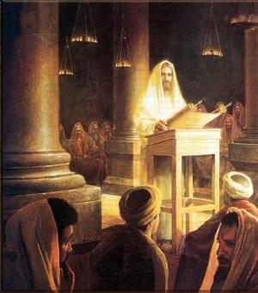
Karl G. Maeser: On one occasion he was going with a group of young missionaries across the alps. They were crossing a high mountain pass on foot. There were long sticks stuck into the snow of the glacier to mark the path so that travelers could find their way safely across the glacier and down the mountain on the other side.
When they reached the summit, Brother Maeser wanted to teach the young elders a lesson. He stopped at the pinnacle of the mountain and pointed to those sticks that they had followed. And he said, “Brethren, behold the priesthood of God. They are just common old sticks, but it’s the position that counts. Follow them and you will surely be safe. Stray from them and you will surely be lost.”
And so it is in the Church. We are called to leadership positions and given the power of the priesthood. And we are just common old sticks, but the position we are given counts.”

Slide 10
Elder James E. Faust: "Members of the Church . . . those of enduring faith . . . willingly accept the leaders of the Church. These leaders of the Church are men with human frailties, and are imperfect in their wisdom and judgment. Perfection in men is not found on the earth. But almost without exception these leaders sincerely, humbly, and prayerfully render great and dedicated Christian service to the best of their ability. More important, they hold a divine warrant and commission through which great and eternal blessings come to those who sustain and follow them. They are God's servants" (Oct. 1985).

Slide 11
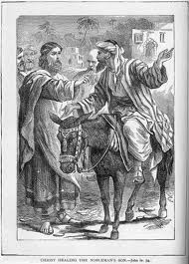
Timing
John 4:46–54: The Second Miracle of Jesus Christ
What principle can we learn from this man’s experience?
(look at the timing of the healing)

Slide 12
Timing
John 4:46–54: The Second Miracle of Jesus Christ
1. Who met Jesus and what blessing did he seek from the Savior?
2. Based on what Jesus said, why did He delay granting the blessing this man sought?
3. How did this man demonstrate that he did not need a sign to believe?
4. According to John 4:51–53, how was this man’s belief in Jesus Christ confirmed?
5. What principle can we learn from this man’s experience?
(look at the timing of the healing)

Slide 13
Timing
Examples of the omniscient timing of God:
1. Abraham and Isaac and the angel
2. Joseph in Egypt
3. Nephi on Christmas Eve
“Commit yourself to put the Lord first in your life, keep his commandments, and do what the Lord’s servants ask you to do. Then your feet are on the path to eternal life. You do not know what will happen; do your best on what is fundamental and personal and then trust in the Lord and in His timing” (Elder Oaks, October, 2003)

Slide 14
Timing
What is he timing for you?
Spouse?
Best friends?
Career?
Kids?
Scholarships?
People on your mission?

Slide 15
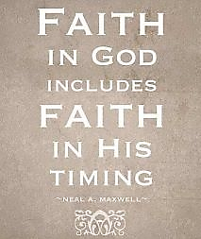

Slide 16
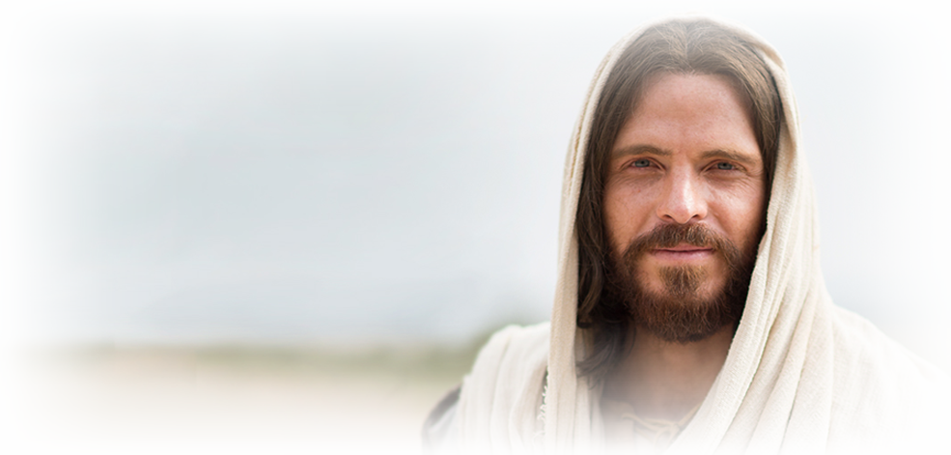
What is something you could ‘go-and-do’ today that would bring you closer to Jesus Christ?
NEXT LESSON: What does it mean to be a disciple of Christ?

