Slide 1
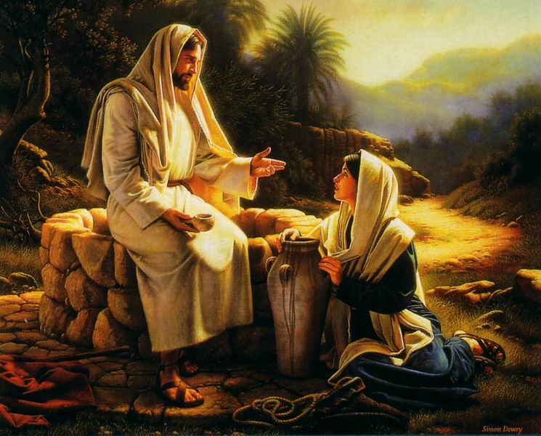
Woman at the well
John 4:1-42

Slide 2


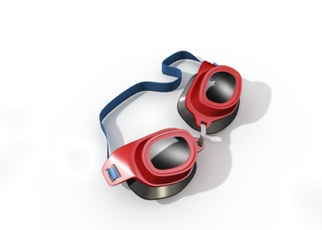

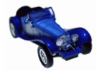


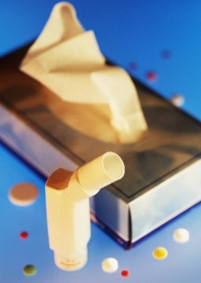

Woman at the well
Think of a few ways to relate a random object to the gospel…

Slide 3
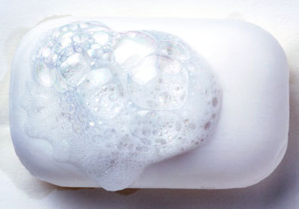
Repentance is like…
(It makes you clean)

Slide 4
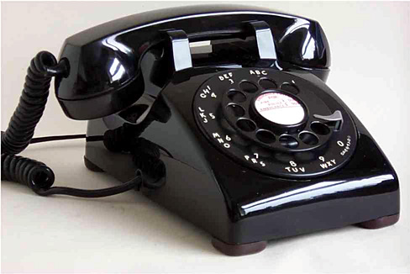
Prayer is like…
(You use it to talk with God)

Slide 5
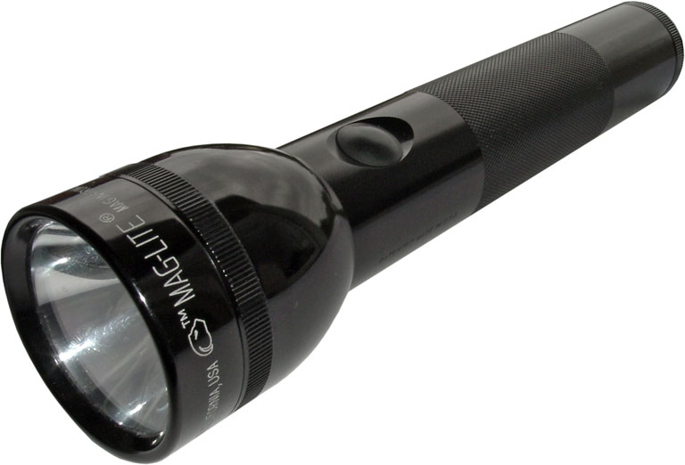
The Holy Ghost is like…
(It helps you see in a dark world)

Slide 6

The prophet is like…
(He helps you see more clearly)

Slide 7
Come up with your own…
A testimony is like…
The scriptures are like…
Anything…

Slide 8
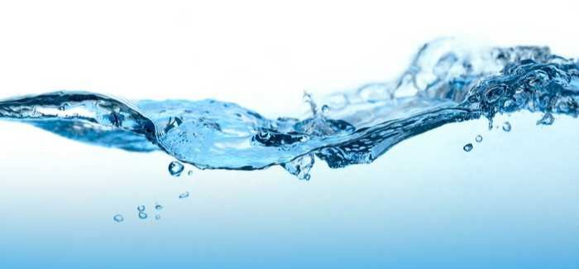
Jesus is like…

Slide 9
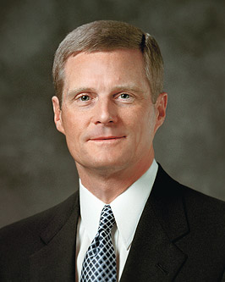
“Of all the materials found on the earth, the most valuable is water. Life springs from water. Life is sustained by water. Our physical bodies are approximately two-thirds water. Whereas a person can survive for many days without food, an individual will usually die in only three or four days without water. Most of the world’s great centers of population are situated near sources of water. Simply stated, life could not exist without water.
Elder Bednar, “A Reservoir of Living Water,” Feb. 4, 2007.

Slide 10
“The living water referred to in the scriptures is a representation of the Lord Jesus Christ. And as water is necessary to sustain physical life, so the Savior is essential for eternal life. You and I need His living water daily and in ample supply to sustain our ongoing spiritual growth.”
Elder Bednar, “A Reservoir of Living Water,” Feb. 4, 2007.

Slide 11
Scripture Study Tips
Relevancy in personal study
Today’s Tip:
These are YOUR stories

Slide 12
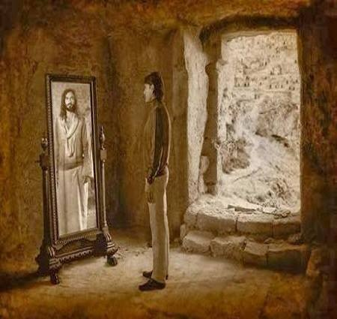
This is our story!
So are we talking about Jesus’ genealogy?
  (No! It’s our genealogy!)
Wise men?
  (No! It’s us seeking Jesus)
Shepherds?
Jesus increased in wisdom, stature?
His baptism?
His temptation?
Is it water that’s made sweet wine?
A temple that is cleansed?
A physical umbilical cord?

Slide 13
Woman at the well
John 4:1-42

Slide 14
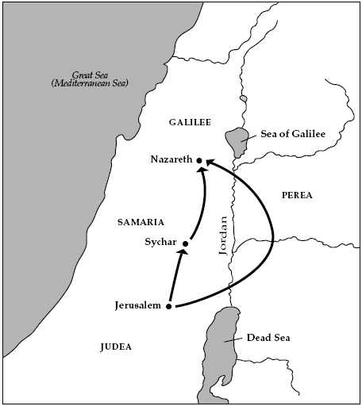
Woman at the well
Why did Jesus take this route?

Slide 15
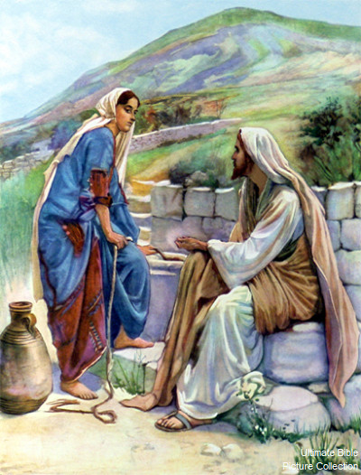
Woman at the well
Why a woman?

Slide 16

Woman at the well
[video]
https://www.churchofjesuschrist.org/media-library/video/2012-06-1710-the-woman-at-the-well?lang=eng (7:29)

Slide 17

  THE WOMAN AT THE WELL
  Read John 4:28-30, 39-42 to see the end of the story.
  Discuss: Where have you found living water in your life? (Where do you go when you feel ‘dry’ spiritually?)
  Look at John 4:11,19,25,29 to see/mark the different titles she uses for Jesus.
  Discuss: How do people’s testimonies evolve over time?
  What time is “the sixth hour” in John 4:6? (Google may help you here).
  Why was she getting water at that time of day? (HINT: vs 16-17)
  Privately ponder: Who in your life needs living water and
  how can you offer it to them?

Slide 18
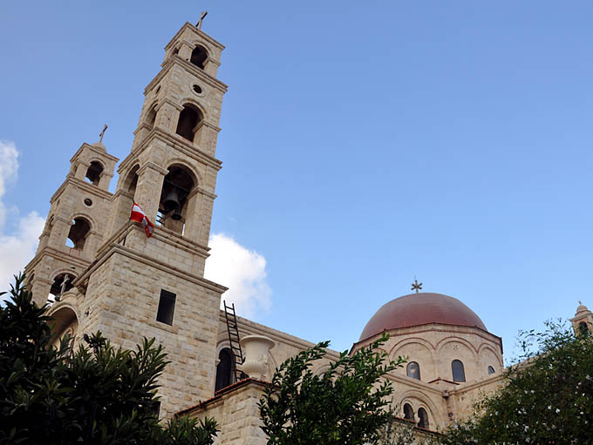

Slide 19
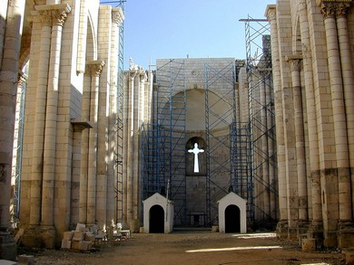
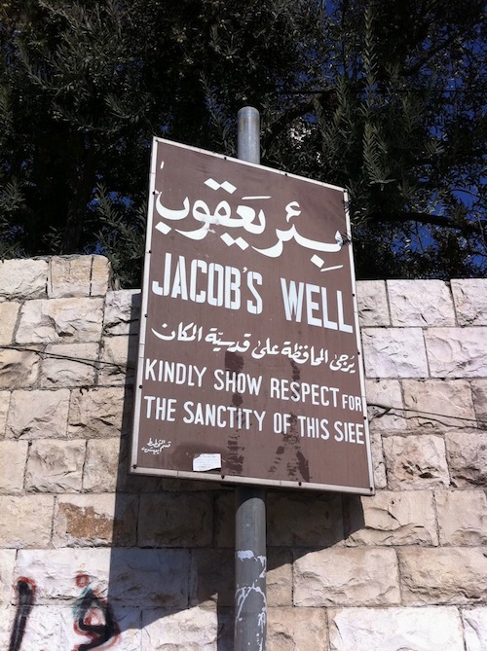

Slide 20
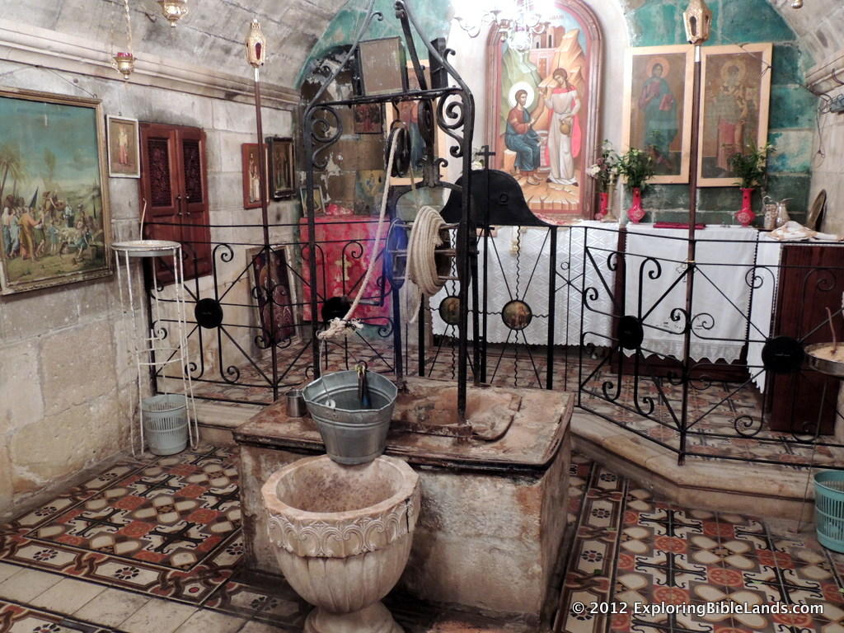

Slide 21
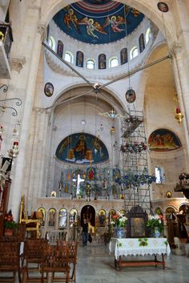
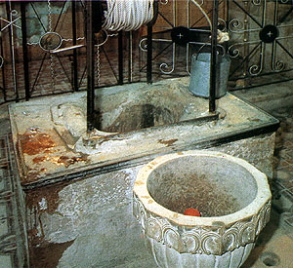

Slide 22
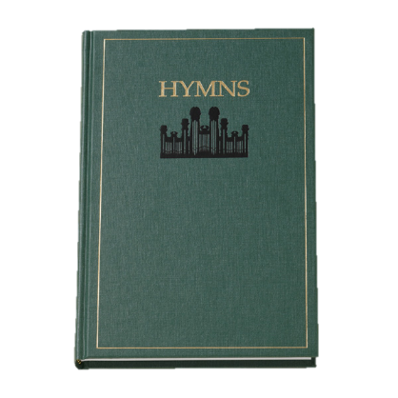
Woman at the well
Why Jacob’s well?
(Genesis 32-33)
The Abrahamic Covenant is passed on (Gen 28:3-4)
The story is told in Hymn 100

Slide 23
Principles from Jacob’s Well:
How badly do we want a blessing? Are you willing to wrestle and struggle to receive it?
Why was Jacob’s name changed?
Why was his hip dislocated?
  The Lord might dislocate or discomfort us so we are reminded of the blessings we do have

Slide 24
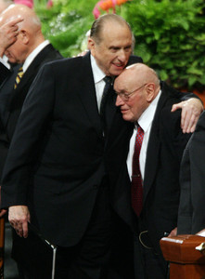
Woman at the well
What principle is taught in John 4:28?
“Throughout history men have always been looking for the easy way. Some have devoted their lives to finding the ‘fountain of youth,’ a miracle water which would bring everlasting life. Today many are still seeking some magic ‘fountain’ that will bring success, fulfillment, and happiness. But most of this searching is in vain. … It is only this ‘living water,’ the gospel of Jesus Christ, that can and will bring a happy, successful, and everlasting life to the children of men…
“By living the gospel of Jesus Christ, we develop within ourselves a living spring that will quench eternally our thirst for happiness, peace, and everlasting life. The Lord explains: “But unto him that keepeth my commandments…the same shall be in him a well of living water, springing up unto everlasting life” [D&C 63:23].
–Joseph B. Wirthlin, April 1995

Slide 25

What is something you could ‘go-and-do’ today that would bring you closer to Jesus Christ?
NEXT LESSON: Think of a time you were rejected by someone you trusted or loved.

Slide 26
In Exodus 15, it had been three days since the children of Israel crossed through the Red Sea, but now they are out of water and… begin to complain. Moses gets to Mara (which means bitter) and the water is bad. The Lord reveals to Moses how to heal the water using a tree-- but instead of just healing the waters, the Lord turns the water sweet. After this miracle, the Children of Israel arrive in Elim. Elim means ‘sweet’. They’ve gone from Mara to Elim. In Elim, there are 12 springs and 70 date trees. Not only is life sweeter, but they have perpetual water and shade!
Principle: they couldn’t get to Elim withut traveling through Mara. They couldn’t skip Mara! And once they pass through the bitter Mara, each of the 12 tribes gets their own personal spring.
John 7:38 records, “He that believeth on me, as the scripture hath said, out of his belly shall flow rivers of living water.”

Slide 27
Woman at the well
Elder Boyd K Packer Salt Story

Slide 28
  Read John 4:5–9.
  What time is “the sixth hour” in verse 6? (Google may help you here).
  Read John 4:10–12. What did Jesus say in response to the woman’s question?
  Read John 4:13–14. What did Jesus say about the water that He offered?
  Read John 4:15–18. What did the woman want and how did the Savior respond?
  Read John 4:25–26. What did Jesus reveal about Himself to the woman?
  Look at John 4:11,19,25,29 to see/mark the different titles she uses for Jesus.
  Discuss: How has your testimony evolved over time?
  Read John 4:28-30, 39-42 to see the end of the story.
  Discuss: Where have you found living water in your life?
  Privately ponder: Who in your life needs living water and
  how can you offer it to them?

Slide 29
John 4:8-26
Read John 4:8-26 together. After, discuss these questions…
What did she need to do to partake of ‘living water’?
According to verses 17–18, how might the Savior’s words have helped the woman realize her need for the living water?
Look at John 4:11,19,25,29 to see/mark the different titles she uses for Jesus.
Discuss: How has your testimony evolved over time?
Read John 4:28-30, 39, 41-42.
Where have you found living water in your life?
Who in your life needs living water and how can you offer it to them?

