Slide 1

Matthew 5

Slide 2
Scripture Study Tips
Relevancy in personal study
Today’s Tip:
Look up words and discover their meaning

Slide 3
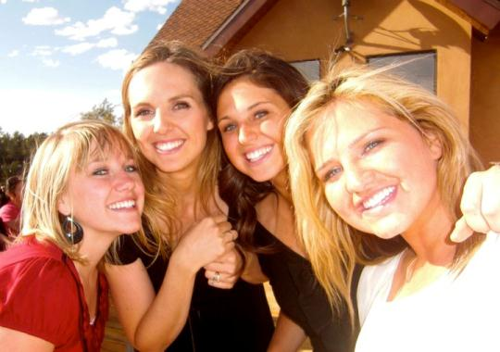
The Beatitudes
What does ‘beatitudes’ mean?
The word beatitude means “blessedness,” “to be fortunate,” or “to be happy.”

Slide 4
When was the last time you felt pure happiness?

Slide 5

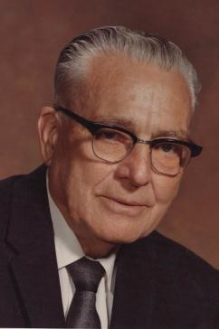
President Harold B. Lee said:
“The beatitudes give us eight distinct ways by which we might receive joy. . . . These declarations are ‘The Constitution for a Perfect Life.’” (Harold B. Lee, Decisions for Successful Living [1973], 56–57).

Slide 6

Using a search engine or scrpitures, type in your assigned Beatitude (from Matthew 5:3-10) and study for a few minutes
                ChurchOfJesusChrist.org
                Footnotes/Topical Guide
                Seminary Student Manual
                Institute Student Manual
                RSC (BYU Religious Study Center)
                FairMormon.org
                Book of Mormon Central
                Scott Woodward (ScottWoodward.org)
                Bruce Satterfield (emp.byui.edu/satterfieldb)
                Blue Letter Bible
Poor in Spirit
Blessed are they that mourn
The Meek
Hunger and Thirst After Righteousness
The Merciful
Pure in Heart
Peacemakers
The Persecuted

Slide 7
Poor in Spirit
Blessed are they that mourn
The Meek
Hunger and Thirst After Righteousness
The Merciful
Pure in Heart
Peacemakers
The Persecuted
Round 1: Match up with others who studied the same Beatitude and teach each other for 2 mins.
Rounds 2-4: Mingle with classmates and pair up with another person and teach/learn for 2 mins.

Slide 8
Poor in Spirit
Blessed are they that mourn
The Meek
Hunger and Thirst After Righteousness
The Merciful
Pure in Heart
Peacemakers
The Persecuted
Is there a pattern with these 8 beatitudes?

Slide 9
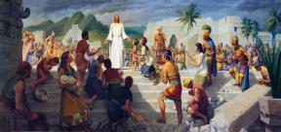
The Sermon on the Mount
BEATTITUDE | BLESSING | PRINCIPLE/ ORDINANCE

Slide 10
The Sermon on the Mount
BEATTITUDE | BLESSING | PRINCIPLE/ ORDINANCE
Poor in Spirit (who come unto me)
Mourn
Meek
Hunger and Thirst

Slide 11
The Sermon on the Mount
BEATTITUDE | BLESSING | PRINCIPLE/ ORDINANCE
Poor in Spirit (who come unto me) | Kingdom of Heaven
Mourn | Comfort
Meek | Inherit the Earth
Hunger and Thirst | Filled w/ Holy Ghost

Slide 12
The Sermon on the Mount
BEATTITUDE | BLESSING | PRINCIPLE/ ORDINANCE
Poor in Spirit (who come unto me) | Kingdom of Heaven | Faith
Mourn | Comfort | Repentance
Meek | Inherit the Earth | Baptism
Hunger and Thirst | Filled w/ Holy Ghost | Gift of the Holy Ghost
4th AOF

Slide 13
The Sermon on the Mount
BEATTITUDE | BLESSING | PRINCIPLE/ ORDINANCE
Poor in Spirit (who come unto me) | Kingdom of Heaven | Faith
Mourn | Comfort | Repentance
Meek | Inherit the Earth | Baptism
Hunger and Thirst | Filled w/ Holy Ghost | Gift of the Holy Ghost
Merciful
Pure in Heart
Peacemakers
Persecuted
4th AOF

Slide 14
The Sermon on the Mount
BEATTITUDE | BLESSING | PRINCIPLE/ ORDINANCE
Poor in Spirit (who come unto me) | Kingdom of Heaven | Faith
Mourn | Comfort | Repentance
Meek | Inherit the Earth | Baptism
Hunger and Thirst | Filled w/ Holy Ghost | Gift of the Holy Ghost
Merciful | Obtain Forgiveness
Pure in Heart | See God
Peacemakers | Kingdom of Heaven
Persecuted | Rewarded in Heaven
4th AOF

Slide 15
The Sermon on the Mount
BEATTITUDE | BLESSING | PRINCIPLE/ ORDINANCE
Poor in Spirit (who come unto me) | Kingdom of Heaven | Faith
Mourn | Comfort | Repentance
Meek | Inherit the Earth | Baptism
Hunger and Thirst | Filled w/ Holy Ghost | Gift of the Holy Ghost
Merciful | Obtain Forgiveness
Pure in Heart | See God
Peacemakers | Kingdom of Heaven
Persecuted | Rewarded in Heaven
4th AOF
D&C 107:18-19
TEMPLE

Slide 16


Slide 17
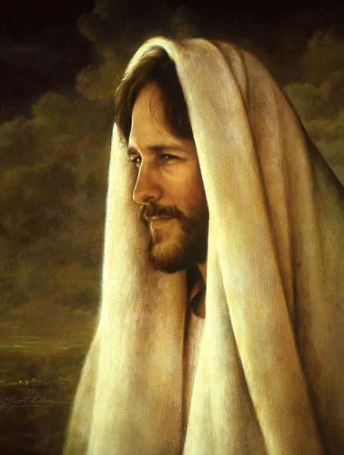
By show of hands…
How many of you have a close family member or friend who doesn’t believe what you believe?
Ever been mocked for what you believe?
Ever been bullied for your beliefs?
Ever been attacked on social media for what you believe?

Slide 18
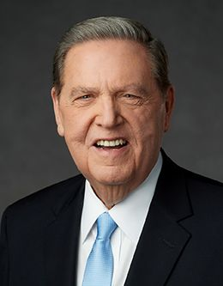
“If you haven’t already, you will one day find yourself called upon to defend your faith or perhaps even endure some personal abuse simply because you are a member of The Church. Such moments will require both courage and courtesy on your part…
Defend your beliefs with courtesy and with compassion.”
(Jeffrey R. Holland, “The Cost—and Blessings—of Discipleship,”
Ensign or Liahona, May 2014, 9).

Slide 19
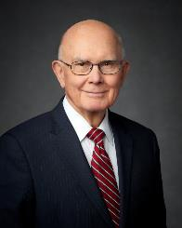
“Followers of Christ should be examples of civility. We should love all people, be good listeners, and show concern for their sincere beliefs. Though we may disagree, we should not be disagreeable. Our stands and communications on controversial topics should not be contentious. We should be wise in explaining and pursuing our positions and in exercising our influence. …
“When our positions do not prevail, we should accept unfavorable results graciously and practice civility with our adversaries”
( “Loving Others and Living with Differences,” Ensign or Liahona, Nov. 2014, 27).
3 Ne 11:29
EGO

Slide 20
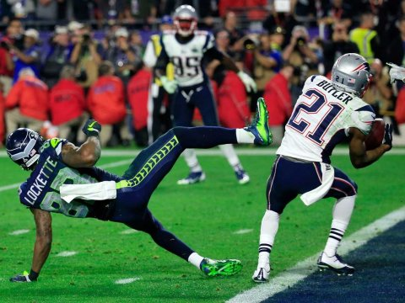
The Beatitudes
An Analogy
Where were you?

Slide 21
The Beatitudes
An Analogy
SCENE I: Popeyes in Vicksburg, Mississippi (2010). Malcolm Butler washing dishes, taking orders, frying chicken.
Kicked off the Hinds Community College football team for a misdemeanor drug charge.
He makes $7.25 per hour and lives in a mobile home.

Slide 22
The Beatitudes
An Analogy
SCENE II: Malcolm Butler walks onto the Patriots training camp to tryout for the team. During the practice, he breaks up so many passes, Patriots veterans nickname him Scrap. Even Tom Brady begins to wonder: Who's that guy running down so many of my passes?
Malcom Butler makes the roster.

Slide 23
The Beatitudes
An Analogy
SCENE III: The Patriots have a great year and make it to the SuperBowl.
“If the Seahawks line up near the goal line with two wide receivers bunched together, jump the route,” said coach Belichick randomly to Malcolm Butler during practice in the week leading up the Super Bowl.

Slide 24
The Beatitudes
An Analogy
SCENE IV: Superbowl Sunday. The Seattle Seahawks are at the 2 yard line with 26 seconds left and “Beast Mode” Marshawn Lynch in the backfield, one of the NFLs leading rushers. Seattle has an 84.4% chance of winning, according to win probability analytics. If they hand the ball off to Lynch, and the game is over.

Slide 25
The Beatitudes
SCENE V: Seattle lines up….and Butler sees the formation…and hears his coaches random comment come to his mind about what to do.

Slide 26
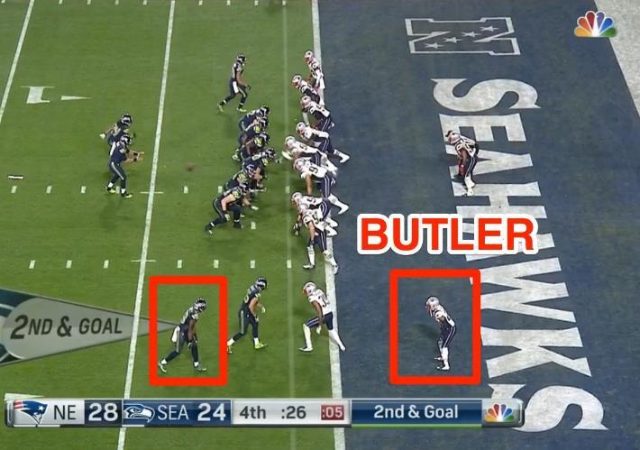
The Beatitudes

Slide 27
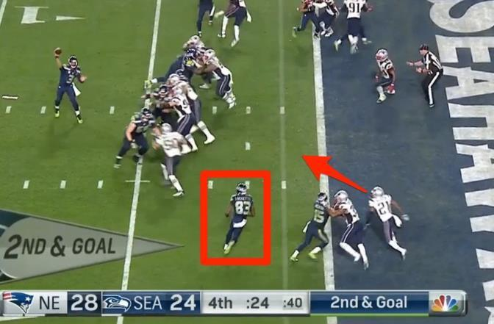
The Beatitudes

Slide 28
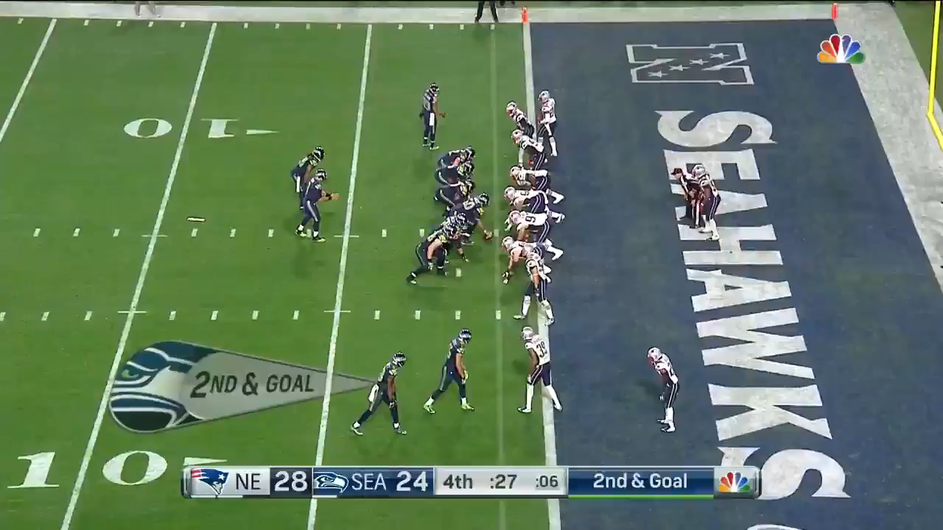
The Beatitudes
https://www.youtube.com/watch?v=U7rPIg7ZNQ8

Slide 29
The Beatitudes
What has your ‘Coach’ whispered to you today?
Which of the Beatitudes do you think you are living live best?
Which one would you like to apply more fully in your life?
The poor in spirit. Are you coming unto Christ?
Those who mourn. Are you repenting?
The meek. Are you controlled?
They who hunger and thirst for righteousness. Are you hungry for the gospel? Do you attend your church meetings ‘hungry’?
The merciful. Are you forgiving?
The pure in heart. Is your media pure?
The peacemakers. Do others consider you a peacemaker?
Persecuted for the sake of righteousness. Are you standing up for your beliefs?

Slide 30
Matthew 5

