Slide 1


Slide 2
Doctrinal Mastery Passages
New Testament
Acquiring Spiritual Knowledge
John 7:17
1 Corinthians 2:5, 9-11
2 Timothy 3:15-17
James 1:5-6
The Godhead
Hebrews 12:9
The Plan of Salvation
John 17:3
1 Corinthians 6:19-20
1 Corinthians 15:20-22
1 Corinthians 15:40-42
1 Peter 4:6
Revelation 20:12
The Atonement of Jesus Christ
Matthew 11:28-30
Luke 24:36-39
James 2:17-18
The Restoration
Acts 3:19-21
2 Thessalonians 2:1-3
Prophets and Revelation
John 15:16
Ephesians 2:19-20
Ephesians 4:11-14
Priesthood and Priesthood Keys
Matthew 16:15-19
Ordinances and Covenants
John 3:5
Marriage and Family
1 Corinthians 11:11
Commandments
Matthew 5:14-16
Matthew 22:36-39
John 14:15

Slide 3
DOCTRINAL MASTERY
New Testament Scripture References
Godhead | Hebrews 12:9
Plan of Salvation | John 17:3 | 1 Cor 6:19-20 | 1 Cor 15:20-22 | 1 Cor 15:40-42 | 1 Peter 4:6 | Rev 20:12
Atonement of Jesus Christ | Matt 11:28-30 | Luke 24:36-39 | James 2:17-18
Prophets & Revelation | John 15:16 | Eph 2:19-20 | Eph 4:11-14
Restoration | Acts 3:19-21 | 2 Thess 2:1-3
Ordinances & Covenants | John 3:5
Commandments | Matt 5:14-16 | Matt 22:36-39 | John 14:15
Marriage & Family | 1 Cor 11:11
Acquiring Spiritual Knowledge | John 7:17 | 1 Cor 2:5, 9-11 | 2 Tim 3:15-17 | James 1:5-6
Priesthood & Priesthood Keys | Matt 16:15-19

Slide 4
DOCTRINAL MASTERY
New Testament Scripture References
Godhead
Plan of Salvation
Atonement of Jesus Christ
Prophets & Revelation
Restoration
Ordinances & Covenants
Commandments
Marriage & Family
Acquiring Spiritual Knowledge
Priesthood & Priesthood Keys

Slide 5
DOCTRINAL MASTERY
New Testament Scripture References
Go
Plan
A
Pro
Rest
Or
Com
Marry
A
Priest

Slide 6
DOCTRINAL MASTERY
New Testament Scripture References
Go Plan A Pro Rest Or Com Marry A Priest

Slide 7
DOCTRINAL MASTERY
New Testament Scripture References
Go Plan A Pro Rest Or Com Marry A Priest

Slide 8
DOCTRINAL MASTERY
New Testament Scripture References
Go Plan A Pro Rest Or Com Marry A Priest

Slide 9
DOCTRINAL MASTERY
New Testament Scripture References
Go Plan A Pro Rest Or Com Marry A Priest

Slide 10
DOCTRINAL MASTERY
New Testament Scripture References
Go _____A ___ Rest Or ___ Marry A ____

Slide 11
DOCTRINAL MASTERY
New Testament Scripture References
____ Plan ___ Pro ___Or ___ Marry A ____

Slide 12
DOCTRINAL MASTERY
New Testament Scripture References
___ ____ A ____Rest ____ Com ___A ____

Slide 13
DOCTRINAL MASTERY
New Testament Scripture References
Go Plan A Pro Rest Or Com Marry A Priest

Slide 14
DOCTRINAL MASTERY
New Testament Scripture References
Go

Slide 15
DOCTRINAL MASTERY
New Testament Scripture References
Go
Plan

Slide 16
DOCTRINAL MASTERY
New Testament Scripture References
Go
Plan
A

Slide 17
DOCTRINAL MASTERY
New Testament Scripture References
Go
Plan
A
Pro

Slide 18
DOCTRINAL MASTERY
New Testament Scripture References
Go
Plan
A
Pro
Rest

Slide 19
DOCTRINAL MASTERY
New Testament Scripture References
Go
Plan
A
Pro
Rest
Or

Slide 20
DOCTRINAL MASTERY
New Testament Scripture References
Go
Plan
A
Pro
Rest
Or
Com

Slide 21
DOCTRINAL MASTERY
New Testament Scripture References
Go
Plan
A
Pro
Rest
Or
Com
Marry

Slide 22
DOCTRINAL MASTERY
New Testament Scripture References
Go
Plan
A
Pro
Rest
Or
Com
Marry
A

Slide 23
DOCTRINAL MASTERY
New Testament Scripture References
Go
Plan
A
Pro
Rest
Or
Com
Marry
A
Priest

Slide 24
DOCTRINAL MASTERY
New Testament Scripture References
Go

Slide 25
DOCTRINAL MASTERY
New Testament Scripture References
GoD

Slide 26
DOCTRINAL MASTERY
New Testament Scripture References
God
Pla

Slide 27
DOCTRINAL MASTERY
New Testament Scripture References
God
PlaN of Salvation

Slide 28
DOCTRINAL MASTERY
New Testament Scripture References
God
Plan of Salvation
A

Slide 29
DOCTRINAL MASTERY
New Testament Scripture References
God
Plan of Salvation
Atonement of Jesus Christ

Slide 30
DOCTRINAL MASTERY
New Testament Scripture References
God
Plan of Salvation
Atonement of Jesus Christ
Pro

Slide 31
DOCTRINAL MASTERY
New Testament Scripture References
God
Plan of Salvation
Atonement of Jesus Christ
Prophets & Revelation

Slide 32
DOCTRINAL MASTERY
New Testament Scripture References
God
Plan of Salvation
Atonement of Jesus Christ
Prophets & Revelation
Rest

Slide 33
DOCTRINAL MASTERY
New Testament Scripture References
God
Plan of Salvation
Atonement of Jesus Christ
Prophets & Revelation
Restoration

Slide 34
DOCTRINAL MASTERY
New Testament Scripture References
God
Plan of Salvation
Atonement of Jesus Christ
Prophets & Revelation
Restoration
Or

Slide 35
DOCTRINAL MASTERY
New Testament Scripture References
God
Plan of Salvation
Atonement of Jesus Christ
Prophets & Revelation
Restoration
Ordinances & Covenants

Slide 36
DOCTRINAL MASTERY
New Testament Scripture References
God
Plan of Salvation
Atonement of Jesus Christ
Prophets & Revelation
Restoration
Ordinances & Covenants
Com

Slide 37
DOCTRINAL MASTERY
New Testament Scripture References
God
Plan of Salvation
Atonement of Jesus Christ
Prophets & Revelation
Restoration
Ordinances & Covenants
Commandments

Slide 38
DOCTRINAL MASTERY
New Testament Scripture References
God
Plan of Salvation
Atonement of Jesus Christ
Prophets & Revelation
Restoration
Ordinances & Covenants
Commandments
Marry

Slide 39
DOCTRINAL MASTERY
New Testament Scripture References
God
Plan of Salvation
Atonement of Jesus Christ
Prophets & Revelation
Restoration
Ordinances & Covenants
Commandments
Marriage & Family

Slide 40
DOCTRINAL MASTERY
New Testament Scripture References
God
Plan of Salvation
Atonement of Jesus Christ
Prophets & Revelation
Restoration
Ordinances & Covenants
Commandments
Marriage & Family
A

Slide 41
DOCTRINAL MASTERY
New Testament Scripture References
God
Plan of Salvation
Atonement of Jesus Christ
Prophets & Revelation
Restoration
Ordinances & Covenants
Commandments
Marriage & Family
Acquire Spiritual Knowledge

Slide 42
DOCTRINAL MASTERY
New Testament Scripture References
God
Plan of Salvation
Atonement of Jesus Christ
Prophets & Revelation
Restoration
Ordinances & Covenants
Commandments
Marriage & Family
Acquiring Spiritual Knowledge
Priest

Slide 43
DOCTRINAL MASTERY
New Testament Scripture References
God
Plan of Salvation
Atonement of Jesus Christ
Prophets & Revelation
Restoration
Ordinances & Covenants
Commandments
Marriage & Family
Acquiring Spiritual Knowledge
Priesthood & Keys

Slide 44
DOCTRINAL MASTERY
New Testament Scripture References
Godhead
Plan of Salvation | John 17:3
Atonement of Jesus Christ | Matt 11:28-30 | Luke 24:36-39
Prophets & Revelation | John 15:16
Restoration
Ordinances & Covenants | John 3:5
Commandments | Matt 5:14-16 | Matt 22:36-39 | John 14:15
Marriage & Family
Acquiring Spiritual Knowledge | John 7:17
Priesthood & Priesthood Keys | Matt 16:15-19

Slide 45
DOCTRINAL MASTERY
New Testament Scripture References
Godhead
Plan of Salvation | J
Atonement of Jesus Christ | M | L
Prophets & Revelation | J
Restoration
Ordinances & Covenants | J
Commandments | M | M | J
Marriage & Family
Acquiring Spiritual Knowledge | J
Priesthood & Priesthood Keys | M

Slide 46
DOCTRINAL MASTERY
New Testament Scripture References
Godhead
Plan of Salvation | J17
Atonement of Jesus Christ | M | L
Prophets & Revelation | J
Restoration
Ordinances & Covenants | J
Commandments | M | M | J
Marriage & Family
Acquiring Spiritual Knowledge | J
Priesthood & Priesthood Keys | M

Slide 47
DOCTRINAL MASTERY
New Testament Scripture References
Godhead
Plan of Salvation | J17
Atonement of Jesus Christ | M11 | L
Prophets & Revelation | J
Restoration
Ordinances & Covenants | J
Commandments | M | M | J
Marriage & Family
Acquiring Spiritual Knowledge | J
Priesthood & Priesthood Keys | M

Slide 48
DOCTRINAL MASTERY
New Testament Scripture References
Godhead
Plan of Salvation | J17
Atonement of Jesus Christ | M11 | L24
Prophets & Revelation | J15
Restoration
Ordinances & Covenants | J
Commandments | M | M | J
Marriage & Family
Acquiring Spiritual Knowledge | J
Priesthood & Priesthood Keys | M

Slide 49
DOCTRINAL MASTERY
New Testament Scripture References
Godhead
Plan of Salvation | J17
Atonement of Jesus Christ | M11 | L24
Prophets & Revelation | J15
Restoration
Ordinances & Covenants | J3
Commandments | M | M | J
Marriage & Family
Acquiring Spiritual Knowledge | J
Priesthood & Priesthood Keys | M

Slide 50
DOCTRINAL MASTERY
New Testament Scripture References
Godhead
Plan of Salvation | J17
Atonement of Jesus Christ | M11 | L24
Prophets & Revelation | J15
Restoration
Ordinances & Covenants | J3
Commandments | M | M | J
Marriage & Family
Acquiring Spiritual Knowledge | J
Priesthood & Priesthood Keys | M

Slide 51
DOCTRINAL MASTERY
New Testament Scripture References
Godhead
Plan of Salvation | J17
Atonement of Jesus Christ | M11 | L24
Prophets & Revelation | J15
Restoration
Ordinances & Covenants | J3
Commandments | M5 | M | J
Marriage & Family
Acquiring Spiritual Knowledge | J
Priesthood & Priesthood Keys | M

Slide 52
DOCTRINAL MASTERY
New Testament Scripture References
Godhead
Plan of Salvation | J17
Atonement of Jesus Christ | M11 | L24
Prophets & Revelation | J15
Restoration
Ordinances & Covenants | J3
Commandments | M5 | M22 | J
Marriage & Family
Acquiring Spiritual Knowledge | J
Priesthood & Priesthood Keys | M

Slide 53
DOCTRINAL MASTERY
New Testament Scripture References
Godhead
Plan of Salvation | J17
Atonement of Jesus Christ | M11 | L24
Prophets & Revelation | J15
Restoration
Ordinances & Covenants | J3
Commandments | M5 | M22 | J14
Marriage & Family
Acquiring Spiritual Knowledge | J
Priesthood & Priesthood Keys | M

Slide 54
DOCTRINAL MASTERY
New Testament Scripture References
Godhead
Plan of Salvation | J17
Atonement of Jesus Christ | M11 | L24
Prophets & Revelation | J15
Restoration
Ordinances & Covenants | J3
Commandments | M5 | M22 | J14
Marriage & Family
Acquiring Spiritual Knowledge | J7
Priesthood & Priesthood Keys | M

Slide 55
DOCTRINAL MASTERY
New Testament Scripture References
Godhead
Plan of Salvation | J17
Atonement of Jesus Christ | M11 | L24
Prophets & Revelation | J15
Restoration
Ordinances & Covenants | J3
Commandments | M5 | M22 | J14
Marriage & Family
Acquiring Spiritual Knowledge | J7
Priesthood & Priesthood Keys | M16

Slide 56
DOCTRINAL MASTERY
New Testament Scripture References
Godhead
Plan of Salvation | John 17:3
Atonement of Jesus Christ | Matt 11:28-30 | Luke 24:36-39
Prophets & Revelation | John 15:16
Restoration
Ordinances & Covenants | John 3:5
Commandments | Matt 5:14-16 | Matt 22:36-39 | John 14:15
Marriage & Family
Acquiring Spiritual Knowledge | John 7:17
Priesthood & Priesthood Keys | Matt 16:15-19

Slide 57
Matthew 5:14-16
Commandments
14 Ye are the light of the world. A city that is set on an hill cannot be hid.
15 Neither do men light a candle, and put it under a bushel, but on a candlestick; and it giveth light unto all that are in the house.
16 Let your light so shine before men, that they may see your good works, and glorify your Father which is in heaven.

Slide 58
DOCTRINAL MASTERY
New Testament Scripture References
Godhead
Plan of Salvation
Atonement of Jesus Christ
Prophets & Revelation
Restoration
Ordinances & Covenants
Commandments | Matt 5:14-16
Marriage & Family
Acquiring Spiritual Knowledge
Priesthood & Priesthood Keys

Slide 59

Let Your Light So Shine
As An Example To Others
I Mat hold my Light to the World with all 5 fingers. I am also an Example by not going to dances till 14 and not dating till 16.
Dancing at 14
Dating at 16
5 fingers

Slide 60
Matthew 11:28-30
The Atonement of Jesus Christ
28 Come unto me, all ye that labour and are heavy laden, and I will give you rest.
29 Take my yoke upon you, and learn of me; for I am meek and lowly in heart: and ye shall find rest unto your souls.
30 For my yoke is easy, and my burden is light.

Slide 61
DOCTRINAL MASTERY
New Testament Scripture References
Godhead
Plan of Salvation
Atonement of Jesus Christ | Matt 11:28-30
Prophets & Revelation
Restoration
Ordinances & Covenants
Commandments
Marriage & Family
Acquiring Spiritual Knowledge
Priesthood & Priesthood Keys

Slide 62


If We Come Unto Jesus,
He Will Ease Our Burdens And Give Us Rest
Mat knows that Football and Soccer teams help Ease each other’s Burdens and give Rest by having 11 players on the field at a time, even if they have 28-30 on their teams.

Slide 63
Matthew 16:15-19
Priesthood & Priesthood Keys
15 He saith unto them, But whom say ye that I am?
16 And Simon Peter answered and said, Thou art the Christ, the Son of the living God.
17 And Jesus answered and said unto him, Blessed art thou, Simon Bar-jona: for flesh and blood hath not revealed it unto thee, but my Father which is in heaven.
18 And I say also unto thee, That thou art Peter, and upon this rock I will build my church; and the gates of hell shall not prevail against it.
19 And I will give unto thee the keys of the kingdom of heaven: and whatsoever thou shalt bind on earth shall be bound in heaven: and whatsoever thou shalt loose on earth shall be loosed in heaven.

Slide 64
DOCTRINAL MASTERY
New Testament Scripture References
Godhead
Plan of Salvation
Atonement of Jesus Christ
Prophets & Revelation
Restoration
Ordinances & Covenants
Commandments
Marriage & Family
Acquiring Spiritual Knowledge
Priesthood & Priesthood Keys | Matt 16:15-19

Slide 65

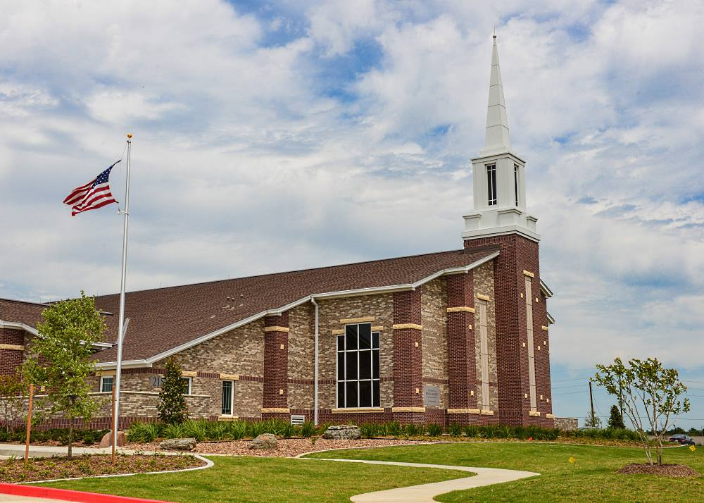
Jesus Christ Promised To Build His Church
And Confer The Keys Of The Kingdom
The door Mat of every Church knows you need to be 16 to get the Keys to drive to Church. You also need to be preparing to Build his Church by preparing for a mission during the Seminary years (ages 15-19).

Slide 66
Matthew 22:36-39
Commandments
36 Master, which is the great commandment in the law?
37 Jesus said unto him, Thou shalt love the Lord thy God with all thy heart, and with all thy soul, and with all thy mind.
38 This is the first and great commandment.
39 And the second is like unto it, Thou shalt love thy neighbour as thyself.

Slide 67
DOCTRINAL MASTERY
New Testament Scripture References
Godhead
Plan of Salvation
Atonement of Jesus Christ
Prophets & Revelation
Restoration
Ordinances & Covenants
Commandments |  | Matt 22:36-39
Marriage & Family
Acquiring Spiritual Knowledge
Priesthood & Priesthood Keys

Slide 68



Love The Lord; Love Thy Neighbor
Mat knows that if you Love the Lord, you are not going to use a .22 on your Neighbor. Mat loves it when his hobbit neighbors stand on him because, they are only yard to a meter tall (36-39 inches), so they weigh less.

Slide 69
Luke 24:36-39
The Atonement of Jesus Christ
36 And as they thus spake, Jesus himself stood in the midst of them, and saith unto them, Peace be unto you.
37 But they were terrified and affrighted, and supposed that they had seen a spirit.
38 And he said unto them, Why are ye troubled? and why do thoughts arise in your hearts?
39 Behold my hands and my feet, that it is I myself: handle me, and see; for a spirit hath not flesh and bones, as ye see me have.

Slide 70
DOCTRINAL MASTERY
New Testament Scripture References
Godhead
Plan of Salvation
Atonement of Jesus Christ | Matt 11:28-30 | Luke 24:36-39
Prophets & Revelation
Restoration
Ordinances & Covenants
Commandments
Marriage & Family
Acquiring Spiritual Knowledge
Priesthood & Priesthood Keys

Slide 71
Jesus Christ Was Resurrected
With A Body Of Flesh And Bone.
I, Luke, the pediatric doctor, stay on call 24 hours a day. I’ve never operated on a Spirit, but most bodies I treat are between a yard and a meter long (36-39 inches).
Dr. Luke’s
Pediatrics
On Call
24 Hours

Slide 72
John 3:5
Ordinances & Covenants
5 Jesus answered, Verily, verily, I say unto thee, Except a man be born of water and of the Spirit, he cannot enter into the kingdom of God.

Slide 73
DOCTRINAL MASTERY
New Testament Scripture References
Godhead
Plan of Salvation
Atonement of Jesus Christ
Prophets & Revelation
Restoration
Ordinances & Covenants | John 3:5
Commandments
Marriage & Family
Acquiring Spiritual Knowledge
Priesthood & Priesthood Keys

Slide 74
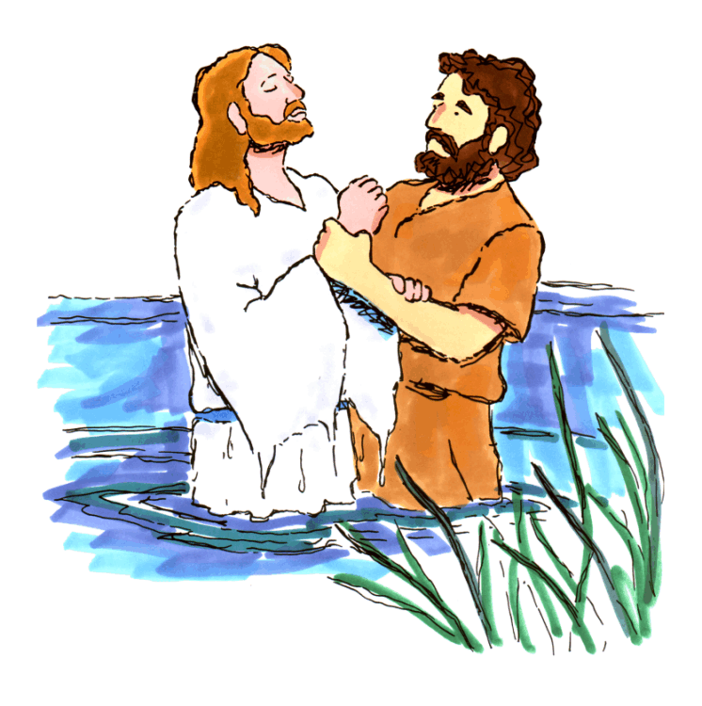
We Must Be Born Of Water And Of The Spirit
To Enter The Kingdom Of God
John the Baptist witnessed all 3 members of the Godhead at Jesus’ Baptism when he held his arm to the square with his 5 fingers pointing heavenward.
5 Fingers
This Is My
Beloved Son

Slide 75
John 7:17
Acquiring Spiritual Knowledge
17 If any man will do his will, he shall know of the doctrine, whether it be of God, or whether I speak of myself.

Slide 76
DOCTRINAL MASTERY
New Testament Scripture References
Godhead
Plan of Salvation
Atonement of Jesus Christ
Prophets & Revelation
Restoration
Ordinances & Covenants
Commandments
Marriage & Family
Acquiring Spiritual Knowledge | John 7:17
Priesthood & Priesthood Keys

Slide 77


Do God’s Will To Know Of The Doctrine
LI:L John, learned that if you want to Know if a Doctrine is true, you have to start to Do His Will before baptism (age 7) and before your mission (age 17).
“LIL John”
LIL upside down looks like 7:17

Slide 78
John 14:15
Commandments
15 If ye love me, keep my commandments.

Slide 79
DOCTRINAL MASTERY
New Testament Scripture References
Godhead
Plan of Salvation
Atonement of Jesus Christ
Prophets & Revelation
Restoration
Ordinances & Covenants
Commandments |  |  | John 14:15
Marriage & Family
Acquiring Spiritual Knowledge
Priesthood & Priesthood Keys

Slide 80
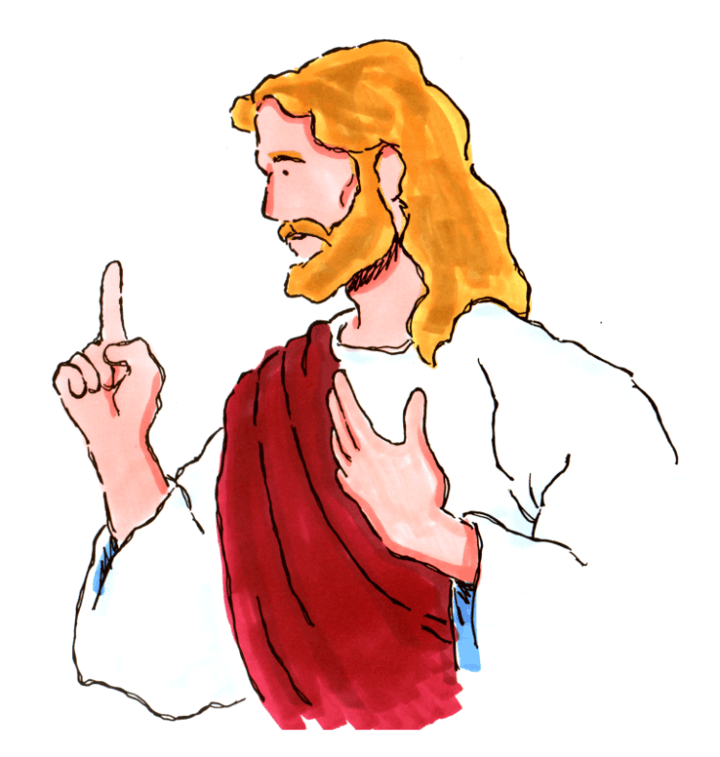

If Ye Love Me, Keep My Commandments
I John, know that a person first starts to think about Love when they become a Miamaid or Teacher (14:15 years old). We show our Love for the Lord by keeping His Commandments
Dances at age 14
------------------------------------------------------------------------------------------------------------------------------------------------------
Command-ments
------------------------------------------------------------------------------------------------------------------------

Slide 81
John 15:16
Prophets & Revelation
16 Ye have not chosen me, but I have chosen you, and ordained you, that ye should go and bring forth fruit, and that your fruit should remain: that whatsoever ye shall ask of the Father in my name, he may give it you.

Slide 82
DOCTRINAL MASTERY
New Testament Scripture References
Godhead
Plan of Salvation
Atonement of Jesus Christ
Prophets & Revelation | John 15:16
Restoration
Ordinances & Covenants
Commandments
Marriage & Family
Acquiring Spiritual Knowledge
Priesthood & Priesthood Keys

Slide 83
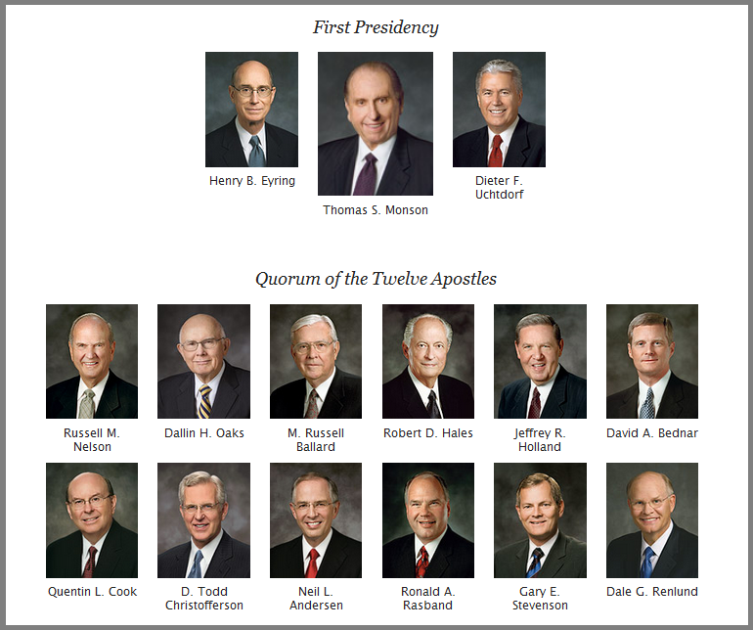
The Lord Chooses And Ordains
Apostles And Prophets
John knows that the Lord chooses 15 men to be ordained and serves as Apostles and Prophets. 16 would be too many.

Slide 84
John 17:3
The Plan of Salvation
3 And this is life eternal, that they might know thee the only true God, and Jesus Christ, whom thou hast sent.

Slide 85
DOCTRINAL MASTERY
New Testament Scripture References
Godhead
Plan of Salvation | John 17:3
Atonement of Jesus Christ
Prophets & Revelation
Restoration
Ordinances & Covenants
Commandments
Marriage & Family
Acquiring Spiritual Knowledge
Priesthood & Priesthood Keys

Slide 86
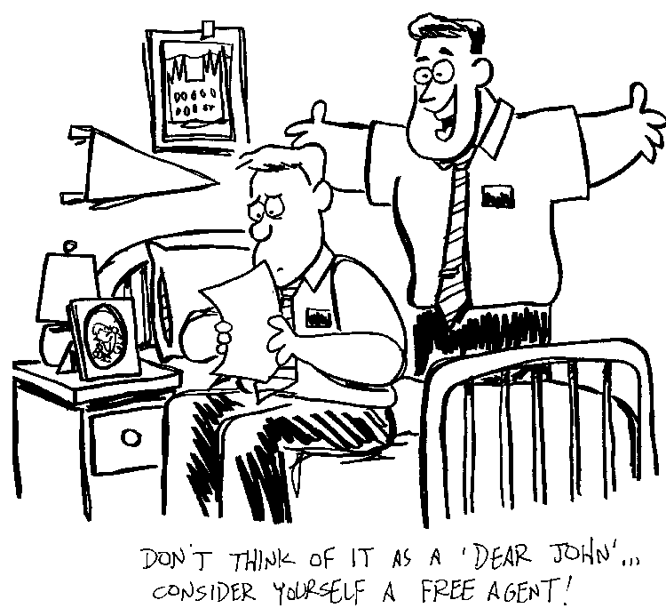
Eternal Life Is Knowing God, And Jesus Christ
She wrote, “Dear John, I am not going to write you anymore. I have found a guy who takes me to R-rated movies (age 17).”
You know Elder- she doesn’t Know God. She is not in tune with the 3rd member of the Godhead.

Slide 87
Acts 3:19-20
The Restoration
19 Repent ye therefore, and be converted, that your sins may be blotted out, when the times of refreshing shall come from the presence of the Lord;
20 And he shall send Jesus Christ, which before was preached unto you:

Slide 88
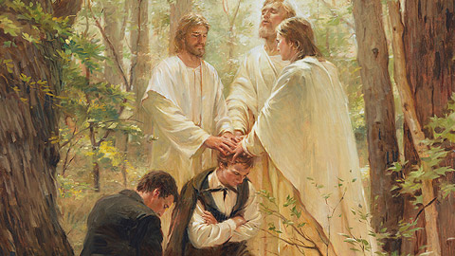
Peter Prophesied Of The Restoration
Peter helped bring one of the Acts of the Restoration by being one of the 3 angels that appeared to Joseph Smith when in a grove full of 19-20 trees

Slide 89
1 Corinthians 2:5, 9-11
Acquiring Spiritual Knowledge
5 That your faith should not stand in the wisdom of men, but in the power of God.
9 But as it is written, Eye hath not seen, nor ear heard, neither have entered into the heart of man, the things which God hath prepared for them that love him.
10 But God hath revealed them unto us by his Spirit: for the Spirit searcheth all things, yea, the deep things of God.
11 For what man knoweth the things of a man, save the spirit of man which is in him? even so the things of God knoweth no man, but the Spirit of God.

Slide 90

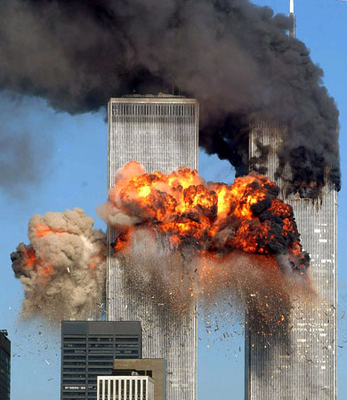

We Can Only Know The Things Of God
Through The Spirit
Cori & Diane knows there are 2 types of things: Worldly Things & Spiritual Things.
Our 5 senses can perceive worldly things like the 9-11 Bombings. But the spiritual meaning of these things comes through The Spirit.

Slide 91
1 Corinthians 6:19-20
The Plan of Salvation
19 What? know ye not that your body is the temple of the Holy Ghost which is in you, which ye have of God, and ye are not your own?
20 For ye are bought with a price: therefore glorify God in your body, and in your spirit, which are God’s.

Slide 92

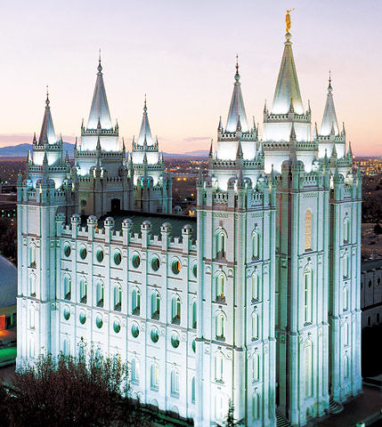
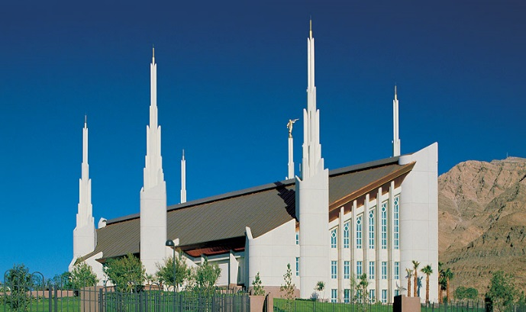
Your Body Is A Temple
Cori knows that many Temples have 6 spires. She wants to keep her body clean so she can go to the temple and be serving a mission at ages 19-20.

Slide 93
1 Corinthians 11:11
Marriage & Family
11 Nevertheless neither is the man without the woman, neither the woman without the man, in the Lord.

Slide 94
Only Together Can A Man And A Woman
Fulfill The Lord’s Plan
Cori & Diane knows that Husbands and Wives have to be a team Together. Football teams have 11 on the field at a time. Soccer teams also have 11 on the field.

Slide 95
1 Corinthians 15:20-22
The Plan of Salvation
20 But now is Christ risen from the dead, and become the firstfruits of them that slept.
21 For since by man came death, by man came also the resurrection of the dead.
22 For as in Adam all die, even so in Christ shall all be made alive.

Slide 96
In Christ Shall All Be Resurrected
We have run over our 1st Corpse in Driver’s Ed (15). I didn’t see him and I have 20/20 vision.
I have 20/20 too (20-22). But we know he will be Resurrected.
Cori
Diana
Driver’s Ed - Age 15
1COR15

Slide 97
1 Corinthians 15:40-42
The Plan of Salvation
40 There are also celestial bodies, and bodies terrestrial: but the glory of the celestial is one, and the glory of the terrestrial is another.
41 There is one glory of the sun, and another glory of the moon, and another glory of the stars: for one star differeth from another star in glory.
42 So also is the resurrection of the dead. It is sown in corruption; it is raised in incorruption:

Slide 98
The Are Three Degrees Of Glory
In The Resurrection
The Degrees of Glory
Presented in
4 D
Cori & Diane (Corinthians) rode in the Driver’s Ed car (15) to a movie. To see a movie about the Degrees of Glory, you need special 4-D (40) glasses. Cori needs 4-D too (42).
Driver’s Ed - Age 15
1COR15

Slide 99
Ephesians 2:19-20
Prophets & Revelation
19 Now therefore ye are no more strangers and foreigners, but fellowcitizens with the saints, and of the household of God;
20 And are built upon the foundation of the apostles and prophets, Jesus Christ himself being the chief corner stone;

Slide 100
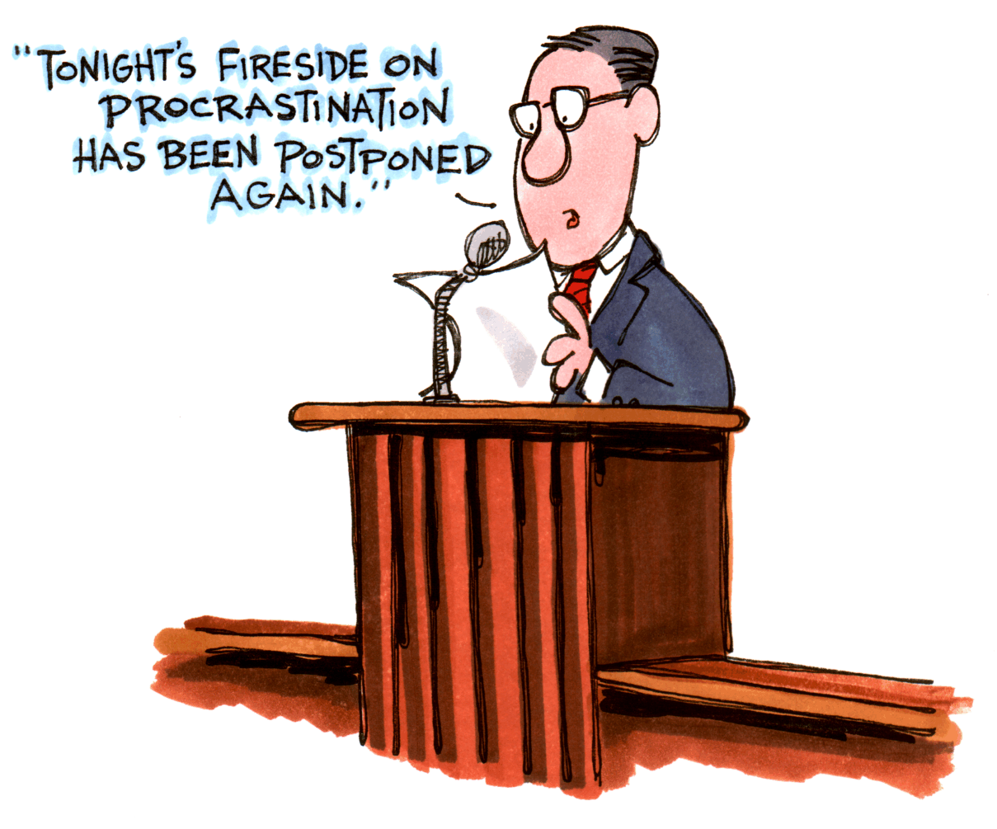

The Lord’s Church Is Founded
On Apostles And Prophets
We can watch General Conference on Tel-Ephesians where we learn that the foundation of the Church is on 2 things: Apostles & Prophets. Young ladies can share this truth as missionaries when they are 19-20.
Tel- Ephesians

Slide 101
Ephesians 4:11-14
Prophets & Revelation
11 And he gave some, apostles; and some, prophets; and some, evangelists; and some, pastors and teachers;
12 For the perfecting of the saints, for the work of the ministry, for the edifying of the body of Christ:
13 Till we all come in the unity of the faith, and of the knowledge of the Son of God, unto a perfect man, unto the measure of the stature of the fulness of Christ:
14 That we henceforth be no more children, tossed to and fro, and carried about with every wind of doctrine, by the sleight of men, and cunning craftiness, whereby they lie in wait to deceive;

Slide 102
Apostles And Prophets Help Perfect The Saints
To help Perfect the Saints, we have General Conference on TelEphesian, channel 4. The Apostles & Prophets, and about 11-14 other speakers, all help Perfect the Saints.
Tel Ephesians
4

Slide 103
2 Thessalonians 2:1-3
The Restoration
1 Now we beseech you, brethren, by the coming of our Lord Jesus Christ, and by our gathering together unto him,
2 That ye be not soon shaken in mind, or be troubled, neither by spirit, nor by word, nor by letter as from us, as that the day of Christ is at hand.
3 Let no man deceive you by any means: for that day shall not come, except there come a falling away first, and that man of sin be revealed, the son of perdition;

Slide 104
Apostasy Was Foretold
This is our 2nd-kiss-alone-again (2 Thessalonians).
Not now. I’m worried the 2nd coming will happen any moment.
Paul said before that will happen, there will be an Apostasy in the 1st - 3rd century A.D.

Slide 105
2 Timothy 3:15-17
Acquiring Spiritual Knowledge
15 And that from a child thou hast known the holy scriptures, which are able to make thee wise unto salvation through faith which is in Christ Jesus.
16 All scripture is given by inspiration of God, and is profitable for doctrine, for reproof, for correction, for instruction in righteousness:
17 That the man of God may be perfect, throughly furnished unto all good works.

Slide 106
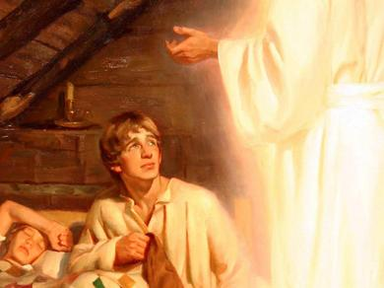
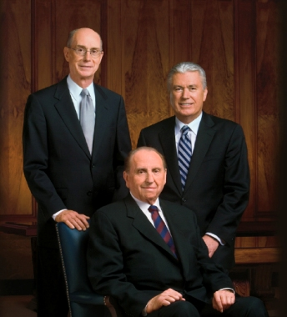
Scriptures Can Make You Wise Unto Salvation
2 TIMe magazines report that Mormons believe the 3 members of the First Presidency receive Inspiration. They also believe in the 15 books of the Book of Mormon which Joseph learned about when he was 17.
TIME
TIME

Slide 107
Hebrews 12:9
The Godhead
9 Furthermore we have had fathers of our flesh which corrected us, and we gave them reverence: shall we not much rather be in subjection unto the Father of spirits, and live?

Slide 108
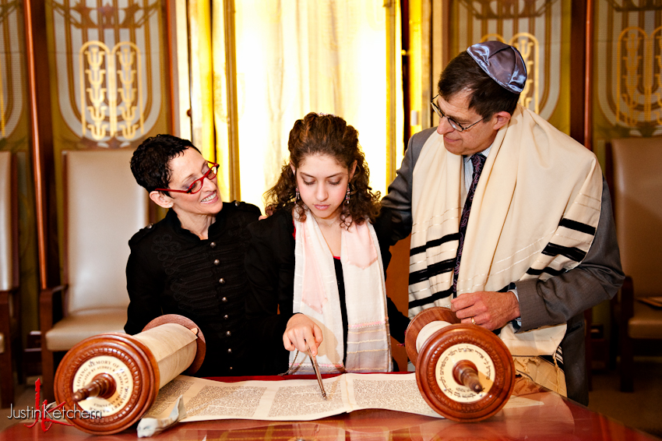
God Is The Father Of Our Spirits
All Hebrews by age 12 know that God is the Father of all 9 billion of our Spirits.

Slide 109
James 1:5-6
Acquiring Spiritual Knowledge
5 If any of you lack wisdom, let him ask of God, that giveth to all men liberally, and upbraideth not; and it shall be given him.
6 But let him ask in faith, nothing wavering. For he that wavereth is like a wave of the sea driven with the wind and tossed.

Slide 110
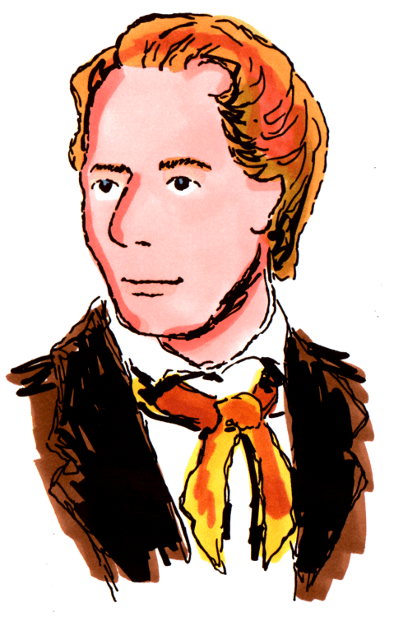
If You Lack Wisdom, Ask God
As I read the Book of James for Wisdom I asked myself, “Of all the churches, which 1 should I join?” My answer was to Ask God. That is simple enough for a kindergarten child to understand (age 5-6)
Age 5-6

Slide 111
James 2:17-18
The Atonement of Jesus Christ
17 Even so faith, if it hath not works, is dead, being alone.
18 Yea, a man may say, Thou hast faith, and I have works: shew me thy faith without thy works, and I will shew thee my faith by my works.

Slide 112



Faith Without Works Is Dead
Here lies
James Bond.
He did not bond the
2 principles of Faith & Works together.
This will be featured in an upcoming
R-rated movie
(ages 17-18).

Slide 113
1 Peter 4:6
The Plan of Salvation
6 For for this cause was the gospel preached also to them that are dead, that they might be judged according to men in the flesh, but live according to God in the spirit.

Slide 114

The Gospel Is Preached To The Dead
The 1st thing Peter did when he died, was go to door 4 in the Spirit World, to Preach to 6 Dead people.
6

Slide 115
Revelation 20:12
The Plan of Salvation
12 And I saw the dead, small and great, stand before God; and the books were opened: and another book was opened, which is the book of life: and the dead were judged out of those things which were written in the books, according to their works.

Slide 116
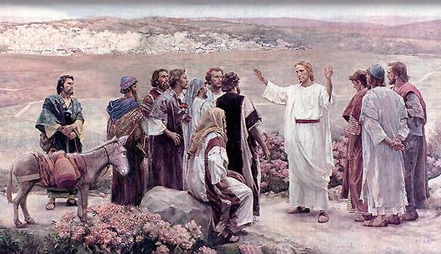

Each Person Will Stand Before God
To Be Judged
The Lord gave a Revelation saying how the dead (eyes look like Latin 20) will be Judged by God and also the Apostles (12).
See D&C 29:12
X X
RIP

Slide 117


Slide 118
Marking
Mark and read the Doctrinal Mastery scriptures. For the first 25 days, the devotional scripture could be a NT Doctrinal Mastery scripture, where everyone follows along, and marks with a unique color.
Spending a little time each month getting to know the books of the New Testament will help them retain, and locate passages in the future. A song is helpful …
https://www.youtube.com/watch?v=2v6c6naFmJg
https://www.youtube.com/watch?v=EFTaYMxxBqE
https://www.lds.org/music/library/childrens-songbook/the-books-in-the-new-testament?lang=eng

Slide 119
Flash Cards
Create their own set of doctrinal mastery flash-cards, and give them time to review five minutes per week (part of the 30 minutes). Creating their own will give them needed repetition for retention, and prepare them for several questions on the doctrinal test. One side has the reference (Matthew 5:14-16), and the other side has the truth (Let your light so shine as an example to others). Or, it could have a phrase straight from the Doctrinal Mastery Core Document.

Slide 120
  SOME 5-10 MINUTE RETENTION ACTIVITY IDEAS
  Divide students in two parts, or by rows. Give a scenario, or a truth, and hand a soft dice to the person who holds up the correct flashcard, or gives the correct answer. First team to 21 points wins.
  Flashcard test a neighbor. Whoever gets the most out of ___ gets a tootsie roll.
  Be in a group of four, and have one be the flashcard reader, and the other three try to say the other side. Whoever guesses the other side gets to keep the card. The one with the most cards after the full review, gets a piece of candy, and gets to be the next reader.
  Spread the flashcards out on their desk, while the teacher gives out scenarios. For each scenario, students should lift up an appropriate card that would help in the particular scenario or case study. Teacher can throw in an occasional random doctrine, Book of the NT, name that hymn, or even questions about teachers in the building. Keep track of correct answers. Try to get at least five points by the end of 10 minutes.
  Hold up the correct flashcard by the time the teacher (or the one calling the clues) slaps their hand on the desk (usually 3-8 seconds). If you do, you get one point. This encourages students to help one another.
  Have a ball. Throw the ball to the student that gets the first answer correct. Then, that student can look for another clue, and throw the ball to the next correct answer. See how quickly ten doctrinal mastery scriptures can be reviewed (so as not to put pressure on the last few standing).
  Many more on page 575-576 of the New Testament Seminary Teacher Manual (2016).

Slide 121
DOCTRINAL MASTERY
New Testament Scripture References
Godhead | Hebrews 12:9
Plan of Salvation | John 17:3 | 1 Cor 6:19-20 | 1 Cor 15:20-22 | 1 Cor 15:40-42 | 1 Peter 4:6 | Rev 20:12
Atonement of Jesus Christ | Matt 11:28-30 | Luke 24:36-39 | James 2:17-18
Prophets & Revelation | John 15:16 | Eph 2:19-20 | Eph 4:11-14
Restoration | Acts 3:19-21 | 2 Thess 2:1-3
Ordinances & Covenants | John 3:5
Commandments | Matt 5:14-16 | Matt 22:36-39 | John 14:15
Marriage & Family | 1 Cor 11:11
Acquiring Spiritual Knowledge | John 7:17 | 1 Cor 2:5, 9-11 | 2 Tim 3:15-17 | James 1:5-6
Priesthood & Priesthood Keys | Matt 16:15-19

