Slide 1
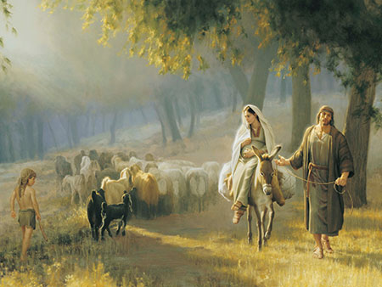
New Testament
Christmas

Slide 2
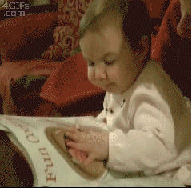
Famous Firsts
First time finding a cookie picture in a cooking magazine

Slide 3
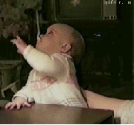
Famous Firsts
First time forgetting how a spoon works

Slide 4
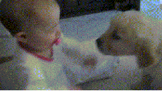
Famous Firsts
First time meeting a puppy

Slide 5
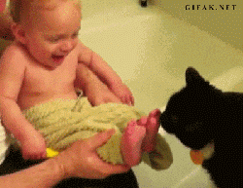
Famous Firsts
First time a cat licked your feet

Slide 6
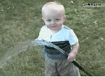
Famous Firsts
First time ‘drinking’ from a hose

Slide 7
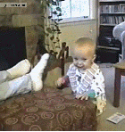
Famous Firsts
First time smelling a foot

Slide 8

Famous Firsts
First time watching TV

Slide 9
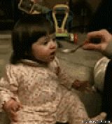
Famous Firsts
First time tasting ‘sour’

Slide 10
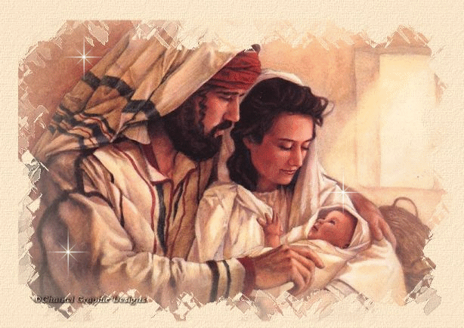
Question of the day:
First time you realized that Jesus was the Christ?

Slide 11
Scripture Study Tips
Relevancy in personal study
Today’s Tip:
Study names

Slide 12
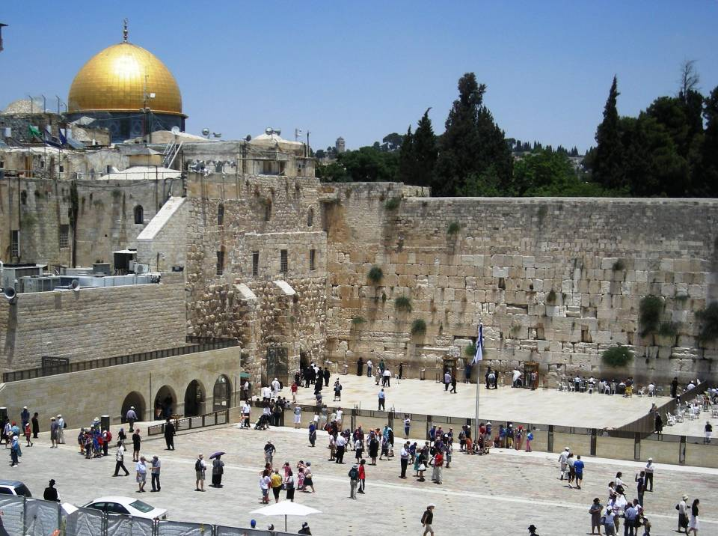
Matthew 1
Skim Matthew 1:1-17. Which names are familiar?
The Genealogy of Jesus

Slide 13
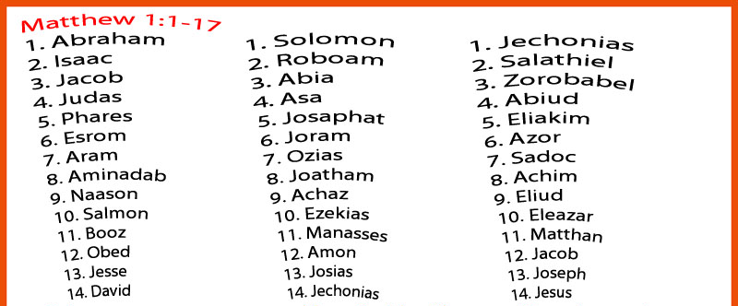

Which ancestors have some ‘history’ behind them?
What does Jesus’ lineage say to you about your lineage?
Notes:
13

Slide 14
Genealogy Application:
What does it mean to me?
“God actively intervenes in some destructive lineages, assigning a valiant spirit to break the chain of destructiveness in such families. Although these children may suffer innocently, they find the strength to “metabolize” the poison within themselves, refusing to pass it on to future generations. Before them were generations of destructive pain; but after them the line flows clear and pure. Their children and children’s children will call them blessed.” (Calfred Broderick, Ensign, Aug. 1996)
God can use anyone to fulfill His purpose!
God Wants To Use You In His Kingdom.

Slide 15
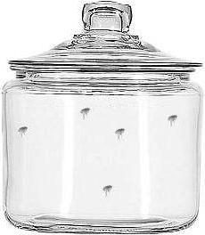
Fleas in a Jar:
An Analogy

Slide 16

Fleas in a Jar:
An Analogy

Slide 17
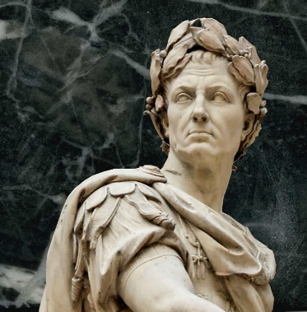
Julius Caesar
44BC
Who killed Julius Caesar? (hint: ‘Et tu’)
Octavius (Nephew) becomes first Emperor of the Roman Empire
Changes his name to ‘Caesar Augustus’
  ‘Augustus’ means ‘ ‘more than human’.
Herod (current Governor of Galilee) has 3 Options:
    Take his life, run, hope Caesar Augustus ignores him
Herod sails to Rhodes; pledges loyalty
Caesar Augustus makes Herod “King” of Judea.
  Uses pigs to clean up after battle to humiliate the Jews

Slide 18
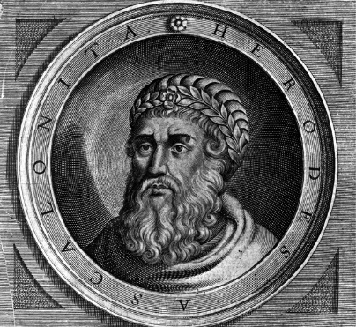
King Herod “The Great”
Wants a legacy
Builds roads and aqueducts
10 wives; executed multiple sons
Age 70, suffering with painful kidney disease
Imprisoned Rabbis and wealthy men and ordered their execution to take place...
…on the day he died (so somebody would mourn at his passing)
Worst news ever…
  Wise Men (Magi)
      5 miles away….
The New King is learning to walk
  He’s been outsmarted by…
Matthew 2:1-16

Slide 19
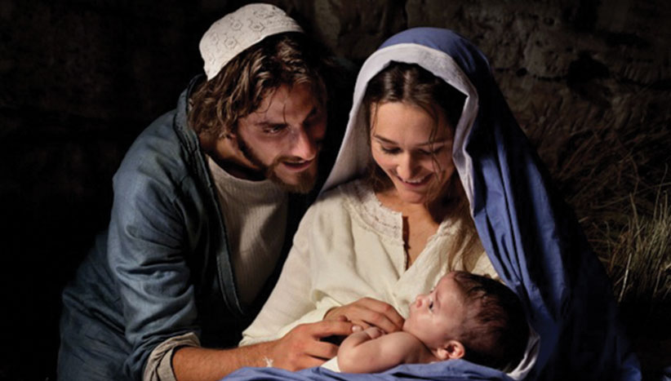
What traits did Jesus inherit from His Father?
What traits did He inherit from His mother?

Slide 20
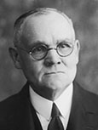
“He was begotten of Elohim the Eternal Father. … In His nature would be combined the powers of Godhood with the capacity of mortality. … The Child Jesus was to inherit the physical and mental traits and tendencies-- and powers - that characterized His parents—one immortal and glorified—God, the other human—woman” (Jesus the Christ, 3rd ed. [1916], 81).

Slide 21
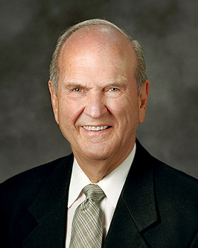
Why Bethlehem?
In His divine role, He could have selected any portion of this bounteous planet to accomplish His mission. He could have selected the beautiful islands of the sea or the scenery of Switzerland or Scandinavia, or He could have preferred to walk upon the acres of Africa or Australia.
Instead, He selected the land with places stark and arid. He did so to teach with geographical visual aids, and to fulfill scripture. Russell M. Nelson, “Why This Holy Land?,” Ensign, Dec 1989, 13

Slide 22
Why among animals?
The “Lamb of God” was born during the season of Passover amongst the animals, as were other lambs being prepared for Paschal sacrifice.
At the birth of Him who is called the “good shepherd” (John 10:14), shepherds were the first to receive the announcement of His holy birth (see Luke 2:8–16).
Shining brightly over Bethlehem, the star had been placed in orbit far in advance of the foretold event in order that its light could coincide in time and place with His blessed birth. Russell M. Nelson, “Why This Holy Land?,” Ensign, Dec 1989, 13

Slide 23
Why raised in Nazareth?
The word Nazareth is derived from the Hebrew word neser, which means “branch.” Jeremiah prophesied that the Lord would “cause the Branch of righteousness to grow up unto David” (Jer. 33:15). Isn’t it interesting that the little town of Nazareth, which name signifies “branch,” was shown to Nephi in vision after his inquiry about the tree of life” Russell M. Nelson, “Why This Holy Land?,” Ensign, Dec 1989, 13

Slide 24
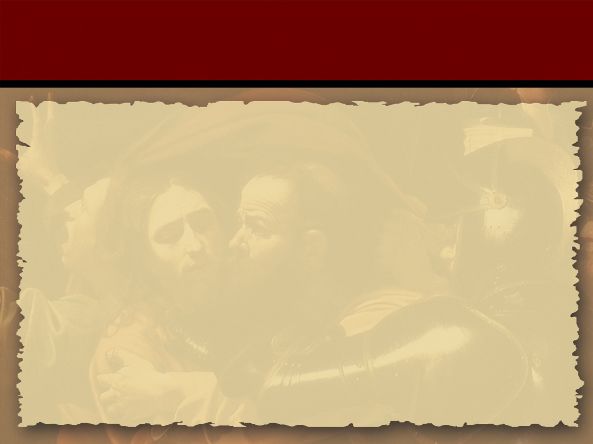
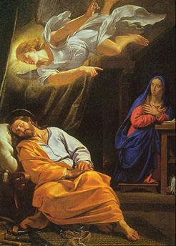
Jesus’ Birth
Have you known someone that had a child out of wedlock?
Matthew 1:18-21, 25.
Have you had an experience that has helped you gain a testimony of the reality of angels?

Slide 25
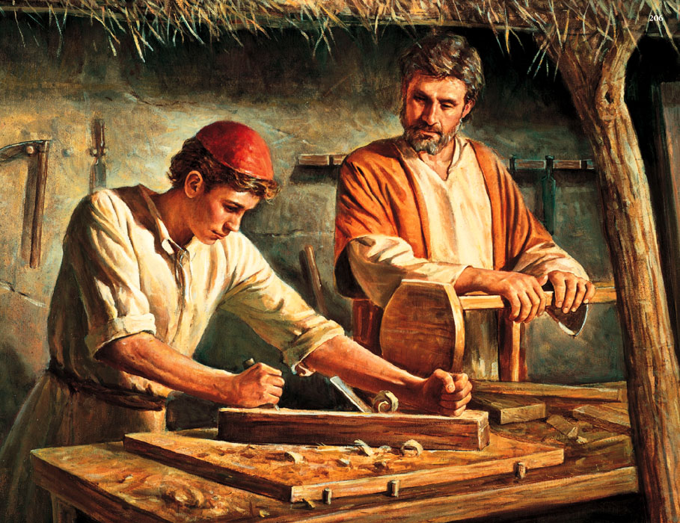
Gratitude
God Interrupts
Action,
growth
Fear
Joseph’s Reaction
“Then Joseph being raised from sleep did as the angel of the Lord had bidden him, and took unto him his wife…”
Inaction,
Lack of growth

Slide 26
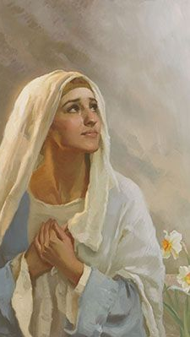
God Interrupts
What challenges did the newlyweds have…
  Financially? Socially? With their family?
  What might Joseph have said each night on the 90 mile journey?
    “God, are you going to come through for Mary and me? Will there be provision? I wasn’t ready for this…But I’m committed - I just wish I could see the end of the story. I really could use some help right now.”
  What might Mary have said each night?
    “Lord, I trust you. I am hoping for strength. I hope we can make it, I’m hoping our marriage can make it. We don’t have money - we don’t come from rich homes - we need help to pay the bills and to raise this child...”
God sent the star and the wise men (with gold), well in advance of this night even as this challenged couple was panic-knocking on the inns of Bethlehem. Application: The Lord has blessings planned even before the crisis occurs.

Slide 27
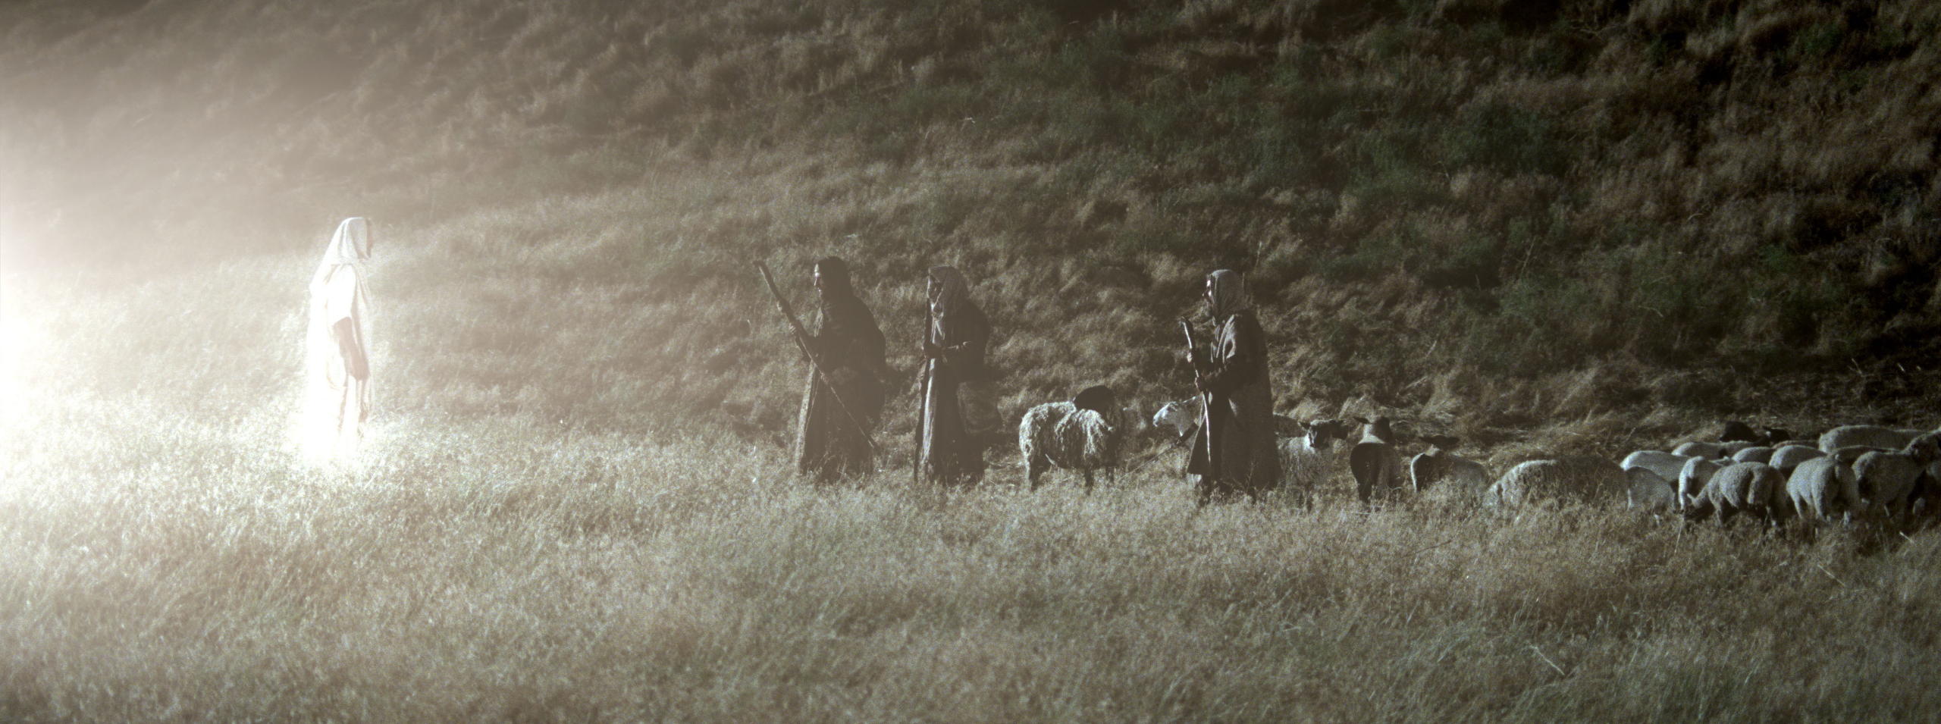
Luke 2:6-14

Slide 28
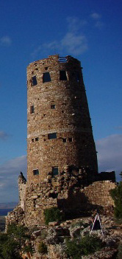
There was a flock near Bethlehem, on the road to Jerusalem, a tower known as Migdal Eder, or the watchtower of the flock. Here was the station where shepherds watched the flocks destined for sacrifice in the temple. . . .
It was a settled conviction among the Jews that the Messiah was to be born in Bethlehem, and equally that he was to be revealed from Migdal Eder.
The flock mentioned in the scripture, then, apparently was the one used for temple sacrifices, and the shepherds thus had responsibility for the most important flock in the region.
(Gerald N. Lund, Selected Writings of Gerald N. Lund: Gospel Scholars Series , p.144)

Slide 29
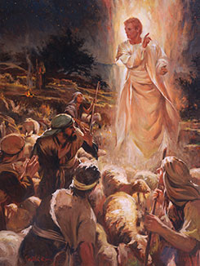
Christmas Trivia
Joseph and Mary were both from Bethlehem.
The innkeeper is a bad man for not letting Joseph and Mary have a room.
Jesus was born on December 25, 0 AD
Joseph and Mary traveled 90 miles to pay taxes
Mary remained a virgin after the birth of Christ.
The Shepherds followed a new star to find the Christ child.
There were three wise men that made the long journey from the East.
A new star guided the Wise Men on their journey.
The Wise Men visited the newborn baby king
Mary, Joseph and Jesus’ first family vacation was to Egypt.
In Canada, Santa’s postal code is HOH OHO

Slide 30
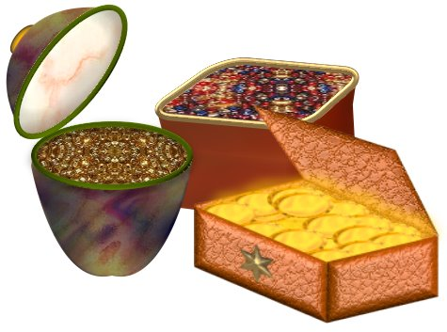
The Gifts of the Magi
What’s the symbolism?

Slide 31
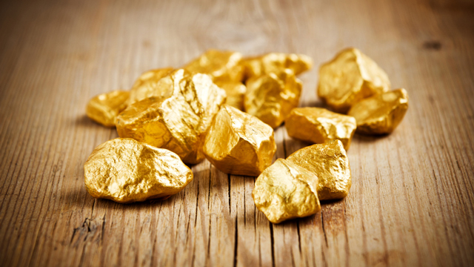
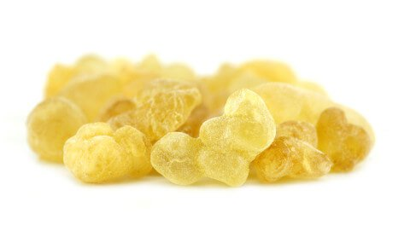
The Gifts of the Magi
Frankincense
  The incense of deity, sprinkled on sacrificial offerings
Gold
  The universal symbol of wealth & royalty

Slide 32
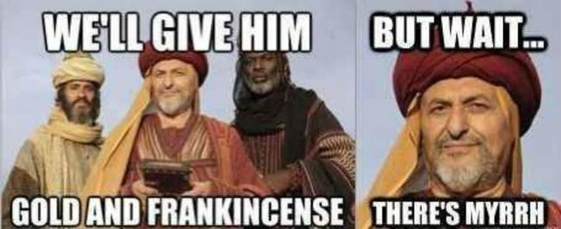

Slide 34
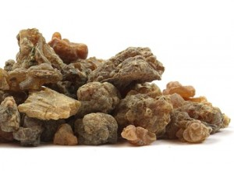
The Gifts of the Magi
Frankincense
  The incense of deity, sprinkled on sacrificial offerings
Myrrh
Used as an anesthetic and in preparation of bodies for burial
Gold
  The universal symbol of wealth & royalty

Slide 35
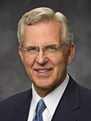
“Is there something in you or in your life that is impure or unworthy? When you get rid of it, that is a gift to the Savior. Is there a good habit or quality that is lacking in your life? When you adopt it and make it part of your character, you are giving a gift to the Lord. Sometimes this is hard to do, but would your gifts of repentance and obedience be worthy gifts if they cost you nothing?” (Elder Christofferson, “When Thou Art Converted,” Ensign or Liahona, May 2004, 12).

Slide 36
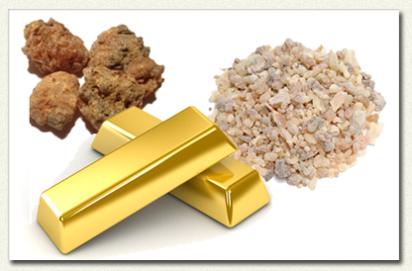
Our Giving
  Gold – 1st and foremost: Glorify God
  Frankincense - The sweet smell of sacrifice!
  Myrrh - Death of self

Slide 37
Matthew 2
Massacre at Bethlehem 2:16-18
Flight to Egypt 2:19-22
Return into Nazareth 2:23

Slide 38
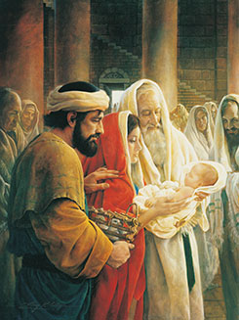
Anna and Simeon
Luke 2:25-38
What principles of application are in this account?

Slide 39
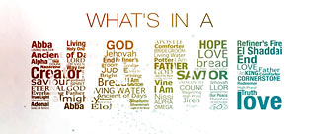
The Names of The Lord
You will be assigned a name of the Lord to study:
Read the chapter heading
Read your assigned verse(s)
How does story relate to the name of the Lord?
What personal or other scriptural experiences testify of how your name for the Lord is valid?

Slide 40
The Names of The Lord
Read your assigned chapter heading and verse(s)
How does your story relate to your name for the Lord?
Name: Elyon “The most high God”
Passage: Genesis 14:17-20
Name: Roi “The strong one who sees.
Passage: Genesis 16:13
Name: El-Shaddai “The Almighty Creator of heaven and earth.”
Passage: Gen. 17:1 and 49:24
Name: Jireh “The Lord will provide”
Passage: Genesis 22:13-14
NAME: Shammah “The Lord who is present”
Passage: Genesis 28:15
Name: Rapha “The Lord our healer.”
Passage: Exodus 15:26
Name: Nissi “The Lord our banner and victor”
Passage: Exodus 17:15
NAME: Adonai “King of kings and the Lord of lords”
Passage: Judges 6:15
Name: Shalom “The Lord is peace”
Passage: Judges 6:24
NAME: Yahweh. “He will always exist”
Passage: 1 Samuel 1:20
Name: Sabbaoth “The Lord of Hosts”
1 Samuel 17:45

Slide 41
The Names of The Lord
Read your assigned chapter heading and verse(s)
How does your story relate to your name for the Lord?
Share a personal or other scriptural experience that testifies of how your name for God is valid.
Name: Elyon “The most high God”
Passage: Genesis 14:17-20
Name: Roi “The strong one who sees.
Passage: Genesis 16:13
Name: El-Shaddai “The Almighty Creator of heaven and earth.”
Passage: Gen. 17:1 and 49:24
Name: Jireh “The Lord will provide”
Passage: Genesis 22:13-14
NAME: Shammah “The Lord who is present”
Passage: Genesis 28:15
Name: Rapha “The Lord our healer.”
Passage: Exodus 15:26
Name: Nissi “The Lord our banner and victor”
Passage: Exodus 17:15
NAME: Adonai “King of kings and the Lord of lords”
Passage: Judges 6:15
Name: Shalom “The Lord is peace”
Passage: Judges 6:24
NAME: Yahweh. “He will always exist”
Passage: 1 Samuel 1:20
Name: Sabbaoth “The Lord of Hosts”
1 Samuel 17:45

Slide 42
Which attribute of god do you need now?
Yahweh. “He will always exist”
Adonai “King of kings”
Elyon “The most high God”
El-Shaddai “The Almighty Creator.”
Shammah “The Lord who is present”
Rapha “The Lord our healer.”
Jireh “The Lord will provide”
Nissi “The Lord our banner and victor”
Shalom “The Lord is peace”
Sabbaoth “The Lord of Hosts”
Roi “The strong one who sees.”
Are you concerned about the future?
Do you need someone to rule your life?
Do you need more power in your life?
Do you need God to create something?
Do you need Him present in your life?
Do you need healing?
Do you need him to provide something?
Do you need a victory?
Do you need peace?
Do you need backup?
Is there something you need to see better?
Which attribute has he been in your life?

Slide 43
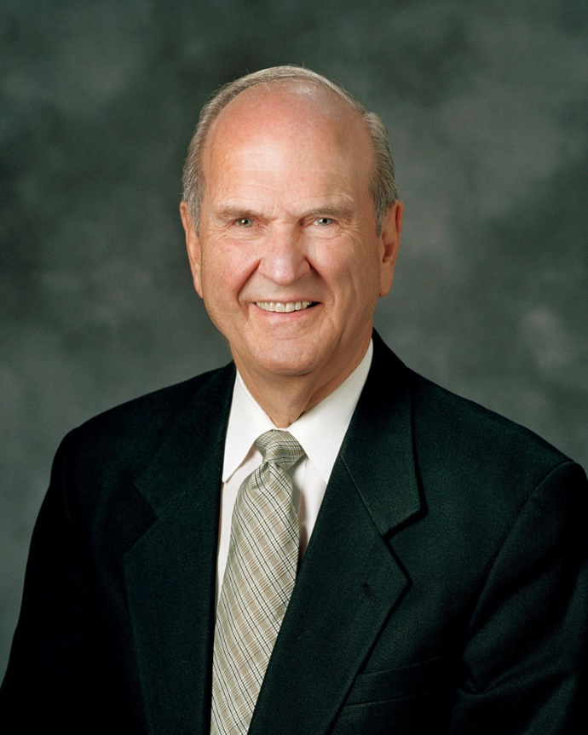
Tender Mercies
“Difficult days are ahead for all mankind but Jesus descended below all things in order to rise above all things. He expects us to follow His example. Yoked with Him, we can rise above all challenges, no matter how difficult they may be. "Be of good cheer, and do not fear, for I the Lord am with you, and will stand by you; and ye shall bear record of me, even Jesus Christ, that I am the Son of the living God, that I was, that I am, and that I am to come” (D&C 68). Lovingly we cling to that promise. “

Slide 44
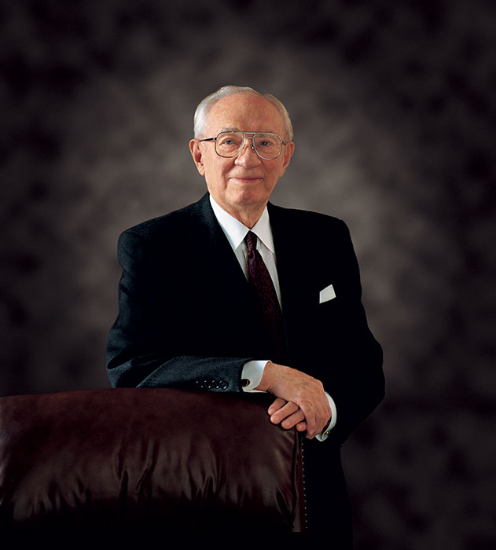
Tender Mercies
“God is at the helm. Never doubt it. When we are confronted with opposition, He will open the way when there appears to be no way. Our individual efforts may be humble and appear somewhat insignificant. But the accumulated good works of all, laboring together with a common purpose, will bring to pass great and wondrous accomplishments.” — President Gordon B. Hinckley, “God Is at the Helm,” Ensign, May 1994, p. 53

Slide 45
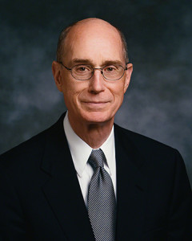
Tender Mercies
“Your life is carefully watched over. The Lord knows both what He will need you to do and what you will need to know. He is kind and He is all-knowing. So you can with confidence expect that He has prepared opportunities for you to learn in preparation for the service you will give.” — President Henry B. Eyring, “Education for Real Life,” Ensign, October 2002, pp. 18-19

Slide 46
Magi, Mary, Joseph and Jesus
Magi were Warned by God
  They were warned by God not to return the way they had come
    God will keep you from the evil one if you walk in obedience to Him!
Departed by another way (Matthew 2:12)
  Anyone who comes to Christ will go home differently and be a new creature.
    2 Corinthians 5:17 - Therefore if any man be in Christ, he is a new creature: old things are passed away; behold, all things are become new
What principle do we learn from Joseph’s flight to Egypt? (Matthew 12:13-14)

Slide 47
Joseph
Gerald N. Lund: ‘Matthew tells us that Joseph was a just and considerate man. In a dream an angel told him who Jesus would be and that he gave Jesus his name, which means savior. We know that he took Mary to Bethlehem, where Jesus was born. Less than two years later, Joseph took his family into Egypt to escape Herod, after being warned in a dream. In Egypt, a dream again told him when to return, and another dream told him to go to Galilee. (See Matt. 2:13–15, 19–22.) Four dreams from God! Joseph must have been an exceptionally visionary and spiritually sensitive man’ (Jesus Christ, Key to the Plan of Salvation [1991], 51–52)” (New Testament Student Manual [Church Educational System manual, 2014], 13–14).

