Slide 1
New Testament
John 1

Slide 2
Scripture Study Tips
Relevancy in personal study
Today’s Tip:
Look up words and discover their meaning

Slide 3


Words
What is your favorite word?
What are words used for?
John 1:1-3: Why would the word ‘Word’ be used as a title of Christ?

Slide 4
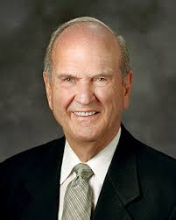
The Word of God
“His title was “the Word.” In the Greek, word was logos, or “expression.” It was another name for the Master. That terminology may seem strange, but it is appropriate. We use words to convey our expression to others. So Jesus was the Word, or expression, of His Father to the world.” (Elder Russell M. Nelson, April 2000 Ensign)

Slide 5

Why do we need to understand the creation?
“An understanding of the doctrine of creation is essential to salvation. Unless and until we gain a true view of the creation, we cannot hope to gain that fulness of eternal reward.”
Bruce R. McConkie
(Christ and the Creation, Ensign, June 1982)

Slide 6
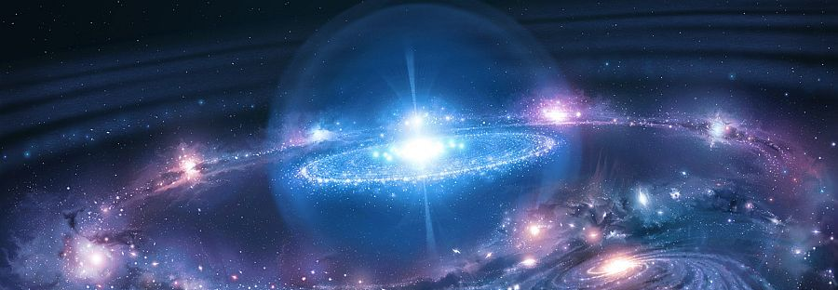

God’s greatest creation: https://www.youtube.com/watch?v=dMZ-ETxj0hE
Review
Who created the earth? (see Moses 1:33)
Why was the earth created? (see Moses 1:39)
What was the ultimate creation?

Slide 7
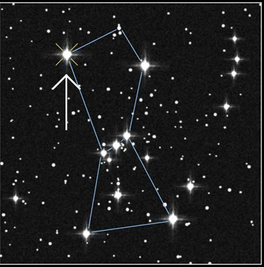
Glance at John 1:4-14
List some Doctrines of Christ
CROSS REFERENCE PSALM 147:4

Slide 8
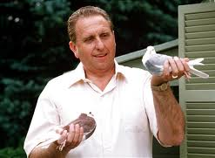
How was the earth created?
“I acknowledge that I do not understand the processes of creation, but I accept the fact of it.”
Thomas S. Monson
BYU Devotional, November 2007

Slide 9
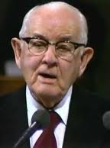
“The Lord made a blueprint, as any great contractor will do before constructing. He drew up the plans, wrote the specifications, and presented them…Our Father called us all together as explained in the scripture, and plans were perfected now for forming an earth. …That assemblage included us all. The gods would make land, water, and atmosphere and then the animal kingdom, and give dominion over it all to man. That was the plan. … God was the Master-worker, and he created us and brought us into existence”
Spencer W. Kimball (The Teachings of Spencer W. Kimball, p.29-30)

Slide 10
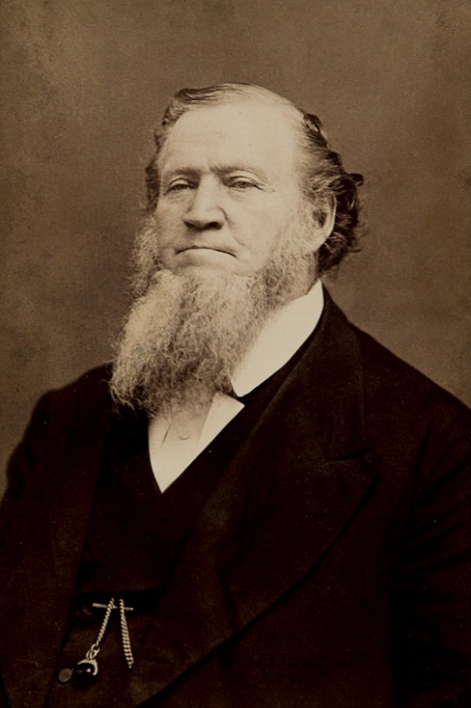
What was the earth made out of?
“God brought forth material out of which he formed this little terra firma upon which we roam. How long had this material been in existence? Forever and forever, in some shape, in some condition” (Discourses of Brigham Young, sel. John A. Widtsoe [1954], 100).

Slide 11

How Long is 1 Day?
One day is with the Lord as a thousand years, and a thousand years as one day.
2 Peter 3:8
1000 years our time=1 day with the Lord
How long have you been away from God’s presence?
If you live 100 years on earth= 1/10 of one day with the Lord. Divide Lord’s day into 24 equal parts (2.4 hours).
100 years on earth = 2.4 hours in the Lord’s time…
(Your age x .694 = how many minutes you’ve been away from God’s presence)
CAN YOU BE GOOD FOR 2 HOURS?
Does God’s foreknowledge interfere with our agency?
(5)

Slide 12
In Moses 2:10, 12, 18, 21, 25, what did God say after each of the first five periods of the Creation was complete? (hint: it’s the same word each time)
Moses 2:31 - what did God say after He completed the Creation?
What’s a principle here?
Principle: Celebrate small victories and accomplishments

Slide 13
What do you have in common with the Creator?

Slide 14

“Create,” Dieter F. Uchtdorf (1:54)

Slide 15
Is the Creation over??? What things has God left uncreated in your life?

Slide 16
New Testament
Introduction

Slide 17
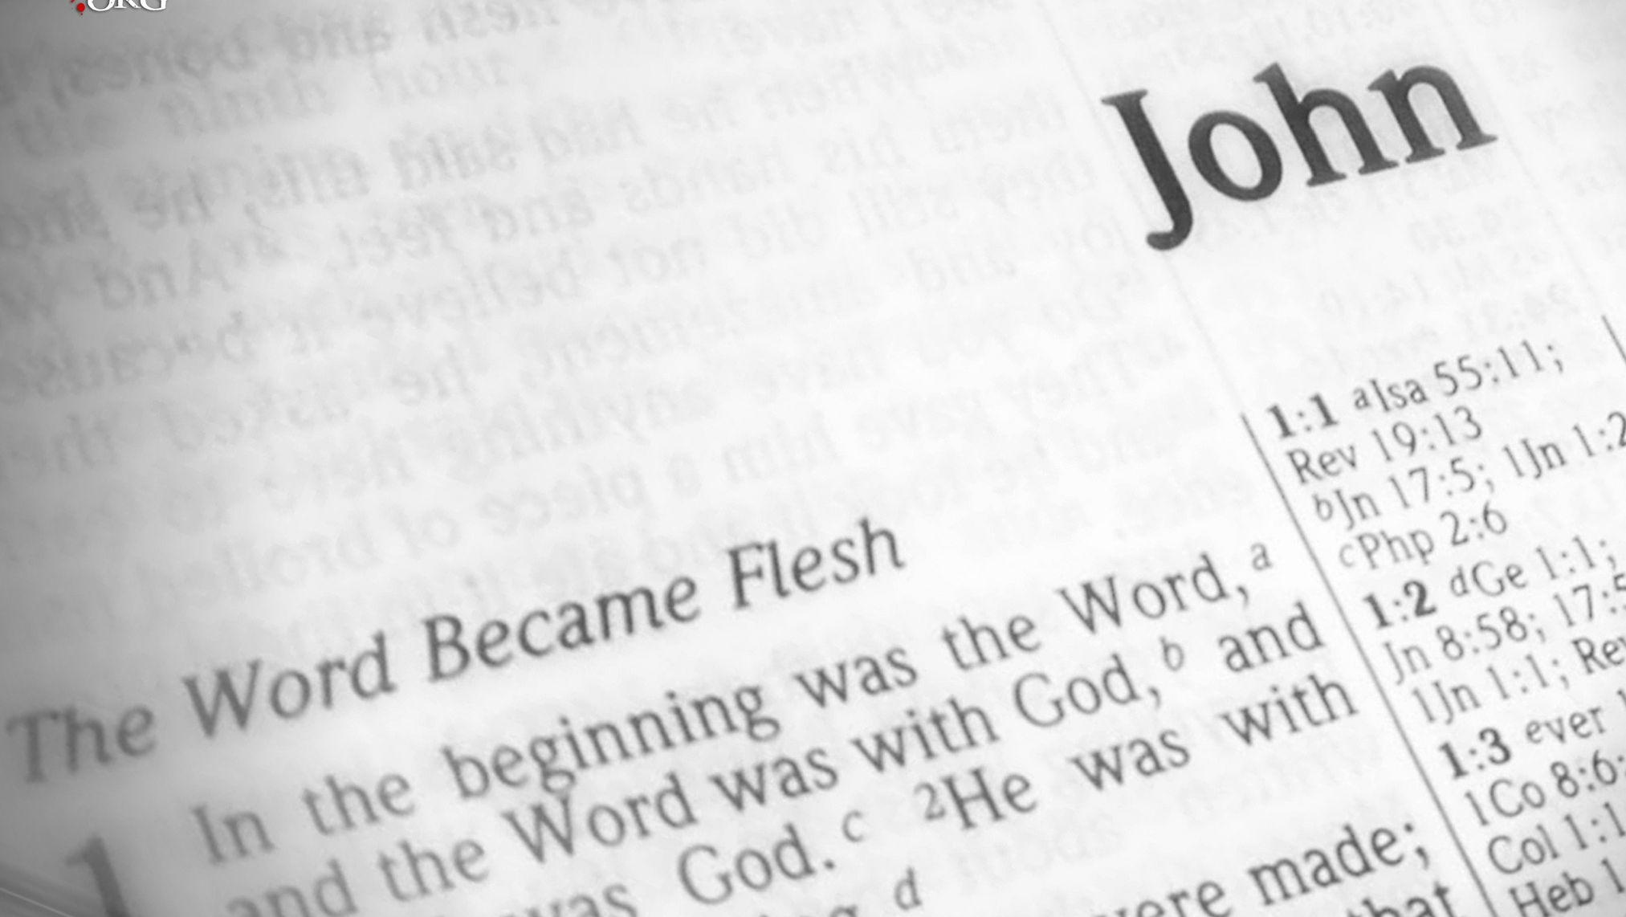
Fun facts about the Gospel of John
John is a master storyteller (feed 5000; the Bread of Life; heal a blind man)
The mention of “life” appears in John’s Gospel more than any other book.
John records the famous seven “I AM” statements.
John is never actually named as the author within the text.

Slide 18
Fun facts about the Gospel of John
Symbolism: Light and darkness, water, bread, sheep, and vines
The other Gospels = as sermons; John = conversations.
Saint Augustine: “The Gospel of John is deep enough for an elephant to swim and shallow enough for a child not to drown.”
On the cross, Jesus asked John to take care of his mother.

Slide 19
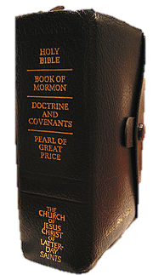
Gospel | Exclusive | Common
Mark Matthew Luke John | 7% 42% 59% 92% | 93% 58% 41% 8%
MATERIAL EXCLUSIVE TO JOHN
Water to wine, Nicodemus, the woman at the well, and cures a nobleman’s son and an impotent man at the pool, heals a man horn blind; the Good Shepherd; raising Lazarus from the dead, Jesus washes the Apostles’ feet, discourses on the Holy Ghost, prays in the Garden of Gethsemane, and promises that John will tarry; Thomas doubts.

Slide 20
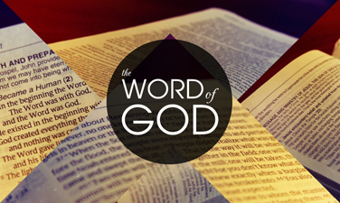
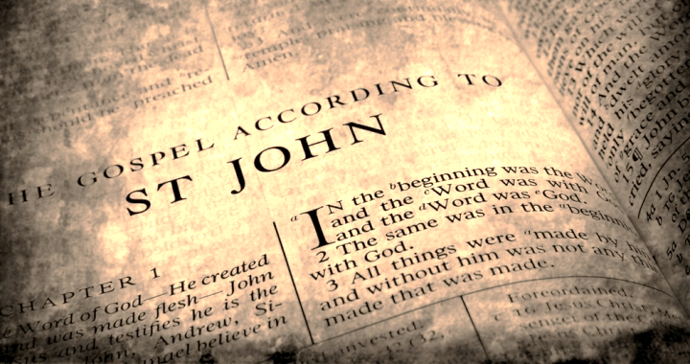
Two words for ‘word’ in Greek:
  Logos, the total inspired Word of God
Jesus, who is the living Word, and scripture.
  Rhema, the spoken word.
The voice of the Holy Ghost speaking

Slide 21

sôd
A confidential discussion, a secret or plan, a circle of confidants, or council.
Isaiah 6: Isaiah enters the presence of the Lord seated on his throne in the temple and sees a divine [sôd] .
Psalm 82 In vs 1 there is a council in the midst of the gods and He holds judgment. Vs 6: I [God] said, “Ye [sôd] are gods, sons of the Most High.”
Amos 3:7 “The Lord will no nothing but he revealeth his [sôd] to his servants the prophets.”
Psalm 25:14 “The [sôd] of the Lord is with them that fear him; and he will shew them his covenant.”
When do we participate in a sôd? How does God reveal His sôd?

