Slide 1
New Testament
Introduction

Slide 2
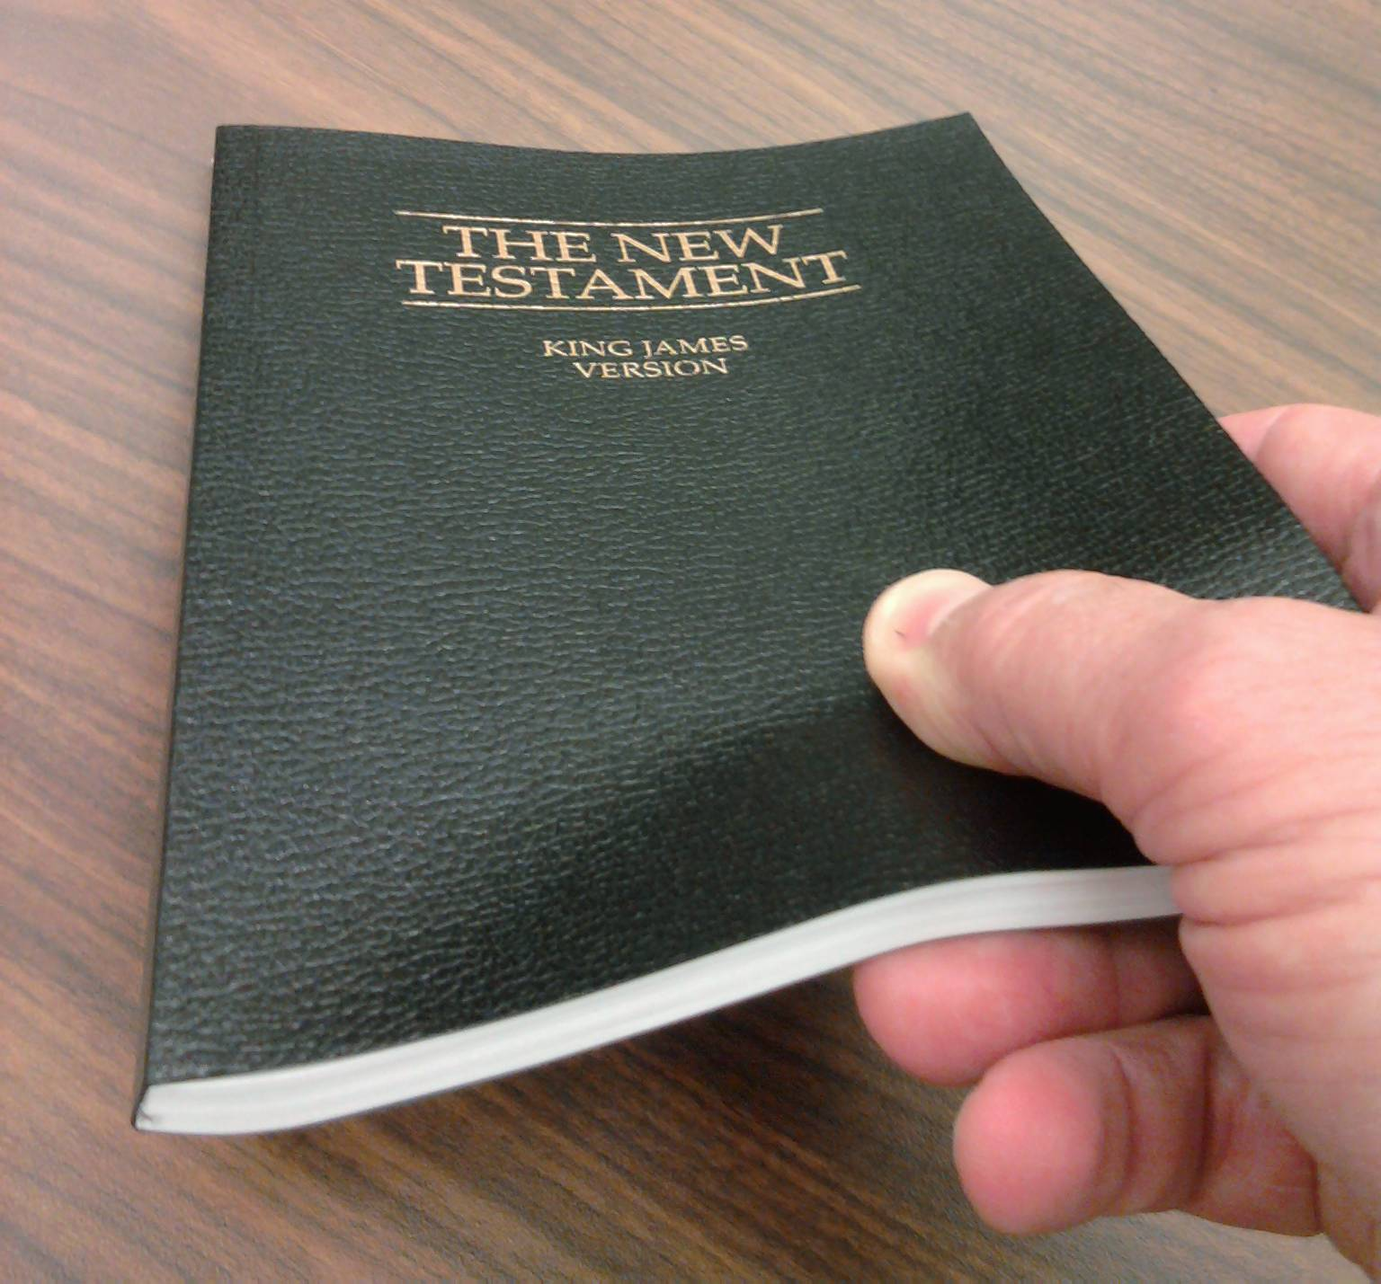
What do you love about the New Testament?

Slide 3
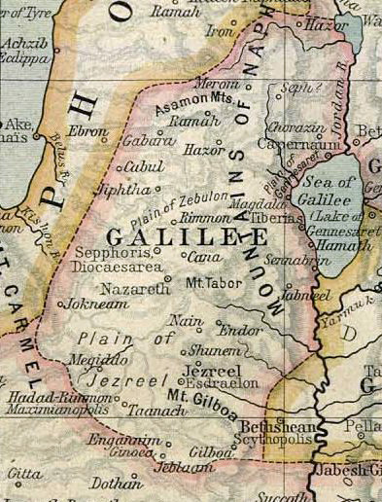
New Testament Setting

Slide 4
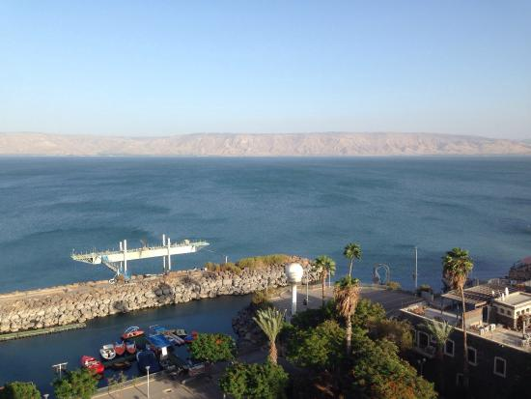
Bear Lake
or
Galilee?

Slide 5
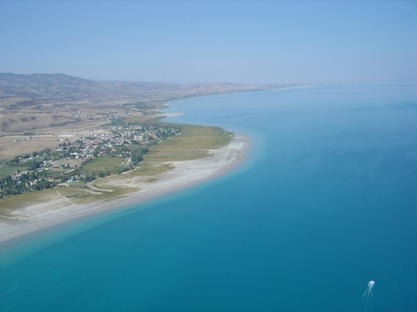
Bear Lake
or
Galilee?

Slide 6
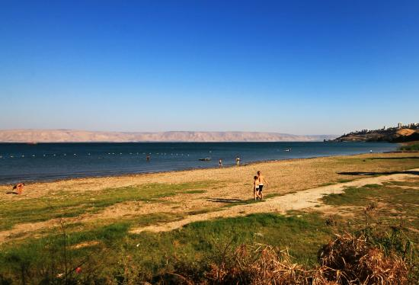
Bear Lake
or
Galilee?

Slide 7
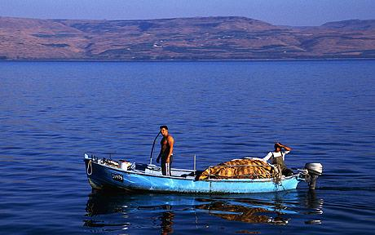
Bear Lake
or
Galilee?

Slide 8
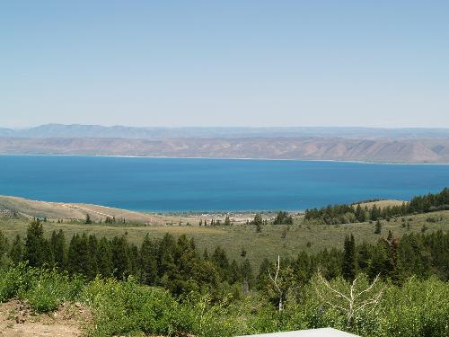
Bear Lake
or
Galilee?

Slide 9
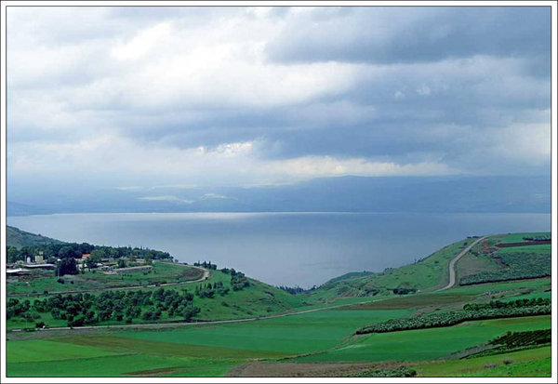
Bear Lake
or
Galilee?

Slide 10
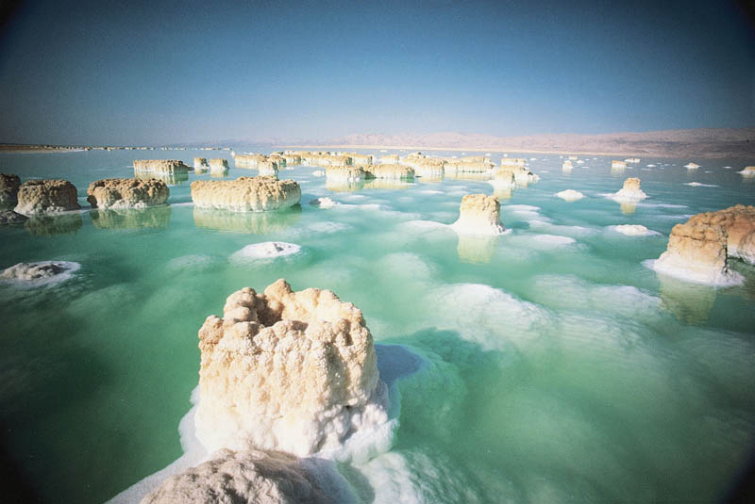
The Dead Sea

Slide 11
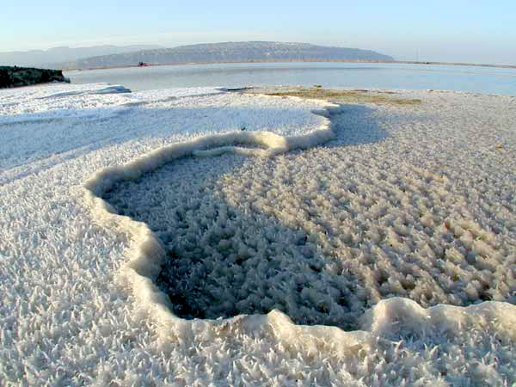
The Dead Sea

Slide 12
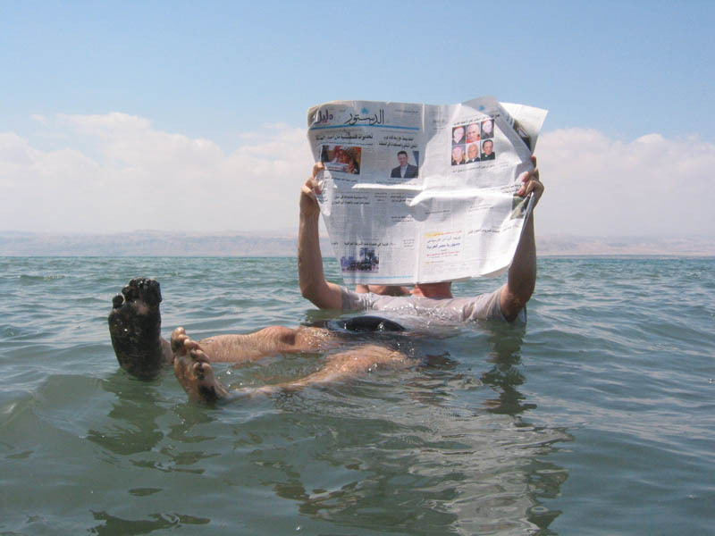

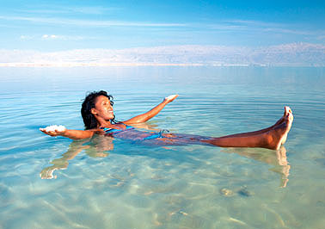
The Dead Sea

Slide 13
The Dead Sea
The Sea of Galilee
Rich with exotic plant and animals
Home to at least 20 different types of fish.
Has supported the lives of many for over two millennia.
Absolutely no life
9 times saltier than ocean water.
Why is one sea so ‘alive’ and the other so ‘dead’? What’s the principle?

Slide 14
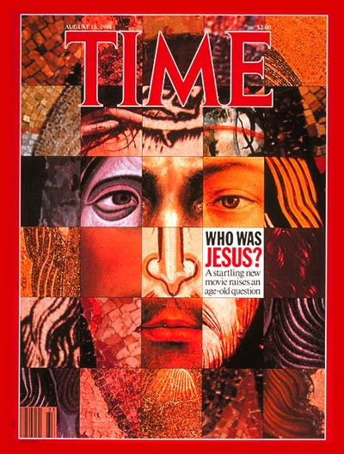

What are some of the answers the world would give to this question?
https://www.youtube.com/watch?v=qPbMQS73wV4

Slide 15


Slide 16
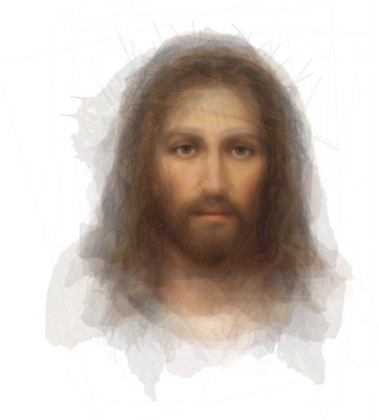
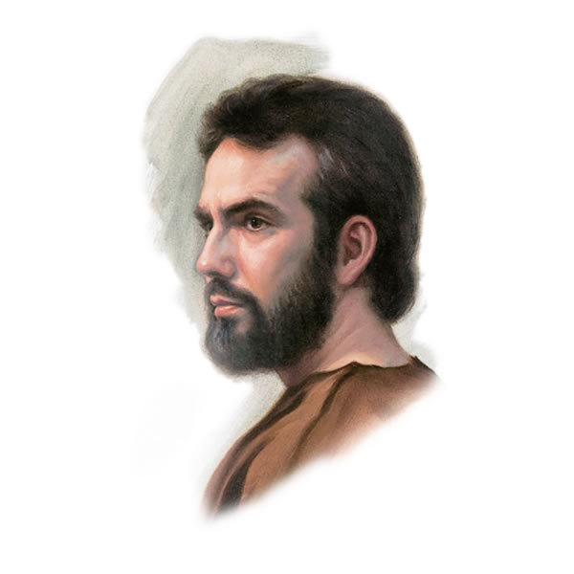
400 Years
Old Testament
New Testament

Slide 17
Except for one small period of independence (thanks, Macabees, the Jewish rebels that came 160 before His birth), the Jews had lived as a conquered people for over 500 years. By the time of Christ’s birth, Rome was reigning over the Jews in Israel under the leadership of King Herod the Great. The Jews resented Roman rule and eagerly looked forward to a promised Messiah who they believed would deliver them from the Romans. (New Testament Manual, Overview of the New Testament)

Slide 18
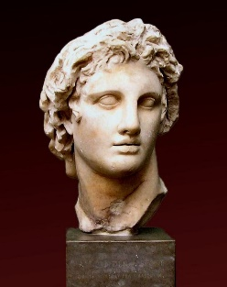
Alexander “The Great”
356 BC - 323 BC
Taught by Aristotle
Never lost a battle in 15 years
Conquered the known world by age 25
  Named 70 cities after himself—and one after his horse, Bucephalus.
His body was preserved in a vat of honey.
Jewish Prohibitions
Theatre (too much worldliness)
Gymnasium (too much skin)
Arena (too much violence)
Humans are the ultimate creation
Human mind is the source of all truth
  Aristotle, Socrates, Plato
Human body is the ultimate source of beauty
Theatre (Art and Dramas)
Education (Universal Language)
Travel (Pax Romana)
Sports (Arenas and Coliseums)
Medicine
Political Turmoil
Jewish Worship
Sabbath
Dress
Diet
Moral Cleanliness
Missionary Spirit
Looking for the Messiah
Persecuted

Slide 19
The Time & Culture of Jesus’ Day
Greeks
Romans
Jews
Universal language
Philosophy
  Rejected Resurrection
Medicine
Athletics
Entertainment
Science
Morality
Violence
Dispersed
Missionary Spirit
Looking for the Messiah
Persecution
Loose interpretations of the Law
Political Power
Political Turmoil
Travel
“Pax Romana”
Does this sound familiar?

Slide 20
The Time & Culture of Jesus’ Day
Society
America
Believers
Universal language
Philosophy
  Rejected Resurrection
Medicine
Athletics
Entertainment
Science
Morality
Violence
Dispersed
Missionary Spirit
Looking for the Messiah
Persecution
Loose interpretations of the Law
Political Power
Political Turmoil
Travel
“Pax Romana”

Slide 21
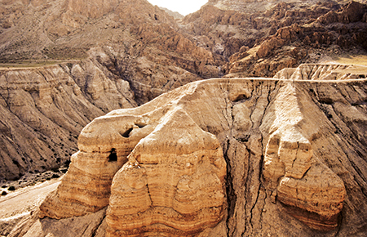
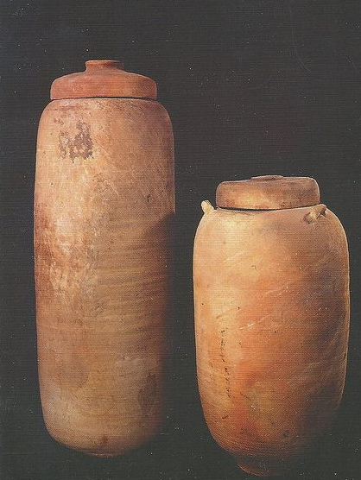
The Dead Sea Scrolls
In early 1947, three Bedouin shepherds were searching for a stray animal. One of them threw a rock into a cave and heard an earthen jar break. When they entered the cave, they saw it contained several large clay jars, some of which held scrolls.* In the ensuing years, several hundred scrolls in 11 caves on the northwest shore of the Dead Sea were found.
The scrolls provide more than 900 texts, most of them written in the original Hebrew of the Old Testament. About 225 of the scrolls contain the oldest copies of the Old Testament, more than 1,000 years older than the copies used during the Middle Ages.
Many scholars believe that the Dead Sea Scrolls are the greatest archaeological discovery of the 20th century.

Slide 22
Timeline
600 B.C.
600 B.C.
587 B.C.
515 B.C.
332 B.C.
Babylon invaded Judah
Jerusalem rebuilt
Alexander the Great conquered
Prophets warned Jerusalem that the temple would be destroyed
(Book of Mormon)
Jerusalem fell
After Malachi: Behold, the days come, saith the Lord God, that I will send a famine in the land, not a famine of bread, nor athirst for water, but of hearing the words of the Lord:
Amos 8:11
(1)

Slide 23
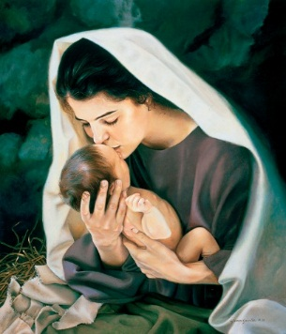
Timeline
162 B.C.
63 B.C
37 B.C.
Birth of Jesus.
Pompeii conquered and made Judea a part of the Roman province.
The Romans appointed Harod the Great as King of the Jews.
The Pharisees came into power.
(1)

Slide 24
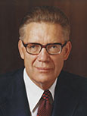
“They took the plain and simple things of pure religion and added to them a host of their own interpretations; they embellished them with added rites and performances; and they took a happy, joyous way of worship and turned it into a restrictive, curtailing, depressive system of rituals and performances. The living spirit of the Lord’s law became in their hands the dead letter of Jewish ritualism” (Elder McConkie, The Mortal Messiah, 4 vols. [1979–81], 1:238).

Slide 25

Why do you think that our need for the scriptures is greater today than any previous time?
What is the danger of adding man-made rules to God’s commandments, like some Jewish leaders did?
What did many Jews expect from the coming Messiah? Why did this false expectation lead many Jews to reject Jesus as the Messiah?
How does inviting others to come unto Christ help us come closer to Him as well?
What is something we can do today to invite others to come unto Him?

Slide 26
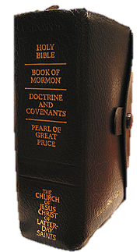
A doctor, a fisherman, a tax collector, and a teenager
wrote some of the most famous books in existence...
Matthew (Tax Collector): Writing to the Jews, showing that Jesus Christ fulfilled Old Testament prophecy.
Mark (Teenager): Miracles, names, places, and detailed accounts (probably got his information from Peter).
Luke (Doctor): Writing to the Gentiles, emphasizing individual salvation. Luke did not know the Savior personally (probably got the information from Mary; see The Mortal Messiah: From Bethlehem to Calvary, 4 vols. (1979–81), 1:324.)
John (The Beloved Fisherman): Writing for the Jews to present Jesus as the literal Son of God.

Slide 27
Gospel | Exclusive | Common
Mark Matthew Luke John | 7% 42% 59% 92% | 93% 58% 41% 8%
Material Exclusive to Matthew
(Jesus fulfills OT prophecies)
Visit of wise men; a star in the east
Flight into Egypt; slaying of children
Sermon on the Mount
Ten parables
Material Exclusive to Mark
One parable
A young man wearing a linen cloth (Mark)
Signs following believers
Material Exclusive to Luke (Salvation)
Gabriel’s visits to Zacharias and to Mary
Births of John the Baptist and Jesus Christ
Jesus at age twelve in the temple
Twelve parables
The Seventy
Christ sweat blood in the Garden of Gethsemane
Discussion with the thief (“To day shalt thou be with me in paradise” [Luke 23:43].)
The Savior ate fish and honey after his resurrection

Slide 28
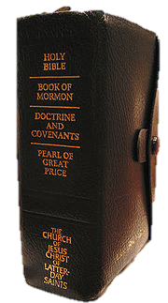
Gospel | Exclusive | Common
Mark Matthew Luke John | 7% 42% 59% 92% | 93% 58% 41% 8%
MATERIAL EXCLUSIVE TO JOHN (Jesus is the literal son of God)
Jesus calls four disciples, turns water to wine at the marriage feast at Cana, teaches Nicodemus, the woman at the well, and cures a nobleman’s son and an impotent man at the pool (see John 1:35-5:24).
The Bread of Life, the Light of the World, and Living Water.
Heals a man horn blind; the Good Shepherd; raising Lazarus from the dead (see 6:23-11:57).
Jesus washes the Apostles’ feet, discourses on the Holy Ghost, prays in the Garden of Gethsemane, and promises that John will tarry; Thomas doubts (see 13:1-21:25).

Slide 29
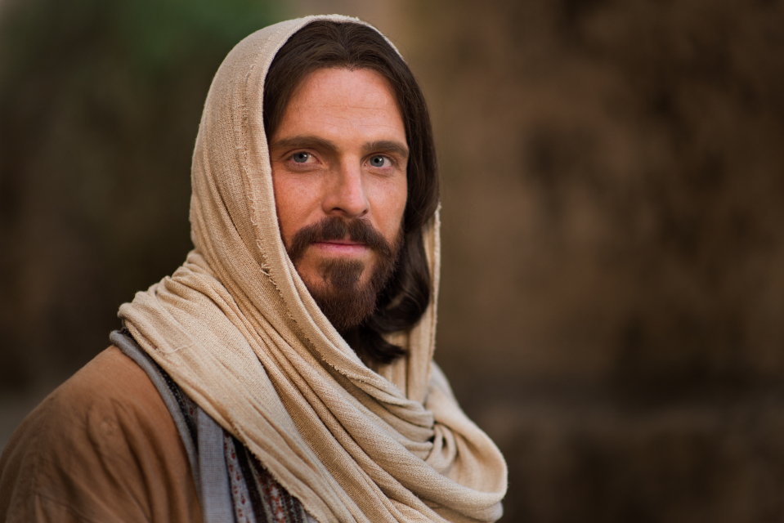
Why do we need a Savior?

Slide 30
Why do we need a Savior?
One sin = deep debt
  (1 Nephi 15:33-34)
Two travelers missed their flight. One was :30seconds late and the other 15minutes late. Which traveler is better off?
Even if we keep 9 of the 10 commandments…
Hanging on a cliff by a chain with 10 links. How many links must break before you fall?
How many sins have you committed so far?

Slide 31
Dating before age 16.
Steady dating after age 16.
Young men not initiating dates or not making dating a priority.
Immodest dress including tight, sheer, short or revealing clothing.
Extreme hairstyles, long hair for young men.
Tattoos, body piercings, multiple earrings on one ear.
Not studying scriptures. Skipping seminary.
Watching shows that are vulgar, or immoral.
Playing games that are violent.
Spending long periods of time on electronics.
Downloading copyrighted material.
List of sins from the For the Strength of Youth Pamphlet

Slide 32
Dishonoring parents.
Not showing genuine interest in others (including siblings).
Not smiling at people.
Being critical, bullying, not inviting people to church.
Being ungrateful. Cheating at school (“utilizing my resources”).
Breaking the Sabbath.
Not writing in your journal. Not doing family history work.
Passionate kissing.
Lying on top of people.
Acting on same gender feelings.
Staying out late.
Not saving money for the future.
List of sins from the For the Strength of Youth Pamphlet

Slide 33
Not preparing for full time missionary service.
Gambling.
Laziness.
Not attending the temple.
Disobeying your bishop.
Not paying tithing.
Not fasting for 2 meals and 24 hours.
Not giving a generous fast offering.
Putting people down – even in joking.
Gossiping, speaking in anger, misusing the name of God, or laughing at inappropriate jokes.
List of sins from the For the Strength of Youth Pamphlet

Slide 34
Listening to loud music.
Not removing earphones when others are talking.
Not learning to sing hymns.
Disobeying the Word of Wisdom.
Using drugs, drinking beverages that produce a “high”.
Dancing with full body contact.
Not eating nutritious food.
Not exercising regularly.
Not getting enough sleep.
List of sins from the For the Strength of Youth Pamphlet

Slide 35
Why do we need a Savior?
How many sins: 5 a day for one year - times 80 years?
Does ‘going’ to church and ‘going’ the temple or ‘going’ on a mission make God feel better about you?
The debt needs to be satisfied – completely. What’s the standard?
It’s like trying to cooking a rotten egg using good eggs.
Are you spending a lifetime trying to pay a bill you will never be able to pay? How can the bill be paid without compromising the standard?
Any payment we make is less than perfect.
What do people do with a bill they can’t pay?
The deal of a lifetime (see 2 Corinthians 5:21)
One day the Lord will say, “You owe me perfection. Where is the payment?” It should be a short conversation...

Slide 36
New Testament
Introduction

