Slide 1
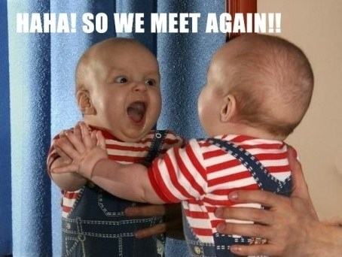

Mark
&
Meet
Doctrine & Covenants DM

Slide 2

Instructions:
Introduce yourself and make sure you know the other person’s name.
Find the Doctrinal Mastery reference and mark it in a DISTINTIVE WAY.
Talk to each other and answer the questions.
Move to the next desk and repeat it.
Have Fun!

Slide 3
LET’S BEGIN

Slide 4
MARK JS-H 1:15-20
The First Vision
& ask your neighbor their name

Slide 5
MARK JS-H 1:15-20
The First Vision
& ask your neighbor their name
Where were you born and what is your birthday?
What is your favorite knock-knock joke?
Do you like sweet or salty treats?
0
5
4
3
2
1
0
0
9
8
7
6
5
4
3
2
1
0
9
8
7
6
5
4
3
2
1
0
9
8
7
6
5
4
3
2
1
0
9
8
7
6
5
4
3
2
1
0
9
8
7
6
5
4
3
2
1
0
9
8
7
6
5
4
3
2
1

Slide 6
ROTATE!

Slide 7
MARK D&C 1:30
The only true and living Church
& ask your neighbor their name

Slide 8
MARK D&C 1:30
The only true and living Church
& ask your neighbor their name
What is your favorite month of the year? Why?
What is your favorite movie?
Favorite song that’s on the radio right now?
0
5
4
3
2
1
0
0
9
8
7
6
5
4
3
2
1
0
9
8
7
6
5
4
3
2
1
0
9
8
7
6
5
4
3
2
1
0
9
8
7
6
5
4
3
2
1
0
9
8
7
6
5
4
3
2
1
0
9
8
7
6
5
4
3
2
1

Slide 9
ROTATE!

Slide 10
MARK D&C 1:37-38
Jesus Christ’s words shall all be fulfilled
& ask your neighbor their name

Slide 11
MARK D&C 1:37-38
Jesus Christ’s words shall all be fulfilled
& ask your neighbor their name
What is your least favorite class at the school?
What are you thinking about doing after high school?
What country has a weird name, in your opinion?
0
5
4
3
2
1
0
0
9
8
7
6
5
4
3
2
1
0
9
8
7
6
5
4
3
2
1
0
9
8
7
6
5
4
3
2
1
0
9
8
7
6
5
4
3
2
1
0
9
8
7
6
5
4
3
2
1
0
9
8
7
6
5
4
3
2
1

Slide 12
ROTATE!

Slide 13
MARK D&C 6:36
Look unto Christ in every thought.
& ask your neighbor their name

Slide 14
MARK D&C 6:36
Look unto Christ in every thought.
& ask your neighbor their name
What is your favorite kind of pizza?
Favorite jungle animal? Favorite domestic animal?
If you could be an animal what would you be?
0
5
4
3
2
1
0
0
9
8
7
6
5
4
3
2
1
0
9
8
7
6
5
4
3
2
1
0
9
8
7
6
5
4
3
2
1
0
9
8
7
6
5
4
3
2
1
0
9
8
7
6
5
4
3
2
1
0
9
8
7
6
5
4
3
2
1

Slide 15
ROTATE!

Slide 16
MARK D&C 8:2-3
Revelation comes to your mind and heart
& ask your neighbor their name

Slide 17
MARK D&C 8:2-3
Revelation comes to your mind and heart
& ask your neighbor their name
What is your favorite subject in school?
Least favorite?
If you had to do one, would you do: bungee jumping, cliff diving, or sky diving?
0
5
4
3
2
1
0
0
9
8
7
6
5
4
3
2
1
0
9
8
7
6
5
4
3
2
1
0
9
8
7
6
5
4
3
2
1
0
9
8
7
6
5
4
3
2
1
0
9
8
7
6
5
4
3
2
1
0
9
8
7
6
5
4
3
2
1

Slide 18
ROTATE!

Slide 19
MARK D&C 13:1
The Aaronic Priesthood was restored.
& ask your neighbor their name

Slide 20
MARK D&C 13:1
The Aaronic Priesthood was restored.
& ask your neighbor their name
What is your favorite candy bar?
Least favorite candy bar?
Do you come from a large or a small family? How many member are there and what number are you?
0
5
4
3
2
1
0
0
9
8
7
6
5
4
3
2
1
0
9
8
7
6
5
4
3
2
1
0
9
8
7
6
5
4
3
2
1
0
9
8
7
6
5
4
3
2
1
0
9
8
7
6
5
4
3
2
1
0
9
8
7
6
5
4
3
2
1

Slide 21
ROTATE!

Slide 22
You will tell the story of the Restoration with your partner, taking turns
CHURCH
HISTORY

Slide 23
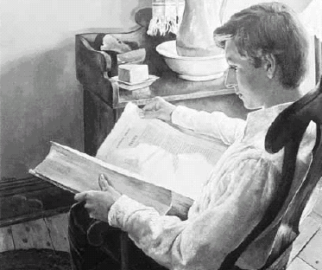
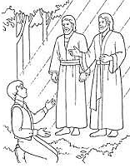
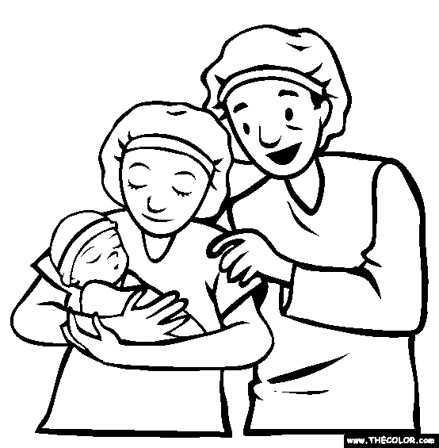


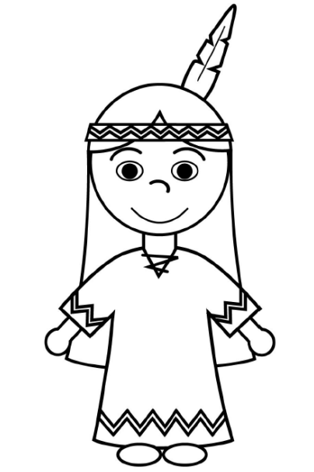
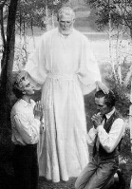
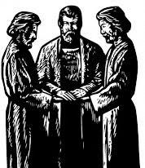

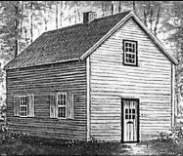




The First Vision
HOW MANY VISITS?
WHERE?
MOVED TO?
WHERE?
BIRTHDAY?
JOSEPH SMITH HISTORY
SECTION #?
NAME?
1812
1815
SCRIPTURE?
WHEN?
DATE?
Joseph receives the Plates
HOW MANY DAYS?
ORIGINAL MEMBERS?
Mission to Lamanites
CHURCH
HISTORY
WHEN?
ORIGINAL COPIES?
DATE?
WHEN?
D&C 3-19
D&C 20-31
D&C 32-42
WHERE?
WHO?
SCRIBES?
WHERE?
CONVERTS?
WHERE?
2 BIG PROJECTS?
3 minutes
CITY?
CITY?
D&C 41-56
D&C 1,63-81, 133
D&C 57-62
The Laws
The Holy Ghost
SEEKING FOR WHAT?
WHAT DOES D&C 76 TEACH?

Slide 24
ROTATE!

Slide 25
MARK D&C 18:10-11
The worth of souls is great.
& ask your neighbor their name

Slide 26
MARK D&C 18:10-11
The worth of souls is great.
& ask your neighbor their name
What is your greatest fear?
What is a perfect weekend for you?
Favorite flavor of gum?
0
5
4
3
2
1
0
0
9
8
7
6
5
4
3
2
1
0
9
8
7
6
5
4
3
2
1
0
9
8
7
6
5
4
3
2
1
0
9
8
7
6
5
4
3
2
1
0
9
8
7
6
5
4
3
2
1
0
9
8
7
6
5
4
3
2
1

Slide 27
ROTATE!

Slide 28
MARK D&C 18:15-16
Great joy comes from bringing souls unto Jesus Christ
& ask your neighbor their name

Slide 29
MARK D&C 18:15-16
Great joy comes from bringing souls unto Jesus Christ
& ask your neighbor their name
Best vacation ever?
Dream vacation?
What do your parents (and/or siblings) do for work?
0
5
4
3
2
1
0
0
9
8
7
6
5
4
3
2
1
0
9
8
7
6
5
4
3
2
1
0
9
8
7
6
5
4
3
2
1
0
9
8
7
6
5
4
3
2
1
0
9
8
7
6
5
4
3
2
1
0
9
8
7
6
5
4
3
2
1

Slide 30
ROTATE!

Slide 31
MARK D&C 19:16-19
Jesus Christ suffered for all of us.
& ask your neighbor their name

Slide 32
MARK D&C 19:16-19
Jesus Christ suffered for all of us.
& ask your neighbor their name
Who are you closest to in your family? Why?
Who is the oddest member of your family?
What family tradition do you have now that you want to keep when you have your own family?
0
5
4
3
2
1
0
0
9
8
7
6
5
4
3
2
1
0
9
8
7
6
5
4
3
2
1
0
9
8
7
6
5
4
3
2
1
0
9
8
7
6
5
4
3
2
1
0
9
8
7
6
5
4
3
2
1
0
9
8
7
6
5
4
3
2
1

Slide 33
ROTATE!

Slide 34
MARK D&C 21:4-6
As we receive the prophet’s word, God will disperse the powers of darkness.
Ask your neighbor their name

Slide 35
MARK D&C 21:4-6
As we receive the prophet’s word, God will disperse the powers of darkness.
Ask your neighbor their name
Café Rio, Costa Vida, or other Mexian food?
What color is your toothbrush?
What do you like most about Seminary?
0
5
4
3
2
1
0
0
9
8
7
6
5
4
3
2
1
0
9
8
7
6
5
4
3
2
1
0
9
8
7
6
5
4
3
2
1
0
9
8
7
6
5
4
3
2
1
0
9
8
7
6
5
4
3
2
1
0
9
8
7
6
5
4
3
2
1

Slide 36
ROTATE!

Slide 37
MARK D&C 29:10-11
Christ will come again with power and glory.
& ask your neighbor their name

Slide 38
MARK D&C 29:10-11
Christ will come again with power and glory.
& ask your neighbor their name
What temple do you want to get married in?
Which temple is the most amazing to you?
Which General Authorities have you met or seen in person?
0
5
4
3
2
1
0
0
9
8
7
6
5
4
3
2
1
0
9
8
7
6
5
4
3
2
1
0
9
8
7
6
5
4
3
2
1
0
9
8
7
6
5
4
3
2
1
0
9
8
7
6
5
4
3
2
1
0
9
8
7
6
5
4
3
2
1

Slide 39
ROTATE!

Slide 40
MARK D&C 42:11
The Lord’s representatives must be called by one who has authority.
Ask your neighbor their name

Slide 41
MARK D&C 42:11
The Lord’s representatives must be called by one who has authority.
Ask your neighbor their name
What do you think is the best thing about serving a mission?
Did you parents serve a mission?
If you could choose to serve a mission anywhere, where would you choose and why?
0
5
4
3
2
1
0
0
9
8
7
6
5
4
3
2
1
0
9
8
7
6
5
4
3
2
1
0
9
8
7
6
5
4
3
2
1
0
9
8
7
6
5
4
3
2
1
0
9
8
7
6
5
4
3
2
1
0
9
8
7
6
5
4
3
2
1

Slide 42
ROTATE!

Slide 43
MARK D&C 49:15-17
Marriage between a man and a woman is ordained of God.
Ask your neighbor their name

Slide 44
MARK D&C 49:15-17
Marriage between a man and a woman is ordained of God.
Ask your neighbor their name
How do you say your name backwards?
Do you have a middle name?
What is the farthest you’ve ever traveled from home?
0
5
4
3
2
1
0
0
9
8
7
6
5
4
3
2
1
0
9
8
7
6
5
4
3
2
1
0
9
8
7
6
5
4
3
2
1
0
9
8
7
6
5
4
3
2
1
0
9
8
7
6
5
4
3
2
1
0
9
8
7
6
5
4
3
2
1

Slide 45
Thank you for marking your Doctrinal Mastery references!
You are done! Great work!

