Slide 1
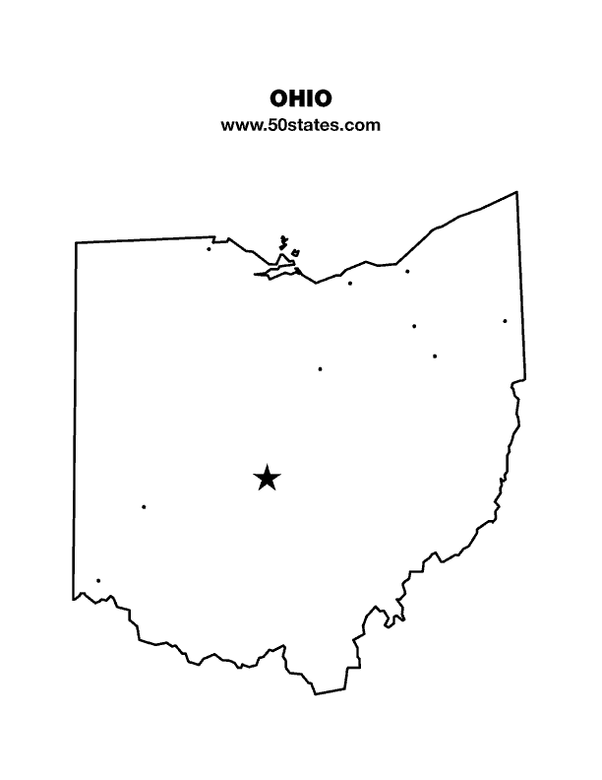
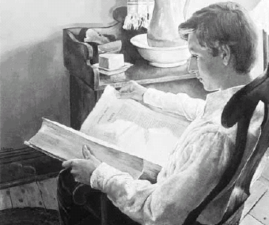
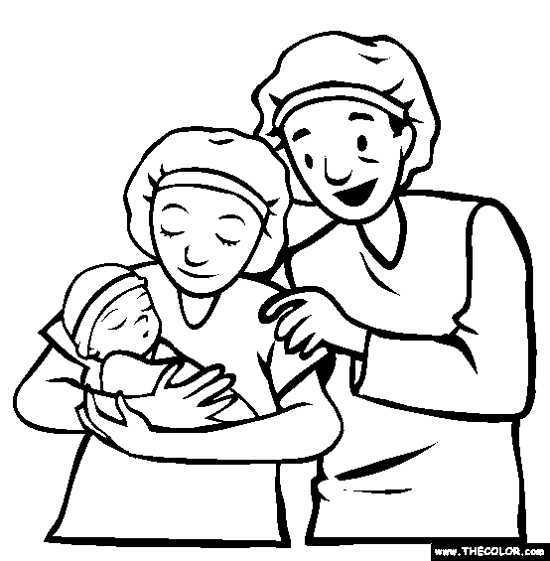
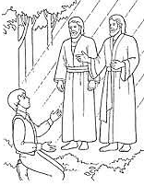

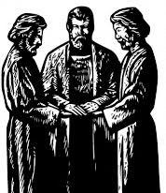

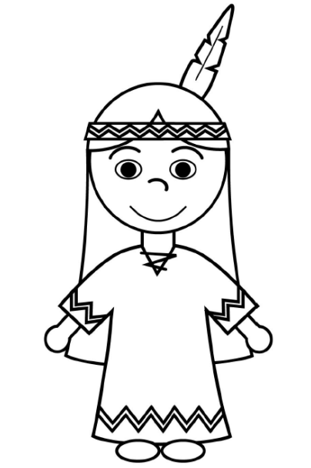
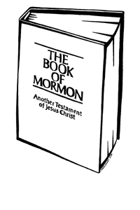
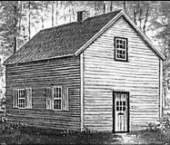
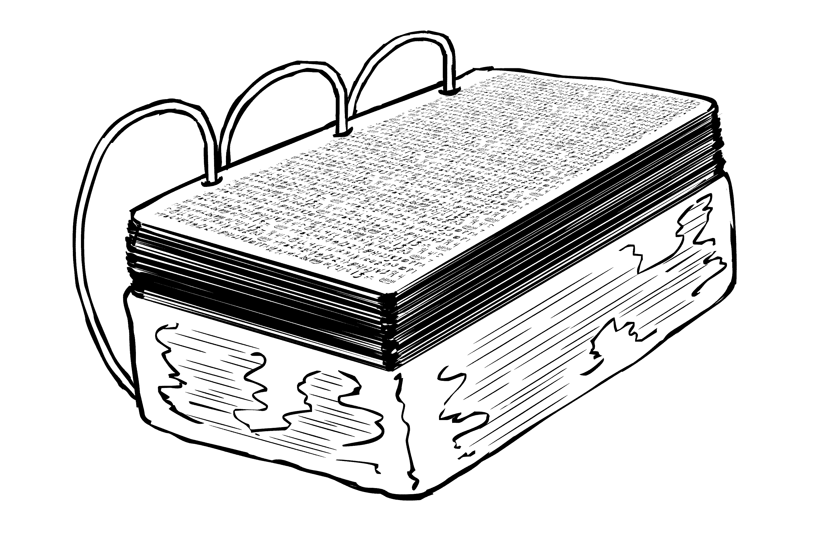


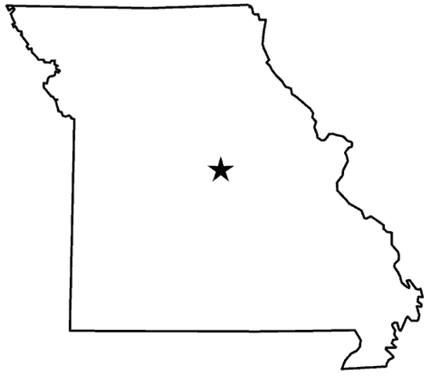
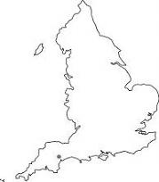
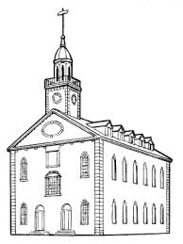
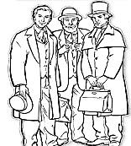

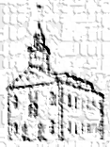
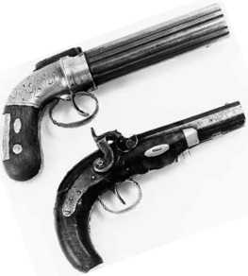
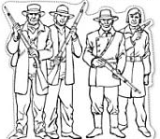




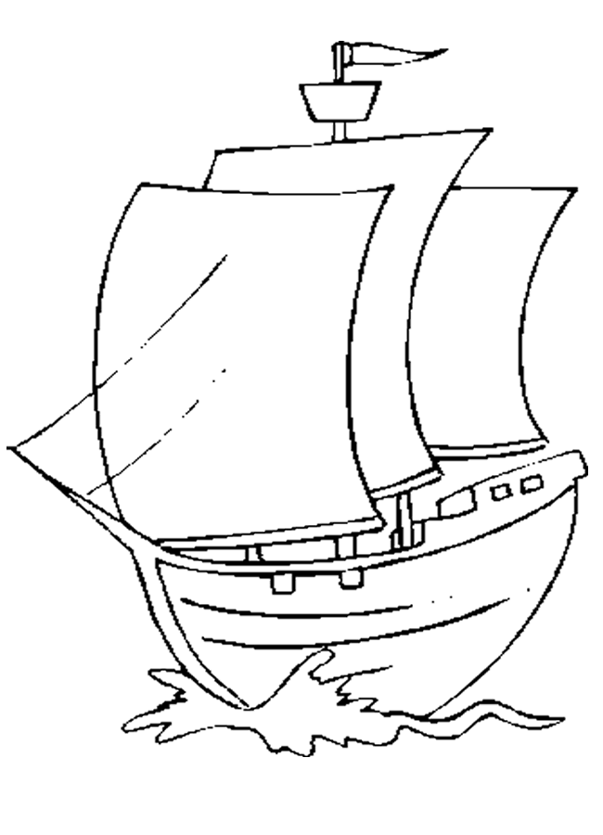
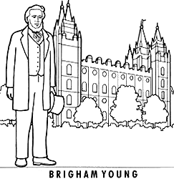

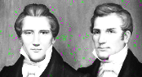



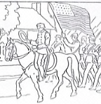
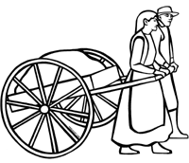



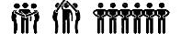
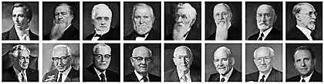
Joseph Smith
Birth and Childhood
James 1:5-6
The First Vision
Moroni Visits
Joseph receives the Plates
Priesthood Restored
Translated & Published
Church Organized
Mission to Lamanites
Move to Ohio
VERMONT
NEW HAMPSIRE
SHARON
LEBANON
5000
NEW YORK
PALMYRA
5
June
1829
March 26
1830
December 23,
1805
Spring
1820
Sept 21-22
1823
Sept 22
1827
May/June
1829
April 6
1830
Fall
1830
Jan-June 1831
JOSEPH SMITH HISTORY
D&C 2
D&C 3-19
D&C 20-31
D&C 32-42
D&C 41-56
Isaiah, Malachi, Joel
Hill Cumorah
John the Baptist
Peter,James,John
Martin Harris (116)
Charles Anton
Oliver Cowdrey
Peter Whitmer Farm, Fayette, NY
Edward Partridge & Sydney Rigdon
The Laws
The Holy Ghost
1812
Mt. Tambora
Bible Translation (JST) Book of Commandments
Building the Temple
Persecutions
In Missouri
Zion’s Camp March
Mission to Europe
Temple Dedicated
Kirtland Apostasy
1815
1500
School of the Prophets
Word of Wisdom
12
70
Visits to Missouri
Move to Missouri
OHIO
KIRTLAND
1831
1832
1831-32
1832-33
1833
1834
1835
1836
1837-1838
Summer 1838
JACKSON COUNTY
D&C 1,63-81, 133
D&C 84-96
D&C 97-102
D&C
103-105
D&C 106-108, 134
D&C 109-110,137
D&C 111-112
D&C 113-120
D&C
57-62
D&C
82-83
The Name of the Church
Tithing
School of the Prophets
Word of Wisdom
Printing Press Destroyed
Move to Clay Co.
Sealing Power
Kirtland Safety Society
MISSOURI
3 Degrees of Glory
9 Apostles
7 Pres of 70
63 Q of 70
Abraham (Mummies)
Hymnal & D&C
John Taylor
Lorenzo Snow
Baptism for Dead
Endowment
Relief Society
The Migration West
Peace in Nauvoo
Martyrdom of Joseph & Hyrum
The Brooklyn
CLAY COUNTY
D&C 136
Extermination Order
NEW YORK
NEW YORK
CALIFORNIA
SAN FRANSISCO
April 1847 - July 24, 1847
70,000 Saints (1,611 original)
ILLINOIS
95%
D&C 138
NAUVOO
Feb 1846 – July 1846
NEBRASKA
SALT LAKE CITY
1840-1844
June 27, 1844
The Mormon Battalion
WINTER QUARTERS
4%
Joseph F. Smith
1838-1839
Martin & Willie
OfficialDeclarationOne (1890;WilfordWoodruff)
D&C 121-123
D&C 124-132
D&C 135
CALIFORNIA
Liberty Jail
Baptism for Dead
Endowment
Relief Society
IOWA
SAN DIEGO
Carthage Jail
COUNCIL BLUFFS
6%
21%
OfficialDeclarationTwo (1978;SpencerWKimball)
1856 - 1860
July 1846 – July1847
10 Handcart Companies (3,000 Saints)
The 13 Articles
of Faith
The Pearl of
Great Price
The Family
A Proclamation to the World
The Living Christ
A Testimony of
the Apostles
1947: 1 million
1982: 5 million
1997: 10 million
2018:16 million
1842
1880
1995
2000

Slide 2
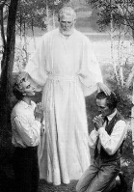
Joseph Smith Born
The First Vision
Moroni Visits
VERMONT
NEW HAMPSIRE
NEW YORK
SHARON
LEBANON
PALMYRA
5
December 23,
1805
Sept 21-22
1823
JOSEPH SMITH HISTORY
D&C 2
Mt. Tambora
1812
1815
James 1:5-6
Spring, 1820
Isaiah, Malachi, Joel
Joseph receives the Plates
Priesthood Restored
Translated & Published
Church Organized
Mission to Lamanites
CHURCH
HISTORY
5000
Sept 22
1827
May/June
1829
March 26
1830
April 6
1830
Fall
1830
D&C 3-19
D&C 20-31
D&C 32-42
John the Baptist
Martin Harris (116)
Oliver Cowdrey
Hill Cumorah
Peter,James,John
Peter Whitmer Farm, Fayette, NY
Edward Partridge & Sydney Rigdon
Move to Ohio
Bible Translation (JST) Book of Commandments
Visit to Missouri
OHIO
MISSOURI
KIRTLAND
INDEPENDENCE (JACKSON COUNTY)
Jan-June 1831
1831-32
1831
D&C 41-56
D&C 1,63-81, 133
D&C 57-62
The Laws
The Holy Ghost
3 Degrees of Glory (D&C 76)
Seeking for Zion

Slide 3
Joseph Smith Born
The First Vision
Moroni Visits
VERMONT
NEW HAMPSIRE
NEW YORK
SHARON
LEBANON
PALMYRA
5
December 23,
1805
Sept 21-22
1823
JOSEPH SMITH HISTORY
D&C 2
Mt. Tambora
1812
1815
James 1:5-6
Spring, 1820
Isaiah, Malachi, Joel
Joseph receives the Plates
Priesthood Restored
Translated & Published
Church Organized
Mission to Lamanites
CHURCH
HISTORY
5000
Sept 22
1827
May/June
1829
March 26
1830
April 6
1830
Fall
1830
D&C 3-19
D&C 20-31
D&C 32-42
John the Baptist
Martin Harris (116)
Oliver Cowdry
Hill Cumorah
Peter,James,John
Peter Whitmer Farm, Fayette, NY
Edward Partridge & Sydney Rigdon
Move to Ohio
Bible Translation (JST) Book of Commandments
Visit to Missouri
OHIO
MISSOURI
KIRTLAND
INDEPENDENCE (JACKSON COUNTY)
Jan-June 1831
1831-32
1831
D&C 41-56
D&C 1,63-81, 133
D&C 57-62
The Laws
The Holy Ghost
3 Degrees of Glory (D&C 76)
Seeking for Zion

Slide 4
Joseph Smith Born
The First Vision
Moroni Visits
VERMONT
NEW HAMPSIRE
NEW YORK
SHARON
LEBANON
PALMYRA
5
December 23,
1805
Sept 21-22
1823
JOSEPH SMITH HISTORY
D&C 2
Mt. Tambora
1812
1815
James 1:5-6
Spring, 1820
Isaiah, Malachi, Joel
Joseph receives the Plates
Priesthood Restored
Translated & Published
Church Organized
Mission to Lamanites
CHURCH
HISTORY
5000
Sept 22
1827
May/June
1829
March 26
1830
April 6
1830
Fall
1830
D&C 3-19
D&C 20-31
D&C 32-42
John the Baptist
Martin Harris (116)
Oliver Cowdry
Hill Cumorah
Peter,James,John
Peter Whitmer Farm, Fayette, NY
Edward Partridge & Sydney Rigdon
Move to Ohio
Bible Translation (JST) Book of Commandments
Visit to Missouri
OHIO
MISSOURI
KIRTLAND
INDEPENDENCE (JACKSON COUNTY)
Jan-June 1831
1831-32
1831
D&C 41-56
D&C 1,63-81, 133
D&C 57-62
The Laws
The Holy Ghost
3 Degrees of Glory (D&C 76)
Seeking for Zion

Slide 5
?
?
?
?
?
?
?
?
JOSEPH SMITH HISTORY
D&C 2
? ?
?
?
? ? ?
?
?
?
?
CHURCH
HISTORY
?
?
?
?
?
?
?
D&C 3-19
D&C 20-31
D&C 32-42
?
?
?
? ?
?
?
?
?
?
D&C 41-56
D&C 1,63-81, 133
D&C 57-62
? ?
?

Slide 6
?
?
?
?
JOSEPH SMITH HISTORY
D&C 2
CHURCH
?
?
?
?
HISTORY
?
?
D&C 3-19
D&C 20-31
D&C 32-42
?
?
?
D&C 41-56
D&C 1,63-81, 133
D&C 57-62

Slide 7
?
?
?
?
?
?
? ? ?
CHURCH
?
?
?
?
HISTORY
?
?
?
?
?
?
?
?
?
?
?

Slide 8
2
7
8
1
6
11
3
10
15
4 5
9
12 13 14
19
22
CHURCH
16
25
HISTORY
17
18
20
23
21
24
28
26 27
29
34
32
31
36
33
30
35

Slide 9
JOSEPH SMITH HISTORY
D&C 2
CHURCH
HISTORY
D&C 3-19
D&C 20-31
D&C 32-42
D&C 41-56
D&C 1,63-81, 133
D&C 57-62

Slide 10
JOSEPH SMITH HISTORY
D&C 2
D&C 3-19
CHURCH
D&C 20-31
HISTORY
D&C 32-42
D&C 41-56
D&C 1,63-81, 133
D&C 57-62

Slide 11
Joseph Smith
Birth and Childhood
James 1:5-6
The First Vision
Moroni Visits
Joseph receives the Plates
Priesthood Restored
Translated & Published
Church Organized
Mission to Lamanites
Move to Ohio
VERMONT
NEW HAMPSIRE
SHARON
LEBANON
5000
NEW YORK
PALMYRA
5
June
1829
March 26
1830
December 23,
1805
Spring
1820
Sept 21-22
1823
Sept 22
1827
May/June
1829
April 6
1830
Fall
1830
Jan-June 1831
JOSEPH SMITH HISTORY
D&C 2
D&C 3-19
D&C 20-31
D&C 32-42
D&C 41-56
Isaiah, Malachi, Joel
Hill Cumorah
John the Baptist
Peter,James,John
Martin Harris (116)
Charles Anton
Oliver Cowdrey
Peter Whitmer Farm, Fayette, NY
Edward Partridge & Sydney Rigdon
The Laws
The Holy Ghost
1812
Mt. Tambora
Bible Translation (JST) Book of Commandments
Building the Temple
Persecutions
In Missouri
Zion’s Camp March
Mission to Europe
Temple Dedicated
Kirtland Apostasy
1815
1500
School of the Prophets
Word of Wisdom
12
70
Visits to Missouri
Move to Missouri
OHIO
KIRTLAND
1831
1832
1831-32
1832-33
1833
1834
1835
1836
1837-1838
Summer 1838
JACKSON COUNTY
D&C 1,63-81, 133
D&C 84-96
D&C 97-102
D&C
103-105
D&C 106-108, 134
D&C 109-110,137
D&C 111-112
D&C 113-120
D&C
57-62
D&C
82-83
The Name of the Church
Tithing
School of the Prophets
Word of Wisdom
Printing Press Destroyed
Move to Clay Co.
Sealing Power
Kirtland Safety Society
MISSOURI
3 Degrees of Glory
9 Apostles
7 Pres of 70
63 Q of 70
Abraham (Mummies)
Hymnal & D&C
John Taylor
Lorenzo Snow
Baptism for Dead
Endowment
Relief Society
The Migration West
Peace in Nauvoo
Martyrdom of Joseph & Hyrum
The Brooklyn
CLAY COUNTY
D&C 136
Extermination Order
NEW YORK
NEW YORK
CALIFORNIA
SAN FRANSISCO
April 1847 - July 24, 1847
70,000 Saints (1,611 original)
ILLINOIS
95%
D&C 138
NAUVOO
Feb 1846 – July 1846
NEBRASKA
SALT LAKE CITY
1840-1844
June 27, 1844
The Mormon Battalion
WINTER QUARTERS
4%
Joseph F. Smith
1838-1839
Martin & Willie
OfficialDeclarationOne (1890;WilfordWoodruff)
D&C 121-123
D&C 124-132
D&C 135
CALIFORNIA
Liberty Jail
Baptism for Dead
Endowment
Relief Society
IOWA
SAN DIEGO
Carthage Jail
COUNCIL BLUFFS
6%
21%
OfficialDeclarationTwo (1978;SpencerWKimball)
1856 - 1860
July 1846 – July1847
10 Handcart Companies (3,000 Saints)
The 13 Articles
of Faith
The Pearl of
Great Price
The Family
A Proclamation to the World
The Living Christ
A Testimony of
the Apostles
1947: 1 million
1982: 5 million
1997: 10 million
2018:16 million
1842
1880
1995
2000

