Slide 1
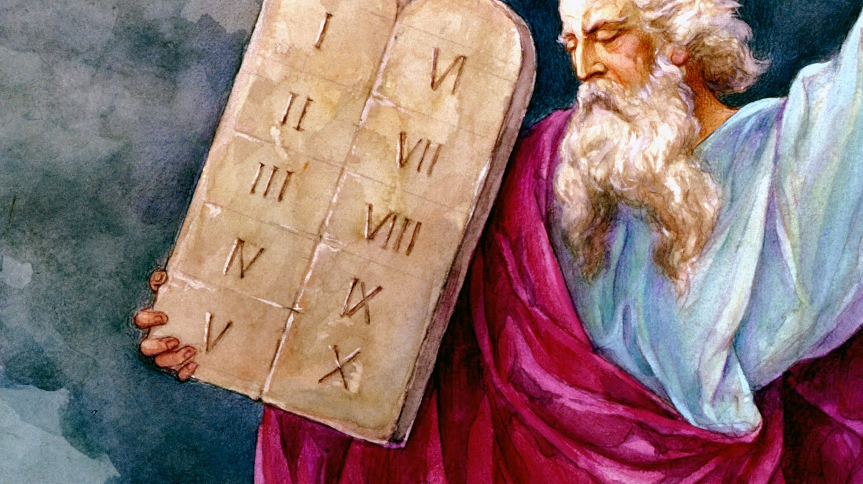
Commandments
Part 3

Slide 2
ACQUIRING SPIRITUAL KNOWLEDGE RECALL
Act in faith.
Examine concepts and questions with an eternal perspective.
Seek further understanding through divinely appointed sources.

Slide 3
RIKA
Imagine you have a friend named Rika whose mother has recently passed away from cancer. Rika’s mother was a faithful member of the Church and had kept the commandments, including the Word of Wisdom, throughout her life. You are good friends with Rika, and as you have talked with her, you have tried to comfort her, but you can tell that she is struggling to make sense of why this would happen to her mother. The last time you spoke with her, she brought up the Word of Wisdom and how it promises physical health to those who keep it. She expressed frustration about why God would let this happen to her mother when she had been faithful in keeping this commandment.

Slide 4
What do you think Rika could do to act in faith in this situation?
What truths have we learned about Heavenly Father and His plan of salvation that can apply to this situation?
How can Doctrine and Covenants 89:18–21 help us see this challenge with an eternal perspective?
What divinely appointed sources could we review to help us understand this issue better?
Share a few additional sources that could help Rika.

Slide 5
Choose one of the key statements of doctrine you have marked this term in your copy of the Core Document that is especially meaningful to you.
Turn to the doctrinal mastery scripture passage associated with this key statement of doctrine and read it.
Discuss:
Why is this key statement of doctrine and doctrinal mastery passage meaningful to you?
How has this passage has helped you?
How has understanding this doctrine influenced your behavior?
Who do you know who could benefit from learning about this doctrine? How might you help that person learn about it?

Slide 6
Commandments
Part 3

