Slide 1
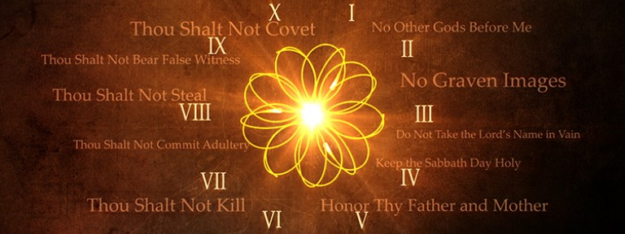
COMMANDMENTS, Part II
God’s commandments include observing the Word of Wisdom and teaching the gospel to others.

Slide 2
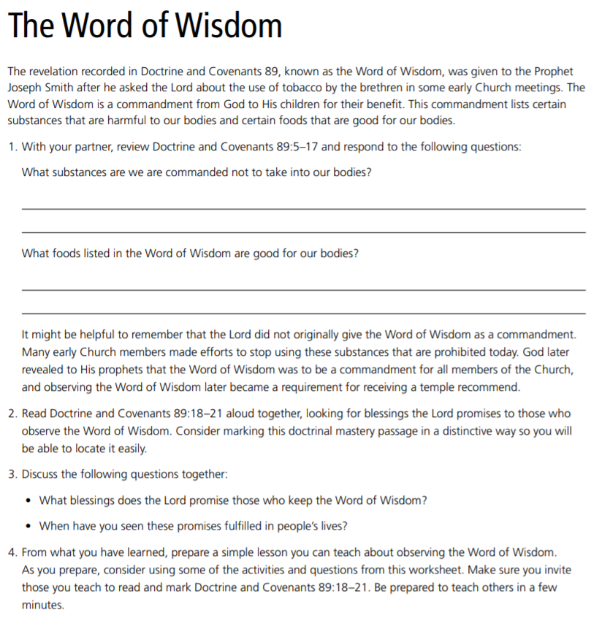
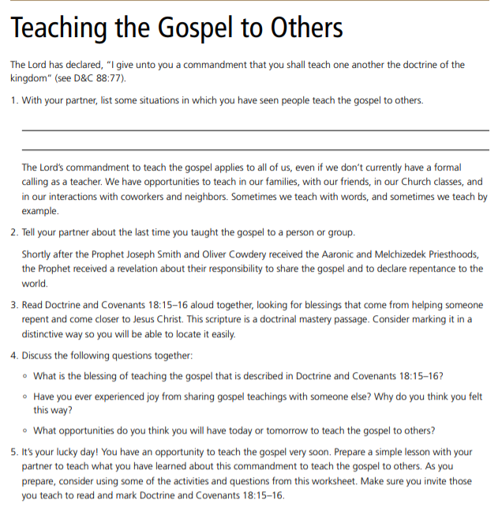
COMMANDMENTS
TEAM WORK

Slide 3
TIME TO TEACH EACH OTHER!

Slide 4
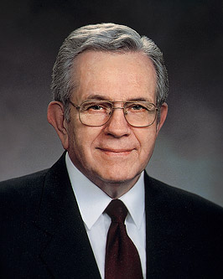
“The Lord said, ‘I . . . Give unto them a promise, that the destroying angel shall pass by them, as the children of Israel, and not slay them’ (D&C 89:21). That is a remarkable promise.
“To understand it, we must turn to the time of Moses. The Israelites had been enslaved for 400 years. Moses came as their deliverer. He called forth plagues upon Egypt. The Pharaoh agreed each time to free the Israelites, but each time he reneged on [disregarded] his promise. Finally, ‘the Lord said unto Moses, Yet will I bring one plague more upon Pharaoh, and upon Egypt; afterwards he will let you go. . . . All the firstborn in the land of Egypt shall die’ (Ex. 11:1, 5). “Moses told the Israelites to ‘take . . . a lamb . . . without blemish, a male of the first year. . . . Neither shall ye break a bone thereof’ (Ex. 12:3, 5, 46; see also John 19:33)….
Boyd K. Packer, “Prayers and Answers,” Ensign, Nov. 1979.

Slide 5
“They were to prepare the lamb as a feast and ‘take of the blood, and strike it on the . . . door post of the houses. . . . For I will pass through the land of Egypt this night, and will smite all the firstborn in the land . . . : and when I see the blood, I will pass over you, and the plague shall not be upon you to destroy you. . . . And this day . . . ye shall keep . . . by an ordinance for ever’ (Ex. 12:7, 12–14). ‘When your children shall say unto you, What mean ye by this . . . ? . . . ye shall say, It is the sacrifice of the Lord’s passover’ (Ex. 12:26–27). “Surely, young people, you see the prophetic symbolism in the Passover. Christ was ‘the Lamb of God’ (John 1:29, 36), the firstborn, male, without blemish. He was slain without breaking his bones, even though the soldiers were sent to do it…
Boyd K. Packer, “Prayers and Answers,” Ensign, Nov. 1979.

Slide 6
“While the Word of Wisdom requires strict obedience, in return it promises health, great treasures of knowledge, and that redemption bought for us by the Lamb of God, who was slain that we might be redeemed. “I have come to know . . . that a fundamental purpose of the Word of Wisdom has to do with revelation. . . . “If someone ‘under the influence’ [of harmful substances] can hardly listen to plain talk, how can they respond to spiritual promptings that touch their most delicate feelings? “As valuable as the Word of Wisdom is as a law of health, it may be much more valuable to you spiritually than it is physically”
Boyd K. Packer, “Prayers and Answers,” Ensign, Nov. 1979.

Slide 7
What do President Packer’s statements help us understand about the promised blessings of the Word of Wisdom?
Boyd K. Packer, “Prayers and Answers,” Ensign, Nov. 1979.

Slide 8
Doctrinal Mastery Review
Doctrine and Covenants 18:15–16
Doctrine and Covenants 64:9–11
Doctrine and Covenants 89:18–21
Provide students with a sheet of paper. Ask them to write the number 18, 64, OR 89 in the middle of the paper. Then invite them to create a picture or pictures using the number 89 to depict the meaning of Doctrine and Covenants 89:18–21 (EXAMPLE: make the 8 or the 9 (or both) into a picture of someone running without weariness or someone opening a treasure chest-- or draw pictures on the paper surrounding the number 89 that represent the promises described in the doctrinal mastery passage).

Slide 9
COMMANDMENTS, Part II
God’s commandments include observing the Word of Wisdom and teaching the gospel to others.

