Slide 1
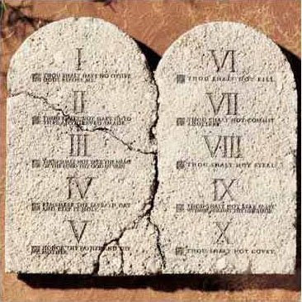
Commandments
Doctrinal mastery, Commandments part one

Slide 2
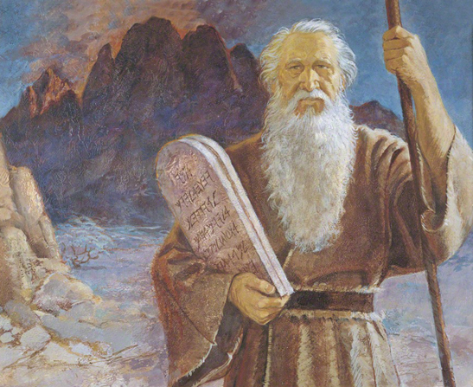
Small Group Activity
List as many commandments as you can in one minute.
Which of these commandments do you think are the greatest or most important?

Slide 3
With a partner…
Read paragraph 9.1 in the Core Document: Why does Heavenly Father give us commandments?
Next, read paragraphs 9.2-9.5 in the Core Document: Look for commandments you can add to your list. Which of these commandments have brought blessings into your life?
Look at paragraph 9.5 and find which commandments are associated with DM passages in the D&C (Hint: God’s commandments include … forgiving others, observing the Word of wisdom, and teaching the gospel to others).
Why do you think God commands us to forgive others?
In what ways does the commandment to forgive others show Heavenly Father’s love for His children?
How do you think forgiving others will help us become more like Heavenly Father?

Slide 4
Can you think of a time when you or someone you know struggled to forgive someone? What did you do to overcome?

Slide 5
D&C 64: 9-11 MARK IT!
The revelation recorded in D&C 64 was given through the Prophet Joseph Smith after he and some other brethren had returned to Ohio from a trip to Missouri. During the journey to and from Missouri, some of the brethren had disagreements with each other and struggled with contentious feelings.
Why do you think we stand condemned, or are considered guilty, if we do not forgive others?
Why does God command us to forgive each other?
What will be the consequences of our not forgiving someone who has wronged us?

Slide 6
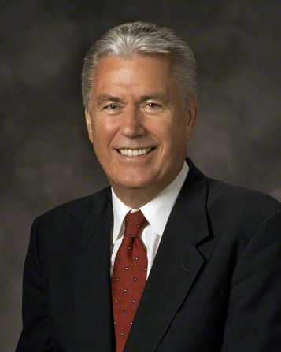
“Extending forgiveness is a precondition to receiving forgiveness. For our own good, we need the moral courage to forgive and to ask for forgiveness. Never is the soul nobler and more courageous than when we forgive. This includes forgiving ourselves. “Each of us is under a divinely spoken obligation to reach out with pardon and mercy and to forgive one another. … “We will receive the joy of forgiveness in our own lives when we are willing to extend that joy freely to others. Lip service is not enough. We need to purge our hearts and minds of feelings and thoughts of bitterness and let the light and the love of Christ enter in. As a result, the Spirit of the Lord will fill our souls with the joy accompanying divine peace of conscience.”
Dieter F. Uchtdorf, “Point of Safe Return,” Ensign or Liahona, May 2007, 101.

Slide 7
Cross-reference Matthew 6:14-15
Why is extending forgiveness critical for our spiritual growth?
From what we have learned so far, what could you tell a friend who is angry and hurt because of something someone did to them?

Slide 8
DM Review
____ 1. It is a commandment to forgive others, even when they are not sorry for what they have done.
____ 2. If we refuse to forgive others, then we cannot be forgiven, and we will stand condemned before the Lord.
____ 3. It is acceptable to withhold forgiveness until the offender has learned to change his or her behavior.
____ 4. Doctrine and Covenants 64:9–11 helps teach the following key statement of doctrine: God’s commandments include forgiving others.
____ 5. With the Lord’s help, we can leave the punishment of someone who has offended us in God’s hands, and we can move on in our lives without holding on to negative thoughts and feelings.
Notes:
Answers to the quiz: 1. True; 2. True; 3. False; 4. True; 5. True.

Slide 9
Commandments
Doctrinal mastery, Commandments part one

