Slide 1
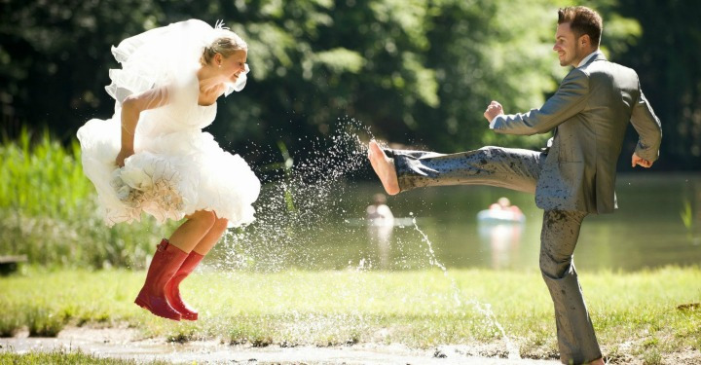
Marriage and Family
Part 2

Slide 2
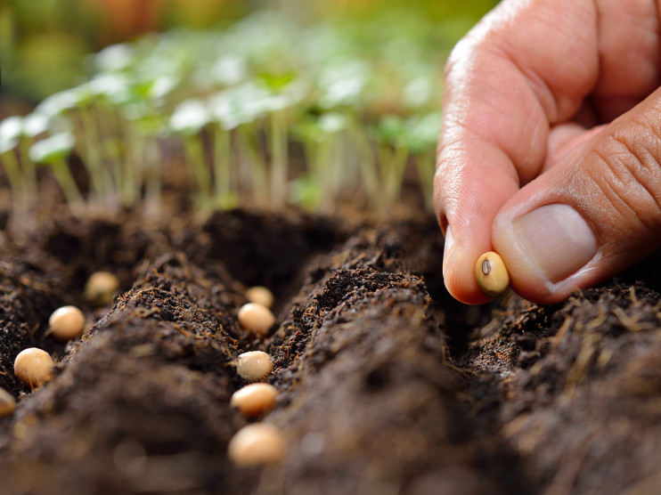
Look at this seed. What does this seed have the potential to become?
What must happen in order for the seed to fulfill its potential?

Slide 3
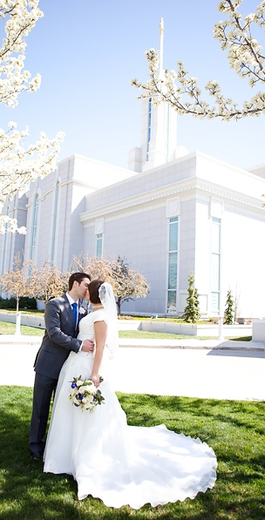
Read 8.1 in the Doctrinal Mastery Core Document. Follow along, looking for what must take place in order for us to fulfill our eternal potential.
What do you think it means for us to enter into and faithfully keep the covenant of celestial marriage?

Slide 4
Read D&C 131:1-4
What did the Prophet Joseph Smith teach about eternal marriage and the celestial kingdom?
What do you think it means to obtain the highest degree of celestial glory? (Explain that this refers to exaltation, or becoming like our Heavenly Father.)
What do you think it means that those who are not exalted cannot have an increase? (Explain that this means that only those who inherit the highest degree of celestial glory can have eternal posterity.)
What are some things that might prevent people from choosing to get married in the temple?

Slide 5
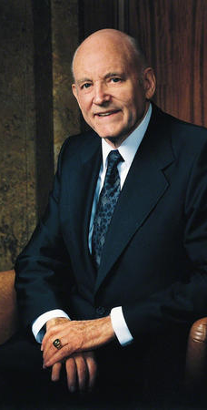
“In the temple we receive the highest ordinance available to men and women, the sealing of husbands and wives together for eternity. We hope our young people will settle for nothing less than a temple marriage.
“Just as baptism is a commandment of the Lord, so is temple marriage. … It is part of our destiny. We cannot fulfill our ultimate aims without it. Do not be satisfied with anything less” (Teachings of Presidents of the Church: Howard W. Hunter [2015], 210).

Slide 6
What are some of the most important reasons why we should not be satisfied with anything less than a temple marriage?
What are some things you can do now to ensure that you settle for nothing less than a temple marriage in the future?

Slide 7
Practice
Divide into 3 groups then read the story: Who Will I Be Sealed to In Eternity?
Group 1: Look for ways that President Eyring invited us to act in faith.
Group 2: Look for ways that President Eyring examined this issue with an eternal perspective.
Group 3: Look for divinely appointed sources that President Eyring used in his discussion of this concept.
A volunteer from each group will report on what each their group discussed.

Slide 8
Marriage and Family
Part 2

