Slide 1
Marriage and Family
PART I

Slide 2
Understanding the Doctrine
Imagine that you have a friend who does not want to get married because he thinks that he could accomplish more in life without a spouse or a family. What would you say to him?

Slide 3
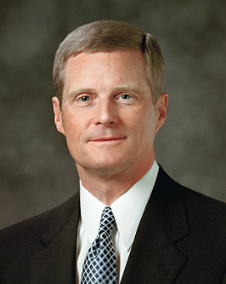
“One of the great tasks of our time … is to help people understand the true meaning and purpose of marriage” (David A. Bednar, “The Divinely Designed Pattern of Marriage” [address at Humanum Symposium, Mar. 9, 2017], mormonnewsroom.org).
Why do you think that helping people to understand the true meaning and purpose of marriage is one of the great tasks of our time?
Read paragraphs 8.1 through 8.4 in the “Marriage and Family,” section in the Doctrinal Mastery Core Document. What are some statements from these paragraphs that describe the true meaning and purpose of marriage?

Slide 4
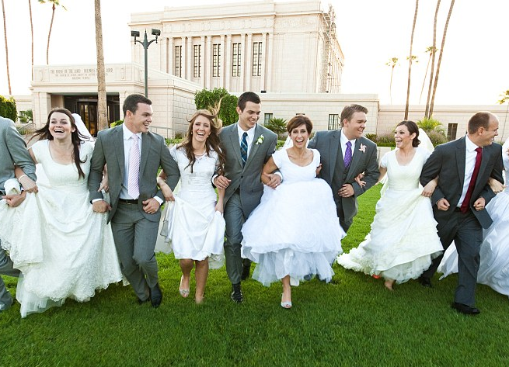
Marriage between a man and a woman is ordained of God, and the family is central to His plan of salvation and to our happiness. What do you think it means that marriage between a man and a woman is ordained of God? In what way is the family central to God’s plan and to our happiness?

Slide 5
Doctrine and Covenants 49:15–17
What are some truths that we can learn about marriage in these verses?
What do you think it means in verse 16 that marriage between a man and a woman helps the earth to “answer the end of its creation”?
What are some worldly viewpoints related to marriage and family that are different from God’s standards?
How these viewpoints differ from the truths that marriage between a man and a woman is ordained of God and that the family is central to God’s plan of salvation and to our happiness.

Slide 6
“All people, especially the rising generation, need a vision of the richness of family life and its potential for developing the highest and best in each of us. In an age of increasing selfishness, we must highlight marriage’s capacity to lift men and women beyond their narrow self-interests to the joys that come from dedicating one’s life to a higher and holy purpose.” (David A. Bednar, “The Divinely Designed Pattern of Marriage” [address at Humanum Symposium, Mar. 9, 2017], mormonnewsroom.org).

Slide 7
In what ways do you think marriage and family relationships can develop “the highest and best in each of us”?
In what ways have you seen family relationships produce joy or self-improvement in your own life or in the life of someone you know?

Slide 8
Practice
Read “Is Marriage Really Necessary?”
Discuss the questions on the handout within your partnership.
Be prepared to have someone share some of their findings.
https://www.lds.org/bc/content/shared/content/images/gospel-library/manual/PD60001174/PD60001174_000_Marriage_Family_handout1.pdf

Slide 9
Act in Faith
How might Luke exercise faith as he searches for answers to his questions?
Examine Concepts and Questions with an Eternal Perspective
What does Luke need to understand about the purpose of marriage in Heavenly Father’s plan?
Why do you think God commands that the sacred powers of procreation are to be used only by a husband and wife?
How could Doctrine and Covenants 49:15–17 help Luke view the concept of marriage with an eternal perspective?
Seek Further Understanding through Divinely Appointed Sources
What are other sources that could be helpful to someone who might be confused about the purpose of marriage?

Slide 10
Marriage and Family
PART I

