Slide 1
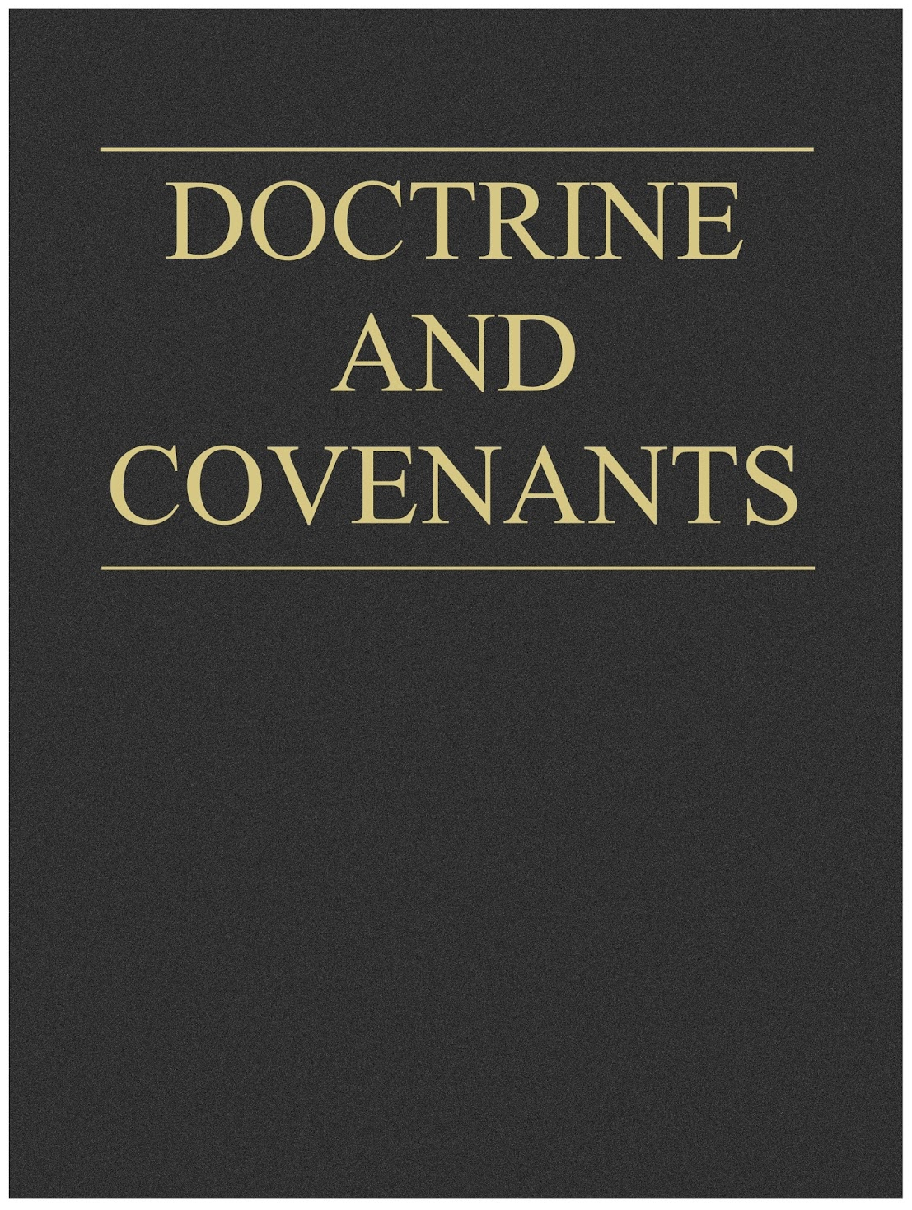
Doctrinal Mastery
Ordinances and Covenants
Part 2

Slide 2
Information to teacher:
The teaching materials for the learning experience on “Ordinances and Covenants” are divided into two parts. Part 2 includes a practice exercise that will help students apply the doctrine they learned from the Doctrinal Mastery Core Document, along with the doctrinal mastery passage found in Doctrine and Covenants 84:20–22. This lesson also includes a cumulative review for all the doctrinal mastery passages students have studied so far.
Note: You could teach the practice exercise and doctrinal mastery review in this lesson in a single class session or in two separate class sessions, sharing class time with your regular sequential scripture lesson from the Doctrine and Covenants.

Slide 3
Practice Exercise
Let’s review the three principles from the “Acquiring Spiritual Knowledge” section in the Doctrinal Mastery Core Document:
Act in faith
Examine concepts and questions with an eternal perspective
Seek further understanding through divinely appointed sources

Slide 4
You have a friend named Lauren who has not come to church for several months. You and some other members of your Sunday School class decide to visit her at her home to encourage her to attend church this coming Sunday.
When you tell her that you’ve missed her at church, she replies, “I’ve been going on hikes on Sundays instead of coming to church. I feel closer to God in nature.”
When you try to tell her about how it will bless her and others if she attends church, she says, “I don’t need the Church in order to be a good person. And I don’t think God is going to reject people from being with Him just because they don’t go to church and do all the things the Church tells them to do.”
How would you help Lauren?

Slide 5
Group Activity
Discuss and answer the questions on the handout.
Be prepared to share your answers with the class.

Slide 6
Note to teacher:
Divide the class into small groups. Provide each group with the accompanying handout, and give each group time to work on it together.
After students have had sufficient time to discuss the questions in the handout, invite each group to share with the class one idea they have for helping Lauren acquire spiritual knowledge.
Encourage students to record in their class notebooks or study journals their thoughts about the experience and the answers their group found.
https://www.lds.org/bc/content/shared/content/images/gospel-library/manual/PD60001174/PD60001174_000_Ordinances_Covenants_handout.pdf

Slide 7
Doctrinal Mastery Cumulative Review

Slide 8
Note to teacher:
Before class begins, write down the scripture reference for each of the doctrinal mastery passages you have studied so far this school year on strips of paper, so that each paper has one scripture reference on it.
If the class is larger than 20 students, you may want to duplicate some references or divide students to work in pairs. If the class is smaller than 20 students, you may want to select specific passages for this activity and make note of the unused passages so they can be used in a future activity.

Slide 9
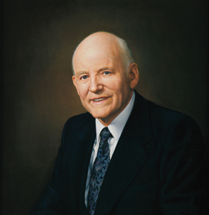
President Howard W. Hunter
“We want … students to have confidence in the strength and truths of the scriptures, confidence that their Heavenly Father is really speaking to them through the scriptures, and confidence that they can turn to the scriptures and find answers to their problems and their prayers”

Slide 10
How has Doctrinal Mastery helped you experience the truth of President Hunter’s words?
In what ways have your confidence and understanding of the doctrinal topics increased?
When we consistently and diligently practice and use the key statements of doctrine and the doctrinal mastery scripture passages, our understanding and confidence in these truths will continue to increase.

Slide 11
Your Assignment:
Select
Each person will select a strip of paper with a doctrinal mastery scripture reference written on it.
Locate
Locate the key statement of doctrine in your copy of the Doctrinal Mastery Core Document that is associated with the doctrinal mastery scripture passage on the strip of paper.
Prepare
Prepare a 2- to 3-minute seminary devotional teaching the truths of these doctrines.

Slide 12
Note to teacher:
If possible, you may want to invite students to use their mobile devices to search LDS.org or the Gospel Library app for articles and other materials that could help them teach these key statements of doctrine and scripture passages. Encourage students to include an invitation or challenge for their peers to apply in their lives as a part of each devotional.
Give students time to study and prepare, and encourage them to record their thoughts in their scripture journals or study notebooks. As time permits, you might invite a student to present his or her devotional as an example for the class. You could also pass a calendar around the class so students can sign up for a date to present their devotional during a class session.

Slide 13
Doctrinal Mastery
Ordinances and Covenants
Part 2

