Slide 1
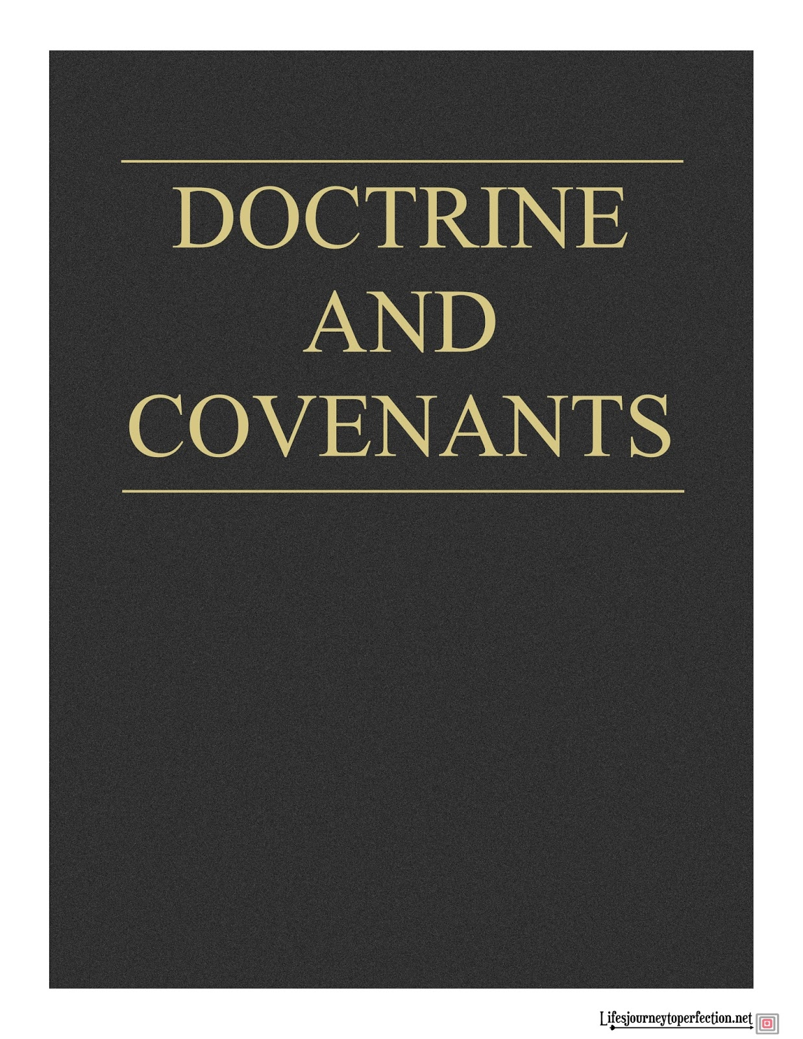
Doctrinal Mastery
Ordinances and Covenants
Part 1

Slide 2
What has Heavenly Father given us to help us become more like Him and to be able to return to live with Him?
Turn to doctrinal topic 7, “Ordinances and Covenants,” in the Doctrinal Mastery Core Document. Read paragraphs 7.1 and 7.2 and look for the definition and purposes of ordinances.

Slide 3
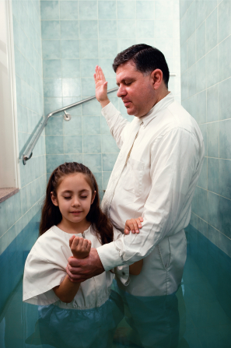
What spiritual truths does the ordinance of baptism symbolically teach?
Why are some ordinances called “saving ordinances”?
Which key statement of doctrine in paragraph 7.2 teaches what saving ordinances do for us? (please mark this statement in your Doctrinal Mastery Core Document).
Without these saving ordinances we cannot become like our Heavenly Father or return to live in His presence eternally.

Slide 4
Assignment:
Read paragraphs 7.3 through 7.6 and look for examples of saving ordinances and other priesthood ordinances.
Mark each saving ordinance.
1
2

Slide 5
Name the saving ordinances found in paragraphs 7.3 through 7.5
Baptism,
Receiving the gift of the holy ghost,
Ordination to the Melchizedekian priesthood (for men),
The temple endowment,
The temple sealing.
Without these saving ordinances we cannot become like our Heavenly Father or return to live in His presence eternally.

Slide 6
Which doctrinal mastery passage helps teach this truth?
Without these saving ordinances we cannot become like our Heavenly Father or return to live in His presence eternally.
D&C 84:20–22
20 Therefore, in the ordinances thereof, the power of godliness is manifest.
21 And without the ordinances thereof, and the authority of the priesthood, the power of godliness is not manifest unto men in the flesh;
22 For without this no man can see the face of God, even the Father, and live.
Please mark these verses in your scriptures
According to these verses, what is shown in the ordinances of the Melchizedek Priesthood?
What do you think the phrase “the power of godliness” means?

Slide 7
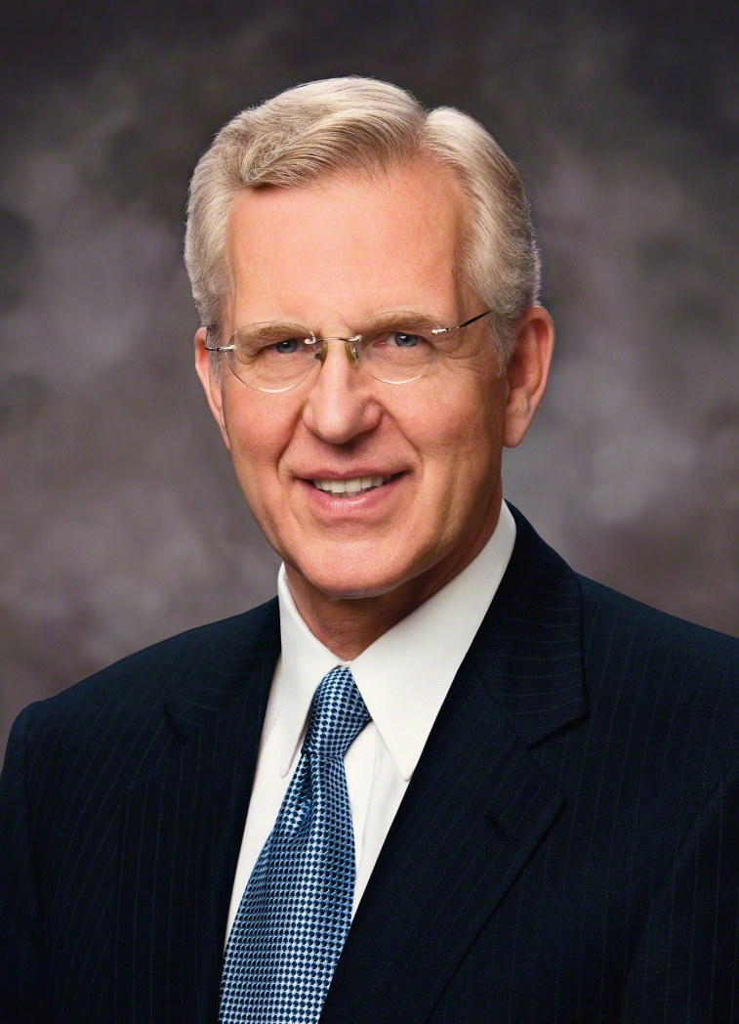
“Our covenant commitment to Him permits our Heavenly Father to let His divine influence, ‘the power of godliness’ (D&C 84:20), flow into our lives. He can do that because by our participation in priesthood ordinances we exercise our agency and elect to receive it. Our participation in those ordinances also demonstrates that we are prepared to accept the additional responsibility that comes with added light and spiritual power.
“In all the ordinances, especially those of the temple, we are endowed with power from on high. This ‘power of godliness’ comes in the person and by the influence of the Holy Ghost. The gift of the Holy Ghost is part of the new and everlasting covenant. It is an essential part of our baptism, the baptism of the Spirit. It is the messenger of grace by which the blood of Christ is applied to take away our sins and sanctify us.
(D. Todd Christofferson, “The Power of Covenants,” Ensign or Liahona, May 2009, 22)
According to Elder Christofferson, what is the power of godliness?
In Elder Christofferson’s words, what can help us invite God’s divine influence into our lives?

Slide 8
Paragraphs 7.7 through 7.9 in the Doctrinal Mastery Core Document and look for how, when, and where covenants are made.
What key statement of doctrine in paragraph 7.7 describes how covenants are made?
According to paragraph 7.8, what is the relationship between saving ordinances and covenants?
What do we covenant to do when we receive the ordinance of baptism?
What blessings does God promise to give us if we keep our baptismal covenant?
How can knowing the specific blessings the Lord has promised us help us want to keep our covenants?

Slide 9
Assignment:
Review paragraph 7.7 in the Doctrinal Mastery Core Document.
Turn to Doctrine and Covenants 82:10. Mark this doctrinal mastery passage in a distinctive way in your scriptures.
1
2

Slide 10
Doctrine and Covenants 82:10
What does the Lord promise in this scripture passage?
How does this doctrinal mastery passage help teach the key statement of doctrine about covenants in paragraph 7.7?
What does the phrase “I, the Lord, am bound when ye do what I say” (D&C 82:10) teach you about how God views covenants?
How does breaking our covenants affect God’s promises?
How has the Lord blessed you for keeping your covenants?

Slide 11
Paragraph 7.8 in the Doctrinal Mastery Core Document, last sentence:
We renew covenants we have made by partaking of the sacrament.
Why do you think we need the opportunity to renew our covenants?
Because the Lord wants to bless us, He wants us to remember and keep the covenants we have made with Him.

Slide 12
What will I do to remember my covenants during the sacrament this week?
What can I do to keep the time during the sacrament sacred?
What can I do this week to remember and keep my covenants?
JOURNAL

Slide 13
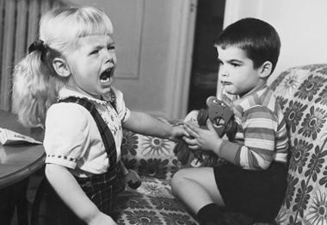
Who will share a thought or experience?

Slide 14
Doctrinal Mastery
Ordinances and Covenants
Part 1

