Slide 1
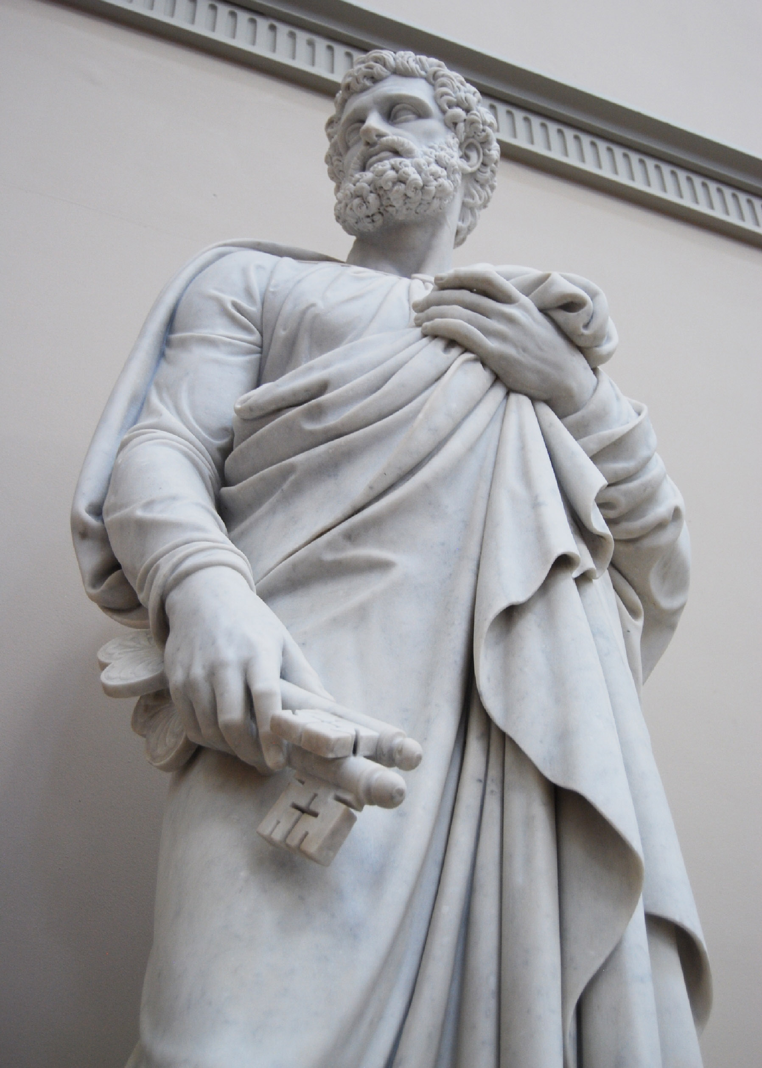
Priesthood & Priesthood Keys
Part 4

Slide 2
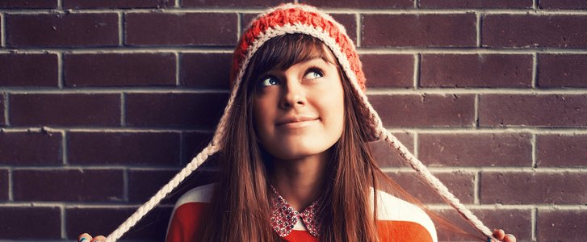
Priesthood and Priesthood Keys
Monika
A young woman named Monika comes from a faithful family and has learned the gospel throughout her life. She loves attending Young Women and seminary. One day a girl from school says to her that the Church does not value women because women do not hold the priesthood or certain leadership positions. The girl argues that the world has recognized the contribution of women and treats them as equals, and then she asks Monika, “When will the Church catch up with the rest of the world on this social issue?”
Monika has never felt unloved or unappreciated at church. She has been taught that she has a divine nature and individual worth. She has observed powerful Young Women leaders and a wonderful mother who happily serve in the Church and in their communities. But Monika is unsure how to answer the question. In fact, it starts to bother her, and she begins to wonder why women don’t hold certain positions in the Church. The argument she heard about equality and fairness for men and women begins to sound reasonable to her.

Slide 3
Priesthood and Priesthood Keys
Monika
One day in seminary Monika writes a note to her seminary teacher, Sister Bell, asking, “When will the Church be like everyone else and start treating men and women equally?” The following day, Sister Bell decides to address the question in class. She asks how a person with this question might act in faith. Students discuss things such as the importance of praying to Heavenly Father for help and understanding. One student expresses the importance of holding on to what they already understand about their relationship with Heavenly Father and shares an example of when she came to know that Heavenly Father loves her and values her.
How could the comments by Monika’s classmates help her act in faith?
What other suggestions do you have for how a person with this question might act in faith?

Slide 4
Priesthood and Priesthood Keys
Monika
To help the class consider how they might examine the question with an eternal perspective, Sister Bell encourages them to think about the worldly assumption or premise upon which the question is based. She asks, “How might the world define equality and fairness?” A few students comment on how some people think that equality and fairness mean that everything must be the same between men and women. A young man explains that according to the world, a person’s position determines his or her importance, and that could lead to the perspective that some Church callings are more valued than others, making it seem unfair if everyone can’t hold those callings.
Can you think of any other worldly assumptions or premises that could influence how some people might view callings or positions in the Church?

Slide 5
Priesthood and Priesthood Keys
Monika
Sister Bell then asks how the class might reframe this question from the Lord’s perspective. Because this is a difficult skill, Sister Bell suggests that they might ask, “How does the Lord define equality and fairness?” Or “How does the Lord view the role of men and women in the plan of salvation?” One student suggests that many prophets have taught that to the Lord, equality does not mean that men and women are exactly the same. Another student brings up “The Family: A Proclamation to the World” and says that in the plan of salvation, and in the Church, men and women have different but equally important roles. One young woman says, “I was thinking of it a little differently. Should this be about what we want, or should we care more about what the Lord wants?”

Slide 6
Priesthood and Priesthood Keys
Monika
Sister Bell thanks the students for their insights and reminds them that the Savior does not view callings and leadership as the world does. She points out that the scriptures teach that “the eye cannot say unto the hand, I have no need of thee” (1 Corinthians 12:21) but that all members are an integral part of the same body and that all are needed and have an opportunity to serve.
Then Sister Bell asks, “During His mortal ministry, how did the Savior show that He loved and valued women?” With the help of their teacher, the students think of examples, like the way He treated His mother, the Samaritan woman at the well, and Mary Magdalene. They also remember miracles that He performed that blessed and healed women.

Slide 7
Priesthood and Priesthood Keys
Monika
To help her students seek further understanding through divinely appointed sources, Sister Bell encourages her students to search their memories for helpful scripture references and talks from Church leaders that relate to this question. They identify resources such as “The Family: A Proclamation to the World” and the Gospel Topics Essays. One particular talk is suggested that catches Monika’s attention. It is a talk by Sister Linda K. Burton called “We’ll Ascend Together” from the April 2015 general conference. Sister Bell also suggests a talk given by President Russell M. Nelson called “A Plea to My Sisters” from the October 2015 general conference. Monika makes a note of these in her study journal and decides to study them later.
Can you think of any additional divinely appointed sources that might help someone with Monika’s question?

Slide 8
Priesthood and Priesthood Keys
Monika
The discussion ends with Sister Bell sharing her testimony that all who serve in the Church—men and women—are called under the direction of one who holds priesthood keys, and she reminds them that this truth is found in Doctrine and Covenants 42:11. She also reminds her students that “whoever functions in an office or calling received from one who holds priesthood keys exercises priesthood authority in performing her or his assigned duties” (Dallin H. Oaks, “The Keys and Authority of the Priesthood,” Ensign or Liahona, May 2014, 51). She also reminds her students of the doctrinal mastery scripture passage that says “The Lord … doeth that which is good among the children of men; … and he inviteth them all to come unto him and partake of his goodness; and he denieth none that come unto him, black and white, bond and free, male and female; … all are alike unto God” (2 Nephi 26:33). Sister Bell encourages her students to continue to prayerfully study this question and invites them to bring to class what they learn.
What did you learn from this scenario about Monika’s question?

Slide 9
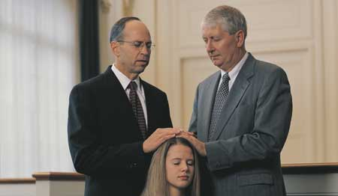
Heavenly Father loves all of His children and that everyone who serves in the Church:
Is called under the direction of one who holds priesthood keys.
Exercises priesthood authority in performing her or his duties
Is an important part of the kingdom of God.

Slide 10
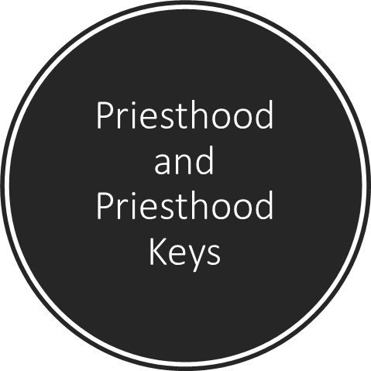
Please review the doctrinal mastery passages and statements of doctrine as we take the assessment.
Priesthood
Priesthood

Slide 11
God has promised to reveal truth to our minds and hearts through the Holy Ghost if we will diligently seek Him.
D&C 8:2–3
Joseph Smith—History 1:15–20
D&C 135:3
The Father and the Son have tangible, glorified bodies of flesh and bone, and the Holy Ghost is a personage of spirit.
D&C 130:22–23
D&C 29:10–11
D&C 1:37–38
Jesus Christ’s atoning sacrifice provided the only way for us to be cleansed and forgiven of our sins so that we can dwell in God’s presence eternally.
D&C 1:30
D&C 19:16–19
D&C 42:11
All who serve in the Church—men and women—are called under the direction of one who holds priesthood keys.
D&C 21:4–6
D&C 19:16–19
D&C 42:11
Priesthood
Priesthood

Slide 12
Because it was established by God Himself, The Church of Jesus Christ of Latter-day Saints is “the only true and living church upon the face of the whole earth.”
D&C 19:16–19
D&C 8:2–3
D&C 1:30
God the Father and His Son, Jesus Christ, appeared to Joseph Smith in response to Joseph’s prayer, and They called him to be the Prophet of the Restoration.
Joseph Smith—History 1:15–20
D&C 6:36
D&C 58:42–43
The Lord Himself has invited us to “look unto [Him] in every thought; doubt not, fear not.”
D&C 76:22–24
D&C 6:36
D&C 21:4–6
The Melchizedek Priesthood is the higher, or greater, priesthood and “holds the right of presidency, and has power and authority over all the offices in the church in all ages of the world, to administer in spiritual things.”
D&C 107:8
D&C 88:118
D&C 1:30
Priesthood
Priesthood

Slide 13
As the Prophet of the Restoration, Joseph Smith translated the Book of Mormon by the gift and power of God.
D&C 107:8
D&C 135:3
D&C 76:22–24
Repentance includes recognizing our sins; feeling remorse, or godly sorrow, for committing sin; confessing our sins to Heavenly Father and, if necessary, to others; forsaking sin; seeking to restore, as far as possible, all that has been damaged as a result of our sins; and living a life of obedience to God’s commandments.
D&C 76:22–24
D&C 58:42–43
D&C 130:22–23
Jesus Christ created the heavens and the earth under the direction of the Father.
D&C 13:1
D&C 76:22–24
D&C 1:30
A prophet is a person who has been called by God to speak for Him.
D&C 18:10–11
D&C 13:1
D&C 1:37–38

Slide 14
Because our Heavenly Father loves us and wants us to progress toward becoming like Him, He has encouraged us to “seek learning, even by study and also by faith.”
D&C 42:11
D&C 1:30
D&C 88:118
If we faithfully receive and obey the teachings of the President of the Church, God will bless us to overcome deception and evil.
D&C 21:4–6
D&C 121:36,41–42
D&C 130:22–23
The Aaronic Priesthood “holds the keys of the ministering of angels, and of the gospel of repentance, and of baptism.”
Joseph Smith—History 1:15–20
D&C 13:1
D&C 6:36
Jesus Christ’s sacrifice benefits each of us and demonstrates the infinite worth of each and every one of Heavenly Father’s children.
D&C 121:36,41–42
D&C 88:118
D&C 18:10–11

Slide 15
Jesus Christ will come again in power and glory and will reign on the earth during the Millennium.
D&C 58:42–43
D&C 13:1
D&C 29:10–11
Priesthood authority can only be exercised in righteousness.
D&C 135:3
D&C 121:36, 41–42
D&C 58:42–43

Slide 16
Answers to the quiz
1. a
2. a
3. b
4. c
5. c
6. a
7. b
8. a
9. b
10. b
11. b
12. c
13. c
14. a
15. b
16. c
17. c
18. b

Slide 17
Priesthood & Priesthood Keys
Part 4

