Slide 1
Priesthood & Priesthood Keys
Part 3

Slide 2
Priesthood and Priesthood Keys
Aaronic Priesthood
Melchizedek Priesthood
How do you explain to someone the differences between these two priesthoods?
What statements from paragraphs (6.5 through 6.7) could help you explain the differences between the Aaronic and Melchizedek Priesthoods?

Slide 3
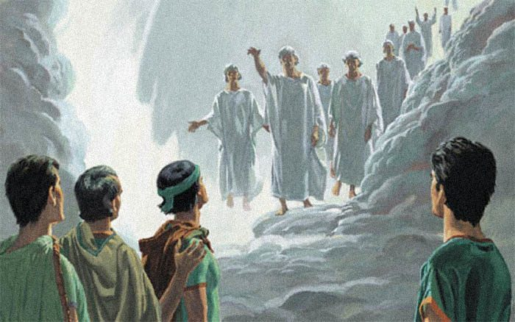
Priesthood and Priesthood Keys
Mark paragraph 6.6 in the Doctrinal Mastery Core Document: The Aaronic Priesthood “holds the keys of the ministering of angels, and of the gospel of repentance, and of baptism”
Read Doctrine and Covenants 13:1 What does it mean that the Aaronic Priesthood holds ‘the key of the ministering of angels’ and of the ‘gospel of repentance and of baptism, and the remission of sins’?

Slide 4
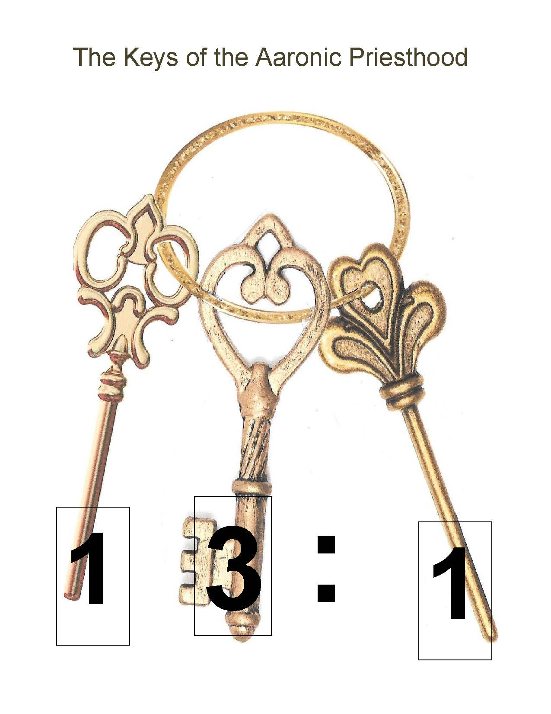
D&C 13:1
UPON you my fellow servants, in the name of Messiah I confer the Priesthood of Aaron, which holds the keys of the ministering of angels, and of the gospel of repentance, and of baptism by immersion for the remission of sins; and this shall never be taken again from the earth, until the sons of Levi do offer again an offering unto the Lord in righteousness.

Slide 5
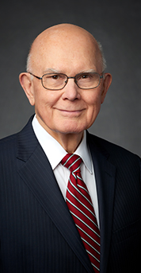
Priesthood and Priesthood Keys
“What does it mean that the Aaronic Priesthood holds ‘the key of the ministering of angels’ and of the ‘gospel of repentance and of baptism, and the remission of sins’ [D&C 84:26–27]? The meaning is found in the ordinance of baptism and in the sacrament. Baptism is for the remission of sins, and the sacrament is a renewal of the covenants and blessings of baptism. Both should be preceded by repentance. When we keep the covenants made in these ordinances, we are promised that we will always have His Spirit to be with us. The ministering of angels is one of the manifestations of that Spirit. …
“We cannot overstate the importance of the Aaronic Priesthood in this. All of these vital steps pertaining to the remission of sins are performed through the saving ordinance of baptism and the renewing ordinance of the sacrament. Both of these ordinances are officiated by holders of the Aaronic Priesthood under the direction of the bishopric, who exercise the keys of the gospel of repentance and of baptism and the remission of sins.

Slide 6
Priesthood and Priesthood Keys
“In a closely related way, these ordinances of the Aaronic Priesthood are also vital to the ministering of angels. …
“… As explained earlier, through the Aaronic Priesthood ordinances of baptism and the sacrament, we are cleansed of our sins and promised that if we keep our covenants we will always have His Spirit to be with us. I believe that promise not only refers to the Holy Ghost but also to the ministering of angels, for ‘angels speak by the power of the Holy Ghost; wherefore, they speak the words of Christ’ (2 Ne. 32:3). So it is that those who hold the Aaronic Priesthood open the door for all Church members who worthily partake of the sacrament to enjoy the companionship of the Spirit of the Lord and the ministering of angels” (Dallin H. Oaks, “The Aaronic Priesthood and the Sacrament,” Ensign, Nov. 1998, 37–39).
What did President Oaks teach about the keys of the Aaronic Priesthood?
How have you been blessed because of the Aaronic Priesthood?

Slide 7
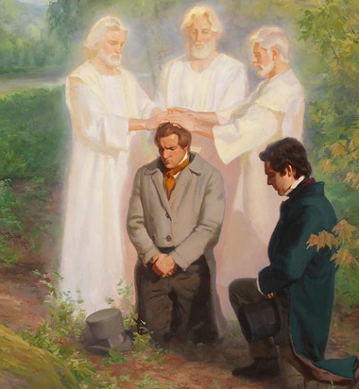
Priesthood and Priesthood Keys
Mark paragraph 6.7: The Melchizedek Priesthood is the higher, or greater, priesthood and “holds the right of presidency, and has power and authority over all the offices in the church In all ages of the world, to administer in spiritual things.”
What are some of the ordinances or blessings that are performed through the authority of the Melchizedek Priesthood?

Slide 8
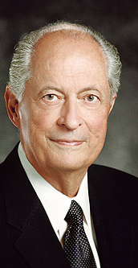
Priesthood and Priesthood Keys
“Can you imagine how dark and empty mortality would be if there were no priesthood? If the power of the priesthood were not upon the earth, the adversary would have freedom to roam and reign without restraint. There would be no gift of the Holy Ghost to direct and enlighten us; no prophets to speak in the name of the Lord; no temples where we could make sacred, eternal covenants; no authority to bless or baptize, to heal or comfort. … There would be no light, no hope—only darkness” (Robert D. Hales, “Blessings of the Priesthood,” Ensign, Nov. 1995, 32).
When have you felt particularly grateful for the blessings available through the Melchizedek Priesthood?

Slide 9
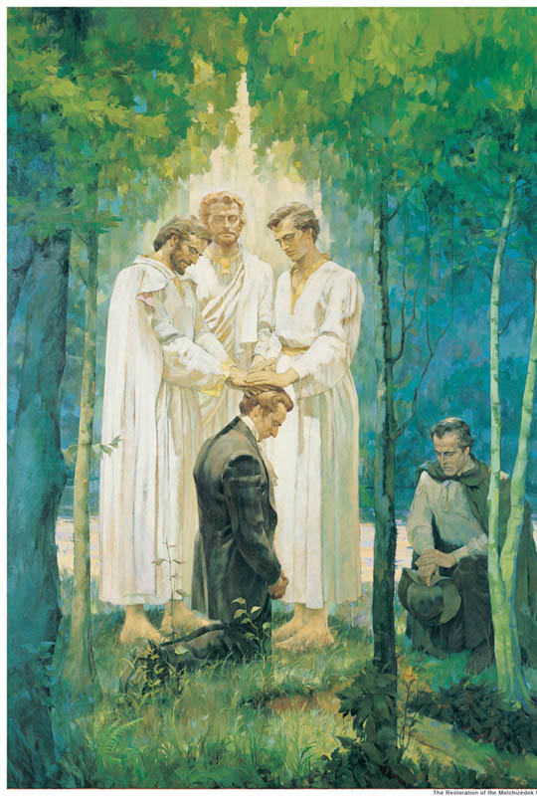
Doctrinal Mastery Review Activity I
The Aaronic Priesthood “holds the keys of the ministering of angels, and of the gospel of repentance, and of baptism” (D&C 13:1).
In what ways can you think of to remember that these events are recorded in Doctrine and Covenants 13?

Slide 10
Doctrinal Mastery Review Activity II
Doctrine and Covenants 107:8
Fix the scrambled statement of doctrine:
and “holds the right of presidency,
to administer in spiritual things” (D&C 107:8).
the higher, or greater, priesthood
in the church in all ages of the world,
The Melchizedek Priesthood is
and has power and authority over all the offices
In what ways can you think of to remember that these events are recorded in Doctrine and Covenants 107?

Slide 11
Priesthood and Priesthood Keys
NOTE TO TEACHER: On four different pieces of paper, write one of the following doctrinal mastery passage references on one side and its corresponding key statement of doctrine on the other side:
Doctrine and Covenants 42:11 All who serve in the Church—men and women—are called under the direction of one who holds priesthood keys.
Doctrine and Covenants 121:36, 41–42 Priesthood authority can only be exercised in righteousness.
Doctrine and Covenants 13:1 The Aaronic Priesthood “holds the keys of the ministering of angels, and of the gospel of repentance, and of baptism.”
Doctrine and Covenants 107:8 The Melchizedek Priesthood is the higher, or greater, priesthood and “holds the right of presidency and has power and authority over all the offices in the church in all ages of the world, to administer in spiritual things.”
Use these “flash cards” to review the doctrinal mastery scripture references along with the key statements of doctrine. You might choose to show students one side of a flash card and ask them to tell you what is on the other side. (If you show students a doctrinal mastery scripture reference, do not require them to tell you the entire corresponding key statement of doctrine. For example, if you show students the reference “Doctrine and Covenants 107:8,” it might be sufficient for them to reply “Melchizedek Priesthood.”) You may want to repeat flash cards that students struggle with until they know them better. Then you might want to repeat the activity using the other side of the flash cards. Do not spend more than five minutes on this activity.

Slide 12
Priesthood & Priesthood Keys
Part 3

