Slide 1
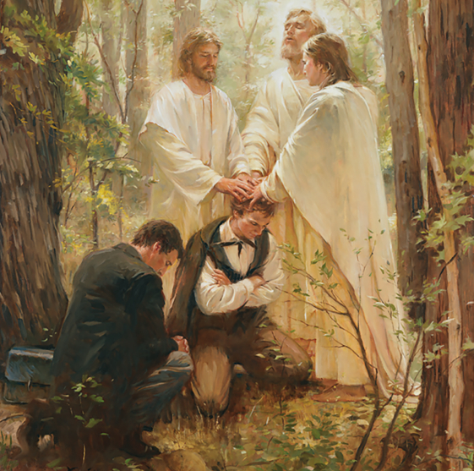
Priesthood and priesthood keys
Part II

Slide 2
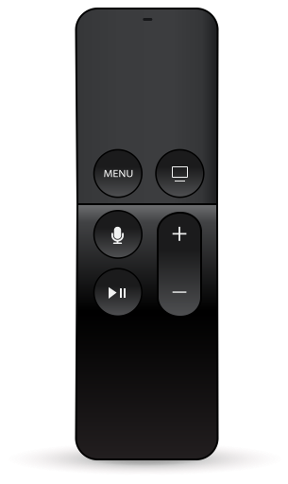
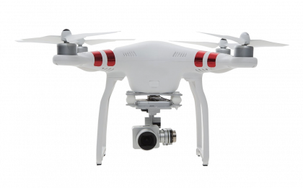
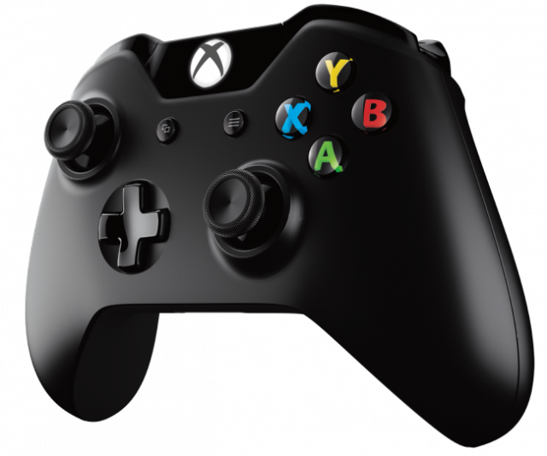
What do these have in common?

Slide 3
What do these have in common with this…

Slide 4
Priesthood authority can only be exercised in righteousness.
Read paragraph 6.4 in the Doctrinal Mastery Core Document
Discuss ideas for how you can remember what Doctrine and Covenants 121:36, 41–42 teaches.
PART I

Slide 5
Priesthood authority can only be exercised in righteousness.
Doctrine and Covenants 121:36, 41–42
What principles of righteousness can you find listed?
How might “no power or influence can or ought to be maintained by virtue of the priesthood” (D&C 121:41) apply to all who have been called to serve in the Church?
How would demonstrating the qualities listed in D&C 121 be more effective than trying to use one’s position of power and authority unrighteously?
How might the principles of righteousness help those with callings in the Church to guide and influence the people over whom they have responsibility?
PART 2

Slide 6
Priesthood authority can only be exercised in righteousness.
Doctrine and Covenants 121:36, 41–42
Think about a Church leader who is a good example of one of the qualities in D&C 121. Talk about this person and how he or she exhibits these qualities.
In what ways has this person influenced you?
Why do you think the qualities of this person influenced you positively?
Why do you think the Lord would encourage us to influence others in this way?
PART 3

Slide 7
Select one of the doctrinal mastery passages you have studied so far this year.
Write down a thought, a feeling, or a question someone might have that could be helped or answered by the doctrinal mastery passage they selected (for example, Doctrine and Covenants 18:10–11, you might write something like: “A friend has been feeling worthless, like he has no value to anyone. Doctrine and Covenants 18:10–11”

Slide 8
I’ll read the papers one at a time and you’ll guess which doctrinal mastery passage you might use to help the problem or answer the question.

Slide 9
Priesthood and priesthood keys
Part II

