Slide 1
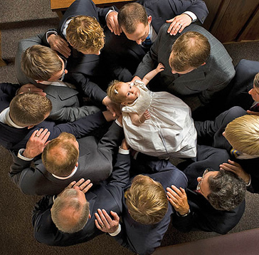
Priesthood & Keys
Part I

Slide 2
study paragraphs 6.1 - 6.3 & complete the quiz
_ 1. God created and governs the heavens and the earth through the priesthood.
_ 2. The blessings of the priesthood are available to all of God’s children, male and female, through the ordinances and covenants of the gospel.
_ 3. The keys of the priesthood are the rights of presidency, or the power God gives to man to govern and direct the kingdom of God on earth.
_ 4. Each of the Apostles is authorized to exercise all of the keys that pertain to the kingdom of God on earth.
_ 5. Every priesthood holder holds priesthood keys to preside and direct the work of the Lord.
Notes:
(statements 1, 2, and 3 are true; statements 4 and 5 are false).

Slide 3
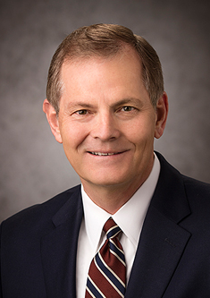
Priesthood
“The priesthood, or priesthood authority, has been defined as ‘the power and authority of God’ and ‘the consummate power on this earth.’ Priesthood keys are defined for our understanding as well: ‘Priesthood keys are the authority God has given to priesthood leaders to direct, control, and govern the use of His priesthood on earth’ [Handbook 2: Administering the Church (2010), 2.1.1]. Priesthood keys control the exercise of priesthood authority. Ordinances that create a record in the Church require keys and cannot be done without authorization. Elder Dallin H. Oaks taught that ‘ultimately, all keys of the priesthood are held by the Lord Jesus Christ, whose priesthood it is. He is the one who determines what keys are delegated to mortals and how those keys will be used’ (Gary E. Stevenson, “Where Are the Keys and Authority of the Priesthood?” Ensign or Liahona, May 2016, 30).

Slide 4
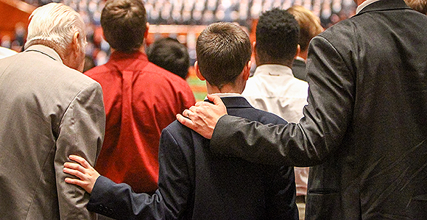
Priesthood
What is the difference between priesthood authority and priesthood keys?
According to paragraph 6.3 in the Doctrinal Mastery Core Document, who holds priesthood keys in a ward?
According to paragraph 6.3 in the Doctrinal Mastery Core Document, how are all who serve in the Church called?

Slide 5
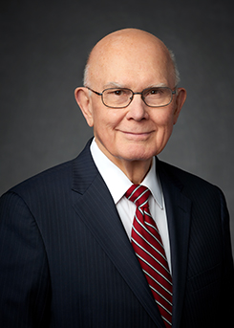
Priesthood
“The Church work done by women or men, whether in the temple or in the wards or branches, is done under the direction of those who hold priesthood keys. …
“We are not accustomed to speaking of women having the authority of the priesthood in their Church callings, but what other authority can it be? When a woman—young or old—is set apart to preach the gospel as a full-time missionary, she is given priesthood authority to perform a priesthood function. The same is true when a woman is set apart to function as an officer or teacher in a Church organization under the direction of one who holds the keys of the priesthood. Whoever functions in an office or calling received from one who holds priesthood keys exercises priesthood authority in performing her or his assigned duties” (Dallin H. Oaks, “The Keys and Authority of the Priesthood,” Ensign or Liahona, May 2014, 51).
What did President Oaks clarify about priesthood authority and serving in the Church?

Slide 6
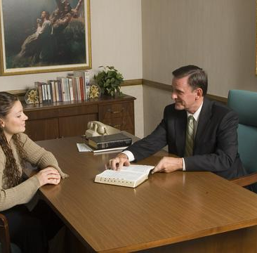
callings
Do you have a calling?
Who extended that calling to you?
How were you called under the direction of one who holds priesthood keys?
According to the statement by President Dallin H. Oaks in paragraph 6.4 in the Doctrinal Mastery Core Document, what authority do you exercise when you perform the duties to which you have been called?
Which doctrinal mastery passage helps teach the key statement of doctrine that all who serve in the Church—men and women—are called under the direction of one who holds priesthood keys?
Read Doctrine and Covenants 42:11, looking for words that teach paragraph 6.4 in the Doctrinal Mastery Core Document. Invite

Slide 7
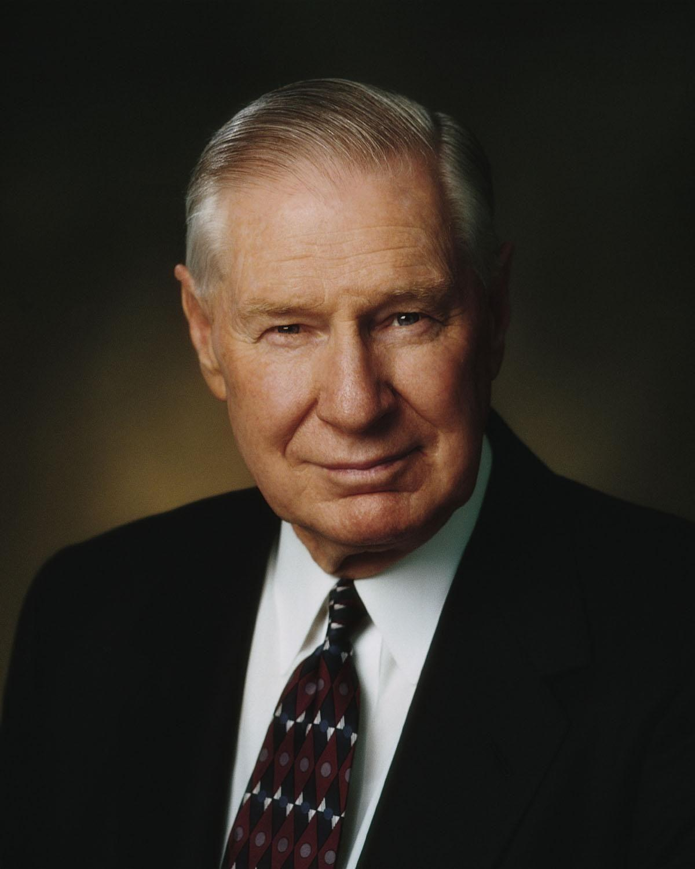
“No one can claim priesthood authority except it is conferred openly by those possessing the authority, ‘and it is known to the church that he has authority and has been regularly ordained by the heads of the church’ (D&C 42:11). The exercise of priesthood authority is directed by the keys of the priesthood. These keys rest with the presiding local and General Authorities of the Church” (James E. Faust, “Keeping Covenants and Honoring the Priesthood,” Ensign, Nov. 1993, 37).
What did President Faust teach about priesthood and priesthood keys?
Why do you think it is important that people are called by those who have priesthood keys?

Slide 8
Priesthood & Keys
Part I

