Slide 1
Prophets and Revelation
Part 3

Slide 2
REVIEW: Acquiring Spiritual Knowledge
What are the three principles from the “Acquiring Spiritual Knowledge” section of the DM Core Document?
Act in Faith
Examine concepts and questions with an eternal perspective
Seek further understanding through divinely appointed sources.

Slide 3
Practice
John is searching online for information about the Church in preparation for an Aaronic Priesthood quorum lesson. He finds a website that contains a comment from a past Church leader that seems to contradict what current Church leaders are saying. After this experience, John approaches you and asks, “It seems like some statements from Church leaders contradict one another. If prophets speak for God, why don’t they always agree?”
How could you help John act in faith in seeking answers to his questions?
How could John’s testimony of prophets help him resolve this concern?
How do you think you could help John examine his question with an eternal perspective?

Slide 4
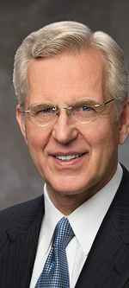
Elder D. Todd Christofferson
“It should be remembered that not every statement made by a Church leader, past or present, necessarily constitutes doctrine. It is commonly understood in the Church that a statement made by one leader on a single occasion often represents a personal, though well-considered, opinion, not meant to be official or binding for the whole Church. The Prophet Joseph Smith taught that ‘a prophet is a prophet only when he [is] acting as such’ [in History of the Church, 5:265]” (“The Doctrine of Christ,” Ensign or Liahona, May 2012, 88).

Slide 5
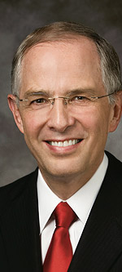
Elder Neil L. Andersen
“A few question their faith when they find a statement made by a Church leader decades ago that seems incongruent [inconsistent] with our doctrine. There is an important principle that governs the doctrine of the Church. The doctrine is taught by all 15 members of the First Presidency and Quorum of the Twelve. It is not hidden in an obscure paragraph of one talk. True principles are taught frequently and by many. Our doctrine is not difficult to find” (Trial of Your Faith,” Ensign or Liahona, Nov. 2012, 41).
How could these statements help John with his concern?
What other divinely appointed sources could help John with his question?

Slide 6
Prophets and Revelation
Part 3

