Slide 1
Part 2

Slide 2
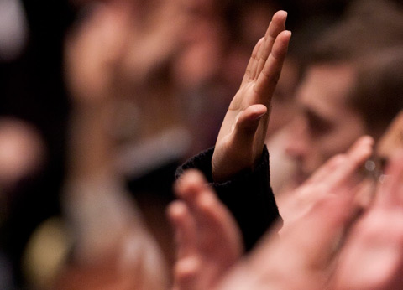
What do you think in means to sustain the prophet?
“Our sustaining of prophets is a personal commitment that we will do our utmost to uphold their prophetic priorities. Our sustaining is an oath-like indication that we recognize their calling as prophet to be legitimate and binding upon us.” (Russell M. Nelson, “Sustaining the Prophets,” Ensign or Liahona, Nov. 2014, 75)

Slide 4
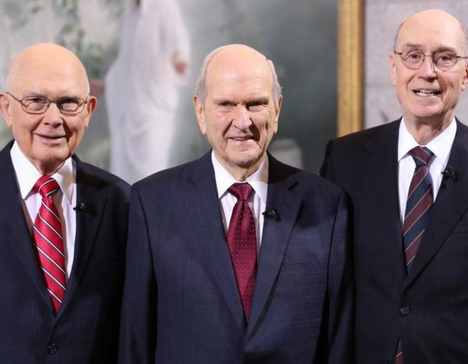
Prophets and Revelation
Read paragraph 5.3 in the Doctrinal Mastery Core Document looking for what this paragraph teaches about sustaining the prophet.
What do we sustain the President of the Church as?
Which sentence in this paragraph explains the blessings we receive from sustaining the prophet?
Mark the following key statement of doctrine in your copy of the Doctrinal Mastery Core Document: If we faithfully receive and obey the teachings of the President of the Church, God will bless us to overcome deception and evil.
What do you think it means to “receive and obey the teachings of the President of the Church”?
Which doctrinal mastery passage helps teach this truth?

Slide 6
Prophets and Revelation
Read and Discuss Doctrine and Covenants 21:4-6
How should we receive a prophet’s words?
How will this help us overcome deception and evil?
Why do you think patience and faith are required to receive the blessings the Lord promises to those who obey a prophet?
What do you think it means that the Lord will “disperse the powers of darkness from before [us]” (D&C 21:6) as we follow His prophet?
If you were somewhere very dark, such as inside a cave, what difference would having even a small flashlight make?
How can following a prophet help us remove spiritual darkness from our lives?

Slide 7
Journal
What are some blessing you have received by sustaining the prophet?
What are you currently doing to sustain and follow the prophet and how might you do that better?

Slide 8
Part 2

