Slide 1
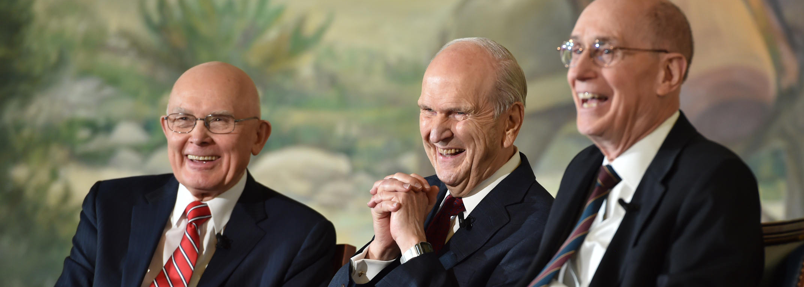
Prophets and Revelation
Doctrinal Mastery

Slide 2
What are some people or groups throughout the world that have a spokesperson?
What reasons can you think of for why these people or groups would have a spokesperson? What are some reasons why God might have a spokesperson? What do we call those who speak for God on earth?

Slide 3
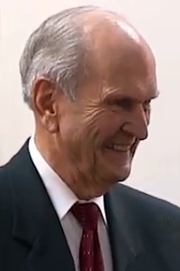
How does he qualify to be a spokesperson?
Prophets and Revelation

Slide 4
Doctrinal Mastery Core Document
A prophet is a person who has been called by God to speak for Him (see Jeremiah 1:4–5; Amos 3:7; John 15:16; D&C 1:37–38). Prophets testify of Jesus Christ and teach His gospel. They make known God’s will and true character. They denounce sin, warn of its consequences, and help us avoid deception (see Ezekiel 3:16–17; Ephesians 4:11–14). At times, they prophesy of future events. Prophets are able to perform these responsibilities because they receive authority and revelation from God.
Read 5.1

Slide 5
What do you think it means that the Lord’s words “shall not pass away, but shall all be fulfilled”?
Why do you think it is important to understand that when a prophet speaks for the Lord, it is the same as if the Lord were speaking?
What effort do you think is required in order for a prophet to obtain the word of the Lord to declare it to the people?
READ Doctrine & Covenants 1:37-38

Slide 6
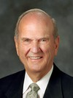
“We sustain 15 men who are ordained as prophets, seers, and revelators. When a thorny problem arises—and they only seem to get thornier each day—these 15 men wrestle with the issue, trying to see all the ramifications of various courses of action, and they diligently seek to hear the voice of the Lord. After fasting, praying, studying, pondering, and counseling with my Brethren about weighty matters, it is not unusual for me to be awakened during the night with further impressions about issues with which we are concerned. And my Brethren have the same experience.
“The First Presidency and Quorum of the Twelve Apostles counsel together and share all the Lord has directed us to understand and to feel individually and collectively. And then we watch the Lord move upon the President of the Church to proclaim the Lord’s will.
President Russell M. Nelson

Slide 7
“This prophetic process was followed in 2012 with the change in minimum age for missionaries and again with the recent additions to the Church’s handbook, consequent to the legalization of same-sex marriage in some countries. Filled with compassion for all, and especially for the children, we wrestled at length to understand the Lord’s will in this matter. Ever mindful of God’s plan of salvation and of His hope for eternal life for each of His children, we considered countless permutations [variations] and combinations of possible scenarios that could arise. We met repeatedly in the temple in fasting and prayer and sought further direction and inspiration. And then, when the Lord inspired His prophet, President Thomas S. Monson, to declare the mind of the Lord and the will of the Lord, each of us during that sacred moment felt a spiritual confirmation. It was our privilege as Apostles to sustain what had been revealed to President Monson. Revelation from the Lord to His servants is a sacred process. And so is your privilege of receiving personal revelation” (Russell M. Nelson, “Becoming True Millennials” [worldwide devotional for young adults, Jan. 10, 2016], broadcasts.lds.org).
President Russell M. Nelson

Slide 8
What did President Nelson teach about the process that prophets and apostles go through to receive revelation to guide the Church? How can this knowledge of how prophets prepare to receive revelation help us when we may have questions about the teachings or practices of the Church?
PONDER

Slide 9
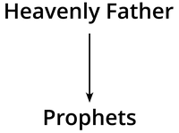
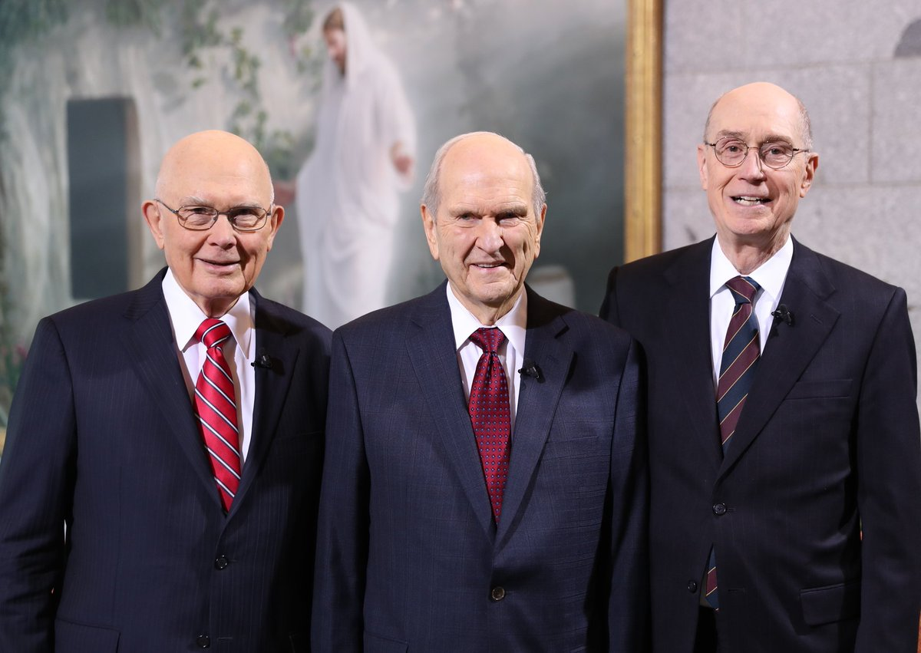
What is the communication between Heavenly Father and His prophets usually called?
Read aloud paragraph 5.2 in the Doctrinal Mastery Core Document.

Slide 10
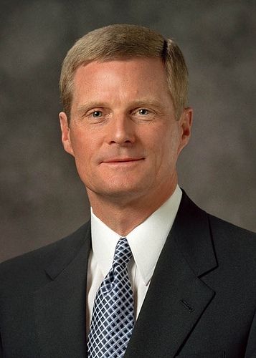
“Each mission call and assignment, or a later reassignment, is the result of revelation through the Lord’s servants. A call to the work comes from God through the President of the Church. An assignment to one of the more than 400 missions presently operating around the world comes from God through a member of the Quorum of the Twelve Apostles, acting with the authorization of the Lord’s living prophet. The spiritual gifts of prophecy and revelation attend all mission calls and assignments. …
“… For the Twelve, nothing affirms the reality of ongoing latter-day revelation more powerfully than seeking to discern the Lord’s will as we fulfill our responsibility to assign missionaries to their respective fields of labor. I witness that the Savior knows and is mindful of each of us one by one and name by name. …I promise that the spiritual gift of revelation will attend your call to the work of proclaiming the gospel and your assignment to a specific field or fields of labor” (David A. Bednar, “Called to the Work,” Ensign or Liahona, May 2017, 68–70).
Besides mission calls, how are members of the Church today blessed by the revelation God gives to His prophets and apostles?

Slide 11
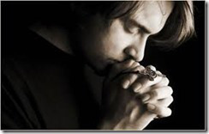
How have you personally been affected by prophetic revelation?

Slide 12
Prophets and Revelation
Doctrinal Mastery

