Slide 1
The Restoration
Part III

Slide 2
Acquiring Spiritual Knowledge
“I heard that Joseph Smith used a stone in a hat to translate the Book of Mormon. That just seems kind of strange to me. Is the Book of Mormon really the word of God, or did Joseph Smith just make it up?”
1. Act in faith
2. Examine concepts and questions with an eternal perspective
3. Seek understanding through divinely appointed sources.
Which information or concepts would be helpful when responding to this question?

Slide 3
You have a friend who has been feeling discouraged lately. When you ask if something is wrong, she is reluctant to tell you, but she eventually admits that she has begun to doubt that God loves her. 1. In what ways might you encourage your friend to act in faith to resolve her concern? 2. How could you help your friend examine her concern with an eternal perspective? 3. How could you use Doctrine and Covenants 18:10–11 to help your friend? 4. What other scriptures or statements by prophets and apostles could you encourage your friend to read in order to seek further understanding of her worth to God?

Slide 4
More help: Read: Doctrine and Covenants 135:3 Doctrinal Mastery Core Document 4:3
In the preface to the 1830 edition of the Book of Mormon, Joseph Smith wrote: “I would inform you that I translated the book by the gift and power of God” (see also D&C 135:3; the title page of the Book of Mormon).

Slide 5
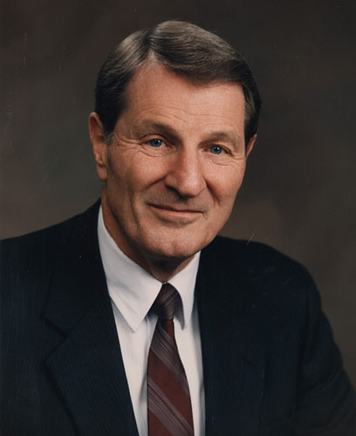
“Many who read the Book of Mormon understandably desire to know more about its coming forth, including the actual process of translation. This was certainly so with faithful and loyal Hyrum Smith. Upon inquiring, Hyrum was told by the Prophet Joseph that ‘it was not intended to tell the world all the particulars of the coming forth of the Book of Mormon’ and that ‘it was not expedient for him to relate these things’ (History of the Church, 1:220). Thus what we do know about the actual coming forth of the Book of Mormon is adequate, but it is not comprehensive. …
“Whatever the details of the process, it required Joseph’s intense, personal efforts along with the aid of the revelatory instruments”
(Neal A. Maxwell, “By the Gift and Power of God,” Ensign, Jan. 1997, 39; see also The Joseph Smith Papers, Documents, Volume 1: July 1828–June 1831, ed. Michael Hubbard MacKay and others [2013], 84).

Slide 6
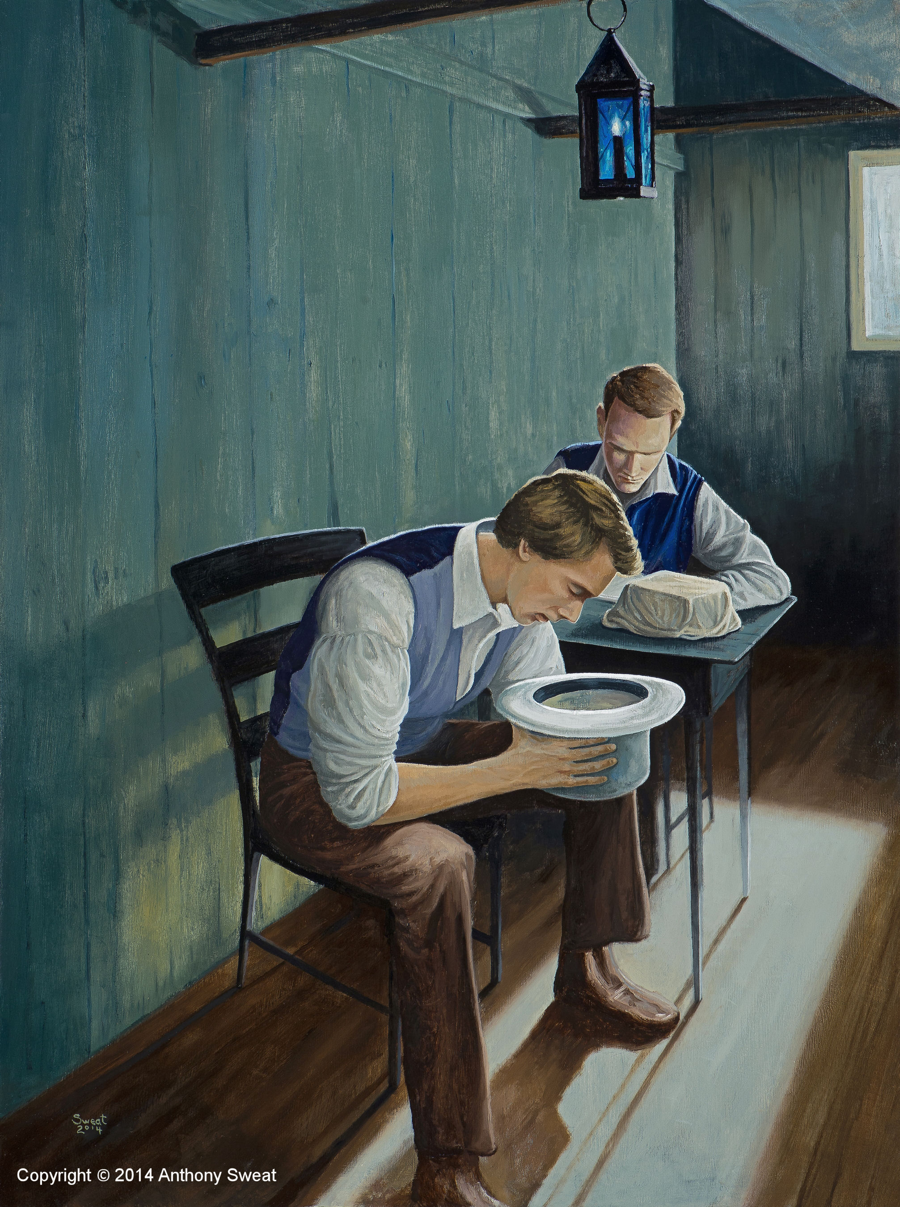
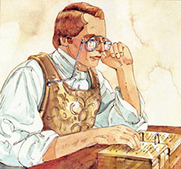
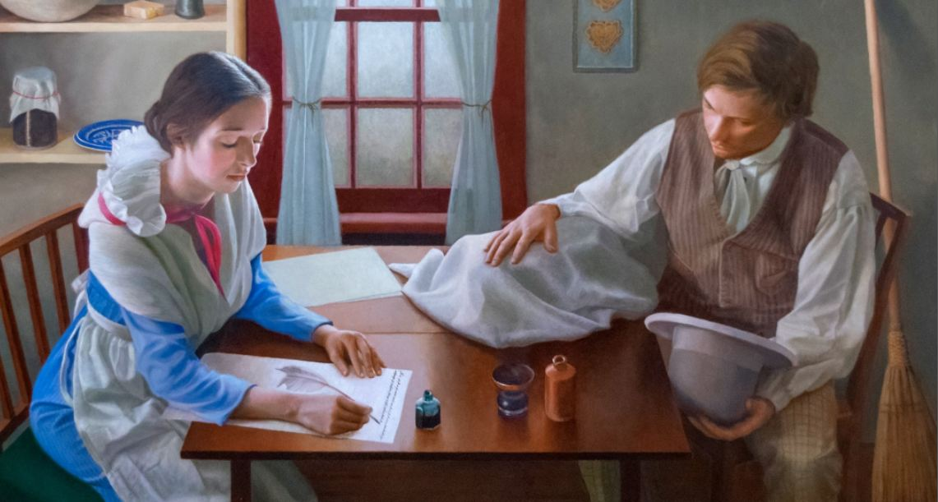
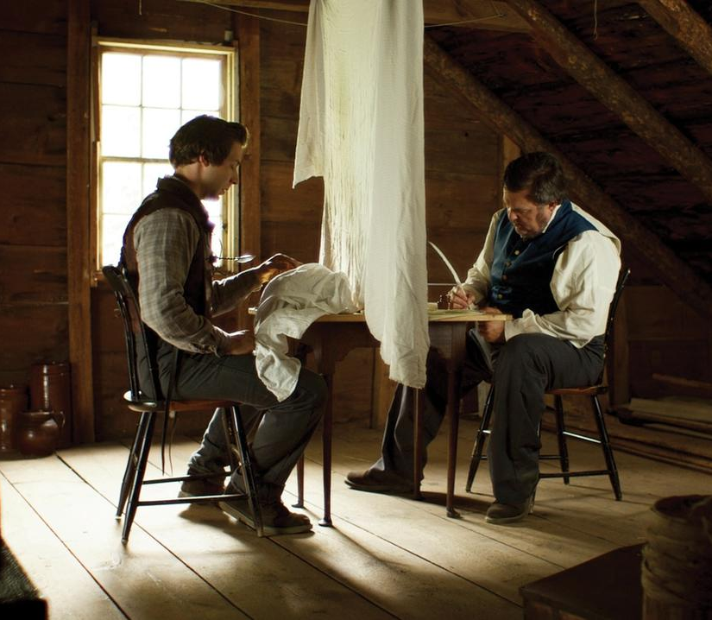
Notes:
NOTE: This is a beautiful example of line upon line. Joseph began with the Urim and Thummin – but it was heavy and slow-going. He most often was described by scribes to use a stone (teenagers understand this – tell them to imagine a smooth dark surface where words appear and change from time to time – as you pick up their cellphone). Now have them imagine trying to read that “stone” in bright sunlight – the hat was used to shade the surface of the stone as he read but allowing his translators to write with light. Remind them that ART is not HISTORY (for those troubled by previous gospel library images depicting traditional translation – assuming Joseph knew both English and Reformed Egyptian)
Joseph Smith’s principal scribe, Oliver Cowdery, stated that by “looking through” the Urim and Thummim, Joseph “was able to read in English, the reformed Egyptian characters, which were engraved upon the plates” (A. W. B., “Mormonites,” Evangelical Magazine and Gospel Advocate 2 [Apr. 19, 1831]: 120). Some later historical accounts indicate that Joseph Smith sometimes also used another instrument while translating the Book of Mormon. This was a small oval stone, referred to as a seer stone, that he discovered several years before he obtained the golden plates. These accounts indicate that Joseph would sometimes place either the interpreters or the seer stone into a hat to block out light, which allowed him to better see the words that appeared on the instrument (see Richard E. Turley Jr., Robin S. Jensen, and Mark Ashurst-McGee, “Joseph the Seer,” Ensign, Oct. 2015, 49–54).

Slide 7
“Of course, the real revelatory process involved Joseph’s mind and faith, which could not be seen by others in any case. …
“Why do we not have more disclosure concerning the process of translation of the Book of Mormon? Perhaps the full process was not disclosed because we would not be ready to understand it, even if given. Perhaps, too, the Lord wanted to leave the Book of Mormon in the realm of faith, though it is drenched with intrinsic evidence. After all, Christ instructed Mormon, who was reviewing the Savior’s own teachings among the Nephites, not to record all of them on the plates because ‘I will try the faith of my people’ (3 Ne. 26:11). Perhaps the details of translation are withheld also because we are intended to immerse ourselves in the substance of the book rather than becoming unduly concerned with the process by which we received it” (Neal A. Maxwell, “By the Gift and Power of God,” 40–41).

Slide 8
FROM FACEBOOK
A Facebook post by President Dieter F. Uchtdorf: “Do you really believe that Joseph Smith translated with seer stones? How would something like this be possible?”
“I answer, ‘Yes! That is exactly what I believe.’ This was done as Joseph said: by the gift and power of God. In reality, most of us use a kind of ‘seer stone’ every day. My mobile phone is like a ‘seer stone.’ I can get the collected knowledge of the world through a few little inputs. I can take a photo or a video with my phone and share it with family on the other side of our planet. I can even translate anything into or from many different languages!
“If I can do this with my phone, if human beings can do this with their phones or other devices, who are we to say that God could not help Joseph Smith, the Prophet of the Restoration, with his translation work? If it is possible for me to access the knowledge of the world through my phone, who can question that seer stones are impossible for God?
“Many religions have objects, places, and events that are sacred to them. We respect the sacred beliefs of other religions and hope to be respected for our own beliefs and what is sacred to us. We should never be arrogant, but rather polite and humble. We still should have a natural confidence, because this is the Church of Jesus Christ” (Dieter F. Uchtdorf’s Facebook page, post from June 21, 2016, facebook.com/lds.dieter.f.uchtdorf).
What principles of acquiring spiritual knowledge did President Uchtdorf demonstrate?

Slide 9
Look up the reference that matches the number that corresponds with the month in which you were born. Stand up and move around the room, asking other students for their key words. Using their Doctrinal Mastery Reference Guide, try to identify all 12 scripture references by talking to different students in the class.
Doctrinal Mastery
Cumulative Review

Slide 10
The Restoration
Part III

