Slide 1
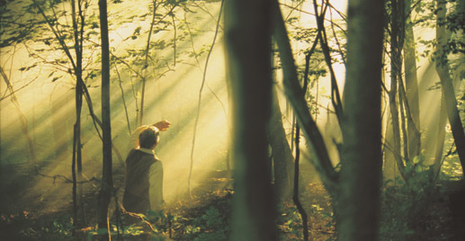
Doctrinal Mastery The Restoration – part 2

Slide 2
Think of synonyms for each of these words.
Create a sentence that uses both of these words.

Slide 3
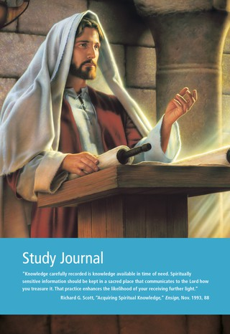
Open your Scripture Study Journal Core Document: The Restoration 4:4
Look for: What statements explain WHY we believe that our Church is the TRUE and LIVING church?
Highlight/Underline: Because it was established by God Himself, The Church of Jesus Christ of Latter-day Saints is “the only true and living church upon the face of the whole earth.

Slide 4
Doctrine & Covenants 1:30
And also those to whom these commandments were given, might have power to lay the foundation of this church, and to bring it forth out of obscurity and out of darkness, the only true and living church upon the face of the whole earth, with which I, the Lord, am well pleased, speaking unto the church collectively and not individually

Slide 5
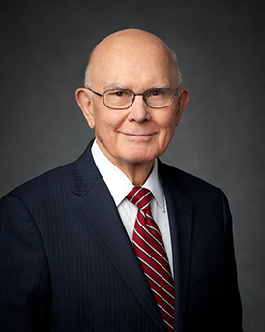
“Because of this declaration of the Lord, we refer to this, His Church—our Church—as the ‘only true Church.’ Sometimes we do this in a way that gives great offense to people who belong to other churches or who subscribe to other philosophies. But God has not taught us anything that should cause us to feel superior to other people. Certainly all churches and philosophies have elements of truth in them, some more than others. Certainly God loves all of His children. And certainly His gospel plan is for all of His children, all according to His own timetable.
“So what does it mean that The Church of Jesus Christ of Latter-day Saints is the only true Church?
“Three features—(1) fulness of doctrine, (2) power of the priesthood, and (3) testimony of Jesus Christ—explain why God has declared and why we as His servants maintain that this is the only true and living Church upon the face of the whole earth. …
“… This Church is ‘living’ because we have prophets who continue to give us the word of the Lord that is needed for our time”
- Dallin H. Oaks

Slide 6
Journal Time: How have you been blessed by being a member of the True and Living Church?

Slide 7
THE ONLY TRUE CHURCH
Diana and Clark are walking to school one morning when Clark turns to Diana and says, “We’ve been good friends for a long time, so don’t take this the wrong way, but why do you Mormons say you belong to the true church? Don’t you think it’s arrogant to say your religion is true and everyone else’s religion is false?” Diana feels surprised by this question and had not considered that saying the Church is true might imply that all other churches are false.
Discuss with your partner what you think is the intent of Clark’s comment to Diana. How would you summarize his feelings and beliefs?

Slide 8
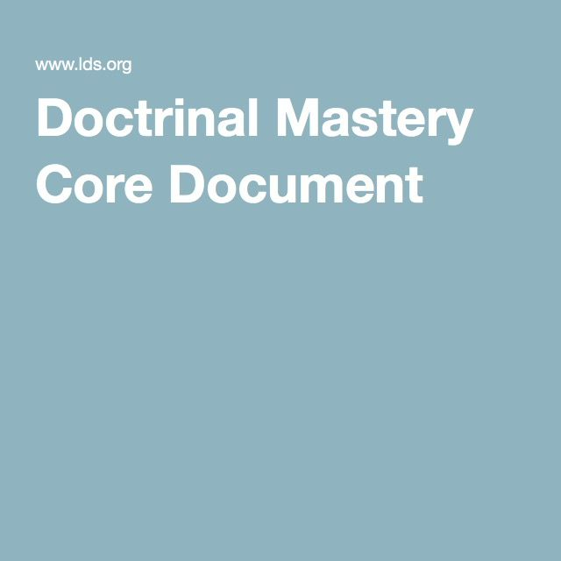
THE ONLY TRUE CHURCH
Review paragraphs 4.1 through 4.11 in the Doctrinal Mastery Core Document. Focus on the key statement of doctrine and the doctrinal mastery passage in paragraph 4.4 for help.

Slide 9
THE ONLY TRUE CHURCH
“The great religious leaders of the world such as Mohammed, Confucius, and the Reformers, as well as philosophers including Socrates, Plato, and others, received a portion of God’s light. Moral truths were given to them by God to enlighten whole nations and to bring a higher level of understanding to individuals. The Hebrew prophets prepared the way for the coming of Jesus Christ, the promised Messiah, who should provide salvation for all mankind who believe in the gospel. Consistent with these truths, we believe that God has given and will give to all peoples sufficient knowledge to help them on their way to eternal salvation, either in this life or in the life to come.
(First Presidency statement, Feb. 15, 1978, quoted in Robert L. Millet, “The Eternal Gospel,” Ensign, July 1996, 56).

Slide 10
THE ONLY TRUE CHURCH
“We also declare that the gospel of Jesus Christ, restored to His Church in our day, provides the only way to a mortal life of happiness and a fulness of joy forever. For those who have not received this gospel, the opportunity will come to them in the life hereafter if not in this life. Our message therefore is one of special love and concern for the eternal welfare of all men and women, regardless of religious belief, race, or nationality, knowing that we are truly brothers and sisters because we are sons and daughters of the same Eternal Father”
(First Presidency statement, Feb. 15, 1978, quoted in Robert L. Millet, “The Eternal Gospel,” Ensign, July 1996, 56).

Slide 11
THE ONLY TRUE CHURCH
Role-play with your partner how you would respond to Clark’s concern if you were Diana.
Why do you Mormons say you belong to the true church? Don’t you think it’s arrogant to say your religion is true and everyone else’s religion is false?

Slide 12
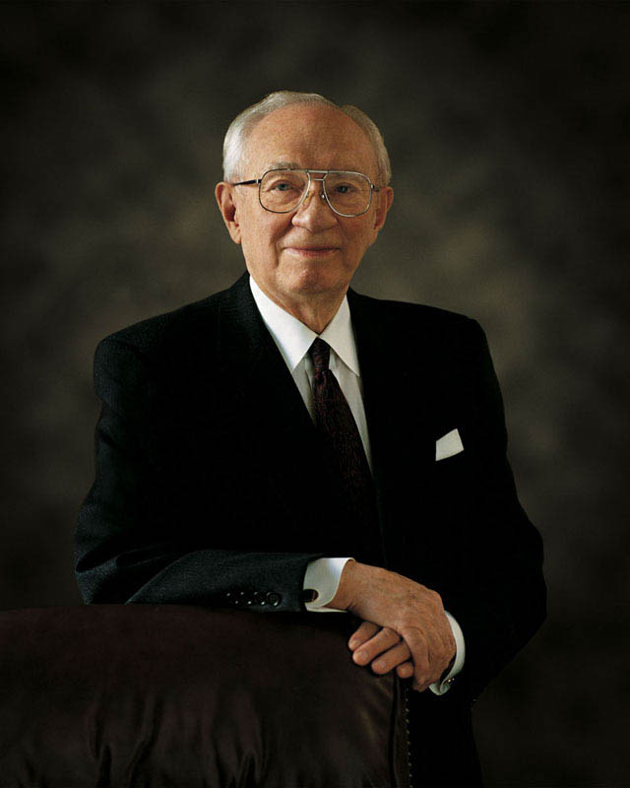
THE ONLY TRUE CHURCH
“We must be a friendly people. We must recognize the good in all people. We don’t go about tearing down other churches. We preach and teach in a positive and affirmative way. We say to those of other faiths, ‘you bring with you all the good that you have and let us see if we can add to it.’” (“Messages of Inspiration from President Hinckley,” Church News, Nov. 7, 1998, 2).

Slide 13
Doctrinal Mastery Review Activity
Why did God the Father and His Son, Jesus Christ, appear to Joseph Smith?
What did Joseph Smith translate?
Which key statement of doctrine helps us understand why The Church of Jesus Christ of Latter-day Saints is “the only true and living church upon the face of the earth”?
How did Joseph Smith translate the Book of Mormon?
Which passage describes Joseph Smith as a prophet?
What can be shown as evidence that Joseph Smith was a prophet of God?
Which passage tells about the translation of the Book of Mormon?
Which passage teaches about a part of the Restoration?
Choose 1, 2, or 3
JSH 1:15–20
D&C 1:30
D&C 135:3
As I read each of the following: Stand up if you feel your scripture answers the question.

Slide 14
Doctrinal Mastery The Restoration – part 2

