Slide 1
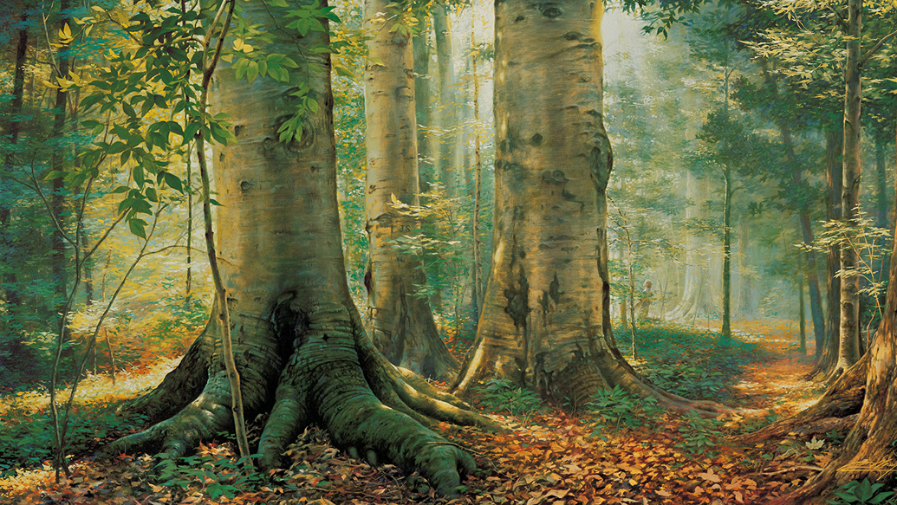
The Restoration
Part I

Slide 2
What would need to be done to restore this item to its original condition?

Slide 3
Who, What, Where, When, Why…
Turn to doctrinal topic 4, “The Restoration,”. Read paragraphs 4.1 through 4.5, 4.8, 4.11 looking for which questions on the board can be answered from the information in these paragraphs.
What was restored?
1
How was it restored?
2
Why was there a need for a restoration?
3
What is a dispensation, and how does it relate to restoration?
4

Slide 4
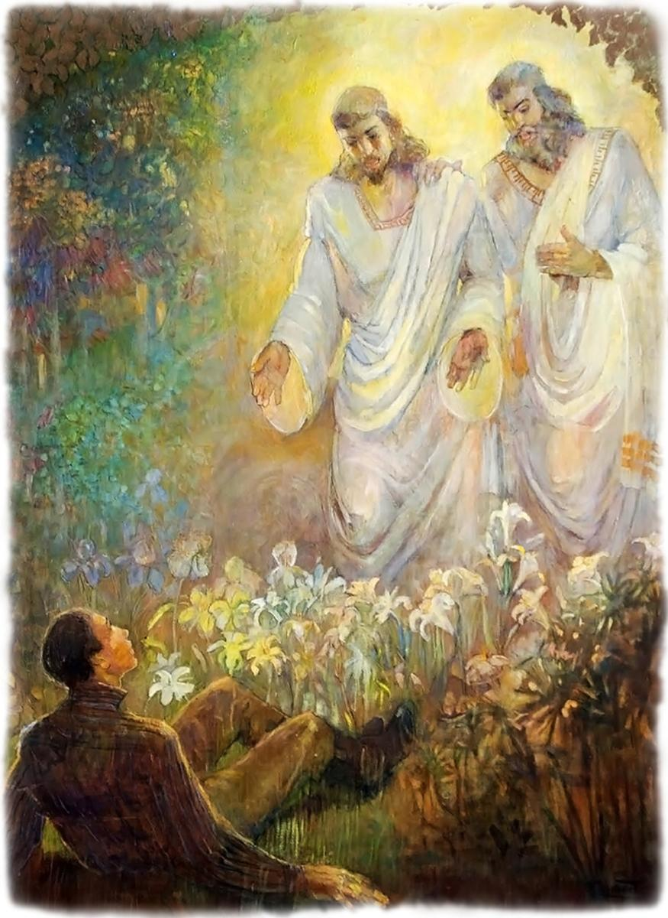
God the Father and His Son, Jesus Christ, appeared to Joseph Smith in response to Joseph’s prayer, and They called him to be the Prophet of the Restoration.
Which doctrinal mastery passage helps teach this key statement of doctrine?
Joseph Smith – History 1:15-20

Slide 5
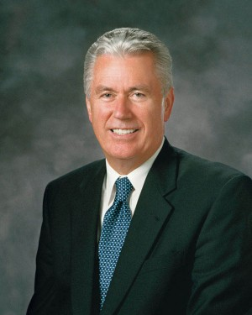
I felt a special spirit while looking at the beautiful scene in this window picture of a believing young boy in a sacred grove who made a courageous decision to earnestly pray to our Heavenly Father, who listened and responded lovingly to him.
“Here I was, a young boy in post–World War II Germany, living in a city in ruins, thousands of miles away from Palmyra in North America and more than a hundred years after the event actually took place. By the universal power of the Holy Ghost, I felt in my heart and in my mind that it was true, that Joseph Smith saw God and Jesus Christ and heard Their voices. The Spirit of God comforted my soul at this young age with an assurance of the reality of this sacred moment. … I believed Joseph Smith’s testimony of that glorious experience in the Sacred Grove then, and I know it now”
- Dieter F. Uchtdorf
How did this experience influence Elder Uchtdorf’s testimony of Joseph Smith?
In addition to pondering the events of the beginning of the Restoration, what else can we do to invite the Holy Ghost to testify of the truth that Joseph Smith was a prophet?

Slide 6
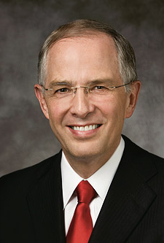
“A testimony of the Prophet Joseph Smith can come differently to each of us. It may come as you kneel in prayer, asking God to confirm that he was a true prophet. It may come as you read the Prophet’s account of the First Vision. A testimony may distill upon your soul as you read the Book of Mormon again and again. It may come as you bear your own testimony of the Prophet or as you stand in the temple and realize that through Joseph Smith the holy sealing power was restored to the earth. With faith and real intent, your testimony of the Prophet Joseph Smith will strengthen”
- Neil L. Anderson

Slide 7
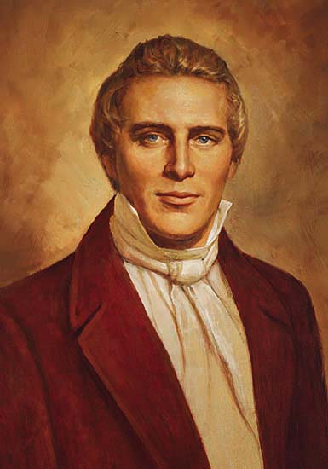
With a partner…
As the Prophet of the Restoration, Joseph Smith translated the Book of Mormon by the gift and power of God.
Why would it be important to know that Joseph Smith was able to translate the Book of Mormon by the gift and power of God?
What doctrinal mastery passage is associated with this key statement of doctrine?
Doctrine and Covenants 135:3 (open and read it together)
What other accomplishments of the Prophet Joseph Smith does this verse mention?
Think about what you know about the life of the Prophet Joseph Smith. In his 38 years on earth, what are some things Joseph Smith was able to accomplish as a prophet of God?

Slide 8
Journal
How have you come to know (or how could you find out) that Joseph Smith was called of God to be the Prophet of the Restoration?
How is your life different because of what happened in the Sacred Grove?

Slide 9
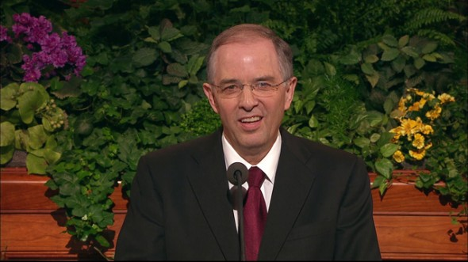
Neil L. Anderson
“To the youth … I give a specific challenge: Gain a personal witness of the Prophet Joseph Smith. … Here are two ideas: First, find scriptures in the Book of Mormon that you feel and know are absolutely true. Then share them with family and friends in family home evening, seminary, and your Young Men and Young Women classes, acknowledging that Joseph was an instrument in God’s hands. Next, read the testimony of the Prophet Joseph Smith in the Pearl of Great Price. … This is Joseph’s own testimony of what actually occurred. Read it often. Consider recording the testimony of Joseph Smith in your own voice, listening to it regularly, and sharing it with friends. Listening to the Prophet’s testimony in your own voice will help bring the witness you seek”

