Slide 1
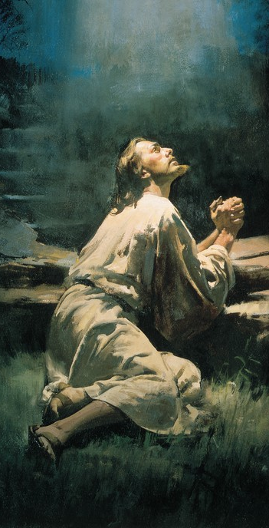
Doctrinal Mastery
The Atonement of Jesus Christ
Part 3

Slide 2
Review: Core Document Acquiring Spiritual Knowledge

Slide 3
PARTNER TIME: Scenario
Sofia has decided that she would like to serve a full-time mission. She has committed some serious sins, and she knows she should confess them to her bishop. However, she decides not to confess her sins because she is afraid of what her bishop may think of her. She tells herself that if she goes on a mission and works extra hard, the Lord will forgive her even if she does not confess her sins.

Slide 4
Partner Time: Discuss
Do you think Sofia is acting in faith? Why or Why not?
How might Sofia act differently if she acted in faith?
How do her choices and behavior demonstrate that she is not examining her situation with an eternal perspective?
How would understanding the Plan of Salvation and the Atonement of Jesus Christ help Sofia act differently?
Pick a Doctrinal Mastery Scripture passage that would help.

Slide 5
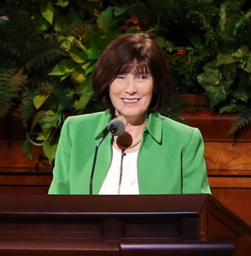
A.S.K
“When I served with my husband as he presided over a mission, we went to the airport to pick up a large group of missionaries one morning. One particular young man caught our eye. He seemed sad, weighed down, almost distraught. We watched him carefully that afternoon. By evening, this young man made a belated confession, and his leaders determined that he needed to return home. Although we were very sad that he had been dishonest and had not repented before coming on his mission, on the way to the airport we sincerely and lovingly praised him for having the courage to come forward, and we pledged to stay in close contact with him.
Linda S. Reeves, “The Great Plan of Redemption,” Ensign or Liahona, Nov. 2016)

Slide 6
A.S.K
This great young man was blessed to have wonderful parents, great priesthood leaders, and a supportive, loving ward. After a year of working hard to fully repent and partake of the Savior’s Atonement, he was able to return to our mission. It is difficult for me to describe the feelings of joy we felt as we picked up this young man from the airport. He was full of the Spirit, happy, confident before the Lord, and anxious to fulfill a faithful mission. He became an outstanding missionary, and later my husband and I had the privilege of attending his temple sealing.
Linda S. Reeves, “The Great Plan of Redemption,” Ensign or Liahona, Nov. 2016)

Slide 7
A.S.K
“By contrast, I’m aware of another missionary who, knowing her unconfessed sin from before her mission would surely cause her to be sent home early, made her own plan to work extra hard during her mission and confess to the mission president just days before completing her mission. She lacked godly sorrow and tried to circumvent the plan that our loving Savior has offered each one of us”
What differences can you see between these two missionaries who needed to repent?
How would each of them have been better off if they had confessed their sins before being called to serve as missionaries?
Why do you think it is important for us to confess and forsake our sins?
Linda S. Reeves, “The Great Plan of Redemption,” Ensign or Liahona, Nov. 2016)

Slide 8
Can you think of any other scriptures or General Conference quotes that would help those struggling like Sofia?

Slide 9
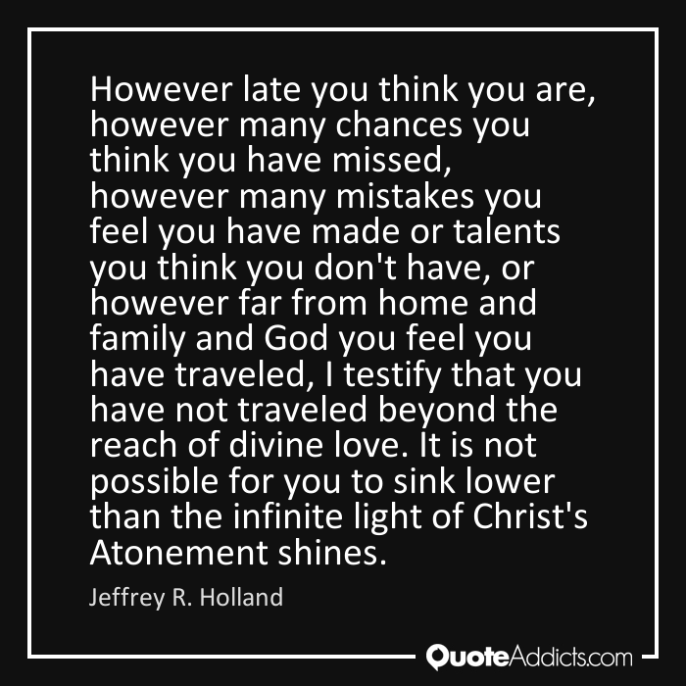
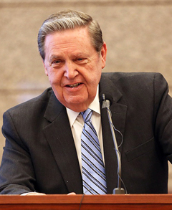

Slide 10
Doctrinal Mastery Review
____ D&C 6:36 ____ D&C 8:2–3 ____ D&C 88:118 ____ D&C 29:10–11 ____ D&C 130:22–23 ____ D&C 76:22–24 ____ D&C 18:10–11 ____ D&C 19:16–19. ____ D&C 58:42–43 | Look unto Christ in every thought. The Father and Son have bodies of flesh and bone. The Holy Ghost speaks to our minds and hearts. The worth of souls is great. The Savior suffered for our sins so we could repent. Christ will come again with power and glory. To repent we must confess and forsake sin. Seek learning by study and faith. Jesus Christ lives and is the Creator of worlds.

Slide 11
Doctrinal Mastery Review
____ D&C 6:36 ____ D&C 8:2–3 ____ D&C 88:118 ____ D&C 29:10–11 ____ D&C 130:22–23 ____ D&C 76:22–24 ____ D&C 18:10–11 ____ D&C 19:16–19. ____ D&C 58:42–43 | Look unto Christ in every thought. The Father and Son have bodies of flesh and bone. The Holy Ghost speaks to our minds and hearts. The worth of souls is great. The Savior suffered for our sins so we could repent. Christ will come again with power and glory. To repent we must confess and forsake sin. Seek learning by study and faith. Jesus Christ lives and is the Creator of worlds.
Correct answers: 1. a; 2. c; 3. h; 4. f; 5. b; 6. i; 7. d; 8. e; 9. g

Slide 12
Doctrinal Mastery
The Atonement of Jesus Christ
Part 3

