Slide 1
The Atonement of Jesus Christ
Part II

Slide 2
STAINS
What’s the worst stain you’ve ever had?

Slide 3
Jesus Christ’s atoning sacrifice provided the only way for us to be cleansed and forgiven of our sins so that we can dwell in God’s presence eternally.
Search paragraph 3.3 in the Core Document.
What must we do to allow the Savior to cleanse and forgive us?

Slide 4
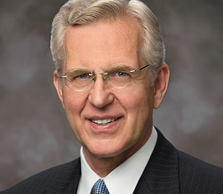
“Only through repentance do we gain access to the atoning grace of Jesus Christ and salvation. Repentance is a divine gift. …
“Repentance exists as an option only because of the Atonement of Jesus Christ” (D. Todd Christofferson, “The Divine Gift of Repentance,” Ensign or Liahona,Nov. 2011, 38).
What are some ways a person might try to deal with their past sins instead of repenting?
Why is it important to understand that the Savior’s atoning sacrifice and our repentance provide the only way for us to be forgiven of our sins?

Slide 5
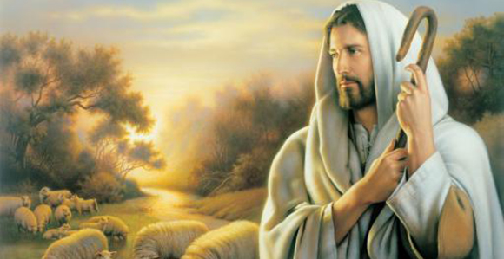
Read 3.6 and 3.7 in the Core Document.
What truths about having faith in Jesus Christ do you feel are important to understand? Why?
Read Doctrine and Covenants 19:16–19.
From what consequence of sin can we be spared because of the Savior’s sufferings?
According to verse 16 what must we do in order to be spared the kind of suffering the Savior experienced?

Slide 6
“It is with respect to our own sins that the scriptures speak of some not receiving the benefit of redemption. … If a man rejects the Savior’s Atonement, he must redeem his debt to justice himself. … An unredeemed individual’s sufferings for sin is known as hell. It means being subject to the devil and is described in scriptural metaphors as being in chains or a lake of fire and brimstone. … Because of the Atonement of Jesus Christ, hell has an end, and those who are obliged to pass through it are ‘redeemed from the devil [in] the last resurrection’ (Doctrine and Covenants 76:85)” (D. Todd Christofferson, “Redemption,” Ensign or Liahona, May 2013, 112, note 4).
When do unrepentant sinners suffer for their own sins? (After this mortal life, in spirit prison.)
When will those suffering for their own sins be redeemed? (During the last resurrection.)

Slide 7
Read 3.8 – 3.10 in the Core Document.
What must we do in order to repent?
Repentance includes recognizing our sins; feeling remorse, or godly sorrow, for committing sin; confessing our sins to Heavenly Father and, if necessary, to others; forsaking sin; seeking to restore, as far as possible, all that has been damaged as a result of our sins; and living a life of obedience to God’s commandments.

Slide 8
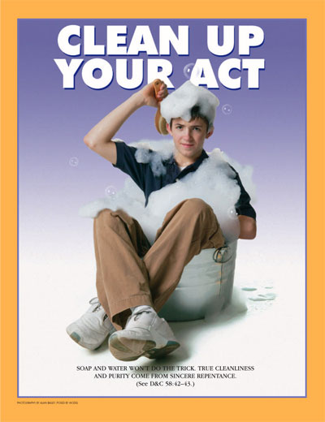
Recognizing our sins
Feeling remorse (godly sorrow)
Confessing our sins to Heavenly Father (and, if necessary, to others)
Forsaking sin
Seeking to restoreall that has been damaged
Living a life of obedience.
How could a person fulfill the requirement of repentance that you were assigned?
Why do you think this element of repentance is important?

Slide 9
Read Doctrine and Covenants 58:42–43, looking for elements of repentance.
What promise does the Lord make to those who will confess and forsake their sins?

Slide 10
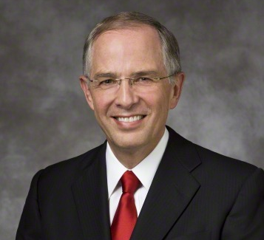
“The scriptures do not say that we will forget our forsaken sins in mortality. Rather, they declare that the Lord will forget [see D&C 58:42–43].
“The forsaking of sins implies never returning. Forsaking requires time. To help us, the Lord at times allows the residue of our mistakes to rest in our memory. It is a vital part of our mortal learning.
“As we honestly confess our sins, restore what we can to the offended, and forsake our sins by keeping the commandments, we are in the process of receiving forgiveness. With time, we will feel the anguish of our sorrow subside, taking ‘away the guilt from our hearts’ [Alma 24:10] and bringing ‘peace of conscience’ [Mosiah 4:3] (Neil L. Andersen, “Repent … That I May Heal You,” Ensign or Liahona, Nov. 2009, 42).
Why do you think it is important to understand that we may not completely forget our sins?

Slide 11
“Confessing and forsaking are powerful concepts. They are much more than a casual ‘I admit it; I’m sorry.’ Confession is a deep, sometimes agonizing acknowledgment of error and offense to God and man. Sorrow and regret and bitter tears often accompany one’s confession, especially when his or her actions have been the cause of pain to someone or, worse, have led another into sin. …
“With faith in the merciful Redeemer and His power, potential despair turns to hope. One’s very heart and desires change, and the once-appealing sin becomes increasingly abhorrent. A resolve to abandon and forsake the sin and to repair, as fully as one possibly can, the damage he or she has caused now forms in that new heart” (D. Todd Christofferson, “The Divine Gift of Repentance,” Ensign or Liahona,Nov. 2011, 40).
What did you learn from Elder Christofferson’s statement about confessing and forsaking sins?
What promise does the Lord make in Doctrine and Covenants 58:42–43 to those who confess and forsake their sins?
What does this promise mean to you?

Slide 13
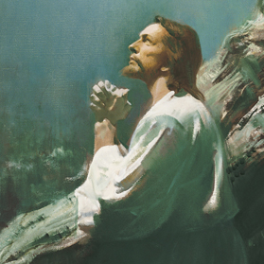
D&C 18:10–11. The worth of souls is great.
D&C 19:16–19. The Savior suffered for our sins so we could repent.
D&C 58:42–43. To repent we must confess and forsake sin.
One of you (in pairs) will see the references and key phrases while your partner cannot.
Read each of the key phrases while your partner names the corresponding doctrinal mastery passage reference.
Repeat the key phrases several times, alternating the order
Then, change roles and repeat the activity.

Slide 14
The Atonement of Jesus Christ
Part II

