Slide 1
The Atonement
Part I

Slide 2
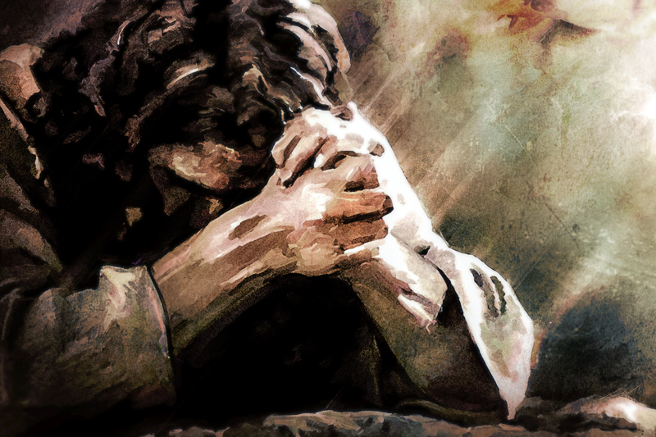
The Atonement
z
Have you ever been asked a question about the Atonement of Jesus Christ that you could not answer?
Turn to doctrinal topic 3, “The Atonement” in the Core Document.
Read paragraphs 3.1-3.5.
Think of a question someone might ask about the Atonement of Jesus Christ that can be answered from those paragraphs.
Why do you think it is important to study and understand the Atonement of Jesus Christ?

Slide 3
His sacrifice benefits each of us and demonstrates the infinite worth of each and every one of Heavenly Father’s children.
z
Search paragraph 3.1 in the Core Document: How does the Savior’s sacrifice demonstrate the worth of each and every one of Heavenly Father’s children?
Which doctrinal mastery passage from the Doctrine and Covenants helps teach the key statement of doctrine above?

Slide 4
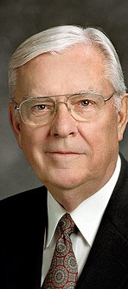
“Even though His life was pure and free of sin, [Jesus Christ] paid the ultimate penalty for sin﻿﻿—yours, mine, and everyone who has ever lived. His mental, emotional, and spiritual anguish were so great they caused Him to bleed from every pore (see Luke 22:44; D&C 19:18). And yet Jesus suffered willingly so that we might all have the opportunity to be washed clean﻿﻿—through having faith in Him, repenting of our sins, being baptized by proper priesthood authority, receiving the purifying gift of the Holy Ghost by confirmation, and accepting all other essential ordinances. Without the Atonement of the Lord, none of these blessings would be available to us, and we could not become worthy and prepared to return to dwell in the presence of God. …
“… I believe that if we could truly understand the Atonement of the Lord Jesus Christ, we would realize how precious is one son or daughter of God. …
“… The irony of the Atonement is that it is infinite and eternal, yet it is applied individually, one person at a time. …Never, never underestimate how precious is the one” (M. Russell Ballard, “The Atonement and the Value of One Soul,” Ensign or Liahona, May 2004, 85–87).
z

Slide 5
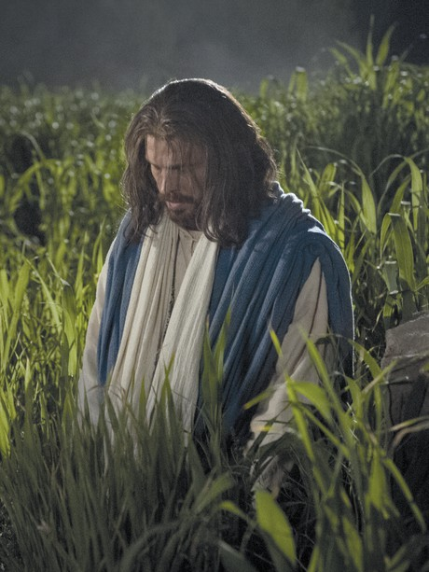
His sacrifice benefits each of us and demonstrates the infinite worth of each and every one of Heavenly Father’s children.
z
Read Doctrine and Covenants 18:10–11. What words or phrases help teach the key statement of doctrine?
According to verse 11, why did the Savior suffer and die for all mankind?
How has knowing that Jesus Christ suffered and died for you helped you realize your worth in the sight of God?

Slide 6
REVIEW and ROLE PLAY
Doctrinal Mastery

Slide 7
You have a friend who has been feeling discouraged lately. When you ask if something is wrong, she is reluctant to tell you, but she eventually admits that she has begun to doubt that God loves her.
In what ways might you encourage your friend to act in faith to resolve her concern?
How could you help your friend examine her concern with an eternal perspective?
How could you use Doctrine and Covenants 18:10–11 to help your friend?
What other scriptures or statements by prophets and apostles could you encourage your friend to read in order to seek further understanding of her worth to God?
Choose someone to act as a friend who has begun to doubt God’s love. Role-play what you might say to your friend (be sure to use Doctrine and Covenants 18:10–11).
Switch roles and practice again.
DISCUSS: What went well or anything that made their conversations difficult.
z

Slide 8
The Atonement
Part I

