Slide 1
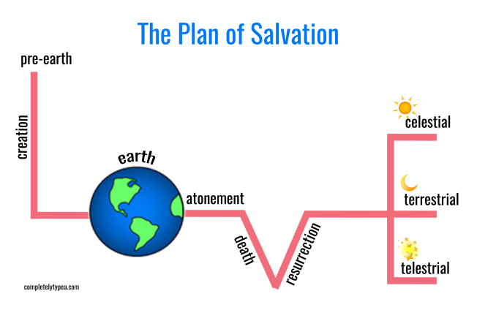
The Plan of Salvation
PART II

Slide 2
THE INTERNET
On average, how long does it take for the search to provide answers?
How is searching for an answer on the internet different from learning eternal truth?
How do you feel when you need to wait for answers to important questions?

Slide 3
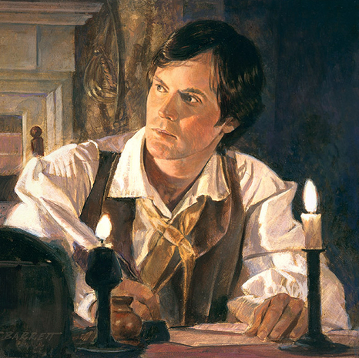
Doctrine and Covenants 9:7–8
What was the reason Oliver was unable to translate?
Why is it important to know that the Lord expects us to study and put forth effort to learn for ourselves?

Slide 4
Acquiring Spiritual Knowledge
Act in faith
Examine concepts and questions with an eternal perspective
Seek further understanding through divinely appointed sources
LOOK for how we can find answers to important questions and resolve our concerns.
CORE DOCUMENT

Slide 5
Video “Examining Questions with an Eternal Perspective”
How did Lauren examine her friend’s question with an eternal perspective?
http://www.lds.org/media-library/video/2016-05-2000-examining-questions-with-an-eternal-perspective

Slide 6
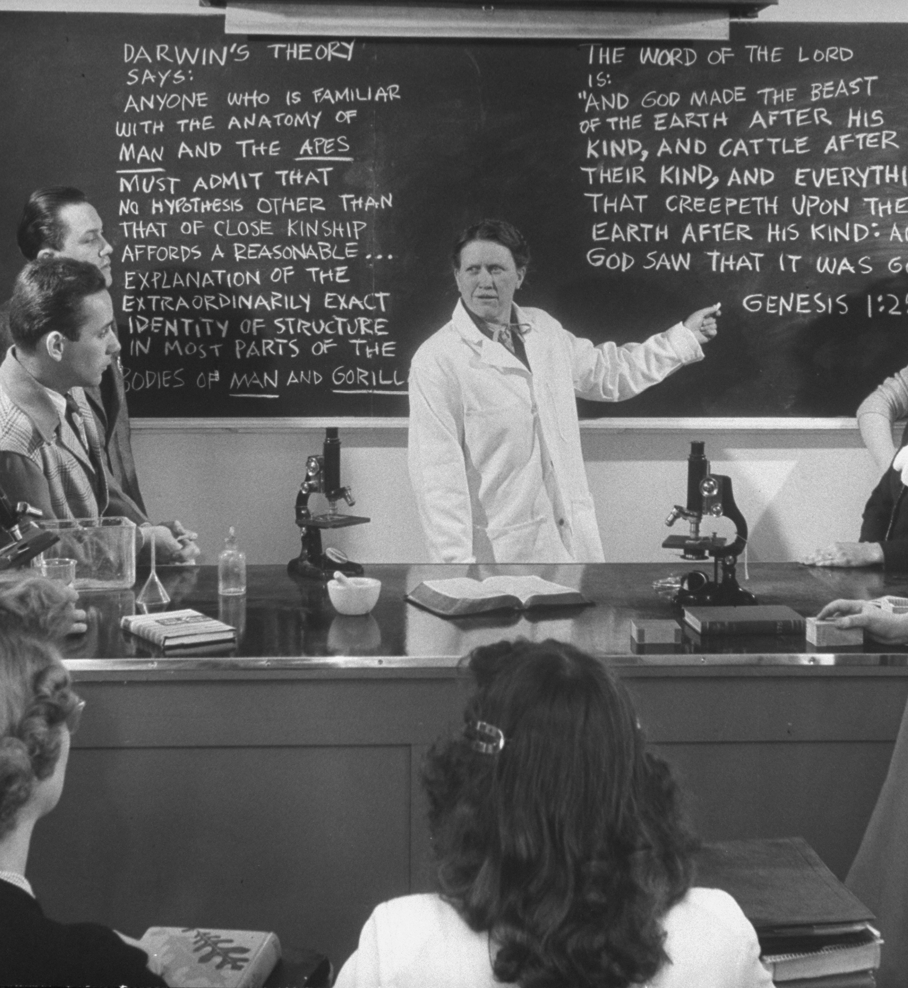
Practice Exercise
You are sitting in a science class where the teacher and students are discussing theories about how our galaxy and solar system came into existence. The teacher takes several opportunities to attempt to discredit the idea that a divine Creator could have played a role in the creation of the world. The teacher points out multiple facts that seem to support this conclusion, and several students voice their support of the teacher’s opinion. By the end of class you are somewhat troubled as you try to reconcile what you have learned at home and in church with what you are learning in this class. By the time you arrive home, the following questions keep coming up in your mind: Was our galaxy really just formed by random events? Are we just here by chance?

Slide 7
JOURNAL
Record what you could do in this situation to show Heavenly Father that you are willing to act in faith.
Share with each other what you wrote.

Slide 8
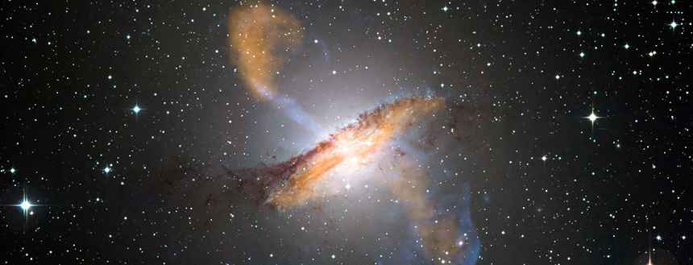
Was our galaxy really just formed by random events? Are we just here by chance?
How can you examine these questions from an eternal perspective?
What do I know about God, and how do I know it?
What do the scriptures or recent prophets say about the Creation?
When or how have I felt the Spirit witness that there is a Creator?
Does any of the scientific evidence disprove the possibility that God exists and could have created the heavens and the earth?
How can the information that science discovers about our galaxy and the earth witness that there is a divine Creator?
What inspired sources can help with these questions?

Slide 9
The Plan of Salvation
PART II

