Slide 1
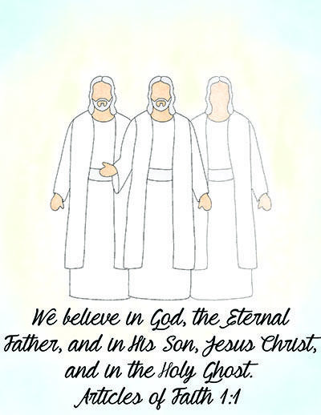
The Godhead
Part II

Slide 2
With a partner... You and your companion are missionaries. You meet a pleasant elderly man named Ben. You talk to Ben and set up an appointment with him. When your companion asks him what his beliefs are about God, Ben says, “I’ve always thought of God as an essence that is everywhere at once.” You and your companion both feel that it would be helpful for Ben to understand the true nature of the Godhead.
Prepare a brief lesson on the Godhead and include the following:
A correction to the misunderstanding your investigator has about God
Scriptures that explain the correct doctrine of the Godhead
An explanation on how having a correct understanding of God would help Ben
Be ready to teach your lesson to another partnership.

Slide 3
Doctrine and Covenants 88:118
Doctrine and Covenants 8:2–3
Doctrine and Covenants 6:36
Doctrine and Covenants 130:22–23
Doctrine and Covenants 29:10–11
Pick one of the references above and write down either a true statement or a false statement describing the doctrinal mastery passage. I will collect the statements and read them aloud to the class and we'll see how you do!
Notes:
Ask the class to give a thumbs up for a true statement. If they know it’s false have them raise their hand and say that isn’t true” Then invite the students to find the doctrinal mastery scripture that teaches the truth.

Slide 4
The Godhead
Part II

