Slide 1
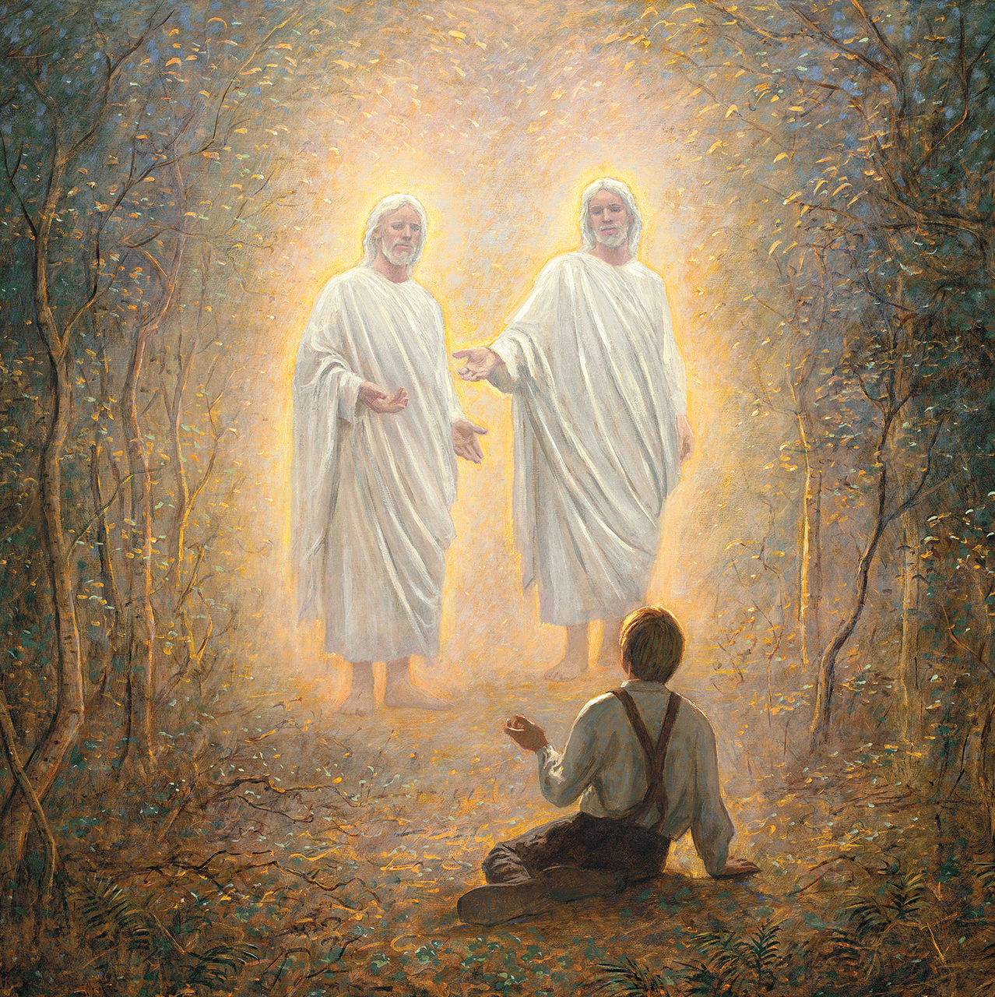
The Godhead
Part 1

Slide 2
Divide into groups How many truths about the Godhead can you think of in 2 mins? Write them down
0
0
5
4
3
2
1
0
0
9
8
7
6
5
4
3
2
1
0
9
8
7
6
5
4
3
2
1
0
9
8
7
6
5
4
3
2
1
0
9
8
7
6
5
4
3
2
1
0
9
8
7
6
5
4
3
2
1
0
9
8
7
6
5
4
3
2
1
2
0
1
Minutes
Seconds
Notes:
Divide students into groups of three or four. Provide a piece of paper for each group, or invite them to use their class notebooks or study journals. Ask each group to write down as many truths about the Godhead as they can think of in 90 seconds.

Slide 3
Take turns reading paragraphs 1.1-1.7 in “The Godhead” – Doctrinal Mastery Core Document
Do any of the truths about the Godhead that you found in these paragraphs support or confirm any of the truths you wrote on your paper? If so, which ones?
What additional truths about the Godhead from these paragraphs stood out to you?
What truths about the Godhead do you think are especially important for people to understand?
Notes:
ask students to turn to doctrinal topic 1, “The Godhead,” in the Doctrinal Mastery Core Document. Invite them to take turns reading paragraphs 1.1–1.7 aloud in their small groups, looking for truths about the Godhead.

Slide 4
“There are three separate personages in the Godhead: God, the Eternal Father; His Son, Jesus Christ; and the Holy Ghost. The Father and the Son have tangible, glorified bodies of flesh and bone, and the Holy Ghost is a personage of spirit.”
Why do you think these are important truths for people to understand?
Notes:
Invite a student to read quote aloud.
Invite students to mark these key statements of doctrine in their copies of the Doctrinal Mastery Core Document.

Slide 5
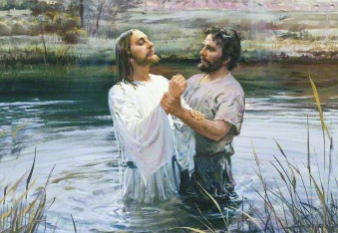
What do we learn about the Godhead from this story?
Notes:
Invite students to briefly explain the event depicted in each of these pictures.
John the Baptist Baptizing Jesus(Matthew 3:13–17). At the Savior’s baptism, the Holy Ghost descended on the Savior like a dove and Heavenly Father spoke from heaven.

Slide 6
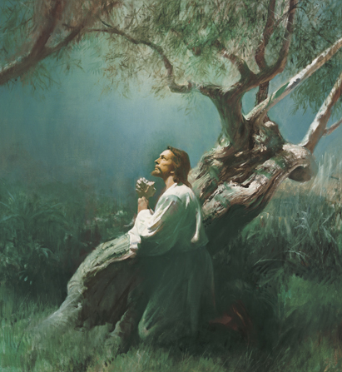
What do we learn about the Godhead from this story?
Notes:
Jesus Praying in Gethsemane (Matthew 26:39, 42). Jesus prayed to Heavenly Father as He suffered in Gethsemane.

Slide 7
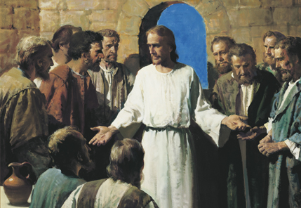
What do we learn about the Godhead from this story?
Notes:
Jesus Shows His Wounds (Luke 24:36–40). Jesus appeared to His Apostles with a resurrected body of flesh and bones.

Slide 8
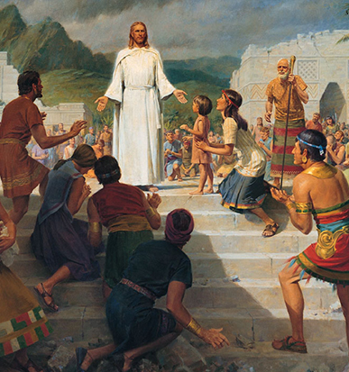
What do we learn about the Godhead from this story?
Notes:
The First Vision (Joseph Smith—History 1:15–20). God the Father and His Son, Jesus Christ, appeared to Joseph Smith.

Slide 9
What do we learn about the Godhead from this story?
Notes:
Jesus Christ Appears to the Nephites(3 Nephi 11:3–11). Heavenly Father testified of His Beloved Son when Jesus Christ appeared to the Nephites in the land Bountiful.

Slide 10
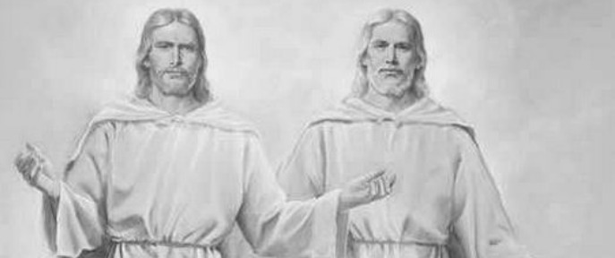
“1.1. There are three separate personages in the Godhead: God, the Eternal Father; His Son, Jesus Christ; and the Holy Ghost. The Father and the Son have tangible, glorified bodies of flesh and bone, and the Holy Ghost is a personage of spirit. They are one in purpose and are perfectly united in bringing to pass Heavenly Father’s plan of salvation.”
D&C 130:22–23
Notes:
Have students read the paragraph 1.1.
Have them turn in their scriptures to D&C 130:22-23 – mark in a distinctive way so they will be able to locate it easily.
Explain: The Prophet Joseph Smith attended a stake conference where Elder Orson Hyde of the Quorum of the Twelve Apostles spoke. In his talk Elder Hyde included some ideas about the Godhead that were commonly taught but are false. After the meeting Joseph Smith offered to correct what Elder Hyde had taught. Elder Hyde gladly received this correction from the Prophet, and these corrections are now recorded in Doctrine and Covenants 130.
Student read scripture aloud
Discuss: How does this DM passage help teach the key statements of doctrine.

Slide 11
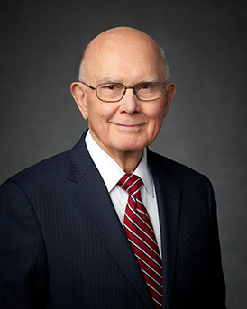
“Because we have the truth about the Godhead and our relationship to Them, the purpose of life, and the nature of our eternal destiny, we have the ultimate road map and assurance for our journey through mortality. We know whom we worship and why we worship. We know who we are and what we can become. We know who makes it all possible, and we know what we must do to enjoy the ultimate blessings that come through God’s plan of salvation. …
“… I testify that we have a Heavenly Father, who loves us. I testify that we have a Holy Ghost, who guides us. And I testify of Jesus Christ, our Savior, who makes it all possible.” Dallin H. Oaks, May 2017
How do you think knowing the truth about the Godhead affects our relationship with the Father, the Son, and the Holy Ghost?
What sources can we go to in order to learn the truth about the members of the Godhead?

Slide 12
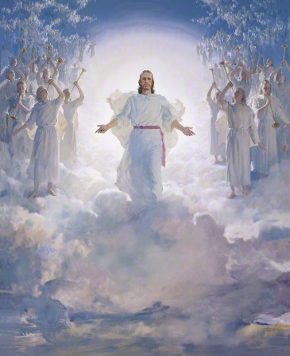
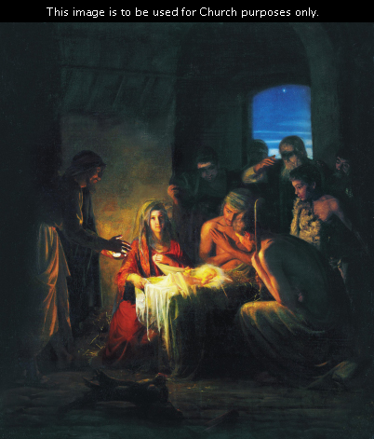
What do these pictures have in common?

Slide 13
1.4. Jesus Christ does the will of the Father in all things. He lived a sinless life and atoned for the sins of all mankind. His life is the perfect example of how we are to live. He was the first of Heavenly Father’s children to be resurrected. In our day, as in ancient times, He stands at the head of His Church. He will come again in power and glory and will reign on the earth during the Millennium. He will judge all mankind.
Notes:
Invite a student to read aloud paragraph 1.4 in the Doctrinal Mastery Core Document. Ask the class to follow along, looking for a key statement of doctrine that relates to the second picture, The Second Coming. (Students should identify the following statement about Jesus Christ: He will come again in power and glory and will reign on the earth during the Millennium. Invite students to mark this key statement of doctrine in their copies of the Doctrinal Mastery Core Document.)

Slide 14
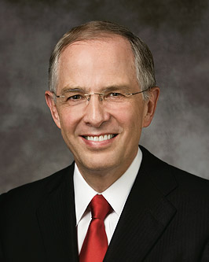
“The thought of His coming stirs my soul. It will be breathtaking! The scope and grandeur, the vastness and magnificence, will exceed anything mortal eyes have ever seen or experienced.
“In that day He will not come ‘wrapped in swaddling clothes, lying in a manger’ but He will appear ‘in the clouds of heaven, clothed with power and great glory; with all the holy angels’
Neil L. Andersen, May 2015

Slide 15
What are the contrasts?
Turn to the hymn “Jesus, Once of Humble Birth” (Hymns, no. 196).
Notes:
Invite students to share what impresses them about the contrast between the Savior’s birth and His Second Coming. You might also invite students to turn to the hymn “Jesus, Once of Humble Birth” (Hymns, no. 196). You could sing this hymn as a class or have several students take turns reading the verses aloud. Invite the class to look for what the coming of Jesus Christ will be like and how it will be different from when He came as a baby born in Bethlehem.

Slide 16
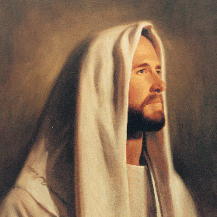
1.4. Jesus Christ does the will of the Father in all things. He lived a sinless life and atoned for the sins of all mankind. His life is the perfect example of how we are to live. He was the first of Heavenly Father’s children to be resurrected. In our day, as in ancient times, He stands at the head of His Church. He will come again in power and glory and will reign on the earth during the Millennium. He will judge all mankind.
D&C 29:10-11
What does verse 11 teach us about the blessing the righteous will enjoy during the Millennium?
Notes:
(Invite students to consider marking D&C 29:10–11 in a distinctive way so they will be able to locate it easily.)
Explain: To help students understand the context of this passage, explain that shortly before a conference in 1830, the Prophet Joseph Smith received this revelation in the presence of six elders. The revelation taught the group about the gathering of the Savior’s elect before His Second Coming.
Ask a student to read aloud Doctrine and Covenants 29:10–11. Invite the class to follow along, looking for how this passage helps teach the key statement of doctrine they marked in paragraph 1.4. Ask students to report what they find.

Slide 17
The Godhead
Part 1

