Slide 1
Acquiring Spiritual Knowledge
PART 4

Slide 2
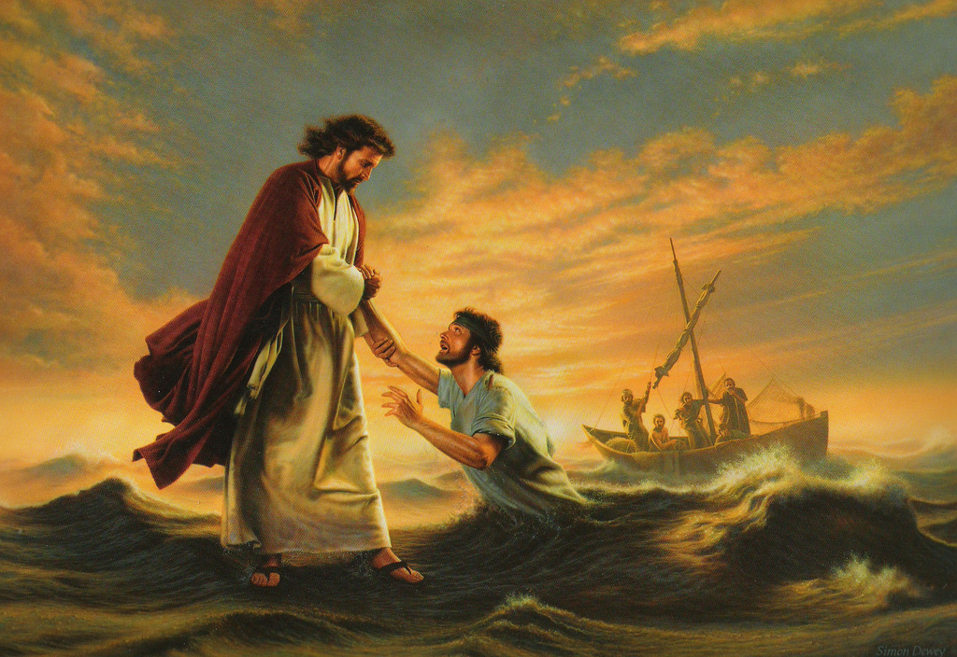
Who knows this story?

Slide 3
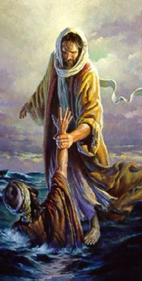
Acquiring Spiritual Knowledge
Read Matthew 14:29-30 and look for when Peter began to sink.
How might our ability to acquire spiritual knowledge be diminished if we take our attention away from the Savior?
Read at the last sentence in paragraph 6 in principle 1, “Act in Faith,” in the “Acquiring Spiritual Knowledge” section in the Doctrinal Mastery Core Document
The Lord Himself has invited us to “look unto [Him] in every thought; doubt not, fear not.”

Slide 5
How does D&C 6:36 encourage us to seek spiritual knowledge from God?
How can we look to the Lord when we have questions and concerns?
In what ways does looking to God and not doubting increase our ability to acquire spiritual knowledge?
Read paragraphs 3, 6, and 8 in the “Acquiring Spiritual Knowledge” section in the Doctrinal Mastery Core Document. Answer this question: What will help me as I seek to acquire spiritual knowledge?

Slide 6
How does your attitude and intent affect your ability to learn by the Spirit?
In what ways does relying on what you already know increase your ability to receive more spiritual understanding?
How can examining questions and concerns you have about the plan of salvation help you acquire spiritual knowledge?
Why is it important to know that God reveals truth through safe and reliable sources?
How have you applied the truths found in the “Acquiring Spiritual Knowledge” section in the Doctrinal Mastery Core Document and received spiritual knowledge from the Lord?

Slide 7
VIDEO: EXAMINING QUESTIONS WITH AN ETERNAL PERSPECTIVE
Watch for how a young woman examined her friend’s question about God with an eternal perspective.
https://www.lds.org/media-library/video/2016-05-2000-examining-questions-with-an-eternal-perspective?lang=eng&_r=1

Slide 8
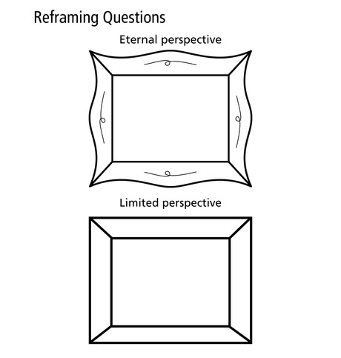
Place the piece of paper with a question inside the “Limited Perspective” frame at the bottom of the handout. Imagine that someone without an eternal perspective is asking this question. What beliefs or assumptions do you think a person with a limited perspective might have? How would this person’s beliefs or assumptions influence his or her conclusion?
Read aloud paragraph 8 in the “Acquiring Spiritual Knowledge” section in the Doctrinal Mastery Core Document. Look for questions we can ask that can help us reframe a question or concern with an eternal perspective.

Slide 9
Move their piece of paper up into the “Eternal Perspective” frame.
The question itself does not change, but as we look at it with an eternal perspective our understanding will change.
Examine the two questions in paragraph 8. How would these beliefs or assumptions influence our conclusion?

Slide 10
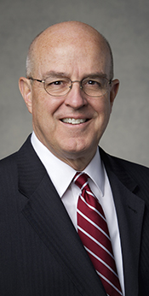
EXAMINING QUESTIONS WITH AN ETERNAL PERSPECTIVE
“[God] doesn’t show us the whole picture from the outset. That is where faith, hope, and trusting in the Lord come in. God asks us to bear with Him—to trust Him and to follow Him. … He cautions us that we shouldn’t expect easy answers or quick fixes from heaven. Things work out when we stand firm during the ‘trial of [our] faith,’ however hard that test may be to endure or slow the answer may be in coming” (L. Whitney Clayton, “Whatsoever He Saith unto You, Do It,” Ensign or Liahona, May 2017, 99).

Slide 11
Acquiring Spiritual Knowledge
PART 4

