Slide 1
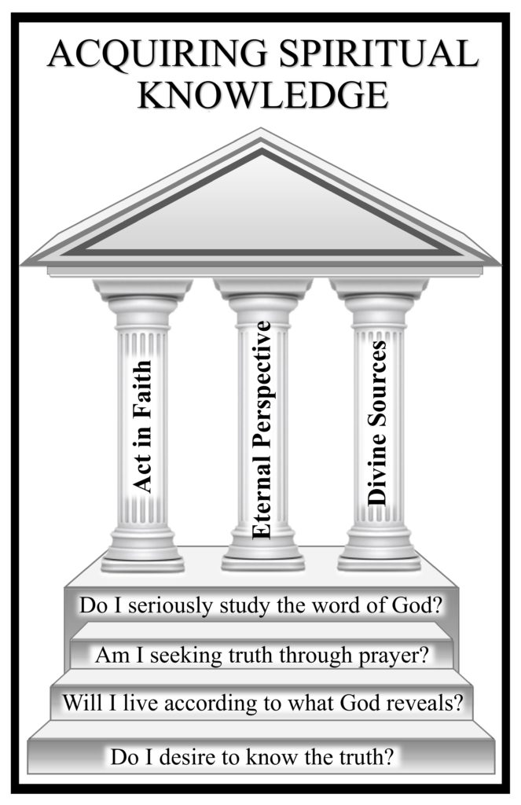
Acquiring Spiritual Knowledge, Part 2

Slide 2
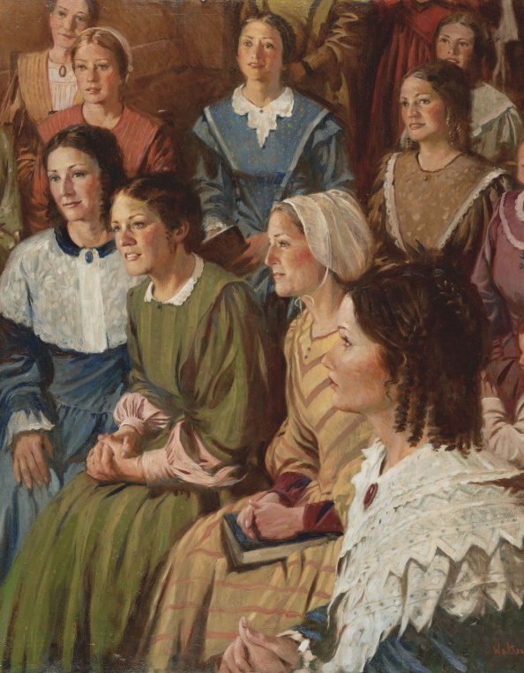
Question…
Why did Joseph Smith and other early Latter-day Saint men practice plural marriage by marrying multiple wives?
Why might it be difficult to know how to address this question?
Read aloud paragraph 3 of the “Acquiring Spiritual Knowledge” section in the Doctrinal Mastery Core Document.
What counsel in this paragraph can help us when we encounter concerns or questions that may be difficult for us to understand or answer?

Slide 3
Three principles of acquiring spiritual knowledge
Act
Act in faith
Examine
Examine concepts and questions with an eternal perspective
Seek
Seek further understanding through divinely appointed sources.

Slide 4
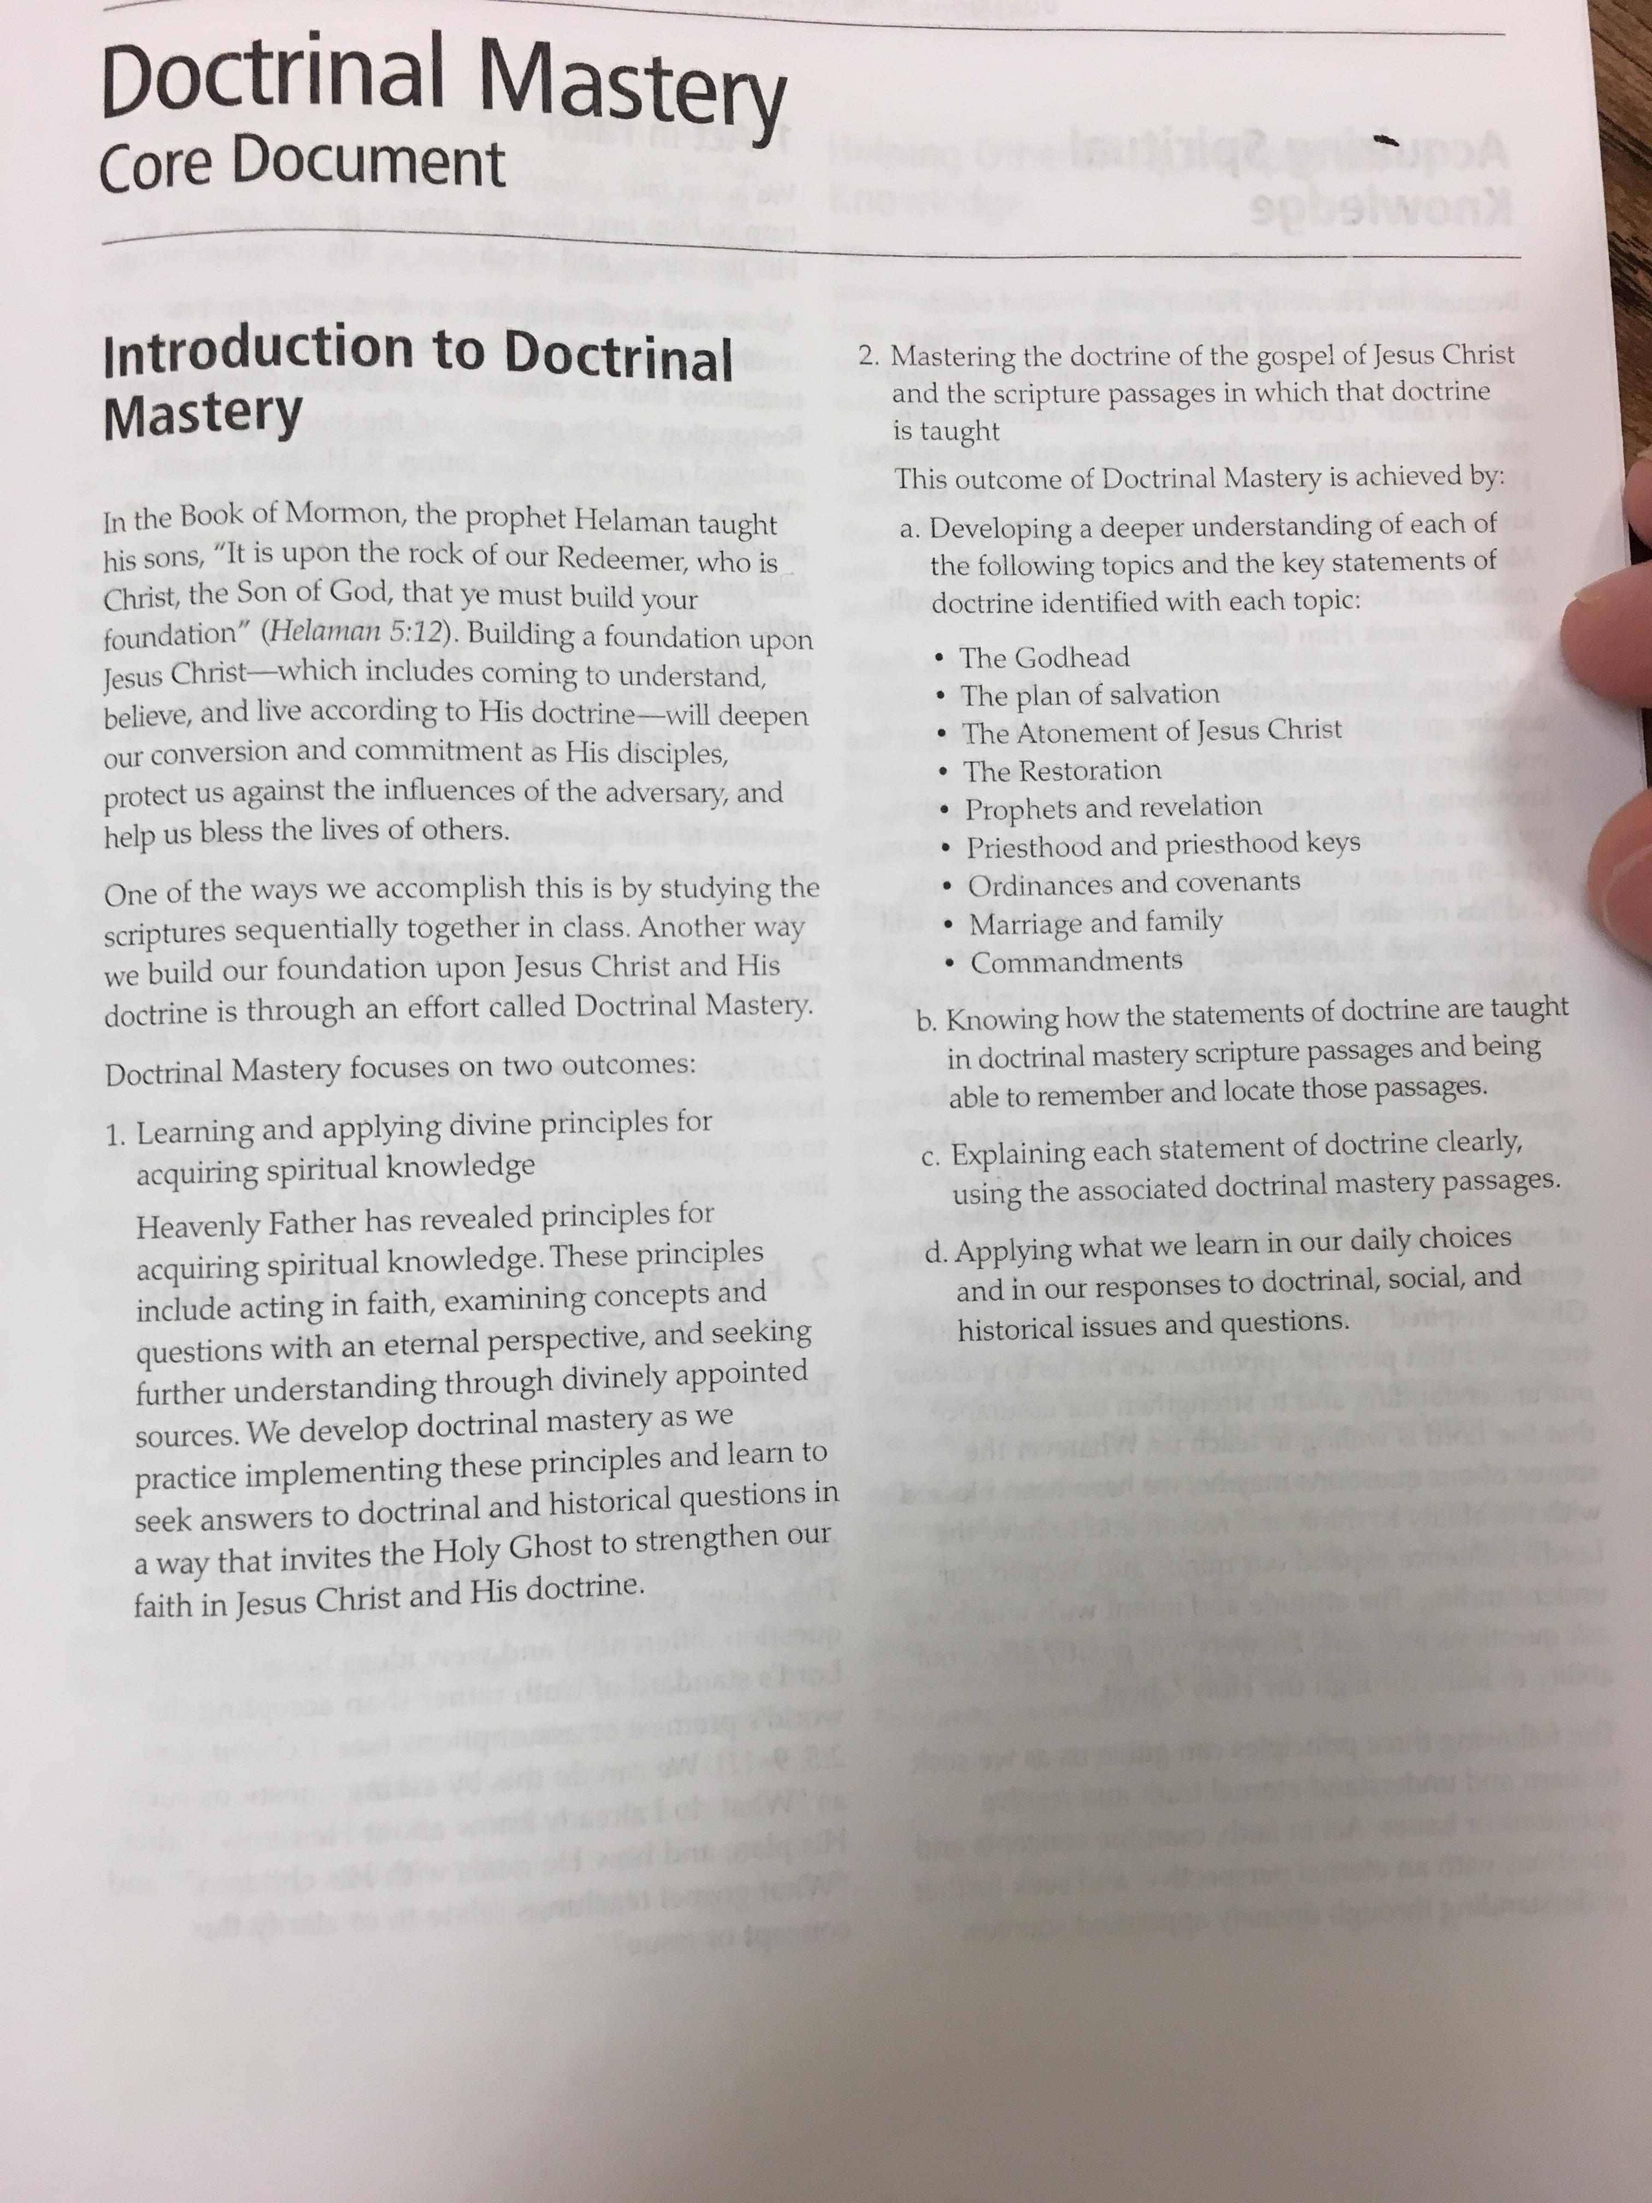
Act in Faith
Read aloud paragraphs 5–7 in the “Acquiring Spiritual Knowledge” section in the Doctrinal Mastery Core Document.
According to these paragraphs, what can we do to act in faith when we have questions and concerns?
The Lord Himself has invited us to “look unto [Him] in every thought; doubt not, fear not.” Which doctrinal mastery passage helps teach this key statement of doctrine?
Answer: D&C 6:36

Slide 5
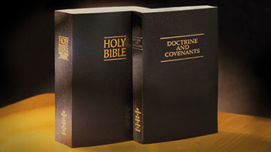
Act in Faith
Read Doctrine and Covenants 6:36, looking for what the Lord counseled Oliver to do
How might the Lord’s counsel in this verse help us when we have questions or experience uncertainty?
How can looking unto the Lord in every thought help us overcome doubt and fear?
Based on what we have discussed, how could you choose to act in faith if you had a concern?
HINT: What do you already know about Heavenly Father, Jesus Christ, and the Prophet Joseph Smith that can help you when you have questions about the history or teachings of the Church?

Slide 6
Examine Concepts and Questions with an Eternal Perspective
Read aloud paragraphs 8–10 in the “Acquiring Spiritual Knowledge” section in the Doctrinal Mastery Core Document.
According to these paragraphs, how can we examine concepts and questions with an eternal perspective?
To examine doctrinal concepts, questions, and social issues with an eternal perspective, we consider them in the context of the plan of salvation and the teachings of the Savior. We seek the help of the Holy Ghost in order to see things as the Lord sees them.

Slide 7
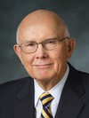
“I suggest that it may be preferable for our young people to refrain from arguing with their associates. … They will often be better off to respond by identifying the worldly premises or assumptions in the assertions they face and then by identifying the different assumptions or premises that guide the thinking of Latter-day Saints” (Dallin H. Oaks, “As He Thinketh in His Heart,” [evening with a General Authority, Feb. 8, 2013], broadcasts.lds.org).
Based on President Oaks’s suggestion, what can we do when we are presented with a difficult concept or question, or a point of view that differs from our own?

Slide 8
How a person’s beliefs, assumptions, or testimony can influence his or her conclusions
God called Joseph Smith to be a prophet
God commanded the Prophet Joseph Smith and other early Latter-day Saints to practice plural marriage
With these beliefs and assumptions, and with the testimony that God called Joseph Smith to be a prophet, what can we conclude about Joseph Smith’s and other early Latter-day Saints’ practice of plural marriage?

Slide 9
Marriage (Guide to the Scriptures, “Marriage, Marry,” scriptures.lds.org).
The Lord has ordained that a man is to have only one wife, unless He commands otherwise by revelation though the President of the Church (see Jacob 2:27–30). “By revelation, plural marriage was practiced in Old Testament times and in the early days of the restored Church by the direction of the prophet who held the priesthood keys (D&C 132:34–40, 45). It is no longer practiced in the Church (OD 1); today, having more than one wife is incompatible with membership in The Church of Jesus Christ of Latter-day Saints…

Slide 10
Marriage (Guide to the Scriptures, “Marriage, Marry,” scriptures.lds.org).
While we do not understand all of God’s purposes for instituting plural marriage, it was part of the “restitution of all things” (Acts 3:21). Other reasons given by the Lord for the practice were to help the Saints fulfill the commandment given to Adam and Eve to “multiply and replenish the earth” (D&C 132:63; see also Genesis 1:28) and “raise up seed unto [the Lord]” (Jacob 2:30). In addition to the purposes given by the Lord in scripture, the practice of plural marriage affected the early Saints in other ways.

Slide 11
Marriage (Guide to the Scriptures, “Marriage, Marry,” scriptures.lds.org).
What insights can help us view the practice of plural marriage among early Latter-day Saints with an eternal perspective?
Some people may choose to examine questions about the early Latter-day Saints’ practice of plural marriage with the assumption that Joseph Smith was not a prophet of God
What conclusion do you think a person might make if he or she started with this assumption?

Slide 12
Seek Further Understanding through Divinely Appointed Sources
Why is it important to have a testimony that Joseph Smith was a prophet of God when we examine this and other questions about the Church’s history and teachings?

Slide 13
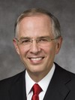
“The negative commentary about the Prophet Joseph Smith will increase as we move toward the Second Coming of the Savior. The half-truths and subtle deceptions will not diminish. There will be family members and friends who will need your help” (Neil L. Andersen, “Joseph Smith,” Ensign or Liahona, Nov. 2014, 30).
Elder Neil L.
Andersen

Slide 14
Read aloud paragraph 11 in the “Acquiring Spiritual Knowledge” section in the Doctrinal Mastery Core Document
What has the Lord given us to help us discover and understand truth?
As part of the Lord’s appointed process for obtaining spiritual knowledge, He has established sources through which He reveals truth and guidance to His children.
What blessings can we receive as we turn to the Lord’s divinely appointed sources of truth?
Why is the Book of Mormon an especially important source for those who desire to know that Joseph Smith was a prophet of God?

Slide 15
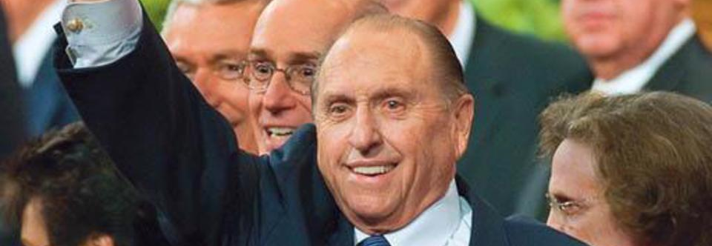
President Thomas S. Monson: “If you will read the Book of Mormon prayerfully and with a sincere desire to know the truth, the Holy Ghost will manifest its truth to you. If it is true—and I solemnly testify that it is—then Joseph Smith was a prophet who saw God the Father and His Son, Jesus Christ.
“Because the Book of Mormon is true, The Church of Jesus Christ of Latter-day Saints is the Lord’s Church on the earth, and the holy priesthood of God has been restored for the benefit and blessing of His children.
“If you do not have a firm testimony of these things, do that which is necessary to obtain one. It is essential for you to have your own testimony in these difficult times, for the testimonies of others will carry you only so far” (Thomas S. Monson, “The Power of the Book of Mormon,” Ensign or Liahona, May 2017, 86–87).

Slide 16
What are some other divinely appointed sources you could turn to if you had concern?
Read aloud paragraph 12 in the “Acquiring Spiritual Knowledge” section in the Doctrinal Mastery Core Document
Why is it important to be wary of unreliable sources of information?
How can we recognize truth in sources of information that are not produced by the Church?

Slide 17
Video
Acquiring Spiritual Knowledge, Madison’s Story
https://www.lds.org/media-library/video/2016-05-4000-acquiring-spiritual-knowledge-madisons-story?lang=eng&_r=1#

Slide 18
Madison’s Story
In what ways did Madison act in faith?
How did Madison examine her question with an eternal perspective?
What are some ways Madison sought further understanding through divinely appointed sources?
How was Madison blessed as a result of applying the principles of acquiring spiritual knowledge?
How did Madison’s experience in applying the principles of acquiring spiritual knowledge prepare her to help others?
How have you been blessed as you have applied the principles of acquiring spiritual knowledge?

Slide 19
Acquiring Spiritual Knowledge, Part 2

