Slide 1
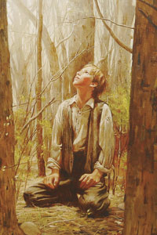
Doctrinal Mastery
Acquiring Spiritual Knowledge

Slide 2
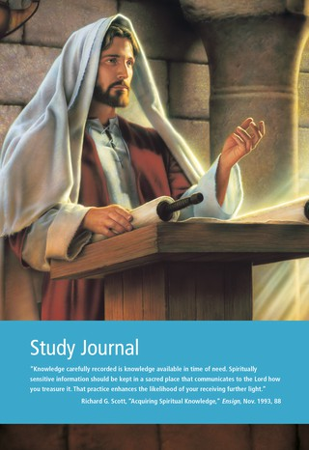
Scripture Study Journal Core Document Acquiring Spiritual Knowledge: Paragraph 1 Look for: (1) Who is the source of all truth? (2) What does Heavenly Father want for us?
What is an experience you have when you recognized that you needed to seek knowledge from your Heavenly Father?

Slide 3
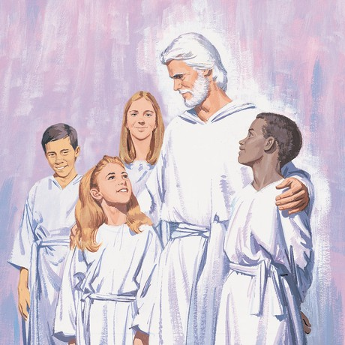
Because our Heavenly Father loves us and wants us to progress toward becoming like Him, He has encouraged us to “seek learning, even by study and also by faith.”

Slide 4
Doctrine & Covenants 88:118
“And as all have not faith, seek ye diligently and teach one another words of wisdom; yea, seek ye out of the best books words of wisdom; seek learning, even by study and also by faith.”

Slide 5
With a Partner…
Why do you think it is important to seek learning by study?
Why do you think it is important that we find the “best books?”
What are some of the “best books?” where we can find “words of wisdom?”
What do you think it means to seek learning by faith?

Slide 6
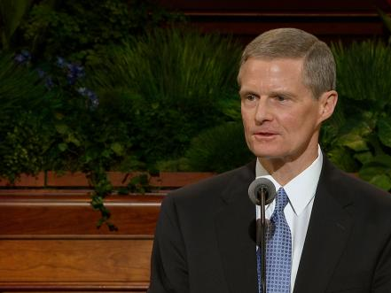
Elder David A. Bednar
“A learner exercising agency by acting in accordance with correct principles opens his or her heart to the Holy Ghost and invites His teaching, testifying power, and confirming witness.
What stands out to you about Elder Bednar’s description of learning by faith

Slide 7
“Learning by faith requires spiritual, mental, and physical exertion and not just passive reception. …cLearning by faith cannot be transferred from an instructor to a student through a lecture, a demonstration, or an experiential exercise; rather, a student must exercise faith and act in order to obtain the knowledge for himself or herself”
What are some things you can DO to seek learning by faith?

Slide 8
Scripture Study Journal Core Document Acquiring Spiritual Knowledge: Paragraph 2
Look for: What has Heavenly Father promised us if we strive to learn by faith and diligently seek Him?

Slide 9
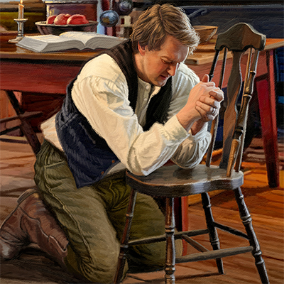
Doctrine & Covenants Section 8:2-3
In what ways might God speak to our mind and heart through the Holy Ghost?
How do I know if it is the Holy Ghost?
Handout: https://www.lds.org/bc/content/shared/content/images/gospel-library/manual/PD60001174/PD60001174_000_Spiritual_Knowledge_handout1.pdf

Slide 10
JOURNAL
What is important to remember about how to recognize thoughts, feelings, and promptings that come from the Holy Ghost?
Record a time when you have received a prompting from the Holy Ghost.

Slide 11
Scripture Study Journal Core Document Acquiring Spiritual Knowledge: Paragraph 2
Look for: What can we DO to invite the Holy Ghost to reveal truth to us?
What is an experience you have when you recognized that you needed to seek knowledge from your Heavenly Father?

Slide 12
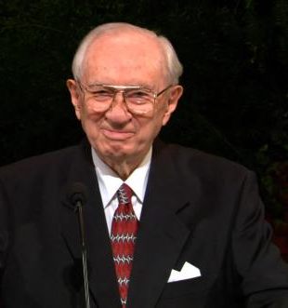
“How do we know the things of the Spirit? How do we know that it is from God? By the fruits of it. If it leads to growth and development, if it leads to faith and testimony, if it leads to a better way of doing things, if it leads to godliness, then it is of God. If it tears us down, if it brings us into darkness, if it confuses us and worries us, if it leads to faithlessness, then it is of the devil” – President Gordon B. Hinckley

Slide 13
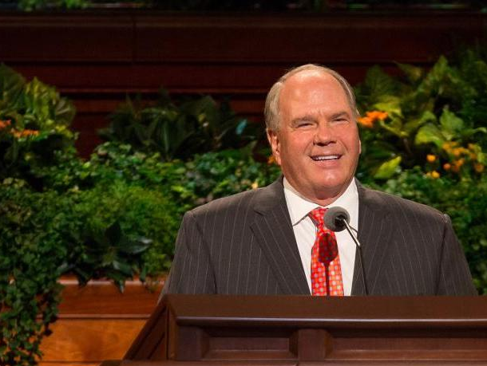
“’My experience has been that the Spirit most often communicates as a feeling. You feel it in words that are familiar to you, that make sense to you, that prompt you…We must be confident in our first promptings. Sometimes we rationalize; we wonder if we are feeling a spiritual impression or if it is just our own thoughts. When we begin to second-guess, even third-guess, our feelings—and we all have—we are dismissing the Spirit; we are questioning divine counsel…First promptings are pure inspiration from heaven. When they confirm or testify to us, we need to recognize them for what they are and never let them slip past”

Slide 14
Doctrinal Mastery
Acquiring Spiritual Knowledge

