Slide 1
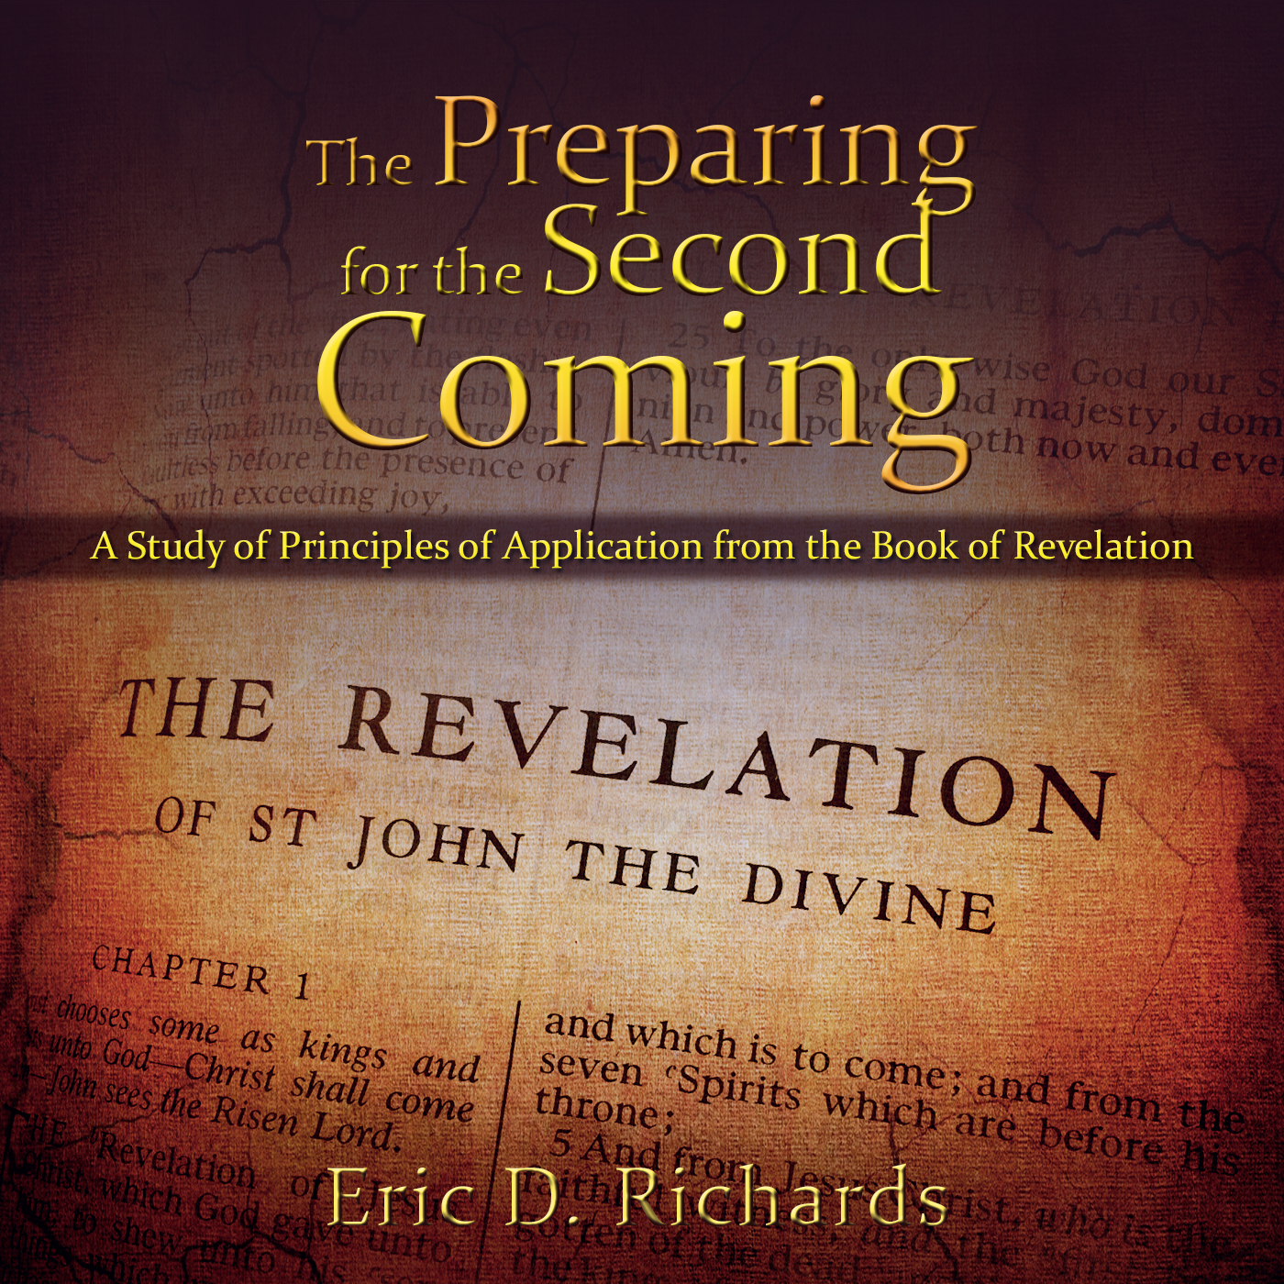
The Book of Revelation:
Preparing for
The Second Coming

Slide 2
Chapter 7
Chapter 6
Seven Seals
144,000 (& more)

Slide 3
Revelation 7
Two Events:
The Sealing/Protection of the Faithful
The Great Tribulation
ADAM
NOAH
AB/JOSEPH
HEROD/ALEX
MARTYRS
APOSTASY
2nd COMING
1st Seal
2nd Seal
3rd Seal
4th Seal
5th Seal
6th Seal
7th Seal
4000 BC
3000 BC
2000 BC
1000 BC
0
1000 AD
2000 AD

Slide 4
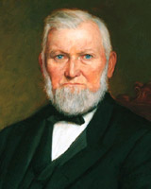
Revelation 7:1-3
“Those angels have left the portals of heaven, and they stand over this people and this nation now, and are hovering over the earth waiting to pour out the judgments. And from this very day they shall be poured out. Calamities and troubles are increasing in the earth, and there is a meaning to these things. Remember this, and reflect upon these matters. If you do your duty, and I do my duty, we’ll have protection, and shall pass through the afflictions in peace and in safety.” (“The Temple Workers’ Excursion,” Young Woman’s Journal, Aug. 1894, pp. 512–13; emphasis added.)
President Wilford Woodruff

Slide 5
Revelation 7:1-3
“Can you tell me who the people are who will be shielded and protected from these great calamities? None but those who honor priesthood will be safe from their fury.”
President Wilford Woodruff
Milton R. Hunter, Pearl of Great Price Commentary: A Selection From the Revelations, Translations, and Narrations of Joseph Smith, 313-314

Slide 6
Priesthood
Hood = A current condition or state
Motherhood, childhood, neighborhood
Priesthood: The quality or state of being a Priest.
Priest (Bible Dictionary): Mediators between man and God.
Priesthood: The condition or state of being a mediator between man and God.
In what ways can men do this?

Slide 7
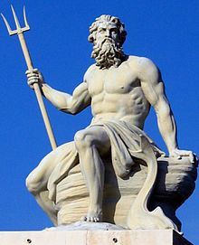
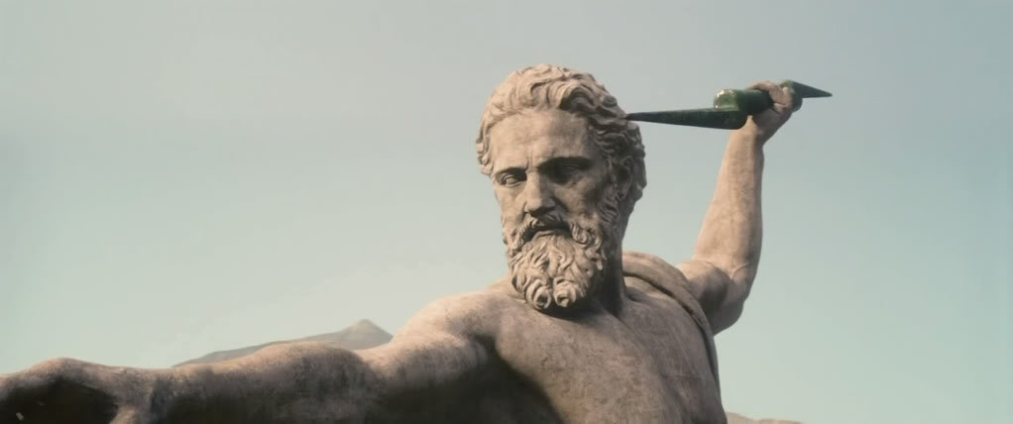
Seal of God in their forehead…
It was a common practice in John’s day for devotees to mark their foreheads. Followers of Zeus with the thunderbolt; followers of Poseidon with the trident
Three Uses/Definitions of “Seal”
The Mind of Christ
An Ordinance
Being Born Again
Calling and Election Made Sure

Slide 8
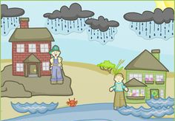
Seal: The Mind of Christ
Seal: To join two things together so as to prevent them from coming apart or to prevent anything from passing between them.
Matthew 7:24-27
What is the rock?
What is the rain?
2 Nephi 28:28
Deuteronomy 32:2

Slide 9
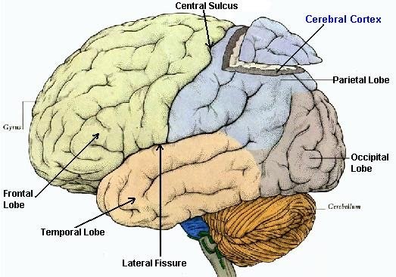
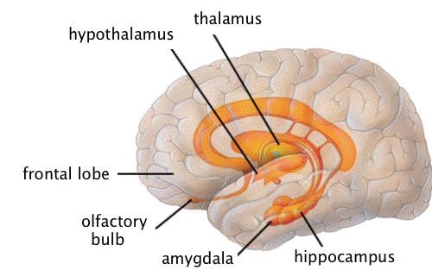
Seal: The Mind of Christ
Revelation 7:3 Where is the seal?
Cross-reference Proverbs 23:7 “For as a man thinketh, so is he.”
Cerebral Cortex
Limbic system

Slide 10
“Hold fast to what you already know and stand strong until additional knowledge comes. The size of your faith or the degree of your knowledge is not the issue—it is the integrity you demonstrate toward the faith you do have and the truth you already know.
“This is a divine work in process, so please don’t hyperventilate if from time to time issues arise that need to be examined and resolved.”
Elder Holland, April 2013 General Conference
D&C 84:54
Jacob 7:5
2 Nephi 4:26

Slide 11
Notes:
On our television at home, I can tune in to over 200 stations. Rarely do I just watch one channel over and over again, day after day. I love to surf around and find programs that interest me. If I do tune into a show and I’m not enjoying it, I am quick to change the channel and look for other programming. Our minds are very much the same. Often, we tune into one station and stay there. We are tempted to stay on a station of negativity or the channel of doubt, forgetting there are hundreds of other stations to turn to. When my mind becomes negative, I love to tune into stations like, “I have been blessing with a great family” or “My wife sure loves me” or “I can’t wait “When is our next vacation?” Focusing on the negative programming in our minds can breed negativity; tuning to other stations brings joy. Strive always to keep your thoughts that are ‘in your forehead’ positive and uplifting.

Slide 12
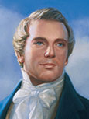
Seal: An Ordinance
Seal: To join two things together so as to prevent them from coming apart or to prevent anything from passing between them.
D&C 76:53, D&C 132:7
“When a seal is put upon the father and mother, it secures their posterity, so that they cannot be lost, but will be saved by virtue of the covenant of their father and mother.” ⁽Joseph Smith, Teachings of the Prophet Joseph Smith,comp. Joseph Fielding Smith (1938), 321.)

Slide 13
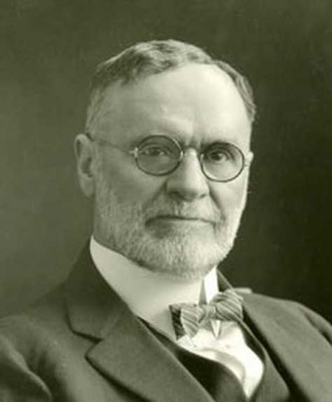
Seal: An Ordinance
Elder Orson F. Whitney: “The Prophet Joseph Smith declared—and he never taught more comforting doctrine—that the eternal sealings of faithful parents would save not only themselves but likewise their posterity. Though some of the sheep may wander, the eye of the Shepherd is upon them, and sooner or later they will feel the tentacles of Divine Providence reaching out after them and drawing them back to the fold. They will have to pay their debt to justice; they will suffer for their sins and may tread a thorny path. Pray for your careless and disobedient children till you see the salvation of God.” (Orson F. Whitney, in Conference Report, Apr. 1929, 110).

Slide 14
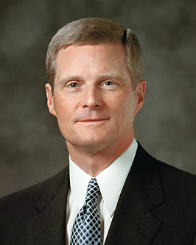
“The ‘tentacles of Divine Providence’ described by Elder Whitney may be considered a type of spiritual power, a heavenly pull or tug that entices a wandering child to return to the fold eventually. Such an influence cannot override the moral agency of a child but nonetheless can invite and beckon. Ultimately, a child must exercise his or her moral agency and respond in faith” (Elder David A. Bednar, Ensign, March 2014)
In what ways have you witnessed these Divine Tentacles?

Slide 15
Seal: Being Born Again
“They are they who received the testimony of Jesus, and believed on his name and were baptized … that by keeping the commandments they might be washed and cleansed from all their sins, and receive the Holy Spirit by the laying on of the hands of him who is ordained and sealed unto this power … are sealed by the Holy Spirit of promise, which the Father sheds forth upon all those who are just and true” (D&C 76:50–53).
“Receiving this ‘stamp of approval’ from the Holy Ghost is the result of faithfulness, integrity, and steadfastness in honoring gospel covenants. However, this sealing can be forfeited through unrighteousness and transgression. Purifying and sealing by the Holy Spirit of Promise constitute the culminating steps in the process of being born again.” (Elder Bednar, “Ye Must be Born Again, October 2007 General Conference).

Slide 16
Seal: Calling and Election
Guide to the Scriptures: “Righteous followers of Christ can become numbered among the elect who gain the assurance of exaltation. This calling and election begins with repentance and baptism. It becomes complete when they “press forward, feasting upon the word of Christ, and endure to the end” (2 Ne. 31:19–20).
“The seal of God in the forehead symbolizes a protection much like the lamb’s blood that ancient Israelites in Egypt placed on their door frames to protect them from the destroying angel.” (History of the Church, 5:530, New Testament Student Manual [Church Educational System manual,2014], 544).

Slide 17
How many? Glance at Revelation 7:5-8
“One hundred and forty-four thousand in all. Chosen for what? …To gather up and hunt out the house of Israel and bring as many as they possibly can into the Church of the firstborn, preparatory to the great day of the coming of the Lord. Quite a host of missionaries.” (Orson Pratt, Journal of Discourses, 18:25)
How many are chosen? (see vs 9)

Slide 18
Genesis 29-30 | Numbers 1 | Revelation 7:4-8
Reuben | Reuben | Reuben
Simeon | Simeon | Simeon
Levi |  | Levi
Judah | Judah | Judah
Dan | Dan
Naphtali | Naphtali | Naphtali
Gad | Gad | Gad
Asher | Asher | Asher
Isaachar | Isaachar | Isaachar
Zebulun | Zebulun | Zebulun
Joseph |  | Joseph
 | Ephraim
 | Manasseh | Manasseh
Benjamin | Benjamin | Benjamin

Slide 19
RACES IN HEAVEN?
“There were no national distinctions among those [premortal] spirits such as Americans, Europeans, Asiatics, Australians, etc. Such bounds of habitation would have to be determined when the spirits entered their earthly existence.” (Home Memories of President David O. McKay, p. 228-30).
“While one portion of the human race is judging and condemning the other without mercy, the Great Parent of the universe looks upon the whole of the human family with a fatherly care and paternal regard; He views them as His offspring.” TEACHINGS OF PRESIDENTS OF THE CHURCH: JOSEPH SMITH, CHAPTER 35: REDEMPTION FOR THE DEAD
“…The light of his countenance did shine upon them, and behold they were as white as the countenance and also the garments of Jesus; and behold the whiteness thereof did exceed all the whiteness, yea, even there could be nothing upon earth so white as the whiteness thereof. (3 Nephi 19:25)

Slide 20
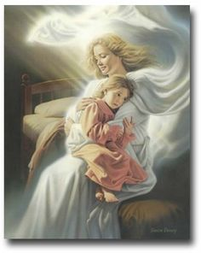
Revelation 7
Revelation 7:13-14
THE TRIBULATION
Why a period of tribulation before His Second Coming?

Slide 21
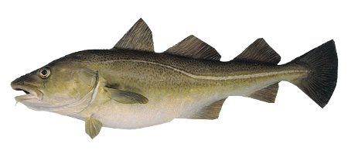
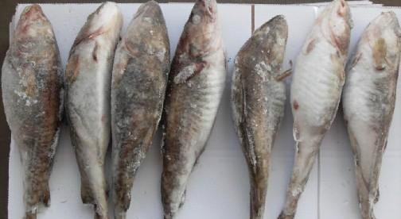
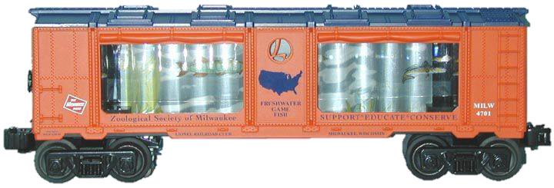
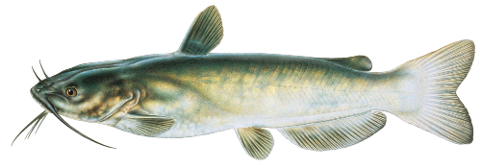
How could they get the fish across the country and still keep it fresh?
PLAN A: Freeze the fish
(mushy and lacked flavor)
PLAN B: Ship the fish live
(still mushy and tasteless)
PLAN C: Catfish

Slide 22
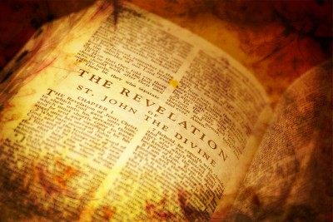
Application for Preparation
Are you grateful for your catfish?

Slide 23
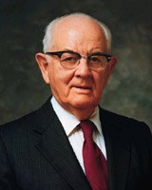
Where does the tribulation lead? Revelation 7:15-17
"I foresee the day when we will make around-the-clock use of all these sacred, holy edifices. . .The day is coming and not too far ahead of us when all temples on this earth will be going day and night.’” (Spender W. Kimball, "Temples—Now and in the Future,“ BYU Speeches, 1 September 1977, 4-5)

Slide 24
The Book of Revelation:
Preparing for
The Second Coming

